Slide 1
JVET-Y0120
EE2-related: Non-adjacent temporal MVP
Fan Wang
Z. Xie, Y. Yu, H. Yu, L.Xu, K.Sato, J.Gan, D. Wang

Slide 2
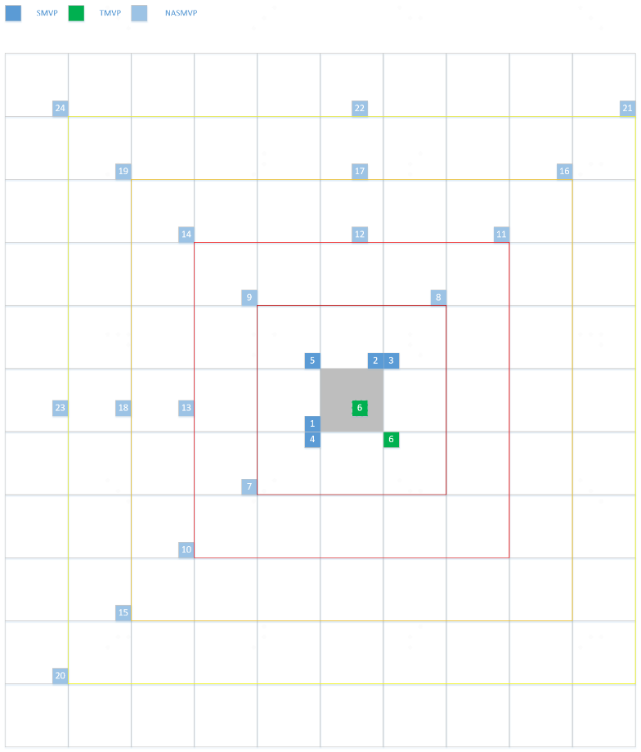
Introduction
The merge candidate list is constructed by including the following six types of candidates:
  1) Spatial MVP from spatial neighbor blocks (SMVP, 1-5 in Figure 1)
  2) Temporal MVP from collocated blocks (TMVP, 6 in Figure 1)
  3) Spatial MVP from non-adjacent spatial neighbor blocks (NASMVP, 7-24 in Figure 1)
  4) History-based MVP from an FIFO table
  5) Pairwise average MVP
  6) Zero MVs.
  The current ECM mainly utilizes correlations from top and left sides. The newly adopted EE2-3.6a includes correlations from right and bottom side in the merge candidate list.
  It is still open for further exploitation in the AMVP candidate list.
Figure 1 SMVP, TMVP and NASMVP

Slide 3
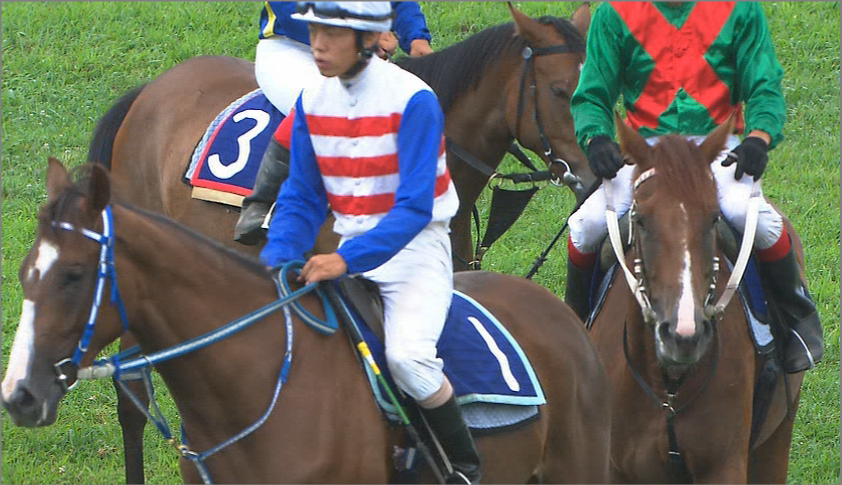
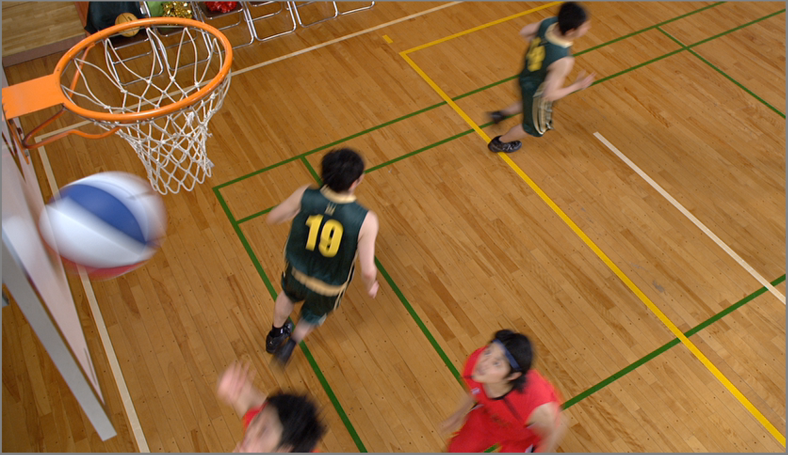
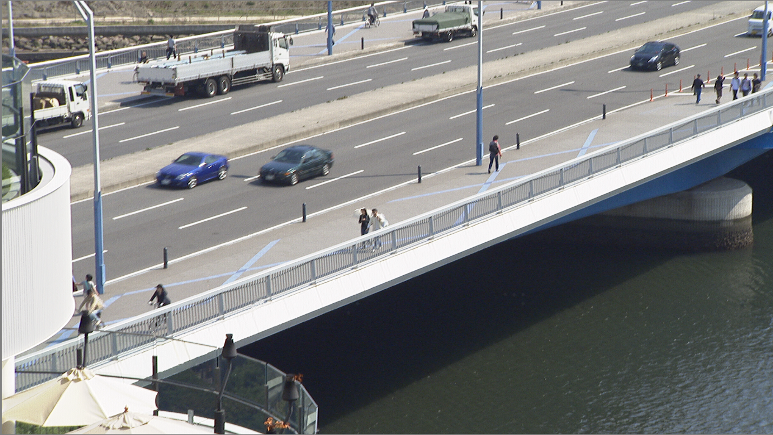
Introduction
In the real world, motion comes from all directions in video.
It is beneficial to utilize more correlations from the right and bottom side, especially for low delay case.
NATMVP can improve motion vector prediction at the boundary of fast moving objects.
RaceHorses
BasketballDrill
BQTerrace

Slide 4
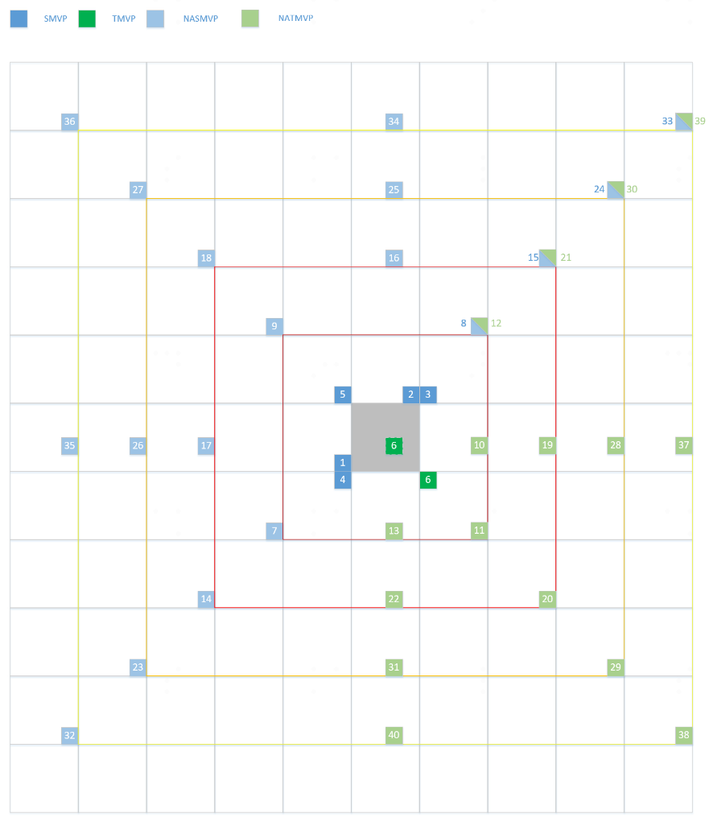
Proposed Method
NATMVPs are added into the merge candidate list and the AMVP candidate list after the NASMVPs of the same distance.
Figure 1 SMVP, TMVP, NASMVP and NATMVP

Slide 5
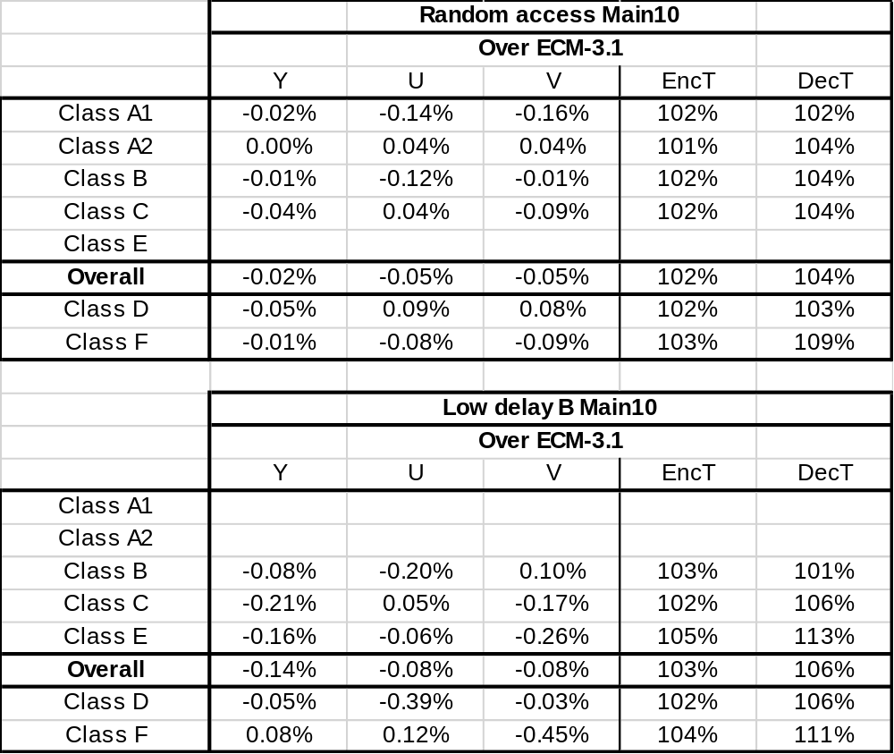
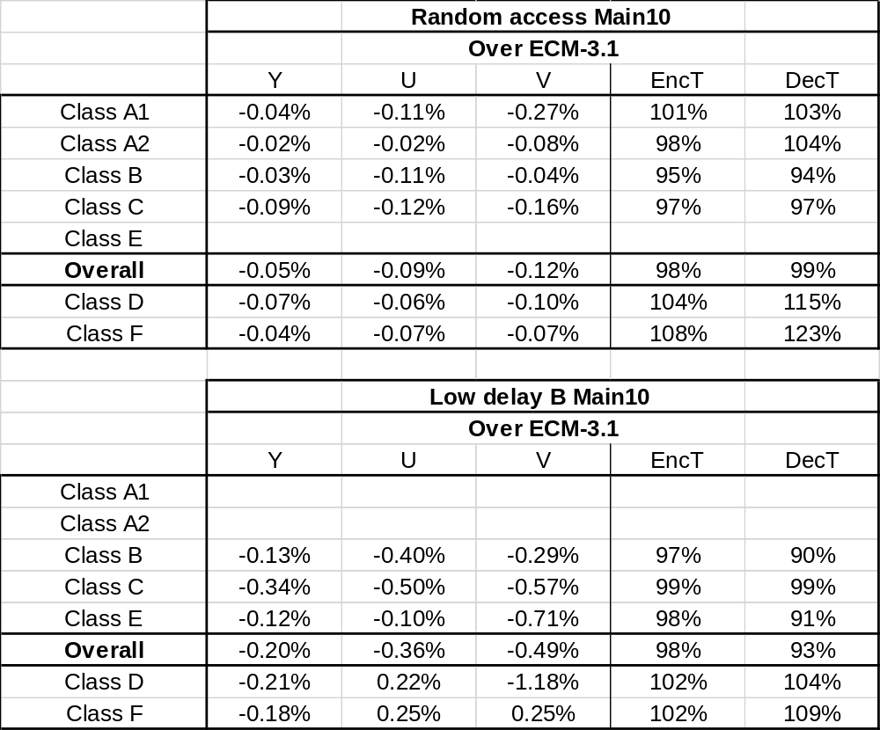
Simulation results
Test 1
  Anchor: ECM3.1
  Test: NATMVP in merge
Test 2
  Anchor: ECM3.1
  Test: NATMVP in merge + AMVP

Slide 6
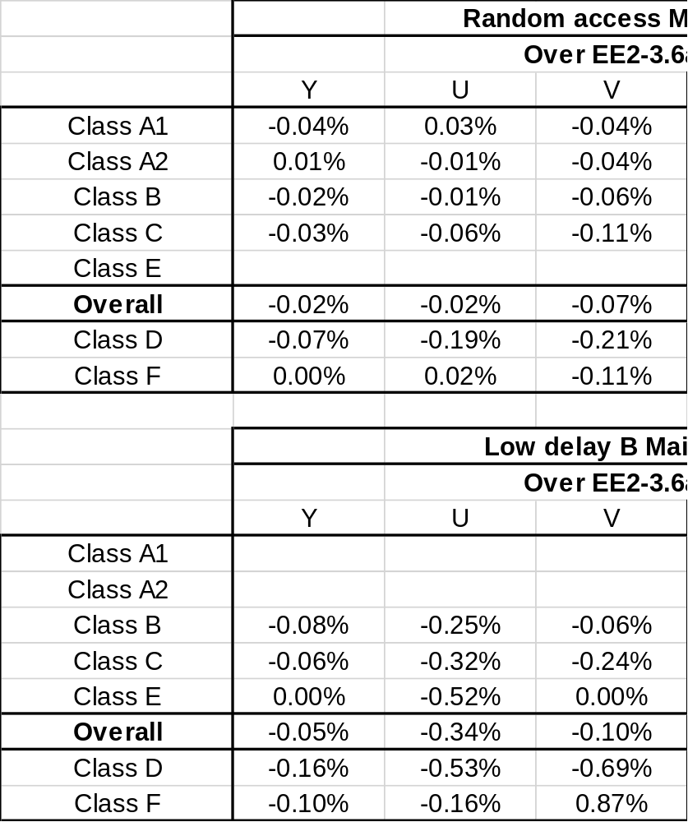
Simulation results
Test 3
  Anchor: EE2-3.6a
  Test: EE2-3.6a + NATMVP in AMVP

Slide 7
Conclusion
This contribution proposes to enhance the usage of the correlation from right side and bottom side in the construction of not only the merge candidate list but also the AMVP candidate list.
It is recommended to adopt test 3 in ECM.

Slide 8
Thanks to Alibaba for crosschecking !

