Slide 1
On conformance point of high throughput profile
Kei Kawamura and K. Unno
KDDI Corp. (KDDI Research, Inc.)

Slide 2
Motivation
The current conformance is realized by the buffer model with the hypothetical reference decoder.
For professional use cases like mezzanine compression or video editing, decoding delay is dominated by CABAC throughput (incl. by-pass coding).
  A varying bit amount of each frame causes an unstable decoding delay.
  A hierarchical-B structure also causes picture re-ordering.
To reduce and/or maintain the decoding delay, an additional bitstream restriction mechanism is helpful to develop a decoder development.

Slide 3
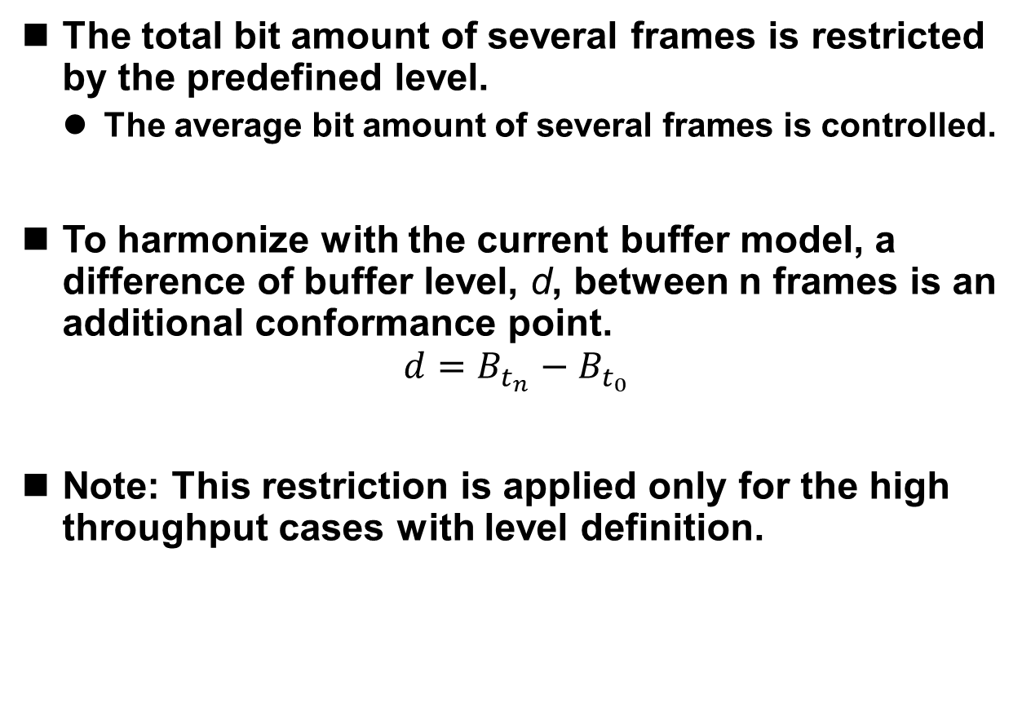
Proposal
The total bit amount of several frames is restricted by the predefined level.
  The average bit amount of several frames is controlled.
To harmonize with the current buffer model, a difference of buffer level, d, between n frames is an additional conformance point.
$$d=B_{t_{n}}−B_{t_{0}}$$
Note: This restriction is applied only for the high throughput cases with level definition.
B_{tn}
d
B_{t0}
I
B
P
B
I

Slide 4
Conclusion
We propose the additional conformance point for the high throughput cases.
The difference of buffer level between several frames was introduced.
We recommend studying such restrictions in the future profile/level.

