Slide 1
AHG11: neural network based in-loop filter
Liqiang Wang, Wei Jiang, Xiaozhong Xu, Shan Liu
Tencent

Slide 2
Outline
Introduction
Proposed method
Results
Conclusions

Slide 3
Introduction
In order to improve the quality of reconstructed image, neural network models are trained for I slice and B slice, separately. In the in-loop filter process, Deblock and SAO are replaced by the proposed NN filter.
LMCS
DBK
SAO
ALF
LMCS
CNNLF
ALF

Slide 4
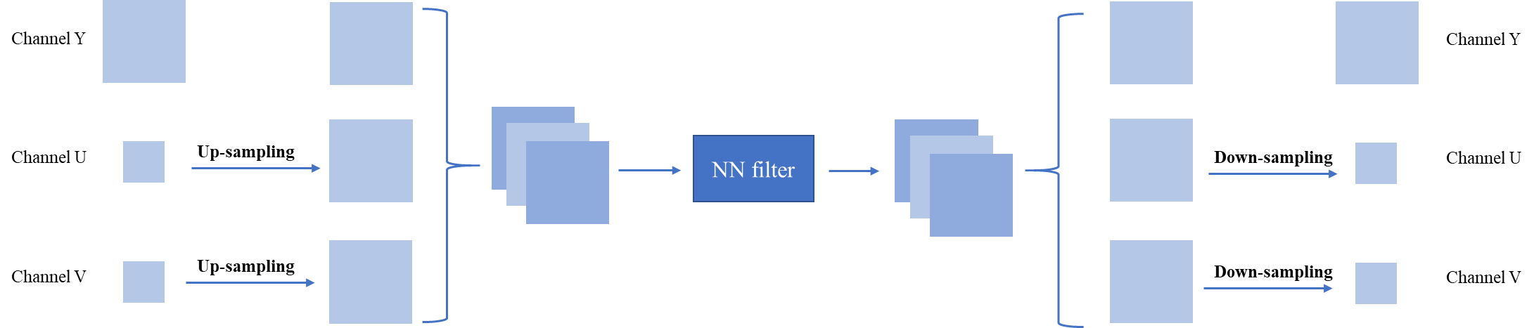
Proposed Method
The pre-processing and post-processing units in this contribution.

Slide 5
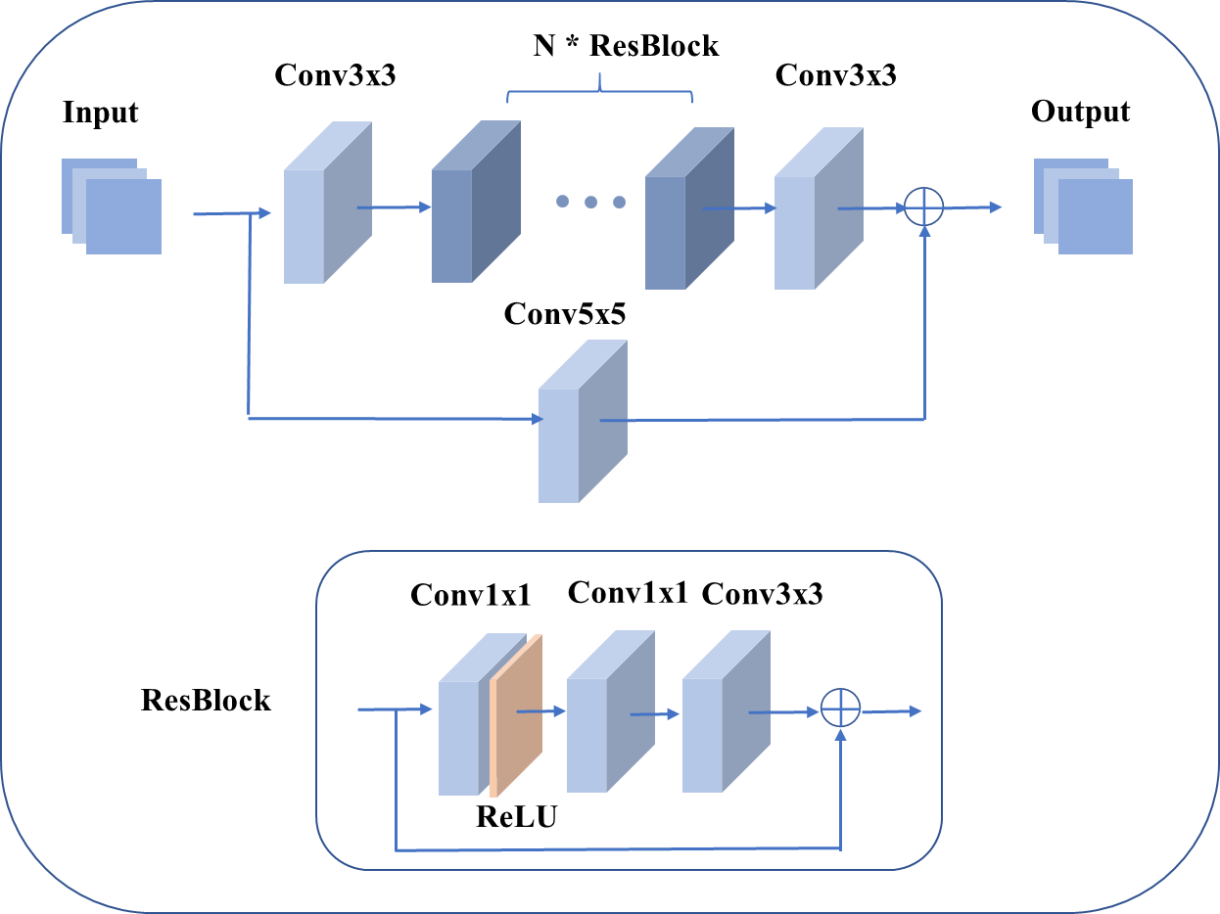
Proposed Method
The network structure of the proposed method.
                The number of ResBlock is set to 8.
                As for the internal convolutional layers, the number of feature maps is set as 64.

Slide 6
Proposed Method
Network information in training and inference stage.
Network Information in Training Stage
Mandatory | GPU Type | GPU: Tesla V100 x 8 x 16GB)
 | Framework: | PyTorch v1.5
 | Number of GPUs per Task
 | Epoch: | 40
 | Batch size: | 128Kx64
 | Loss function: | L1 30 epochs then L2 10 epochs
 | Training time: | 72h
 | Training data information: | DIV2K, BVI-DVC
 | Training configurations for generating compressed training data (if different to VTM CTC): | Disable Deblock and SAO
Optional
 | Number of iterations
 | Patch size | 128x128
 | Learning rate:
 | Optimizer:
 | Preprocessing:
 | Mini-batch selection process:
 | Other information:
Network Information in Inference Stage
Mandatory | HW environment:
 | GPU Type | CPU only
 | Framework: | PyTorch v1.5
 | Number of GPUs per Task | 0
 | Total Parameter Number | 596k
 | Parameter Precision (Bits) | 32
 | Memory Parameter (MB) | 2.28M/model, 10 models in all
 | Multiplay Accumulate (MAC) | 621k/pixel
Optional
 | Total Conv. Layers
 | Total FC Layers
 | Total Memory (MB)
 | Batch size: | 1
 | Patch size | 128x128
 | Changes to network configuration or weights required to generate rate points
 | Peak Memory Usage (Total)
 | Peak Memory Usage (per Model)
 | Border handling
 | Other information:

Slide 7
Proposed Method
Implementation
  Deblock and SAO are disabled, and the proposed filter is placed before ALF.
  The proposed filter can be turned on/off at the CTU level and slice level.
  A scaling operation is carried out to refine the result of NN filter. The scaling factors are signaled in the slice header for each component.

Slide 8
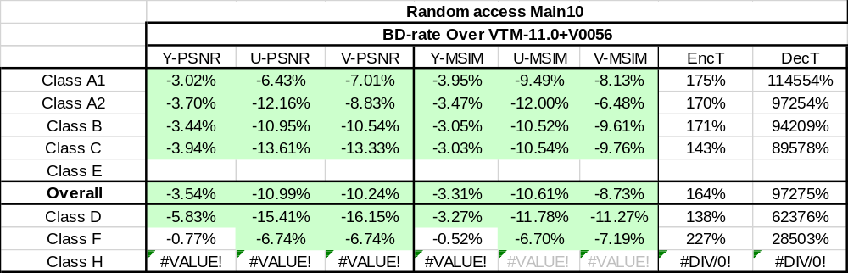
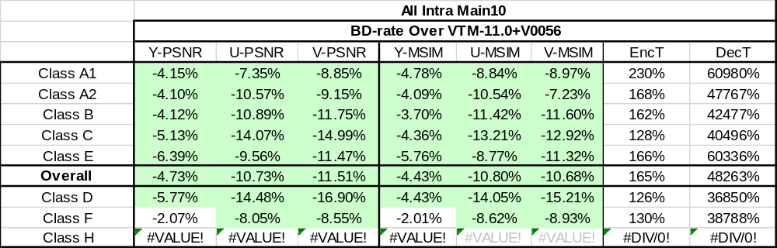
Results
The anchor is VTM11+V0056, and the CTC results are provided.

Slide 9
Conclusions
The neural network based in-loop filter is presented in this contribution, where Deblock and SAO are both replaced with the NN based filter.
Good coding performance can be achieved by applying the proposed method.

