Slide 1
Compression efficiency methods beyond VVC
JVET-U0100
Yao-Jen Chang, Chun-Chi Chen, Jianle Chen, Jie Dong, Hilmi E. Egilmez, Nan Hu, Han Huang, Marta Karczewicz, Jingya Li, Bappaditya Ray, Kevin Reuze, Vadim Seregin, Nikolay Shlyakhov, Luong Pham Van, Hongtao Wang, Yan Zhang, Zhi Zhang

Slide 2
Summary of the modifications
Intra
  Multi-model LM
  Gradient PDPC
  Secondary MPM
  Reference sample interpolation
  Decoder side intra
Inter
  Local illumination compensation
  Non-adjacent candidates
  Template matching
  Multi-pass decoder side MV refinement
  OBMC
  Sample-based BDOF
  12-tap interpolation
  Multi-hypothesis prediction
Transform and coefficient coding
  CTU and max transform is 256
  Extended LFNST
  Sign prediction
ALF
  9x9 filter shape
  Multiple fixed filters
Entropy coding
  Extended precision
  Slice type based CABAC window size

Slide 3
Intra prediction
Multi-model LM (JVET-D0110)
  Neighboring samples are classified into 2 classes
  Linear model is derived per class
  Linear least square method is used
Gradient PDPC (JVET-Q0391)
  Gradient PDPC method of horizontal/vertical modes is extended to other modes
Secondary MPM (JVET-D0114)
  Primary MPM consists of 5 entries
  Secondary MPM list of 16 entries is introduced
  Shape dependent order of neighboring blocks to construct the list
Reference sample interpolation (JVET-D0119)
  4-tap cubic interpolation is replaced by 6-tap filter
  6-tap Gaussian filter is used for larger blocks
  4-tap filtering is used instead of the nearest neighbor to derive extended reference
Decoder side intra mode derivation (JVET-O0449)
  Intra prediction is derived as a weighted average between Planar and two derived directions
  The first DIMD mode is stored with a block and is included into the primary MPM list of the neighboring blocks

Slide 4
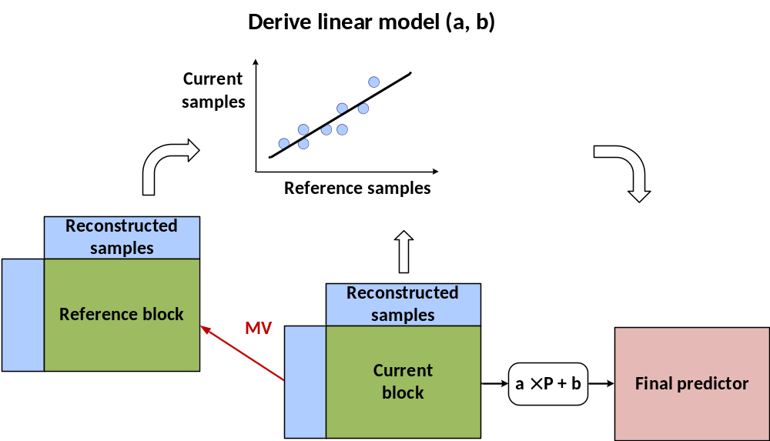
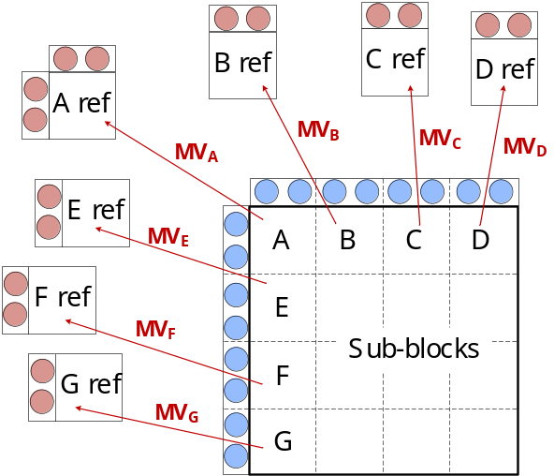
Local illumination compensation
Linear model compensating local illumination variation is derived between current block and its prediction block.
It is based on CE test JVET-O0066 with the following changes:
  LIC is disabled for blocks with less than 32 luma samples;
  For both non-subblock and affine modes, LIC parameter derivation is performed based on the template block samples corresponding to the current CU, instead of partial template block samples corresponding to first top-left 16x16 unit;
  Intra neighbor samples can be used in LIC parameter derivation;
  Samples of the reference block template are generated by using MC with the block MV without rounding it to integer-pel precision.
For sub-block modes (affine), LIC model is derived based on the boundary sub-blocks and the derived single model is applied to the entire block

Slide 5
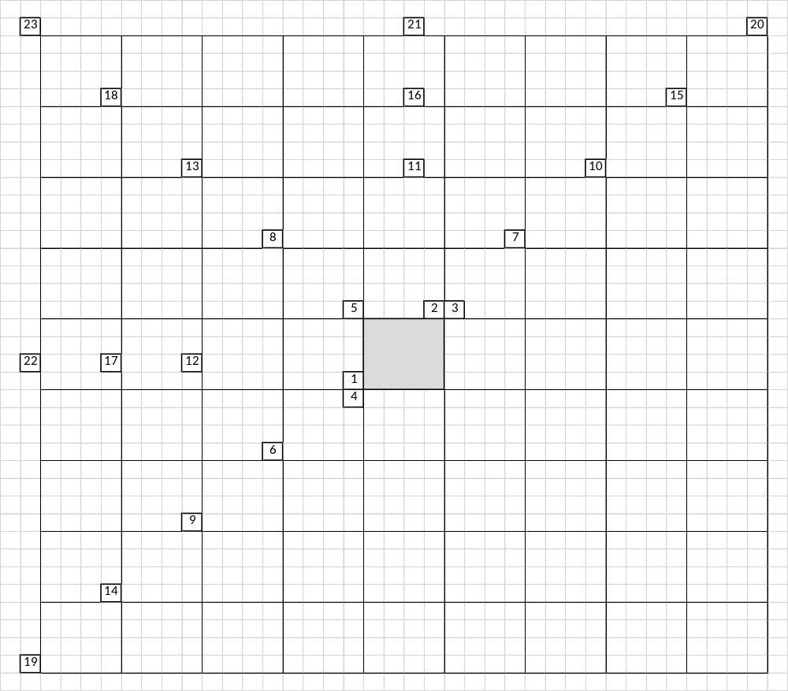
Non-adjacent spatial candidate
Non-adjacent spatial merge candidates are inserted after TMVP for regular merge mode (JVET-L0399)
Spatial candidates for blocks 2→1→3→4
Spatial candidate (block 5) if previous number less than 4
TMVP candidate
Non-adjacent spatial candidates (blocks 6 to 23)
HMVP
Pair-wise
Zero candidates

Slide 6
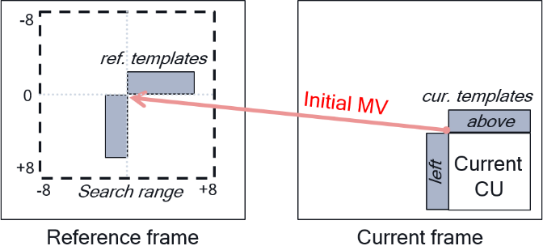
Template matching
Decode side MV refinement based on template matching (JVET-J0021)
Search range is [-8, +8] around the initial MV using iterative search process
Initial MV comes from the merge mode or AMVP
In AMVP mode, MVP is refined by this process
Search pattern | AMVR mode |  |  |  | Merge mode
 | 4-pel | Full-pel | Half-pel | Quarter-pel | AltIF=0 | AltIF=1
4-pel diamond | v
4-pel cross | v
Full-pel diamond |  | v | v | v | v | v
Full-pel cross |  | v | v | v | v | v
Half-pel cross |  |  | v | v | v | v
Quarter-pel cross |  |  |  | v | v
1/8-pel cross |  |  |  |  | v

Slide 7
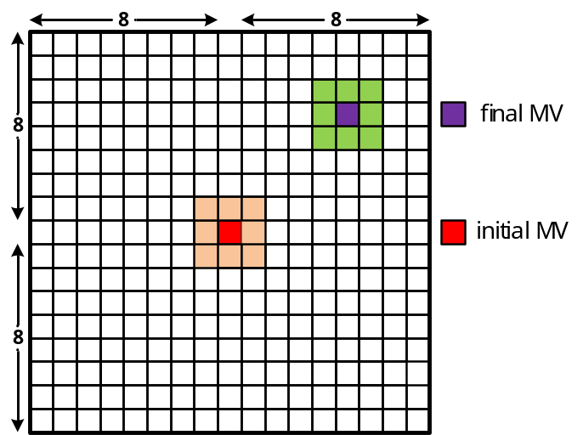
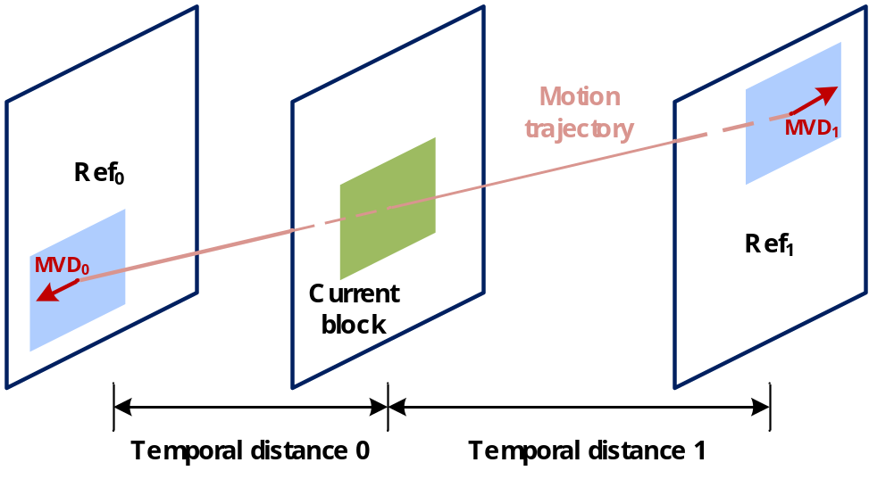
Multi-pass decoder-side motion vector refinement (1)
Bilateral merge is applied to bi-prediction only, and both MVs are simultaneously refined in a symmetrical manner
First pass:
  Bilateral template matching is applied to the whole block to get the updated MV
  3x3 square search is used within up to [-8, +8]
  MV distance cost is added to SAD matching cost
  Search is terminated if the cost in the center of 3x3 square reaches the minimum

Slide 8
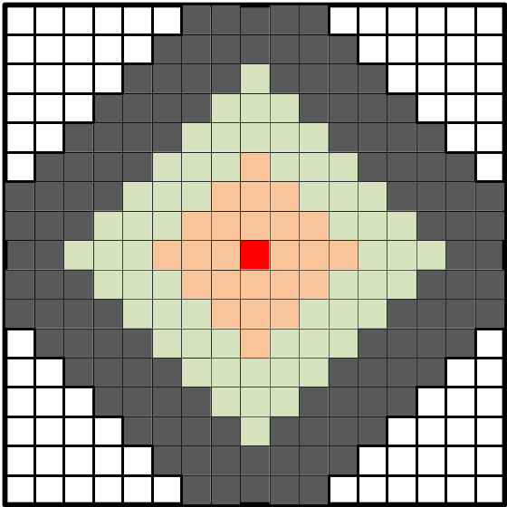
Multi-pass decoder-side motion vector refinement (2)
Second pass:
  Bilateral template matching is applied to 16x16 subblocks to update the first pass MV
  Full integer search is performed within up to [-8, +8]
  SATD cost is multiplied by the cost factor depending on the search region
  Each region is processed in the raster scan order
  Integer search is terminated if the minimum cost in the search region is less than a threshold
  The existed DMVR fractional sample refinement is further applied to the derived integer MV
Third pass:
  BDOF refinement is applied to 8x8 subblocks
  For each 8x8 subblock, Vx and Vy offsets are derived
  Vx and Vy are rounded to 1/16 and clipped between -32 and 32

Slide 9
Other inter modifications
OBMC (JVET-L0101)
  Top and left CU boundaries are refined using neighbor block motion
  Top, left, bottom, and right subblock boundaries are refined using neighbor subblock motion
Sample-based BDOF
  Instead of the block basis, BDOF refinement is derived per sample
  5x5 window around each sample is used to derive Vx and Vy refinement
  On 8x8 subblock basis, whether to apply BDOF or not is determined by checking the SAD between the two reference subblocks against a threshold
Multi-hypothesis prediction (JVET-M0425)
  Applied to bi-prediction in AMVP mode (for non equal BCW weights), affine AMVP, and regular merge mode
  Up to 2 additional predictors are signalled or inherited for merge mode
12-tap interpolation for luma

Slide 10
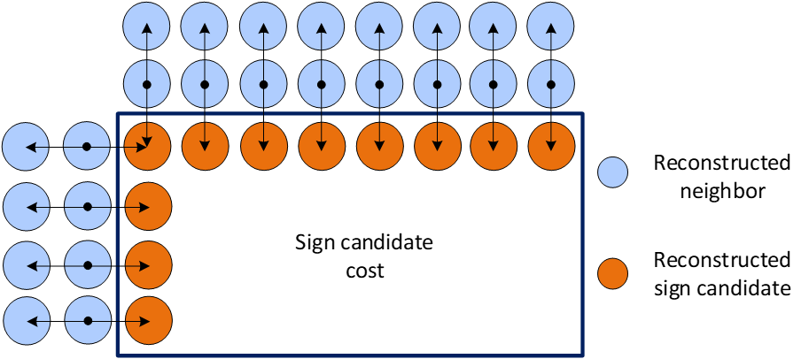
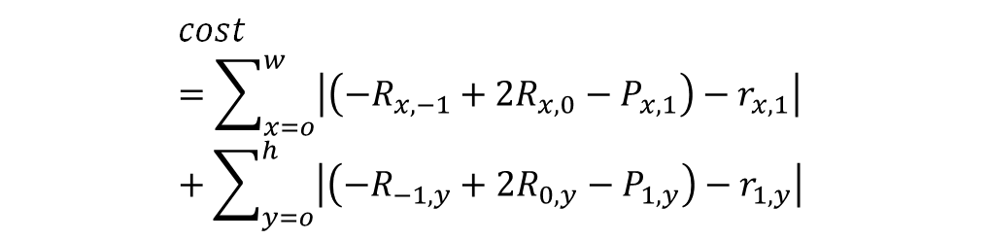
Transform and coefficient coding
CTU and max transform size is extended to 256
The number of LFNST sets is extended to 35 with 3 candidates
Full 64x64 LFNST matrix is used (no zeroing out)
8-state DQ is utilized (JVET-Q0243)
Sign prediction is applied for up to 6 transform coefficients (JVET-D0031, JVET-J0021)
$$cost=\sum_{x=o}^{w}{\left|\left(−R_{x,−1}+2R_{x,0}−P_{x,1}\right)−r_{x,1}\right| }+\sum_{y=o}^{h}{\left|\left(−R_{−1,y}+2R_{0,y}−P_{1,y}\right)−r_{1,y}\right| }$$

Slide 11
Entropy coding
The precisions for two probability states are both increased to 15 bits, in comparison to 10 bits and 14 bits in VVC
LPS range update process is modified as follows
CABAC context window is defined for each slice type (I-, B-, and P-slices)
if q >= 2¹⁴
q = 2¹⁵ – 1 – q
R_{LPS} = ( ( range × (q>>6) ) >>9 ) + 1
range: width of the current interval, 9-bit
q: probability state of the current context model, 15-bit
R_{LPS}: updated range for LPS, 8-bit

Slide 12
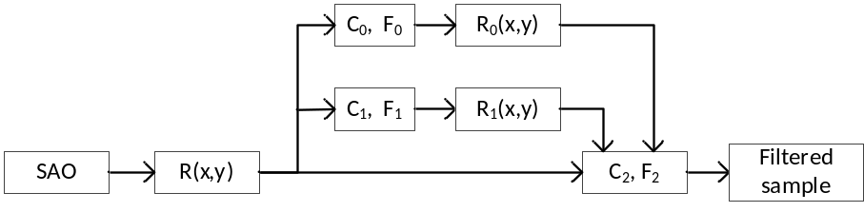
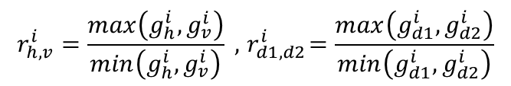
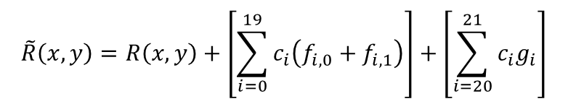
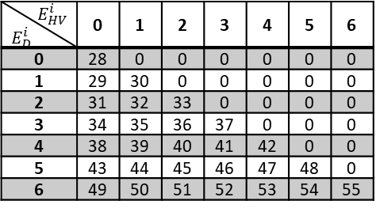
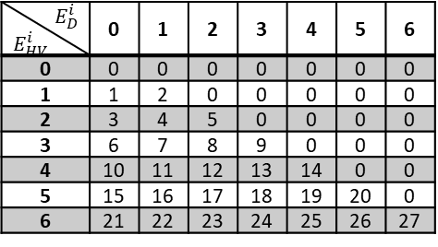
Adaptive loop filter
Luma and chroma filter shapes are extended to 9x9
Classification is performed on 2x2 basis
Luma filtering is applied using 1 signaled F2 9x9 filter and 2 fixed F0, F1 13x13 filters
Weighting coefficients for F0 and F1 fixed filters are signalled
Different 2x2 based classifiers are used for F0, F1, and F2 filters
  Directionality is derived by comparing the ratio of horizontal, vertical, and diagonal gradients with a set of thresholds, which supports more edge strengths
$$\tilde{R}\left(x,y\right)=R\left(x, y\right)+\left[\sum_{i=0}^{19}{c_{i}\left(f_{i,0}+f_{i,1}\right)}\right]+\left[\sum_{i=20}^{21}{c_{i}g_{i}}\right]$$
$$E_{D}^{i}$$ $$E_{HV}^{i}$$ | 0 | 1 | 2 | 3 | 4 | 5 | 6
0 | 0 | 0 | 0 | 0 | 0 | 0 | 0
1 | 1 | 2 | 0 | 0 | 0 | 0 | 0
2 | 3 | 4 | 5 | 0 | 0 | 0 | 0
3 | 6 | 7 | 8 | 9 | 0 | 0 | 0
4 | 10 | 11 | 12 | 13 | 14 | 0 | 0
5 | 15 | 16 | 17 | 18 | 19 | 20 | 0
6 | 21 | 22 | 23 | 24 | 25 | 26 | 27
$$E_{HV}^{i}$$ $$E_{D}^{i}$$ | 0 | 1 | 2 | 3 | 4 | 5 | 6
0 | 28 | 0 | 0 | 0 | 0 | 0 | 0
1 | 29 | 30 | 0 | 0 | 0 | 0 | 0
2 | 31 | 32 | 33 | 0 | 0 | 0 | 0
3 | 34 | 35 | 36 | 37 | 0 | 0 | 0
4 | 38 | 39 | 40 | 41 | 42 | 0 | 0
5 | 43 | 44 | 45 | 46 | 47 | 48 | 0
6 | 49 | 50 | 51 | 52 | 53 | 54 | 55
$$r_{h,v}^{i}=\frac{max\left(g_{h}^{i}, g_{v}^{i}\right)}{min\left(g_{h}^{i}, g_{v}^{i}\right)} , { r}_{d1,d2}^{i}=\frac{max\left(g_{d1}^{i}, g_{d2}^{i}\right)}{min\left(g_{d1}^{i}, g_{d2}^{i}\right)}$$

Slide 13
Results
 | All Intra Main10
 | Over VTM-10.0 GOP32 MCTF |  |  |  |  | Over VTM-11.0
 | Y | U | V | EncT | DecT | Y | U | V | EncT | DecT
Class A1 | -5.45% | -9.86% | -10.74% | 208% | 215% | -5.45% | -9.86% | -10.74% | 208% | 221%
Class A2 | -5.12% | -8.08% | -6.15% | 200% | 194% | -5.12% | -8.08% | -6.15% | 201% | 204%
Class B | -4.69% | -7.43% | -7.82% | 219% | 211% | -4.69% | -7.43% | -7.82% | 220% | 201%
Class C | -5.54% | -7.59% | -7.89% | 214% | 190% | -5.54% | -7.59% | -7.89% | 213% | 178%
Class E | -6.21% | -8.27% | -6.87% | 223% | 227% | -6.21% | -8.27% | -6.87% | 226% | 225%
Overall | -5.33% | -8.12% | -7.88% | 214% | 206% | -5.33% | -8.12% | -7.88% | 214% | 203%
Class D | -4.62% | -5.71% | -5.71% | 222% | 187% | -4.62% | -5.71% | -5.71% | 223% | 184%
Class F (optional) | -8.19% | -10.45% | -10.96% | 172% | 199% | -8.19% | -10.45% | -10.96% | 172% | 191%
 | Random Access Main 10
 | Over VTM-10.0 GOP32 MCTF |  |  |  |  | Over VTM-11.0
 | Y | U | V | EncT | DecT | Y | U | V | EncT | DecT
Class A1 | -11.40% | -13.14% | -15.81% | 262% | 392% | -11.40% | -13.21% | -15.80% | 260% | 392%
Class A2 | -12.58% | -14.30% | -14.11% | 239% | 448% | -12.58% | -14.32% | -14.10% | 242% | 452%
Class B | -10.49% | -12.01% | -11.28% | 235% | 376% | -10.49% | -12.02% | -11.26% | 238% | 395%
Class C | -12.03% | -12.83% | -12.95% | 244% | 373% | -12.03% | -12.83% | -12.95% | 246% | 390%
Class E
Overall | -11.50% | -12.91% | -13.19% | 243% | 392% | -11.50% | -12.94% | -13.19% | 245% | 404%
Class D | -13.01% | -13.17% | -12.86% | 253% | 395% | -13.01% | -13.17% | -12.86% | 255% | 410%
Class F (optional) | -10.20% | -11.78% | -11.82% | 214% | 263% | -10.20% | -11.78% | -11.82% | 216% | 276%
 | Low delay B Main10
 | Over VTM-10.0 GOP32 MCTF |  |  |  |  | Over VTM-11.0
 | Y | U | V | EncT | DecT | Y | U | V | EncT | DecT
Class A1
Class A2
Class B
Class C | -10.40% | -10.82% | -11.29% | 224% | 268% | -10.40% | -10.63% | -11.31% | 226% | 292%
Class E | -9.24% | -10.29% | -8.48% | 183% | 258% | -9.25% | -10.39% | -8.42% | 184% | 259%
Overall
Class D | -12.17% | -11.72% | -11.95% | 234% | 314% | -12.16% | -11.75% | -11.93% | 235% | 315%
Class F (optional) | -10.46% | -10.55% | -10.28% | 197% | 226% | -10.47% | -10.34% | -10.34% | 199% | 239%

Slide 14
Tool on results RA
Tool | Y | U | V | Enc | Dec
Intra prediction | -0.55% | -1.36% | -1.89% | 103% | 98%
LIC | -0.90% | -0.46% | -0.52% | 122% | 102%
Template matching | -1.84% | -2.02% | -2.18% | 111% | 115%
Template + bilateral matching | -3.07% | -3.22% | -3.44% | 141% | 220%
Non-adjacent candidates | -0.48% | -0.47% | -0.43% | 100% | 102%
12-tap | -0.59% | -0.28% | -0.22% | 104% | 105%
OBMC | -0.81% | -1.44% | -1.46% | 109% | 170%
Extended LFNST + sign prediction | -0.94% | -0.85% | -0.87% | 111% | 110%
ALF | -1.59% | -1.51% | -1.69% | 110% | 176%

