Slide 1
JVET-R0366:
Simplified disLut for GPM
Yanzhuo Ma, Qihong Ran, Ruipeng Qiu, Haixin Wang,
Junyan Huo, Shuai Wan, Fuzheng Yang,
Yuanfang Yu, Yang Liu
April. 2020

Slide 2




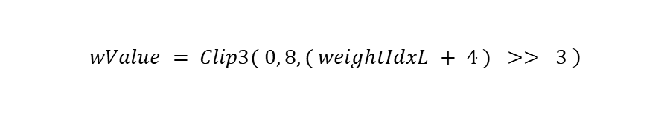
Problem statement
In VVC Draft
The derivation of weight value for each pixel
idx | 0 | 2 | 3 | 4 | 5 | 6 | 8 | 10 | 11 | 12 | 13 | 14
disLut[idx] | 8 | 8 | 8 | 4 | 4 | 2 | 0 | −2 | −4 | −4 | −8 | −8
idx | 16 | 18 | 19 | 20 | 21 | 22 | 24 | 26 | 27 | 28 | 29 | 30
disLut[idx] | −8 | −8 | −8 | −4 | −4 | −2 | 0 | 2 | 4 | 4 | 8 | 8
$$displacementX=angleIdx$$
$$xL,yL$$
$$displacementY=\left(displacementX+8\right)\%32$$
$$wValue$$
$$angleIdx$$
$$weightIdx = \left( \left( \left( xL + offsetX \right) << 1 \right)+ 1 \right)∗ disLut\left[ displacementX \right]$$
$$+( ( ( yL + offsetY ) << 1 ) + 1 ) ) ∗ disLut[ displacementY ]$$
$$weightIdxL = partFlip ? 32 + weightIdx : 32 − weightIdx$$
$$\left.wValue = Clip3( 0, 8, ( weightIdxL + 4 ) >> 3 \right)$$
weightIdx value occur
wValue
weightIdx value never occur
8
4
-40
-32
-24
-16
-8
0
8
16
24
32
weightIdx

Slide 3
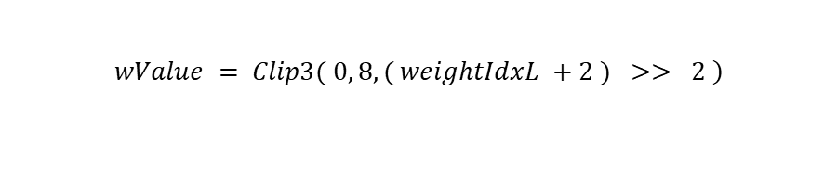
Proposed method
Changing each value to half
idx | 0 | 2 | 3 | 4 | 5 | 6 | 8 | 10 | 11 | 12 | 13 | 14
disLut[idx] | 4 | 4 | 4 | 2 | 2 | 1 | 0 | −1 | −2 | −2 | −4 | −4
idx | 16 | 18 | 19 | 20 | 21 | 22 | 24 | 26 | 27 | 28 | 29 | 30
disLut[idx] | −4 | −4 | −4 | −2 | −2 | −1 | 0 | 1 | 2 | 2 | 4 | 4
$$displacementX=angleIdx$$
$$xL,yL$$
$$displacementY=\left(displacementX+8\right)\%32$$
$$wValue$$
$$angleIdx$$
$$weightIdx = \left( \left( \left( xL + offsetX \right) << 1 \right)+ 1 \right)∗ disLut\left[ displacementX \right]$$
$$+( ( ( yL + offsetY ) << 1 ) + 1 ) ) ∗ disLut[ displacementY ]$$
$$weightIdxL = partFlip ? 16 + weightIdx : 16 − weightIdx$$
$$\left.wValue = Clip3( 0, 8, ( weightIdxL +2 ) >> 2 \right)$$
wValue
weightIdx value occur
8
4
weightIdx
-20
-16
-12
-8
-4
0
4
8
12
16
20

Slide 4
Experimental results
 |  |  | Random Access
 | Over VTM8.0
 | Y | U | V | EncT | DecT
Class A1 | 0.00% | 0.00% | 0.00% | 97% | 95%
Class A2 | 0.00% | 0.00% | 0.00% | 97% | 97%
Class B | 0.00% | 0.00% | 0.00% | 100% | 98%
Class C | 0.00% | 0.00% | 0.00% | 98% | 99%
Class E
Overall | 0.00% | 0.00% | 0.00% | 98% | 97%
Class D | 0.00% | 0.00% | 0.00% | 97% | 96%
Class F | 0.00% | 0.00% | 0.00% | 98% | 96%
 |  |  | Low Delay B
 | Over VTM8.0
 | Y | U | V | EncT | DecT
Class A1
Class A2
Class B | 0.00% | 0.00% | 0.00% | 102% | 97%
Class C | 0.00% | 0.00% | 0.00% | 102% | 96%
Class E | 0.00% | 0.00% | 0.00% | 93% | 93%
Overall | 0.00% | 0.00% | 0.00% | 100% | 96%
Class D | 0.00% | 0.00% | 0.00% | 100% | 98%
Class F | 0.00% | 0.00% | 0.00% | 93% | 92%

Slide 5
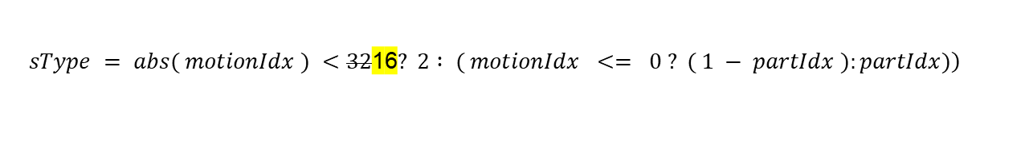
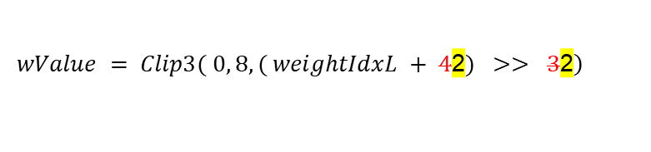
Spec text changes
$$weightIdx = \left( \left( \left( xL + offsetX \right) << 1 \right)+ 1 \right)∗ disLut\left[ displacementX \right]$$
$$+( ( ( yL + offsetY ) << 1 ) + 1 ) ) ∗ disLut[ displacementY ]$$
(1045)
$$weightIdxL = partFlip ? 32\text{1}\text{6}+ weightIdx : 32\text{1}\text{6}− weightIdx$$
(1046)
$$\left.wValue = Clip3( 0, 8, ( weightIdxL + 4\text{2}) >> 3\text{2}\right)$$
(1047)
…
Table 37 ‑ Specification of the geometric partitioning distance array disLut.
idx | 0 | 2 | 3 | 4 | 5 | 6 | 8 | 10 | 11 | 12 | 13 | 14
disLut[idx] | 84 | 84 | 84 | 42 | 42 | 21 | 0 | −21 | −42 | −42 | −84 | −84
idx | 16 | 18 | 19 | 20 | 21 | 22 | 24 | 26 | 27 | 28 | 29 | 30
disLut[idx] | −84 | −84 | −84 | −42 | −42 | −21 | 0 | 21 | 42 | 42 | 84 | 84
…
$$\left.sType = abs( motionIdx ) <32\text{1}\text{6}? 2∶ ( motionIdx <= 0 ? ( 1 − partIdx ):partIdx)\right)$$
(1059)

Slide 6
Conclusion
Proposed to change each value in the disLut to half.
  1 bit could be saved for each value
Coding performance:
RA: 0.00% 0.00% 0.00%, 98% 97%
    LDB: 0.00% 0.00% 0.00%, 100% 96%
  No change on performance and enc./dec. time.
Recommend to adopt into VVC.
Thanks for crosschecking by Kwai.

Slide 7
Thank you

