Slide 1
AHG14: On interaction between ACT and BDPCM
(JVET-R0353)
T. Tsukuba, Y. Yagasaki, M. Ikeda, T. Suzuki

Slide 2
Summary of JVET-R0353
Introduction
  In current VVC, BDPCM can not be applied to chroma component when ACT is used, while RDPCM in HEVC can be done to both luma and chorma components.
Proposal
  Allow BDPCM to be applied to not only luma but also chroma when ACT is used
Experimental results
Thanks to Kwai for the crosscheck
Lossless DualTreeOff | RGB 4:4:4
 | Bit-rate savings | EncT | DecT
AI | -2.19% | 96% | 92%
RA | -1.23% | 99% | 98%
LB | -1.19% | 100% | 96%
Lossless DualTreeOn | RGB 4:4:4
 | Bit-rate savings | EncT | DecT
AI | 0.00% | 99% | 97%
RA | -0.71% | 100% | 97%
LB | -0.90% | 101% | 98%
CTC | RGB 4:4:4
 | R | G | B | EncT | DecT
AI | 0.07% | 0.10% | 0.09% | 96% | 97%
RA | 0.01% | 0.03% | 0.04% | 99% | 100%
LB | -0.07% | -0.06% | -0.07% | 99% | 97%
LowQP | RGB 4:4:4
 | R | G | B | EncT | DecT
AI | -0.22% | -0.18% | -0.20% | 95% | 99%
RA | -0.05% | -0.08% | -0.13% | 99% | 100%
LB | -0.13% | -0.14% | -0.17% | 99% | 98%

Slide 3
Introduction
In current VVC, BDPCM can not be applied to chroma component when ACT is used, while RDPCM in HEVC can be applied to both luma and chorma components.
  If ACT is used, chroma BDPCM related syntaxes are skipped as shown below.
if( ( treeType = = SINGLE_TREE | | treeType = = DUAL_TREE_CHROMA ) && ChromaArrayType != 0 ) {
if( pred_mode_plt_flag && treeType = = DUAL_TREE_CHROMA )
palette_coding( x0, y0, cbWidth / SubWidthC, cbHeight / SubHeightC, treeType )
else if( !pred_mode_plt_flag ) {
if( !cu_act_enabled_flag ) {
if( cbWidth / SubWidthC <= MaxTsSize && cbHeight / SubHeightC <= MaxTsSize && sps_bdpcm_enabled_flag )
intra_bdpcm_chroma_flag | ae(v)
if( intra_bdpcm_chroma_flag )
intra_bdpcm_chroma_dir_flag | ae(v)
else {
if( CclmEnabled )
cclm_mode_flag | ae(v)
if( cclm_mode_flag )
cclm_mode_idx | ae(v)
else
intra_chroma_pred_mode | ae(v)
}
}
}
}
…

Slide 4
Proposal
Propose to allow Chorma BDPCM by aligning signaling location of cu_act_enabled_flag for both Intra CU and non-Intra CU (see the table below)
Case | ACT (cu_act_enabled_flag) | Luma BDPCM (BdpcmMode) | Luma Intra Pred | Chroma BDPCM (BdpmMode) | Chroma Intra Pred | Allowed combination?
1 | 1 | 0(Off) | HOR | 1 (HOR) | HOR | Y
2 | 1 | 0(Off) | VER | 2(VER) | VER | Y
3 | 1 | 1(HOR) | HOR | 1(HOR) | HOR | Y
4 | 1 | 2(VER) | VER | 2(VER) | VER | Y
BdpcmMode equal to 0 indicates (intra_bdpcm_x_flag, intra_bdpcm_x_dir_flag) equal to (0,0).
BdpcmMode equal to 1 indicates (intra_bdpcm_x_flag, intra_bdpcm_x_dir_flag) equal to (1,0).
BdpcmMode equal to 2 indicates (intra_bdpcm_x_flag, intra_bdpcm_x_dir_flag) equal to (1,1).
DM stands for Direct Mode
Notes:
Non-intra CU = inter CU ?

Slide 5
Proposed Changes
Align signaling location of cu_act_enabled_flag for both Intra CU and Non-Intra CU
Signal cu_act_enabled_flag for Intra CU if following conditions are satisfied:
  CuPredMode is equal to MODE_INTRA
  IntraSubpartitionSplitType is equal to ISP_NO_SPLIT
  sps_act_enabled_flag is equal to 1
  chroma intra prediction mode is identical to luma intra prediction
No change to signaling condition of cu_act_enabled_flag for Non-Intra CU
To reduce encoder runtime for selecting Chroma BDPCM in ACT, Luma BDPCM mode is reused as Chroma BDPCM mode:
  Set intra_bdpcm_chroma_flag equal to intra_bdpcm_luma_flag
  Set intra_bdpcm_chroma_dir_flag equal to intra_bdpcm_luma_dir_flag

Slide 6
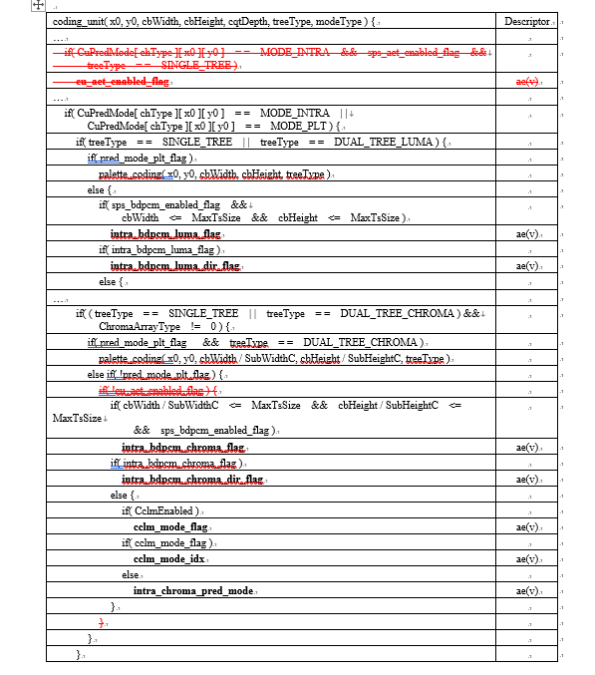
Proposed Changes
…

Slide 7
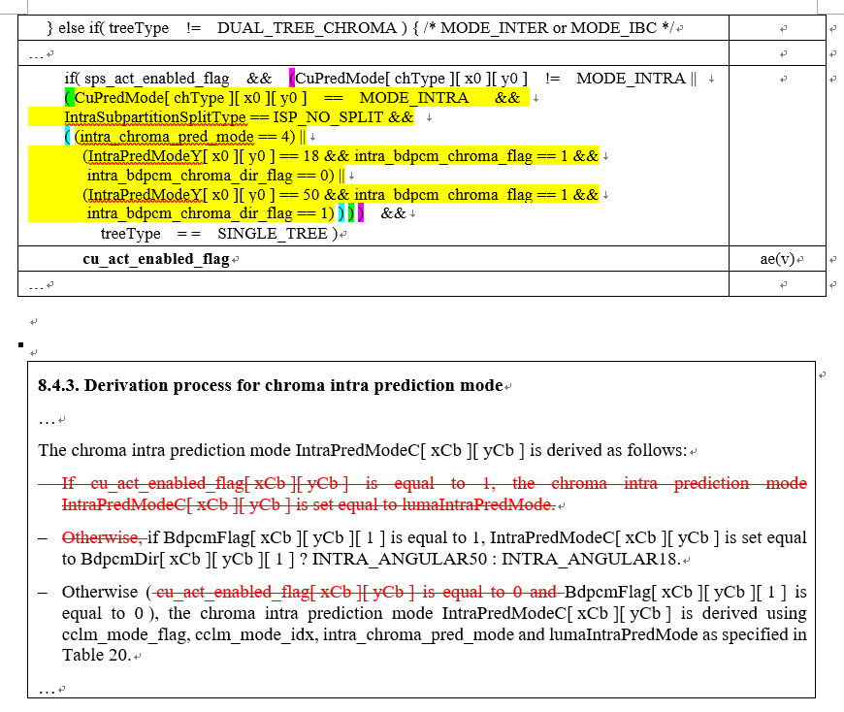
Proposed Changes

Slide 8
Simulation
Proposal was implemented on top of VTM-8.0
Simulation were conducted under following condition
  444/lossless condition (DualTreeOn)
  444/lossless condition (DualTreeOff)
  444/SCC/common QP condition (DualTreeOff)
  444/SCC/low QP condition (QP=2,7,12,17, DualTreeOff) with first 100 frames

Slide 9
Coding performance under 444/lossless coding (DualTreeOff)
RGB | All Intra |  |  | Random Access |  |  | Low delay B
 | ratio |  | bit-rate savings | ratio |  | bit-rate savings | ratio |  | bit-rate savings
 | VTM-8.0 DualTreeOff | test |  | VTM-8.0 DualTreeOff | test |  | VTM-8.0 DualTreeOff | test
TGM 1080p | 14.0 | 14.0 | -0.78% | 215.0 | 217.0 | -0.56% | 300.6 | 302.9 | -0.46%
TGM 720p | 5.9 | 6.1 | -3.63% | 57.1 | 59.3 | -2.29% | 94.5 | 99.1 | -2.35%
A | 3.2 | 3.3 | -1.83% | 8.7 | 8.7 | -0.51% | 7.2 | 7.2 | -0.46%
M | 3.3 | 3.5 | -3.52% | 19.4 | 19.8 | -2.18% | 21.2 | 21.7 | -2.06%
CC | 0.9 | 0.9 | -0.67% | 0.9 | 0.9 | -0.15% | 0.9 | 0.9 | -0.10%
Overall | 6.3 | 6.4 | -2.19% | 73.4 | 74.5 | -1.23% | 104.2 | 106.0 | -1.19%
Enc Time[%] | 96% |  |  | 99% |  |  | 100%
Dec Time[%] | 92% |  |  | 98% |  |  | 96%
YUV | All Intra |  |  | Random Access |  |  | Low delay B
 | ratio |  | bit-rate savings | ratio |  | bit-rate savings | ratio |  | bit-rate savings
 | VTM-8.0 DualTreeOff | test |  | VTM-8.0 DualTreeOff | test |  | VTM-8.0 DualTreeOff | test
TGM 1080p | 14.4 | 14.4 | 0.00% | 225.6 | 225.6 | 0.00% | 312.4 | 312.4 | 0.00%
TGM 720p | 7.5 | 7.5 | 0.00% | 73.6 | 73.6 | 0.00% | 123.7 | 123.7 | 0.00%
A | 3.7 | 3.7 | 0.00% | 8.0 | 8.0 | 0.00% | 7.9 | 7.9 | 0.00%
M | 4.4 | 4.4 | 0.00% | 26.8 | 26.8 | 0.00% | 29.2 | 29.2 | 0.00%
CC | 1.0 | 1.0 | 0.00% | 1.1 | 1.1 | 0.00% | 1.1 | 1.1 | 0.00%
Overall | 7.1 | 7.1 | 0.00% | 81.4 | 81.4 | 0.00% | 116.1 | 116.1 | 0.00%
Enc Time[%] | 100% |  |  | 100% |  |  | 100%
Dec Time[%] | 98% |  |  | 96% |  |  | 97%
Note that ACT is not applied for YUV

Slide 10
Coding performance under 444/lossless coding (DualTreeOn)
RGB | All Intra |  |  | Random Access |  |  | Low delay B
 | ratio |  | bit-rate savings | ratio |  | bit-rate savings | ratio |  | bit-rate savings
 | VTM-8.0 DualTreeOn | Tested |  | VTM-8.0 DualTreeOn | Tested |  | VTM-8.0 DualTreeOn | Tested
TGM 1080p | 10.9 | 10.9 | 0.00% | 173.2 | 173.2 | -0.10% | 251.2 | 251.4 | -0.11%
TGM 720p | 5.0 | 5.0 | 0.00% | 51.5 | 52.2 | -1.03% | 90.1 | 93.0 | -1.74%
A | 3.0 | 3.0 | 0.00% | 8.6 | 8.6 | -0.41% | 7.1 | 7.2 | -0.42%
M | 3.0 | 3.0 | 0.00% | 19.1 | 19.5 | -1.79% | 21.0 | 21.4 | -1.84%
CC | 0.9 | 0.9 | 0.00% | 0.9 | 0.9 | -0.12% | 0.9 | 0.9 | -0.09%
Overall | 5.2 | 5.2 | 0.00% | 61.5 | 61.7 | -0.71% | 90.7 | 91.6 | -0.90%
Enc Time[%] | 99% |  |  | 100% |  |  | 101%
Dec Time[%] | 97% |  |  | 97% |  |  | 98%
YUV | All Intra |  |  | Random Access |  |  | Low delay B
 | ratio |  | bit-rate savings | ratio |  | bit-rate savings | ratio |  | bit-rate savings
 | VTM-8.0 DualTreeOn | Tested |  | VTM-8.0 DualTreeOn | Tested |  | VTM-8.0 DualTreeOn | Tested
TGM 1080p | 10.7 | 10.7 | 0.00% | 174.7 | 174.7 | 0.00% | 252.9 | 252.9 | 0.00%
TGM 720p | 6.4 | 6.4 | 0.00% | 64.5 | 64.5 | 0.00% | 115.8 | 115.8 | 0.00%
A | 3.5 | 3.5 | 0.00% | 7.9 | 7.9 | 0.00% | 7.9 | 7.9 | 0.00%
M | 3.9 | 3.9 | 0.00% | 26.3 | 26.3 | 0.00% | 28.9 | 28.9 | 0.00%
CC | 1.0 | 1.0 | 0.00% | 1.1 | 1.1 | 0.00% | 1.1 | 1.1 | 0.00%
Overall | 5.8 | 5.8 | 0.00% | 66.3 | 66.3 | 0.00% | 99.2 | 99.2 | 0.00%
Enc Time[%] | 101% |  |  | 101% |  |  | 100%
Dec Time[%] | 100% |  |  | 99% |  |  | 99%
Note that ACT is not applied for YUV

Slide 11
Coding performance under 444/SCC/low QP condition (QP=2,7,12,17, DualTreeOff)
 | All Intra Main10
 | YUV 4:4:4 |  |  |  |  | RGB 4:4:4
 | Y | U | V | EncT | DecT | Y | U | V | EncT | DecT
TGM 1080p | 0.00% | 0.00% | 0.00% | 100% | 100% | -0.14% | -0.02% | -0.05% | 93% | 99%
TGM 720p | 0.00% | 0.00% | 0.00% | 100% | 99% | -0.36% | -0.30% | -0.32% | 94% | 98%
Animation | 0.00% | 0.00% | 0.00% | 98% | 97% | -0.13% | -0.24% | -0.29% | 98% | 101%
Mixed content | 0.00% | 0.00% | 0.00% | 99% | 97% | -0.22% | -0.19% | -0.17% | 96% | 98%
Overall | 0.00% | 0.00% | 0.00% | 100% | 98% | -0.22% | -0.18% | -0.20% | 95% | 99%
 | Random access Main10
 | YUV 4:4:4 |  |  |  |  | RGB 4:4:4
 | Y | U | V | EncT | DecT | Y | U | V | EncT | DecT
TGM 1080p | 0.00% | 0.00% | 0.00% | 100% | 99% | -0.08% | 0.01% | -0.05% | 99% | 100%
TGM 720p | 0.00% | 0.00% | 0.00% | 100% | 100% | -0.07% | -0.08% | -0.21% | 99% | 99%
Animation | 0.00% | 0.00% | 0.00% | 98% | 99% | 0.01% | -0.18% | -0.15% | 98% | 100%
Mixed content | 0.00% | 0.00% | 0.00% | 99% | 93% | -0.05% | -0.11% | -0.12% | 99% | 99%
Overall | 0.00% | 0.00% | 0.00% | 100% | 98% | -0.05% | -0.08% | -0.13% | 99% | 100%
 | Low delay B Main10
 | YUV 4:4:4 |  |  |  |  | RGB 4:4:4
 | Y | U | V | EncT | DecT | Y | U | V | EncT | DecT
TGM 1080p | 0.00% | 0.00% | 0.00% | 101% | 99% | -0.10% | -0.06% | -0.04% | 100% | 99%
TGM 720p | 0.00% | 0.00% | 0.00% | 100% | 97% | -0.19% | -0.16% | -0.28% | 99% | 100%
Animation | 0.00% | 0.00% | 0.00% | 98% | 92% | -0.05% | -0.22% | -0.23% | 100% | 95%
Mixed content | 0.00% | 0.00% | 0.00% | 99% | 93% | -0.14% | -0.13% | -0.15% | 99% | 98%
Overall | 0.00% | 0.00% | 0.00% | 100% | 96% | -0.13% | -0.14% | -0.17% | 99% | 98%
Note that ACT is not applied for YUV

Slide 12
Coding performance under 444/SCC/common QP condition (DualTreeOff)
 | All Intra Main10
 | YUV 4:4:4 |  |  |  |  | RGB 4:4:4
 | Y | U | V | EncT | DecT | Y | U | V | EncT | DecT
TGM 1080p | 0.00% | 0.00% | 0.00% | 98% | 95% | 0.15% | 0.12% | 0.12% | 94% | 97%
TGM 720p | 0.00% | 0.00% | 0.00% | 100% | 99% | -0.01% | 0.08% | -0.02% | 96% | 97%
Animation | 0.00% | 0.00% | 0.00% | 100% | 100% | 0.05% | 0.06% | 0.10% | 97% | 96%
Mixed content | 0.00% | 0.00% | 0.00% | 99% | 95% | 0.10% | 0.14% | 0.18% | 97% | 97%
Overall | 0.00% | 0.00% | 0.00% | 99% | 97% | 0.07% | 0.10% | 0.09% | 96% | 97%
 | Random access Main10
 | YUV 4:4:4 |  |  |  |  | RGB 4:4:4
 | Y | U | V | EncT | DecT | Y | U | V | EncT | DecT
TGM 1080p | 0.00% | 0.00% | 0.00% | 98% | 98% | 0.01% | 0.06% | 0.04% | 98% | 101%
TGM 720p | 0.00% | 0.00% | 0.00% | 100% | 99% | 0.04% | 0.06% | 0.05% | 99% | 100%
Animation | 0.00% | 0.00% | 0.00% | 98% | 102% | 0.07% | -0.02% | 0.04% | 100% | 99%
Mixed content | 0.00% | 0.00% | 0.00% | 99% | 99% | -0.07% | -0.01% | 0.01% | 101% | 101%
Overall | 0.00% | 0.00% | 0.00% | 99% | 99% | 0.01% | 0.03% | 0.04% | 99% | 100%
 | Low delay B Main10
 | YUV 4:4:4 |  |  |  |  | RGB 4:4:4
 | Y | U | V | EncT | DecT | Y | U | V | EncT | DecT
TGM 1080p | 0.00% | 0.00% | 0.00% | 96% | 93% | -0.06% | -0.04% | -0.07% | 101% | 99%
TGM 720p | 0.00% | 0.00% | 0.00% | 98% | 96% | 0.00% | 0.05% | 0.00% | 100% | 99%
Animation | 0.00% | 0.00% | 0.00% | 95% | 94% | -0.05% | -0.05% | -0.07% | 97% | 92%
Mixed content | 0.00% | 0.00% | 0.00% | 98% | 90% | -0.21% | -0.26% | -0.15% | 98% | 97%
Overall | 0.00% | 0.00% | 0.00% | 97% | 94% | -0.07% | -0.06% | -0.07% | 99% | 97%
Note that ACT is not applied for YUV

Slide 13
Conclusion
Allow combination of ACT and Chroma BDPCM to have design consistency of ACT and BDPCM like HEVC
Improved coding performance under 444/lossless, 444/SCC/low QP condition
Recommend: Adopt JVET-R0353 into the next VTM/VVC WD

