Slide 1
JVET-R0293
Fixes for 6-tap interpolation filtering for affine motion compensation
K. Andersson, R. Ruoyang, Z. Zhang, J. Ström
Ericsson

Slide 2
Summary
It is asserted that the some of the current 6-tap interpolation filters for affine motion compensation have significant phase misalignments compared to the expected phases of the interpolation filters.
This contribution proposes modifications of the filters for the fractional positions 4/16, 5/16, 6/16, 10/16, 11/16 and 12/16, and it is claimed that this fixes the phase misalignments of the current filters.

Slide 3
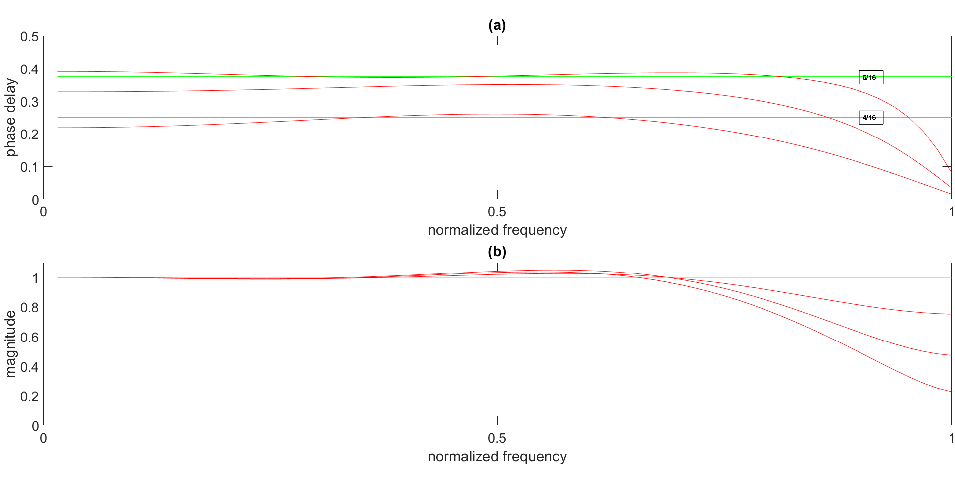
VVC 6-tap filters

Slide 4
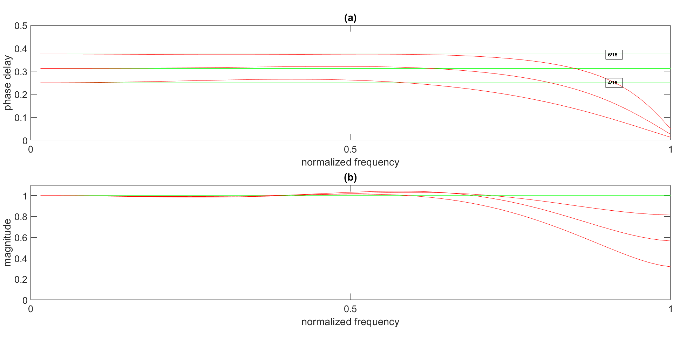
Proposed 6-tap filters

Slide 5
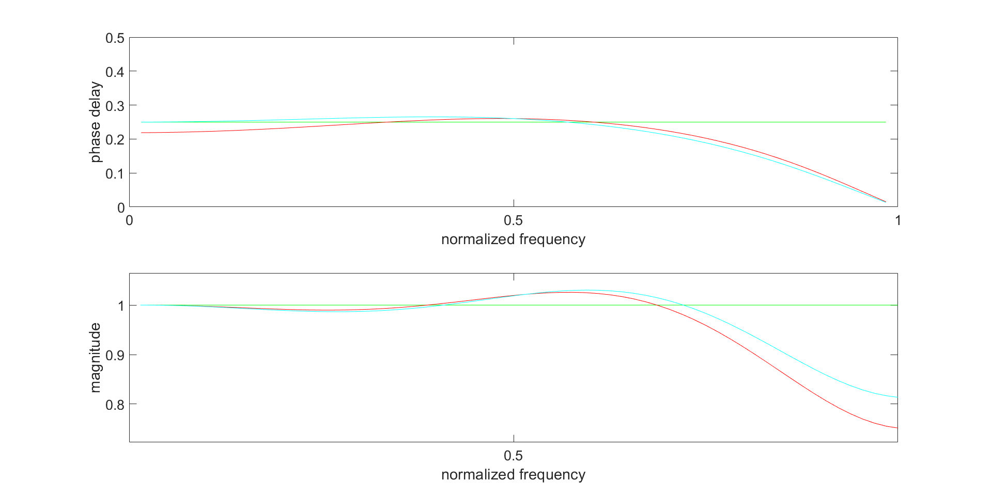
Individual filter responses 6-tap filters (4/16)

Slide 6
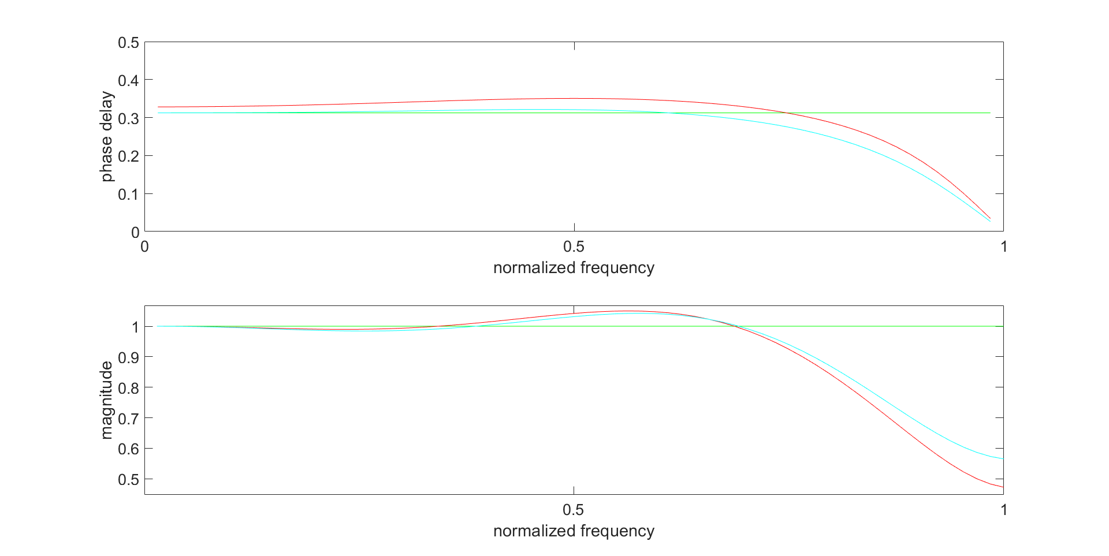
Individual filter responses 6-tap filters (5/16)

Slide 7
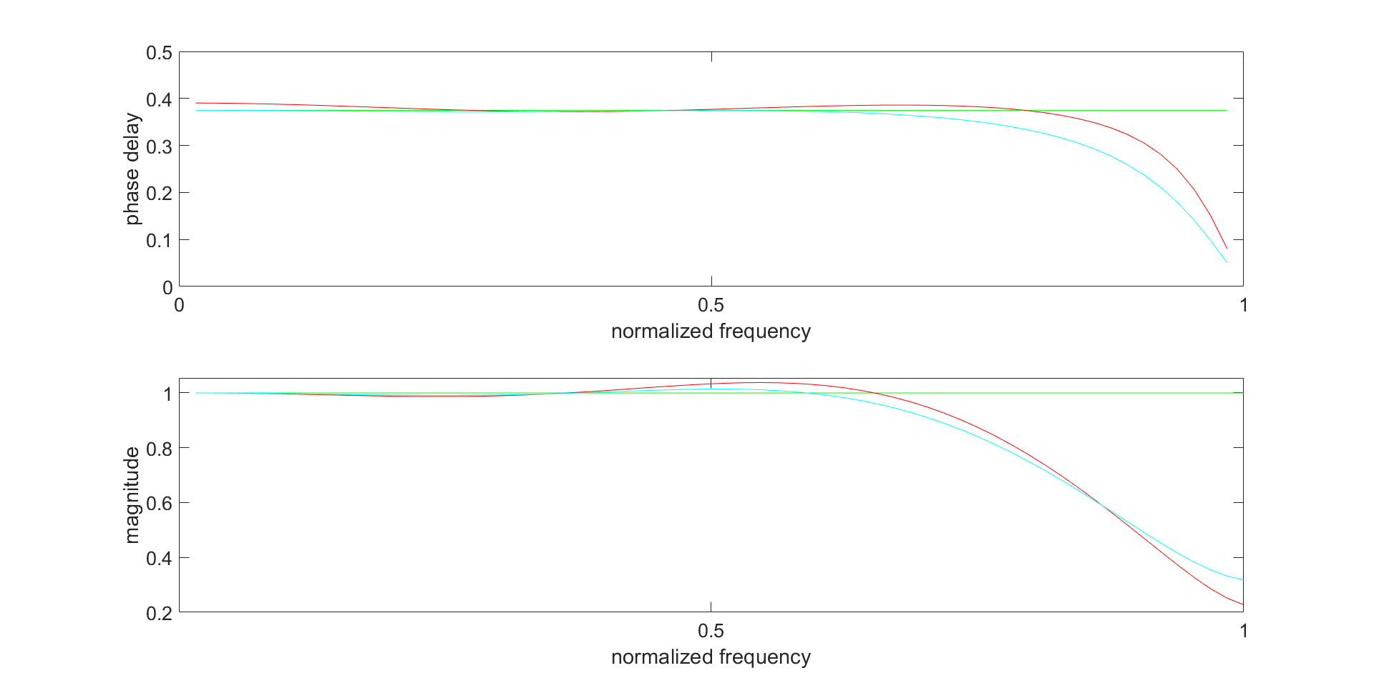
Individual filter responses 6-tap filters (6/16)

Slide 8
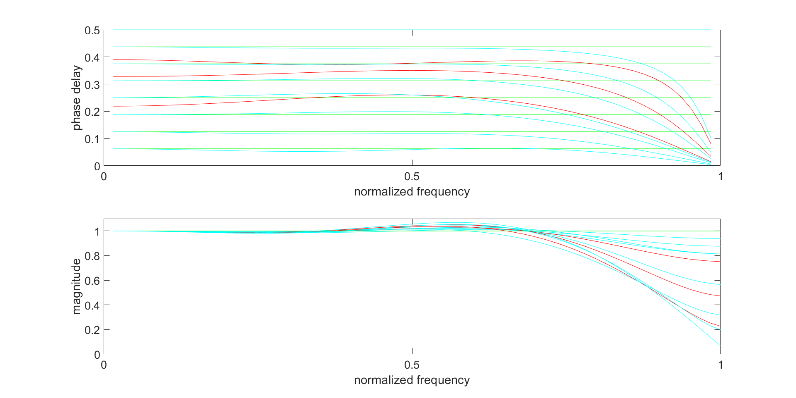
Filter responses 6-tap filters (1/16 to 8/16)

Slide 9
Objective performance
In combination with JVET-R0292
 | Random access Over VTM-8.0
 | Y | U | V | EncT | DecT
Class A1 | 0,01% | -0,02% | 0,06% | 102% | 100%
Class A2 | -0,04% | -0,03% | 0,07% | 102% | 100%
Class B | -0,02% | -0,04% | -0,08% | 89% | 101%
Class C | 0,01% | 0,05% | -0,12% | 84% | 98%
Class E
Overall | -0,01% | -0,01% | -0,03% | 92% | 100%
Class D | 0,05% | 0,19% | -0,01% | 83% | 98%
Class F | 0,01% | -0,03% | -0,07% | 86% | 100%
 | Random access Over VTM-8.0
 | Y | U | V | EncT | DecT
Class A1 | -0,02% | -0,02% | -0,11% | 112% | 98%
Class A2 | -0,05% | -0,03% | -0,08% | 113% | 100%
Class B | -0,03% | -0,15% | -0,18% | 102% | 101%
Class C | -0,05% | -0,16% | -0,26% | 93% | 100%
Class E
Overall | -0,04% | -0,11% | -0,17% | 103% | 100%
Class D | 0,04% | 0,13% | -0,10% | 91% | 98%
Class F | -0,01% | -0,18% | -0,08% | 96% | 101%
 | Low-delay B Over VTM-8.0
Class A1
Class A2
Class B | -0,06% | 0,15% | -0,08% | 101% | 100%
Class C | -0,13% | -0,16% | -0,10% | 98% | 100%
Class E | -0,09% | 0,25% | -0,03% | 91% | 102%
Overall | -0,09% | 0,07% | -0,07% | 98% | 100%
Class D | 0,00% | -0,89% | 0,15% | 84% | 100%
Class F | -0,13% | 0,03% | -0,13% | 94% | 102%
 | Low-delay B Over VTM-8.0
Class A1
Class A2
Class B | -0,04% | -0,13% | -0,38% | 114% | 100%
Class C | -0,13% | -0,60% | -0,20% | 111% | 101%
Class E | -0,01% | -0,80% | -0,24% | 104% | 98%
Overall | -0,06% | -0,46% | -0,29% | 110% | 100%
Class D | -0,02% | -0,83% | -0,18% | 93% | 98%
Class F | -0,08% | 0,27% | -0,43% | 105% | 102%
 | Random access Over VTM-8.0
 | Y | U | V | EncT | DecT
JetsPart_1280x720_25 | -0,13% | -0,63% | 0,07% | 98% | 104%
SpincalendarPart_1280x720_0 | -0,44% | -0,61% | -0,24% | 102% | 101%
BlueSkyPart_1920x1080_25 | -0,08% | -0,01% | 0,00% | 98% | 112%
ShieldsPart_1920x1080_50 | -0,18% | -2,01% | -0,62% | 99% | 97%
StationKtaPart_1920x1080_25 | -0,15% | -0,34% | -0,17% | 98% | 103%
TractorPart_1920x1080_25 | -0,21% | 0,00% | -0,04% | 97% | 96%
Overall | -0,20% | -0,60% | -0,17% | 99% | 100%
 | Random access Over VTM-8.0
 | Y | U | V | EncT | DecT
JetsPart_1280x720_25 | -0,20% | -0,36% | -1,08% | 107% | 101%
SpincalendarPart_1280x720_50 | -0,44% | -0,32% | 0,02% | 108% | 98%
BlueSkyPart_1920x1080_25 | -0,04% | -0,14% | -0,30% | 107% | 95%
ShieldsPart_1920x1080_50 | -0,45% | -1,75% | 0,20% | 111% | 91%
StationKtaPart_1920x1080_25 | -0,32% | 0,19% | -0,14% | 115% | 101%
TractorPart_1920x1080_25 | -0,23% | -0,08% | -0,15% | 111% | 98%
Overall | -0,28% | -0,41% | -0,24% | 110% | 100%

Slide 10
Proposed modifications to VVC
Table 30 – Specification of the luma interpolation filter coefficients fL[ p ] for each 1/16 fractional sample position
p for affine motion mode
Fractional sample position p | interpolation filter coefficients
 | f_{L}[ p ][ 0 ] | f_{L}[ p ][ 1 ] | f_{L}[ p ][ 2 ] | f_{L}[ p ][ 3 ] | f_{L}[ p ][ 4 ] | f_{L}[ p ][ 5 ] | f_{L}[ p ][ 6 ] | f_{L}[ p ][ 7 ]
1 | 0 | 1 | −3 | 63 | 4 | −2 | 1 | 0
2 | 0 | 1 | −5 | 62 | 8 | −3 | 1 | 0
3 | 0 | 2 | −8 | 60 | 13 | −4 | 1 | 0
4 | 0 | 3 | -11 | 59 | 16 | -4 | 1 | 0
5 | 0 | 3 | -11 | 54 | 23 | -7 | 2 | 0
6 | 0 | 2 | -9 | 48 | 29 | -8 | 2 | 0
7 | 0 | 3 | −11 | 45 | 34 | −10 | 3 | 0
8 | 0 | 3 | −11 | 40 | 40 | −11 | 3 | 0
9 | 0 | 3 | −10 | 34 | 45 | −11 | 3 | 0
10 | 0 | 2 | -8 | 29 | 48 | -9 | 2 | 0
11 | 0 | 2 | -7 | 23 | 54 | -11 | 3 | 0
12 | 0 | 1 | -4 | 16 | 59 | -11 | 3 | 0
13 | 0 | 1 | −4 | 13 | 60 | −8 | 2 | 0
14 | 0 | 1 | −3 | 8 | 62 | −5 | 1 | 0
15 | 0 | 1 | −2 | 4 | 63 | −3 | 1 | 0

Slide 11
Conclusions
It has been shown that the phase delay responses of some of the current 6-tap interpolation filters have significant deviations from the ideal phase delay responses.
We propose to adopt the fixes of filter coefficients for the 6-tap interpolation filters for fractional sample positions 4/16, 5/16, 6/16, 10/16, 11/16 and 12/16 to VVC specification and software such that VVC has 6-tap interpolation filters for affine motion compensation with proper interpolation properties.
Thanks to HHI for cross-checking

