Slide 1
JVET-Q0500
AHG16: On derivation of CCLM predictors
Yi-Wen Chen, Xiaoyu Xiu, Xianglin Wang and et al.

Slide 2
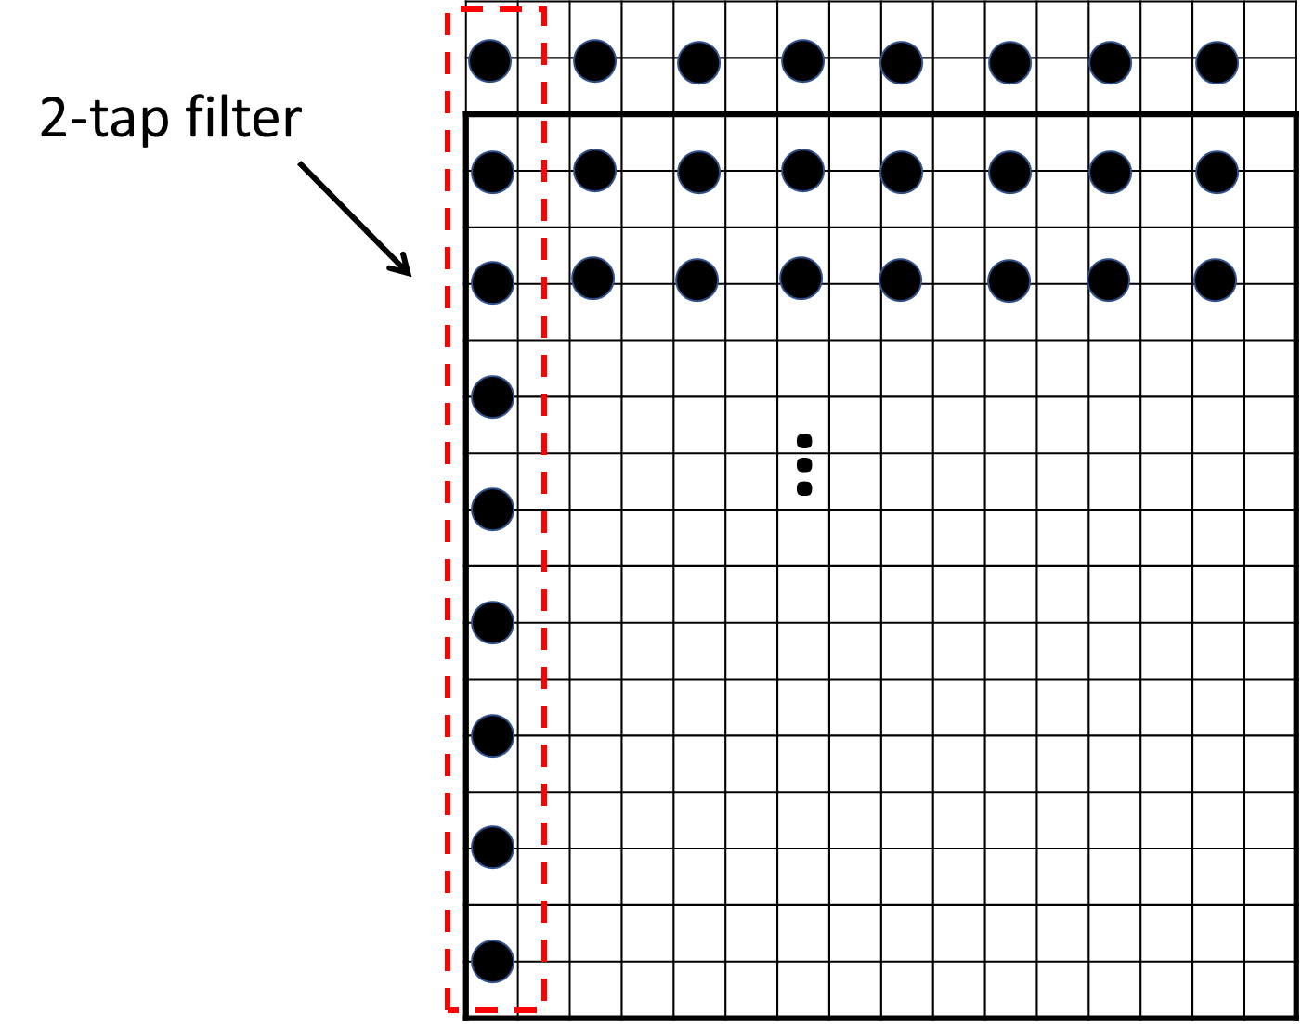
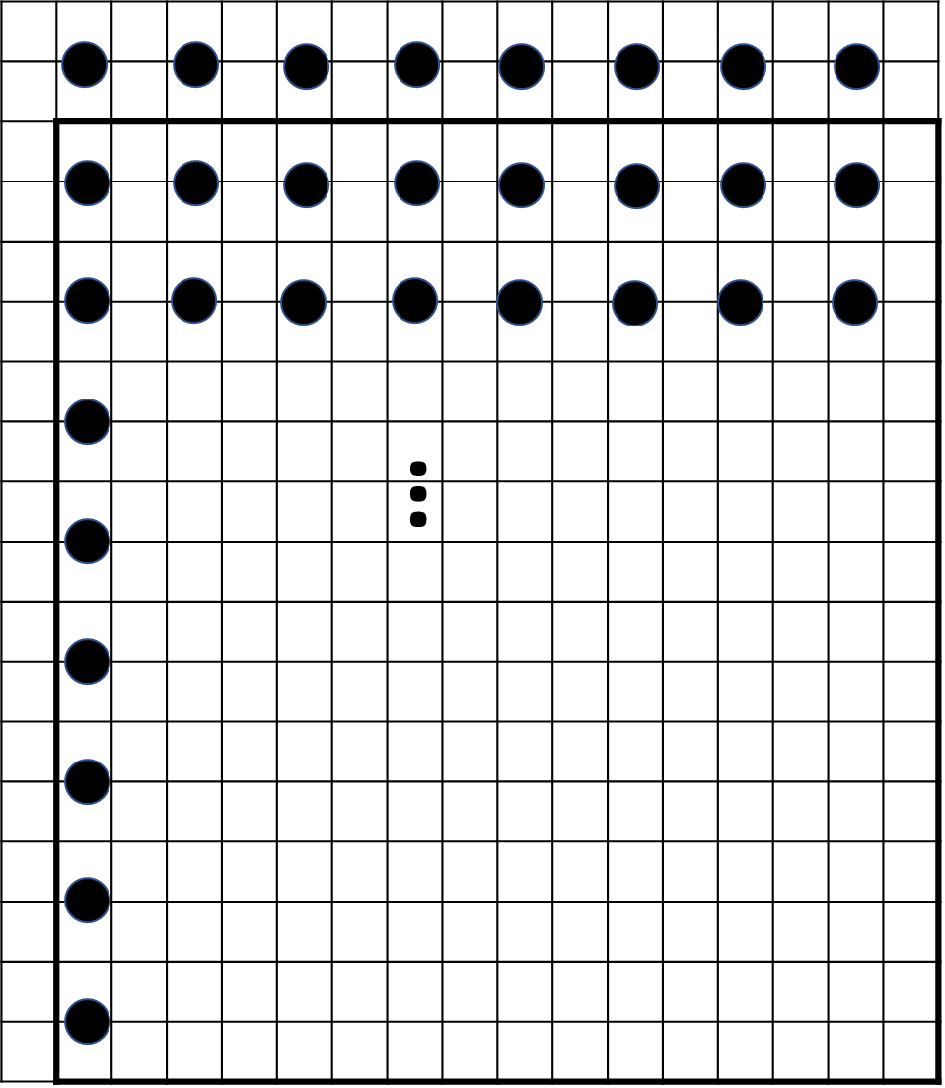
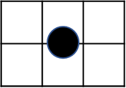

Introduction
In current CCLM, different down-sample filters used for different case
  2/6-taps filters switch (1/3-taps at CTU boundary)
  Different SIMD implementations under different conditions
  Conditions checking are required
2-tap/6-tap filters switch
6-tap filter
6-tap filter
2-tap filter

Slide 3
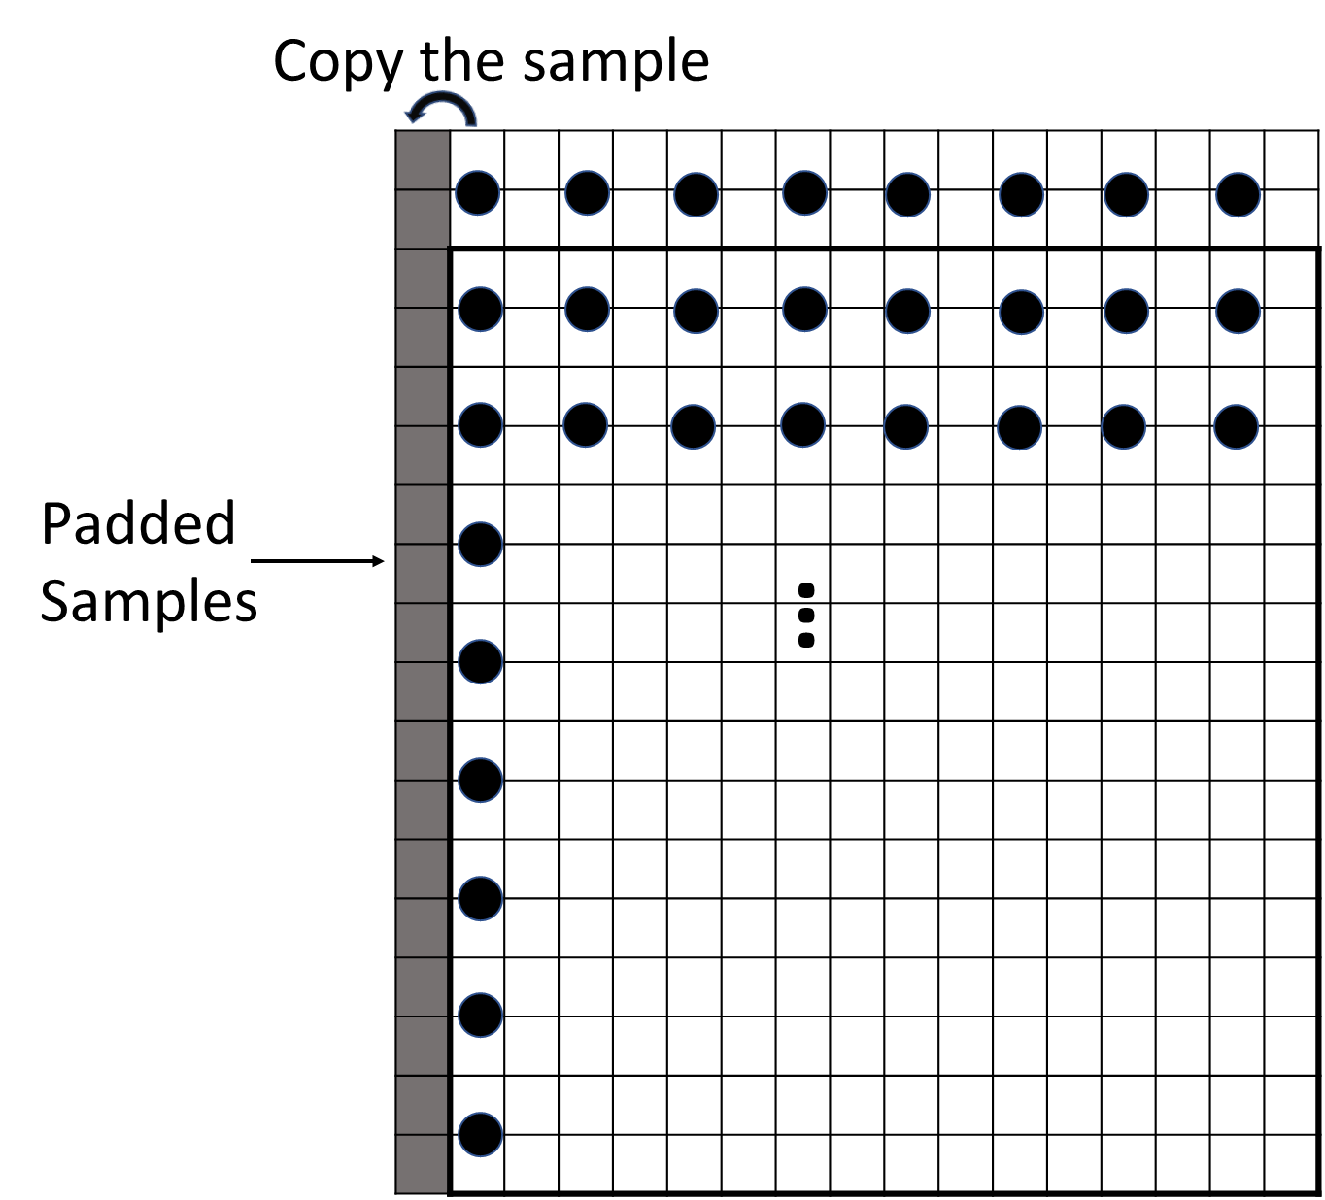
Proposed Simplifications
Repetitive padding for unavailable luma samples for CCLM
  Always using 6-taps filter (3-taps at CTU boundary)
  Regular SIMD implementations
  VVC spec simplification (~100 lines removed)

Slide 4
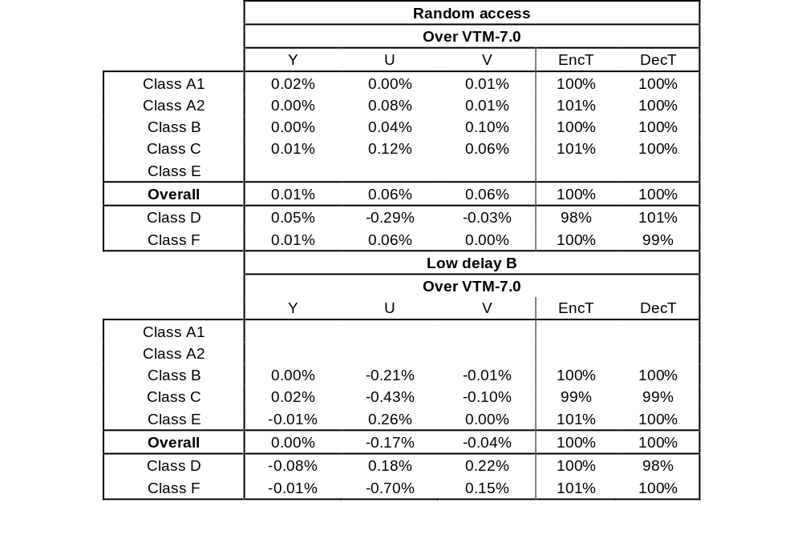
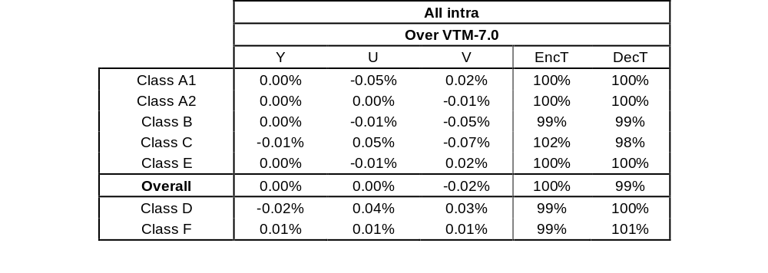
Simulation Results
Anchor :VTM-7.0
Test: Anchor + Proposed method

Slide 5
Summary
Propose repetitive padding to generate the alternatives for unavailable samples in CCLM
  ~100 lines of conditions checking are removed in VVC spec
  More friendly to SIMD implementation
It is recommended the proposed method be adopted into VVC
Thanks for Qualcomm’s crosschecking

Slide 6
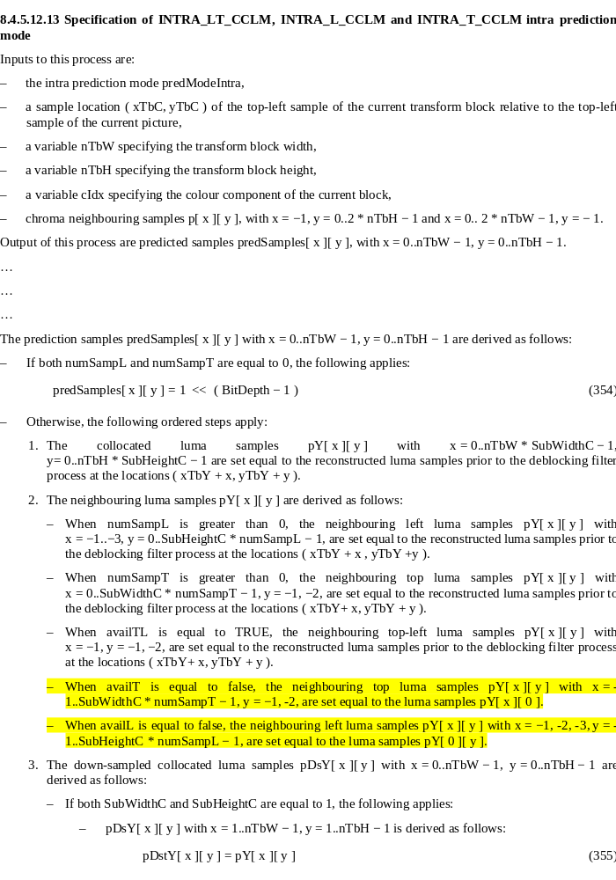
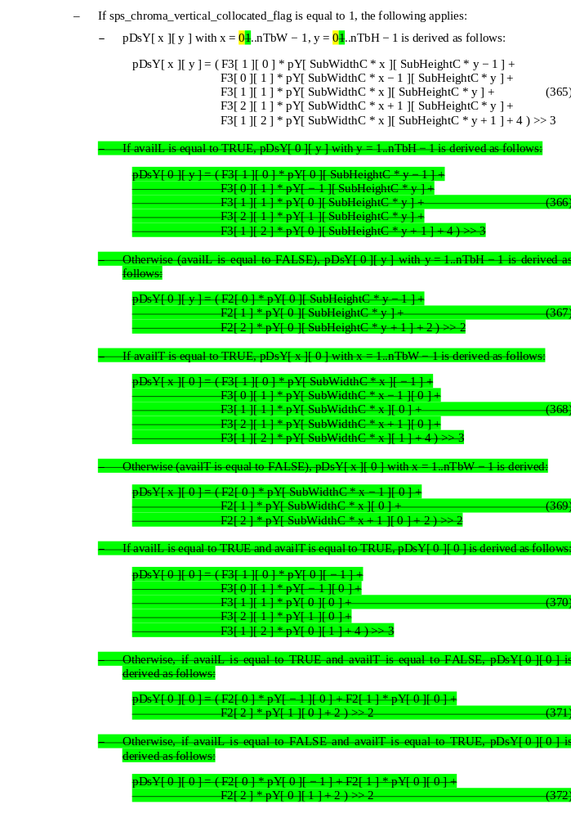

Slide 7
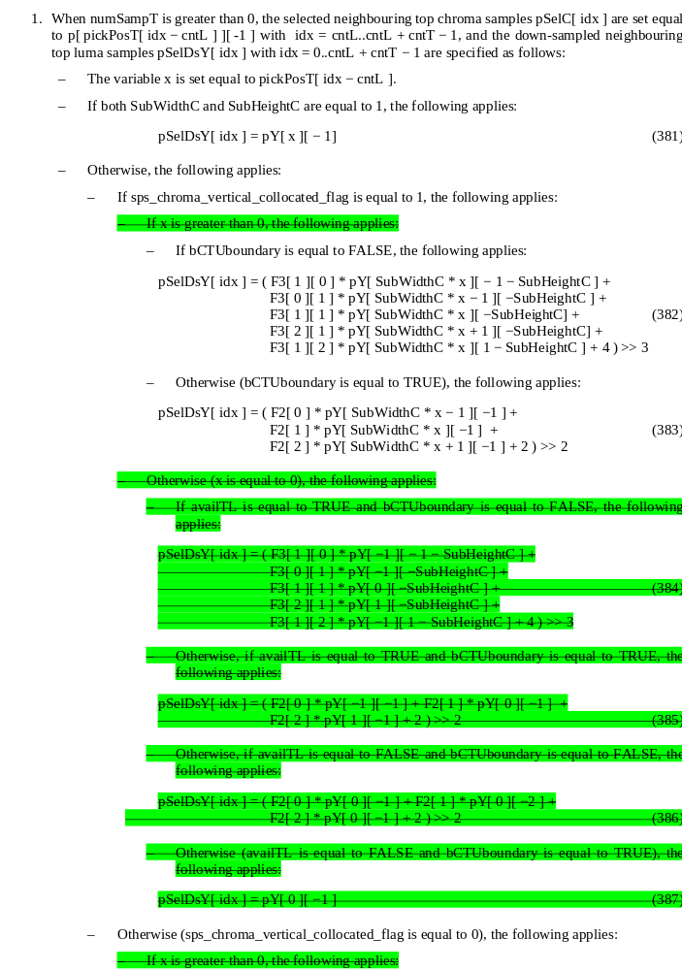
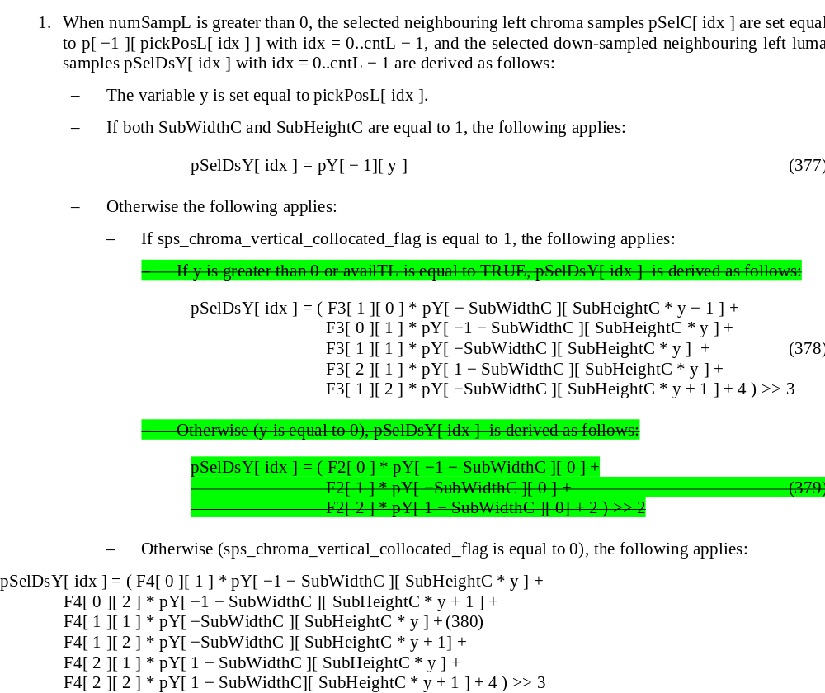

Slide 8
Thank you

Slide 9
Proposed Simplifications
Perform repeat padding for those unavailable luma samples for CCLM
  Parallel friendly (SIMD)
  VVC spec simplification (~100 lines removed)
VTM7.0 (2-tap/6-tap filters switch)
Proposed (one 6-tap filter)

Slide 10
Introduction
In current CCLM, different filters are used for luma down-sampling depending on whether the luma samples are available or not
  Different filters used for one block (Not SIMD friendly)
  Conditions checking are required
Proposed to perform padding for those unavailable samples
  Negligible coding performance changes
  One filter is used for one block (SIMD friendly)
  Conditions checking removed (~ 100 lines are removed in VVC spec)

Slide 11
Luma Down-sampling in VTM7
Conditional filter selection:
  6-taps filter when all 6 samples are available (3-taps at CTU boundary)
  2-taps filter when some samples are not available (1-tap at CTU boundary)
Different SIMD implementations for different conditions
2-tap/6-tap filters switch
6-tap filter

Slide 12
Luma Down-sampling in VTM7
Conditional filter selection:
  6-taps filter when all 6 samples are available (3-taps at CTU boundary)
  2-taps filter when some samples are not available (1-tap at CTU boundary)
Different SIMD implementations for different conditions
2-tap/6-tap filters switch
6-tap filter

