Slide 1
JVET-Q0352 (On subpicture boundary)
Hyeongmun Jang,
Hendry, Junghak Nam, Seethal Paluri, Seung-hwan Kim, Jaehyun Lim
Notes:
This is presentation for P0577, APS support for initial palette predictor entry.

Slide 2
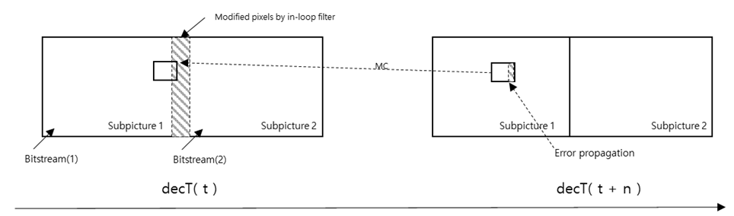
Summary
Motivation
  In VVC draft7, the loop filter is allowed across subpicture boundary even if subpicture is treated as a picture.
  It cause mismatch on the subpicture boundary and the error from mistmatch could be propagated at the following picture.
  It is not clear that enabling loop filter at the subpicture helps subjective quality inside picture.
Notes:
this proposal follows same sprit of HEVC’s scc extension.

Slide 3
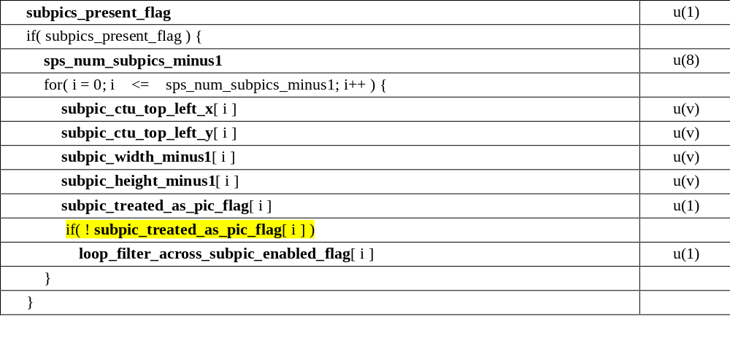
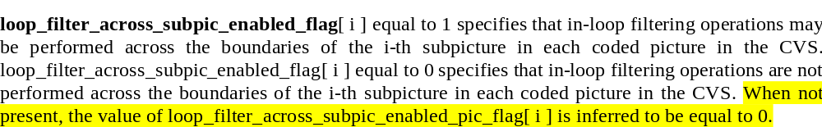
Proposed method 1
Simply disallow enabling loop filter across subpicture boundary for the subpicture which is treated as a picture.

Slide 4
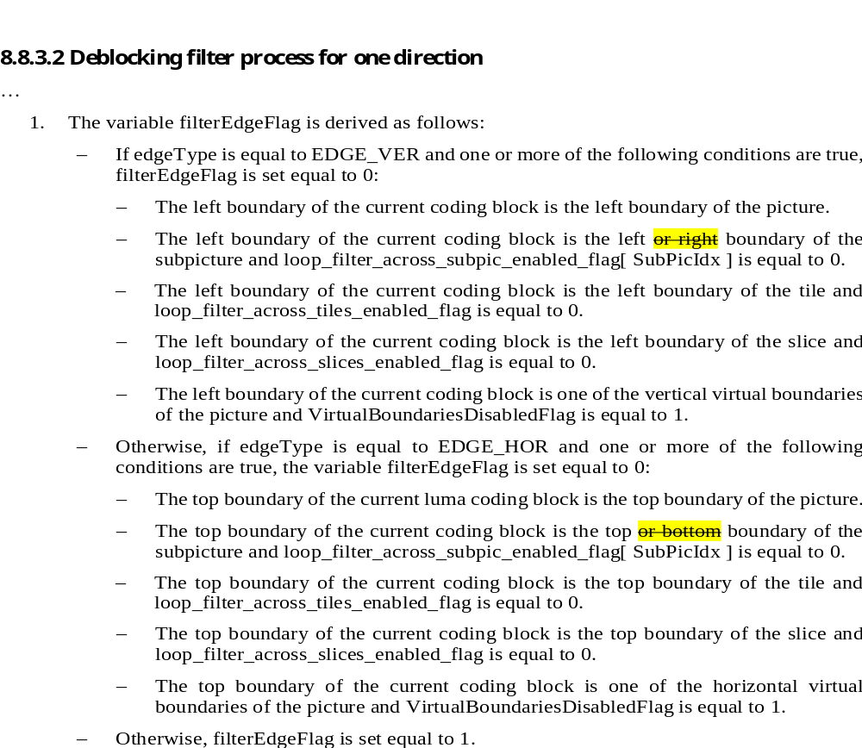
Proposed method 2
In order to prevent mismatch at the right/bottom boundary from following subpicture,

Slide 5
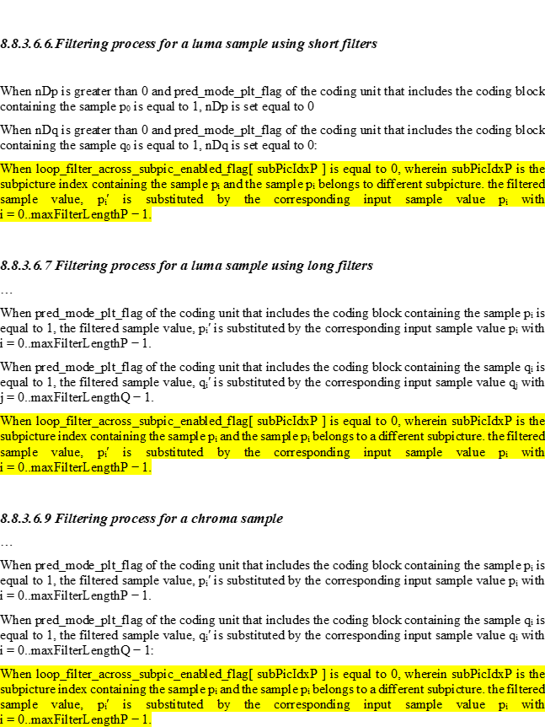
Proposed method 2

Slide 6
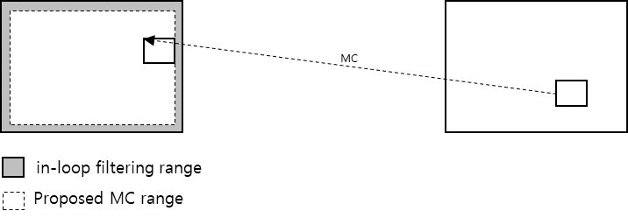
Proposed method 3
To keep subjective quality at the subpicture boundary and to avoid error propagation
  The subpicture boundary is defined not to include area where potentially mismatch happened.
  Motion compensation is applied only inside this area.

Slide 7
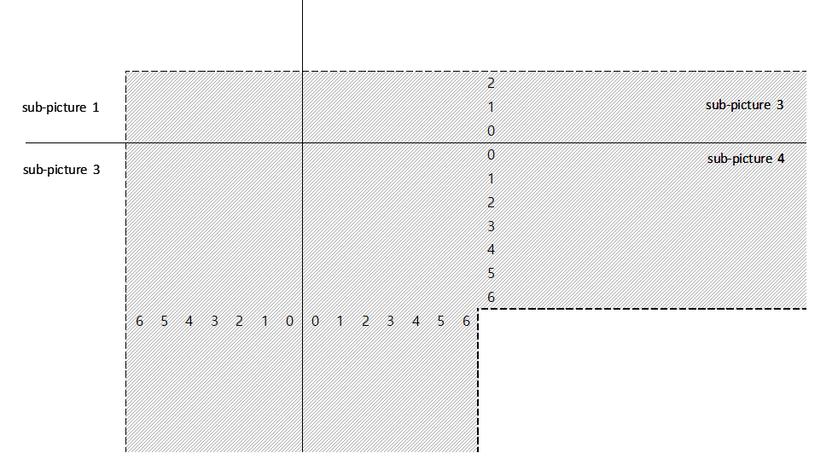
Proposed method 3
Deblocking filter in VVC draft7 modify below area when long-tap DBF is applied.
  Hence, define subpicture boundary is defined not to include this area
Bottom boundary
Top boundary
Right boundary
Left boundary

Slide 8
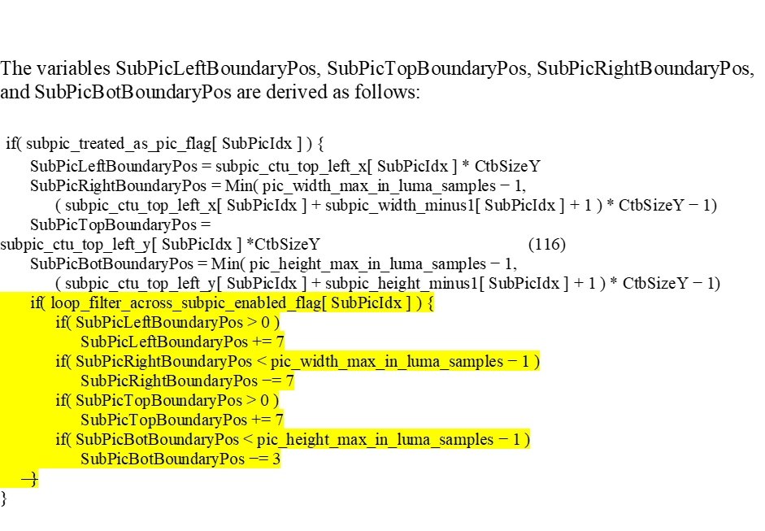
Proposed method 3

