Slide 1
AHG9: on signaling inter-layer dependency information in SPS
Biao Wang, Anand Meher Kotra, Semih Esenlik, Han Gao, Elena Alshina

Slide 2
A situation not clear in the Spec.
inter_layer_ref_pics_present_flag
inter_layer_ref_pics_present_flag equal to 0 specifies that no ILRP is used for inter prediction of any coded picture in the CLVS. inter_layer_ref_pic_flag equal to 1 specifies that ILRPs may be used for inter prediction of one or more coded pictures in the CLVS. When sps_video_parameter_set_id is equal to 0, the value of inter_layer_ref_pics_present_flag is inferred to be equal to 0. When vps_independent_layer_flag[ GeneralLayerIdx[ nuh_layer_id ] ] is equal to 1, the value of inter_layer_ref_pics_present_flag shall be equal to 0.
Layer1: dependent
What shall be the value of
inter_layer_ref_pics_present_flag?
One sps
One flag
Layer0: independent

Slide 3
Option one:
seq_parameter_set_rbsp( ) { | Descriptor
sps_decoding_parameter_set_id | u(4)
sps_video_parameter_set_id | u(4)
sps_max_sublayers_minus1 | u(3)
…
long_term_ref_pics_flag | u(1)
sps_num_shared_layers_minus1 | u(6)
for (i=0; i < =sps_num_shared_layers_minus1; i++)
sps_shared_layer_idx[i] | u(6)
for (i=0; i <= sps_num_shared_layers_minus1; i++)
inter_layer_ref_pics_present_flag [i] | u(1)
…
vps_layer_id[0] = 0,
vps_layer_id[1] = 2 → shared SPS
and vps_layer_id[2] = 4 → shared SPS
sps_num_shared_layers_minus1 = 1
sps_shared_layer_idx[0] = 1
sps_shared_layer_idx[1] = 2
sps_num_shared_layers_minus1 plus 1 specifies the number of video coding layers to which the current SPS applies to. The value of sps_num_shared_layers_minus1 ranges from 0 to 55, inclusive. When not present, the value of sps_num_shared_layers_minus1 is inferred to equal to 0.
sps_other_layer_idx[i] specifies the layer index of i-th layer to which the current SPS applies to.
inter_layer_ref_pics_present_flag[i] equal to 0 specifies that no ILRP is used for inter prediction of any coded picture in the i-th CLVS to which the current SPS applies. inter_layer_ref_pic_flag[i] equal to 1 specifies that ILRPs may be used for inter prediction of one or more coded pictures in the i-th CLVS to which the current SPS applies. When sps_video_parameter_set_id is equal to 0, the value of inter_layer_ref_pics_present_flag[i] is inferred to be equal to 0. When vps_independent_layer_flag[ GeneralLayerIdx[ nuh_layer_id ] ] is equal to 1, the value of inter_layer_ref_pics_present_flag[i] shall be equal to 0.

Slide 4
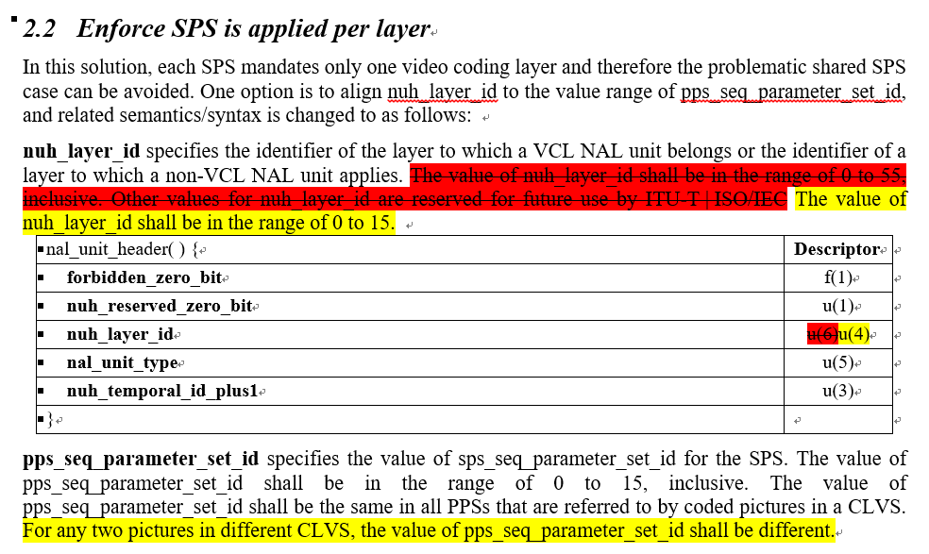

Slide 5
