Slide 1
AHG9: Miscellaneous fixes for HLS in Specification
Biao Wang, Anand Meher Kotra, Semih Esenlik, Han Gao, Elena Alshina
AHG9: Miscellaneous fixes for HLS in Specification
AHG9: Miscellaneous fixes for HLS in Specification

Slide 2
Overall summary
1st aspect fix
In the SH and PH header, semantics related to ref_pic_list_sps_flag and ref_pic_list_idx are broken.
ref_pic_list_sps_flag has been replaced by
  slice_rpl_sps_flag in SH
  pic_rpl_sps_flag in PH
ref_pic_list_idx has been replaced by
  slice_rpl_idx in SH
  pic_rpl_idx in PH
2nd aspect fix
ph_poc_msb_cycle_present_flag has been replaced by
  ph_poc_msb_present_flag
3rd: a suggestion
have a unified prefix in picture header, either ph_XXX or pic_XXX, but not both

Slide 3
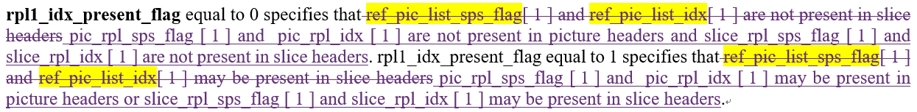
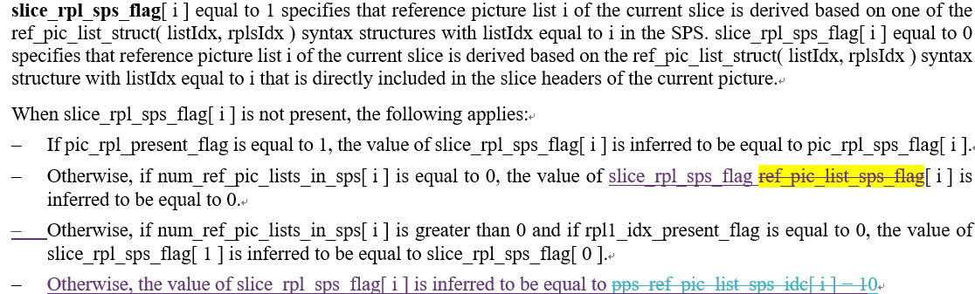
Main Semantics Fixed

Slide 4
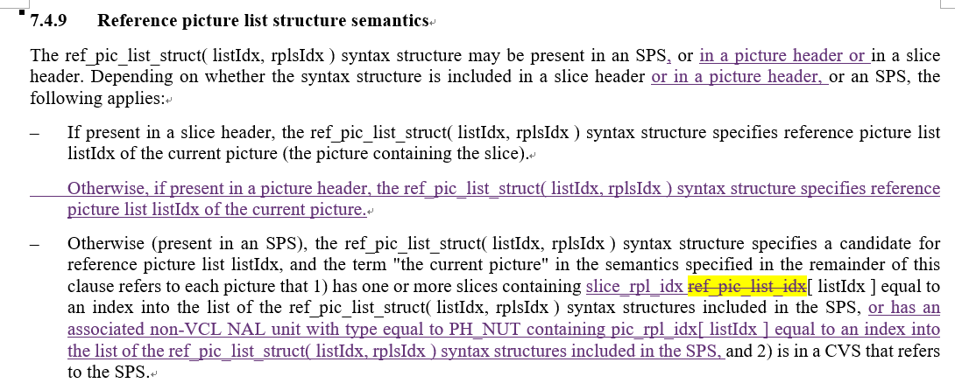
Main Semantics Fixed

