Slide 1
JVET-Q0167
Non-CE5: Multiplication simplification for ALF and CC-ALF
Jacob Ström, Zhi Zhang, Kenneth Andersson
Ericsson Research

Slide 2
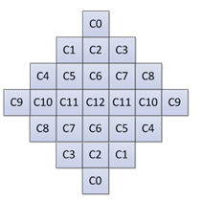
Background: Adaptive loop filtering (ALF)
ALF Classifies samples into 25 possible classes, and each can have a unique filter.
Most often these filters are merged, which is a form of quantization.
ALF filter support for luma

Slide 3
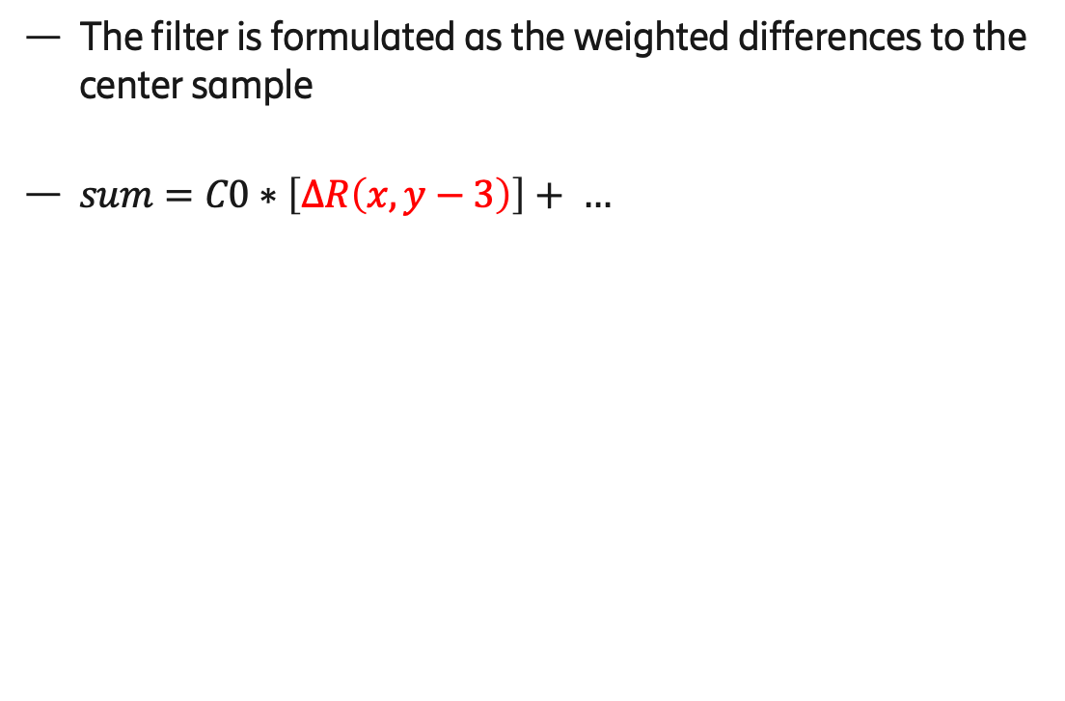

Filter formula in VVC-ALF
$$ΔR\left(x,y−3\right)= \\ =R\left(x,y−3\right)−R\left(x,y\right)$$
The filter is formulated as the weighted differences to the center sample
$sum=C0∗\left[ΔR\left(x,y−3\right)\right]+ …$
signaled
coefficient
difference
value

Slide 4
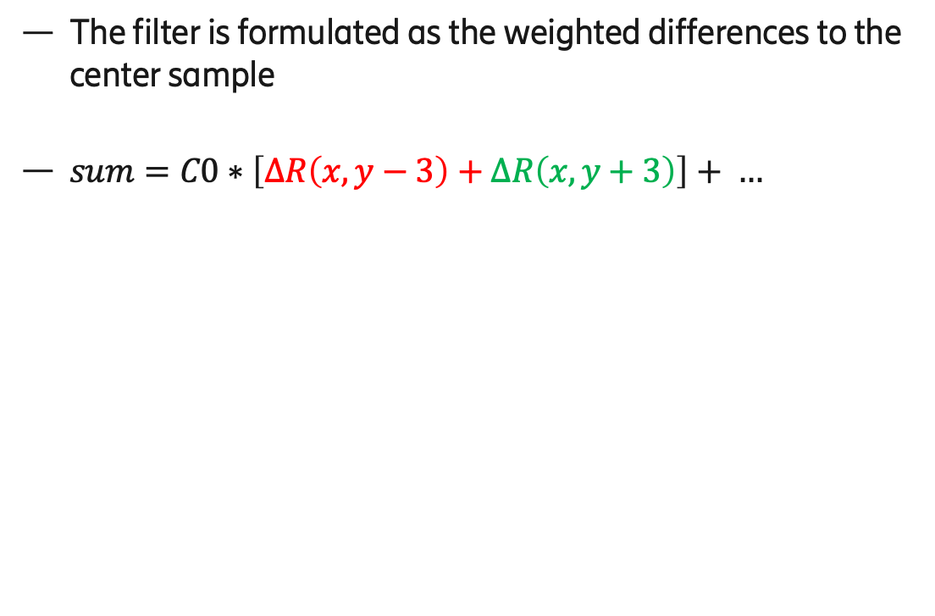

Filter formula in ALF
The filter is formulated as the weighted differences to the center sample
$sum=C0∗\left[ΔR\left(x,y−3\right)+ΔR\left(x,y+3\right)\right]+ …$
signaled
coefficient
second
difference value
$$ΔR\left(x,y−3\right)= \\ =R\left(x,y−3\right)−R\left(x,y\right)$$

Slide 5
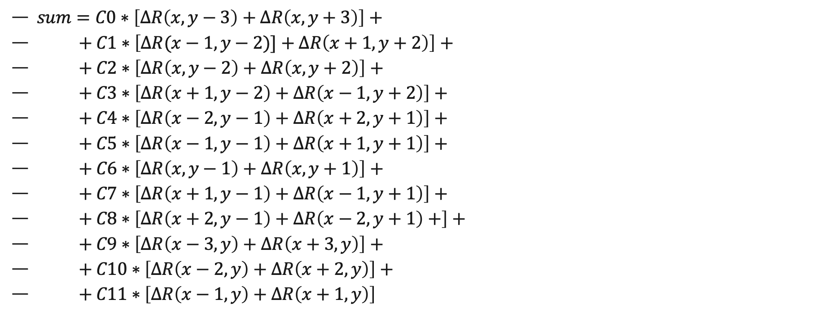
Full ALF equation (in VTM)
$sum=C0∗\left[ΔR\left(x,y−3\right)+ΔR\left(x,y+3\right)\right]+$
$+ C1∗\left[ΔR(x−1,y−2)]+ΔR\left(x+1,y+2\right)\right]+$
$+ C2∗\left[ΔR\left(x,y−2\right)+ΔR\left(x,y+2\right)\right]+$
$+ C3∗\left[ΔR\left(x+1,y−2\right)+ΔR\left(x−1,y+2\right)\right]+$
$+ C4∗\left[ΔR\left(x−2,y−1\right)+ΔR\left(x+2,y+1\right)\right]+$
$+ C5∗\left[ΔR\left(x−1,y−1\right)+ΔR\left(x+1,y+1\right)\right]+$
$+ C6∗\left[ΔR\left(x,y−1\right)+ΔR\left(x,y+1\right)\right]+$
$+ C7∗\left[ΔR\left(x+1,y−1\right)+ΔR\left(x−1,y+1\right)\right]+$
$+ C8∗\left[ΔR\left(x+2,y−1\right)+ΔR\left(x−2,y+1\right)+\right]+$
$+ C9∗\left[ΔR\left(x−3,y\right)+ΔR\left(x+3,y\right)\right]+$
$+ C10∗\left[ΔR\left(x−2,y\right)+ΔR\left(x+2,y\right)\right]+$
$+ C11∗\left[ΔR\left(x−1,y\right)+ΔR\left(x+1,y\right)\right]$

Slide 6
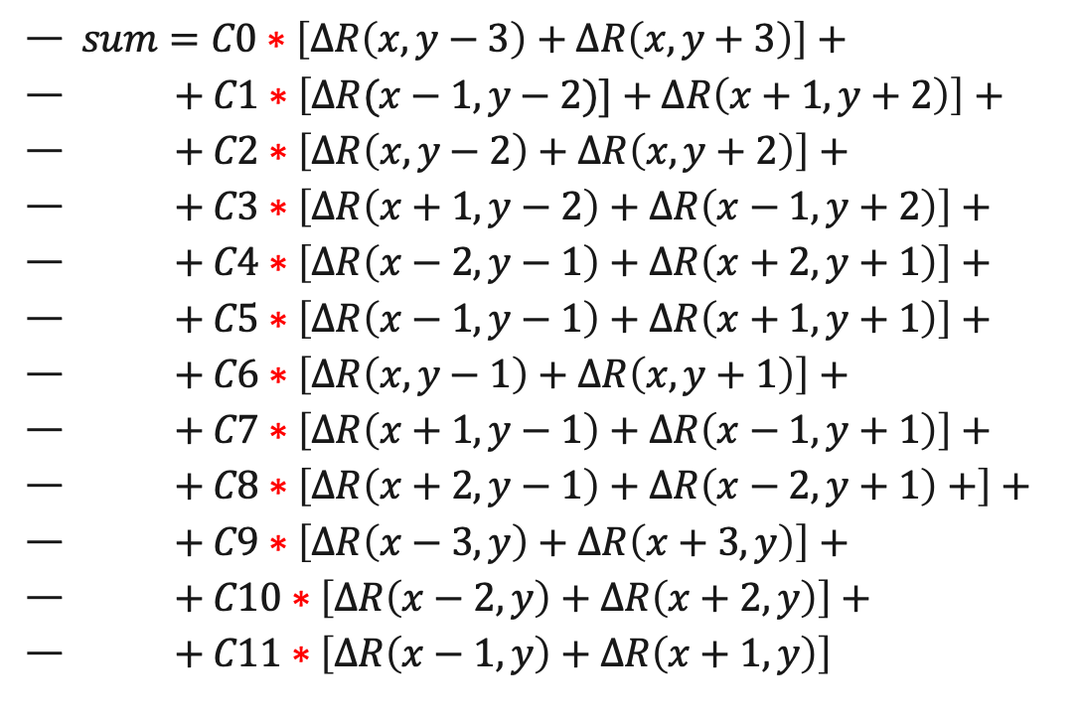
Problem that we attack
$sum=C0∗\left[ΔR\left(x,y−3\right)+ΔR\left(x,y+3\right)\right]+$
$+ C1∗\left[ΔR(x−1,y−2)]+ΔR\left(x+1,y+2\right)\right]+$
$+ C2∗\left[ΔR\left(x,y−2\right)+ΔR\left(x,y+2\right)\right]+$
$+ C3∗\left[ΔR\left(x+1,y−2\right)+ΔR\left(x−1,y+2\right)\right]+$
$+ C4∗\left[ΔR\left(x−2,y−1\right)+ΔR\left(x+2,y+1\right)\right]+$
$+ C5∗\left[ΔR\left(x−1,y−1\right)+ΔR\left(x+1,y+1\right)\right]+$
$+ C6∗\left[ΔR\left(x,y−1\right)+ΔR\left(x,y+1\right)\right]+$
$+ C7∗\left[ΔR\left(x+1,y−1\right)+ΔR\left(x−1,y+1\right)\right]+$
$+ C8∗\left[ΔR\left(x+2,y−1\right)+ΔR\left(x−2,y+1\right)+\right]+$
$+ C9∗\left[ΔR\left(x−3,y\right)+ΔR\left(x+3,y\right)\right]+$
$+ C10∗\left[ΔR\left(x−2,y\right)+ΔR\left(x+2,y\right)\right]+$
$+ C11∗\left[ΔR\left(x−1,y\right)+ΔR\left(x+1,y\right)\right]$
In total there are 12 multiplications per sample.
Multiplications are expensive in hardware:
(In software they are cheap.)

Slide 7
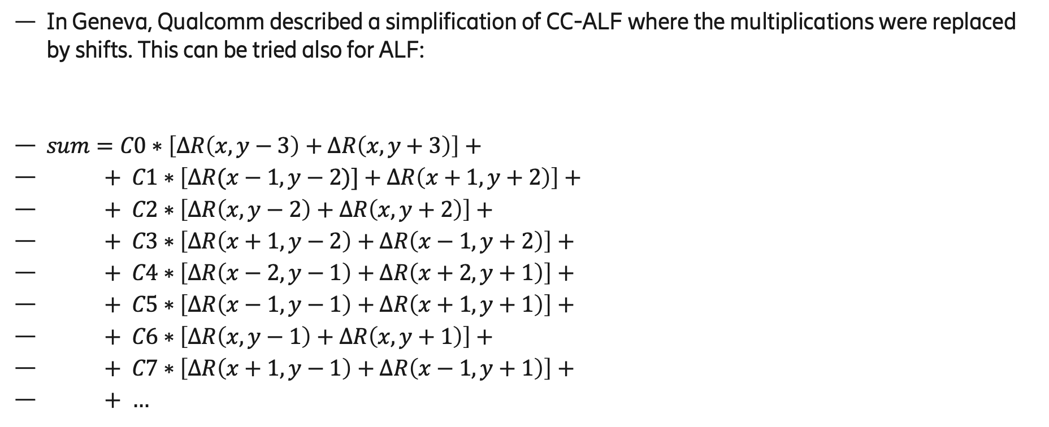
Inspiration
In Geneva, Qualcomm described a simplification of CC-ALF where the multiplications were replaced by shifts. This can be tried also for ALF:
$sum=C0∗\left[ΔR\left(x,y−3\right)+ΔR\left(x,y+3\right)\right]+$
$+ C1∗\left[ΔR(x−1,y−2)]+ΔR\left(x+1,y+2\right)\right]+$
$+ C2∗\left[ΔR\left(x,y−2\right)+ΔR\left(x,y+2\right)\right]+$
$+ C3∗\left[ΔR\left(x+1,y−2\right)+ΔR\left(x−1,y+2\right)\right]+$
$+ C4∗\left[ΔR\left(x−2,y−1\right)+ΔR\left(x+2,y+1\right)\right]+$
$+ C5∗\left[ΔR\left(x−1,y−1\right)+ΔR\left(x+1,y+1\right)\right]+$
$+ C6∗\left[ΔR\left(x,y−1\right)+ΔR\left(x,y+1\right)\right]+$
$+ C7∗\left[ΔR\left(x+1,y−1\right)+ΔR\left(x−1,y+1\right)\right]+$
$+ …$

Slide 8
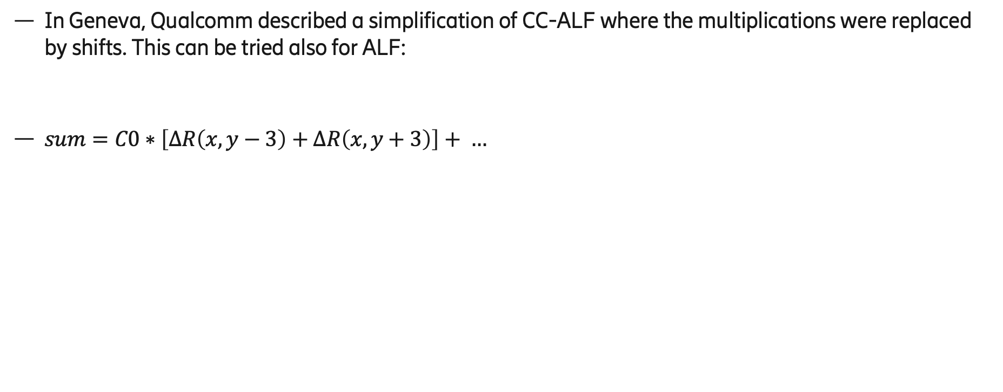
Inspiration
In Geneva, Qualcomm described a simplification of CC-ALF where the multiplications were replaced by shifts. This can be tried also for ALF:
$sum=C0∗\left[ΔR\left(x,y−3\right)+ΔR\left(x,y+3\right)\right]+ …$

Slide 9
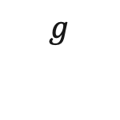
Inspiration
In Geneva, Qualcomm described a simplification of CC-ALF where the multiplications were replaced by shifts. This can be tried also for ALF:
$sum=C0∗\left[ΔR\left(x,y−3\right)+ΔR\left(x,y+3\right)\right]+ …$
$$g$$

Slide 10
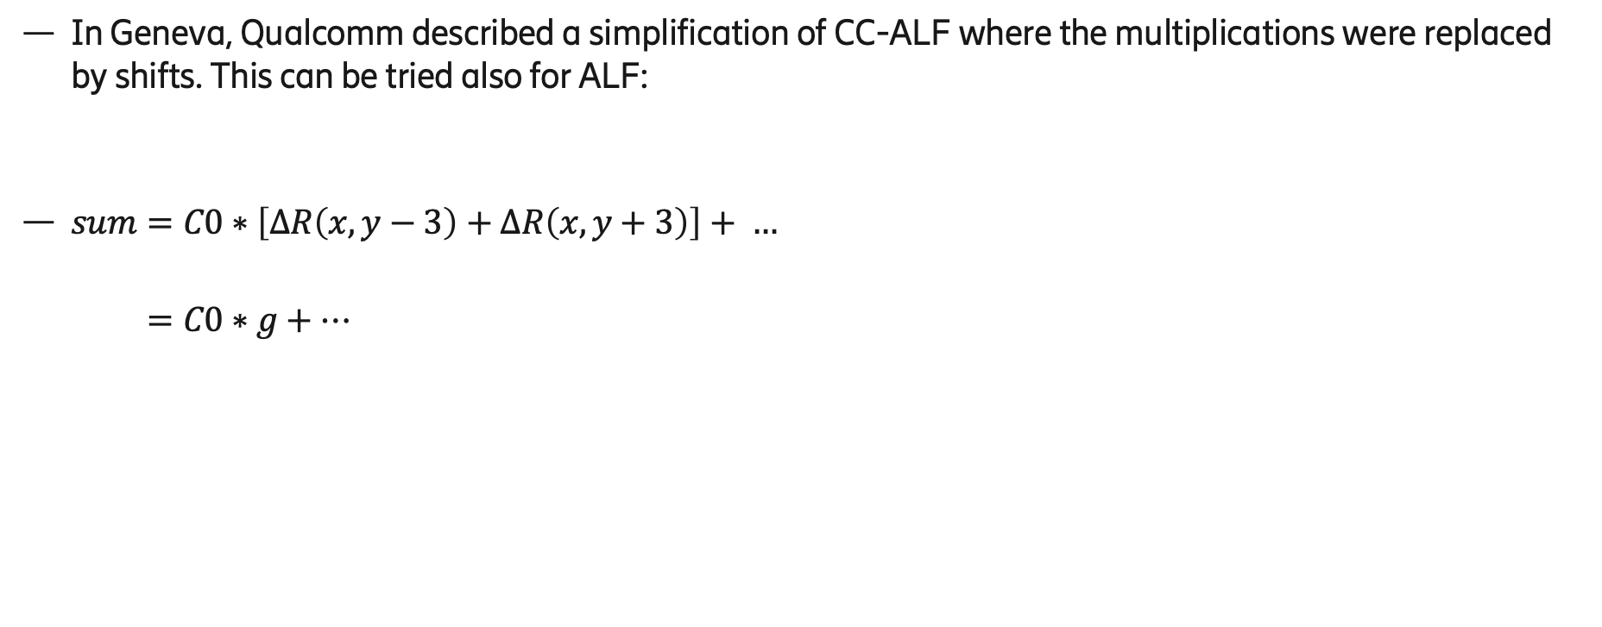
Inspiration
In Geneva, Qualcomm described a simplification of CC-ALF where the multiplications were replaced by shifts. This can be tried also for ALF:
$sum=C0∗\left[ΔR\left(x,y−3\right)+ΔR\left(x,y+3\right)\right]+ …$
$=C0∗g+…$
$$g$$

Slide 11
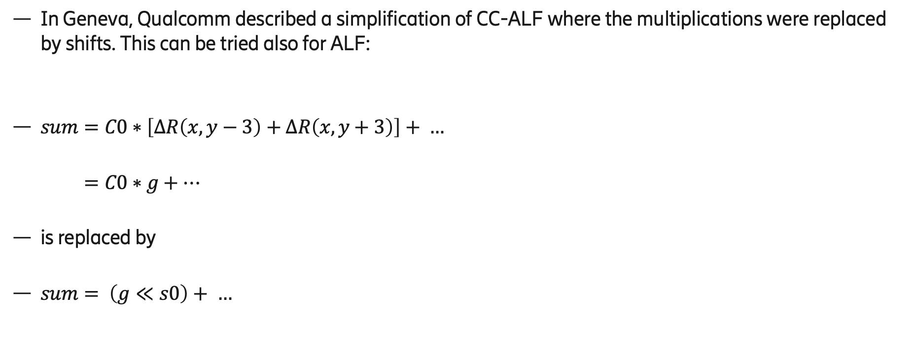
Inspiration
In Geneva, Qualcomm described a simplification of CC-ALF where the multiplications were replaced by shifts. This can be tried also for ALF:
$sum=C0∗\left[ΔR\left(x,y−3\right)+ΔR\left(x,y+3\right)\right]+ …$
$=C0∗g+…$
is replaced by
$sum= \left(g≪s0\right)+ …$
$$g$$
shift

Slide 12
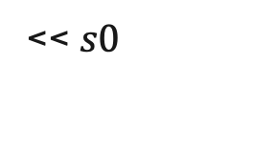
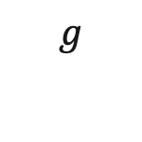
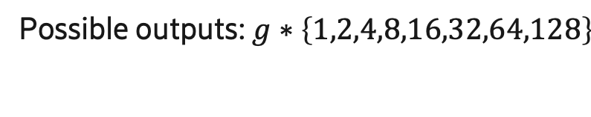
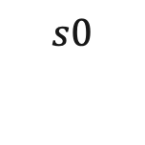
Implementation of pure power of two multiplication
$$g$$
output
<< $s0$
$$s0$$
Possible outputs: $g∗\left\{1,2,4,8,16,32,64,128\right\}$

Slide 13
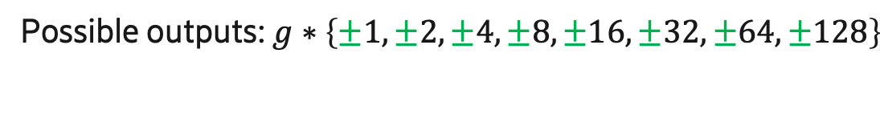
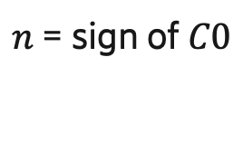
Implementation of pure power of two multiplication
$n$ = sign of $C0$
$$g$$
conditional
negate
output
<< $s0$
$$s0$$
Possible outputs: $g∗\left\{±1,±2,±4,±8,±16,±32,±64,±128\right\}$

Slide 14
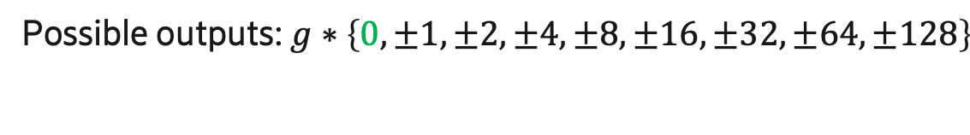
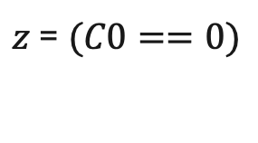
Implementation of pure power of two multiplication
$n$ = sign of $C0$
$z$ = $(C0==0)$
$$g$$
conditional
zero out
conditional
negate
output
<< $s0$
$$s0$$
Possible outputs: $g∗\left\{0,±1,±2,±4,±8,±16,±32,±64,±128\right\}$

Slide 15
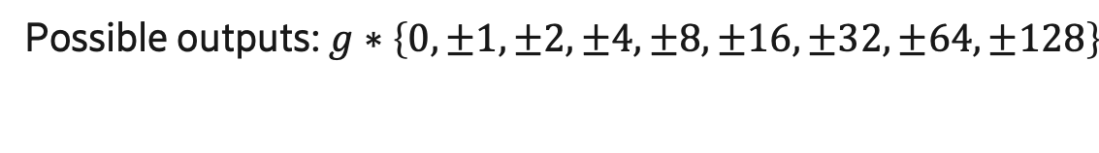
Implementation of pure power of two multiplication
$n$ = sign of $C0$
cheap
cheap
cheap
$z$ = $(C0==0)$
$$g$$
conditional
zero out
conditional
negate
output
<< $s0$
$$s0$$
Possible outputs: $g∗\left\{0,±1,±2,±4,±8,±16,±32,±64,±128\right\}$

Slide 16
However, BDR figures are not good.
BDR loss for Random Access is about 0.2%
Some sequences get BDR penalties of more than 0.4%

Slide 17
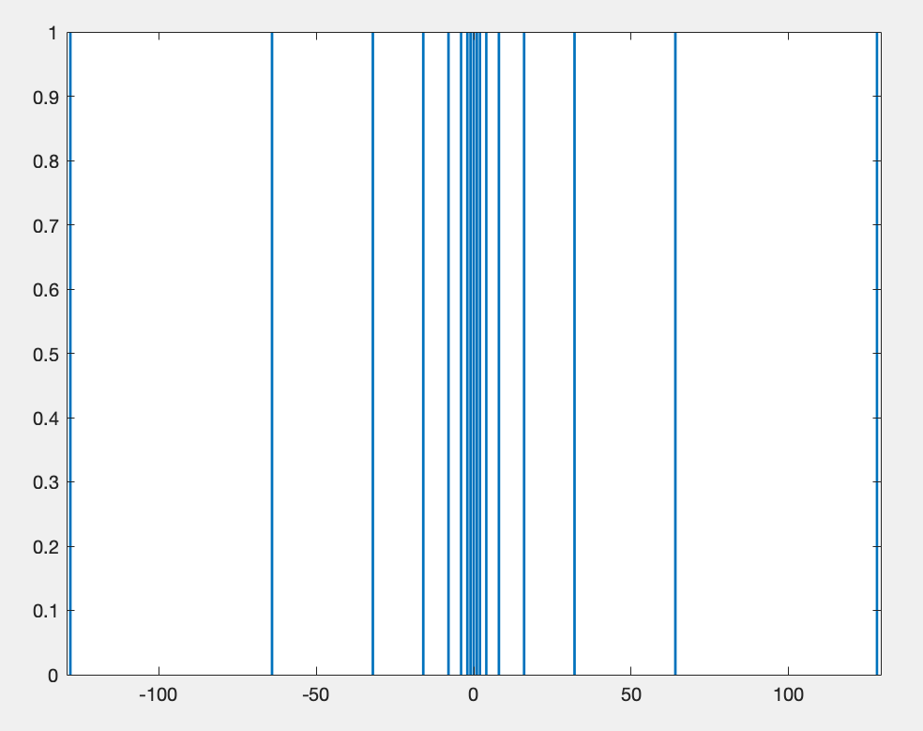
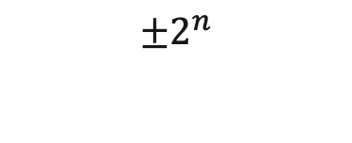
Idea
$$±2^{n}$$
Pure power of two coefficients too restrictive
Our idea is to allow more coefficients but still have low complexity hardware.

Slide 18
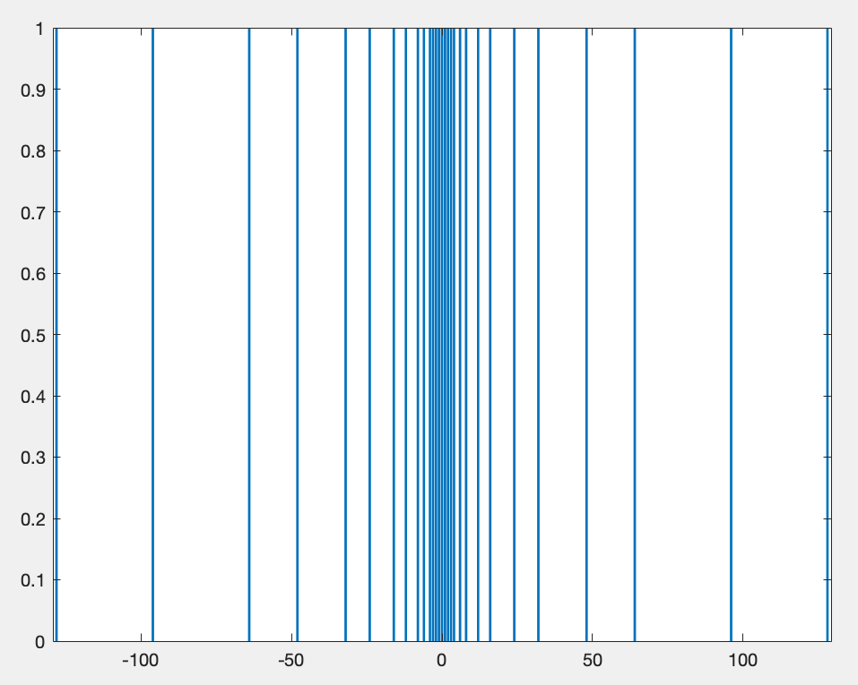
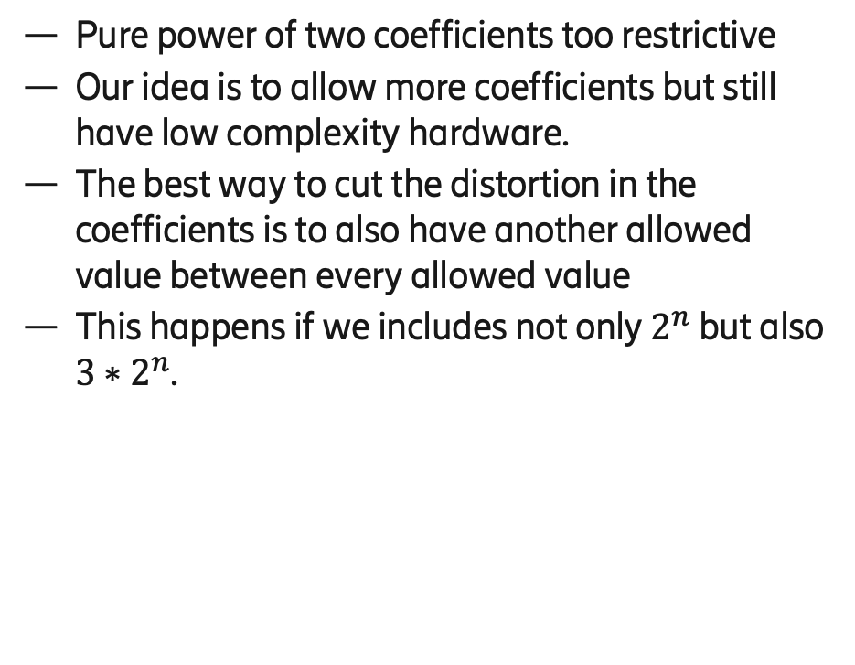
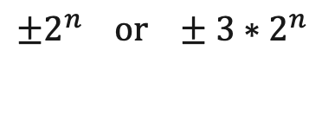
Idea
$$±2^{n}$$
Pure power of two coefficients too restrictive
Our idea is to allow more coefficients but still have low complexity hardware.
The best way to cut the distortion in the coefficients is to also have another allowed value between every allowed value
This happens if we includes not only $2^{n}$ but also $3∗2^{n}$.
$${±2^{n} or ±3∗2}^{n}$$

Slide 19
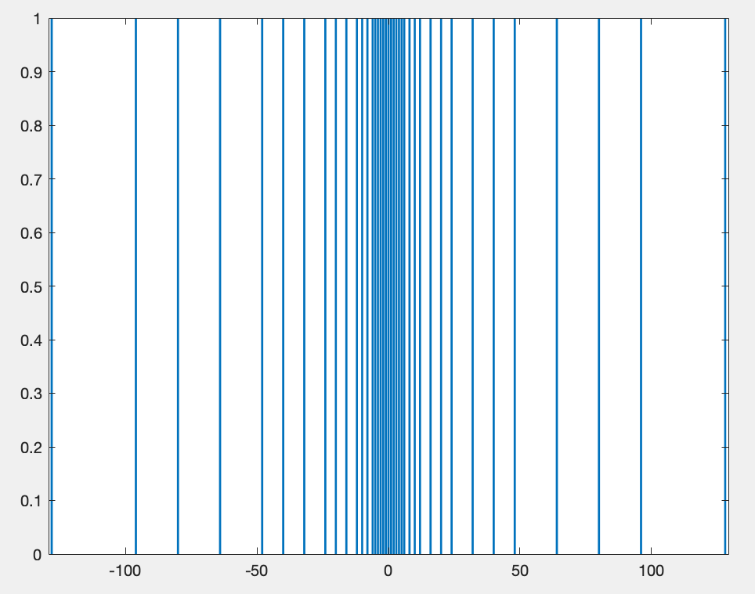
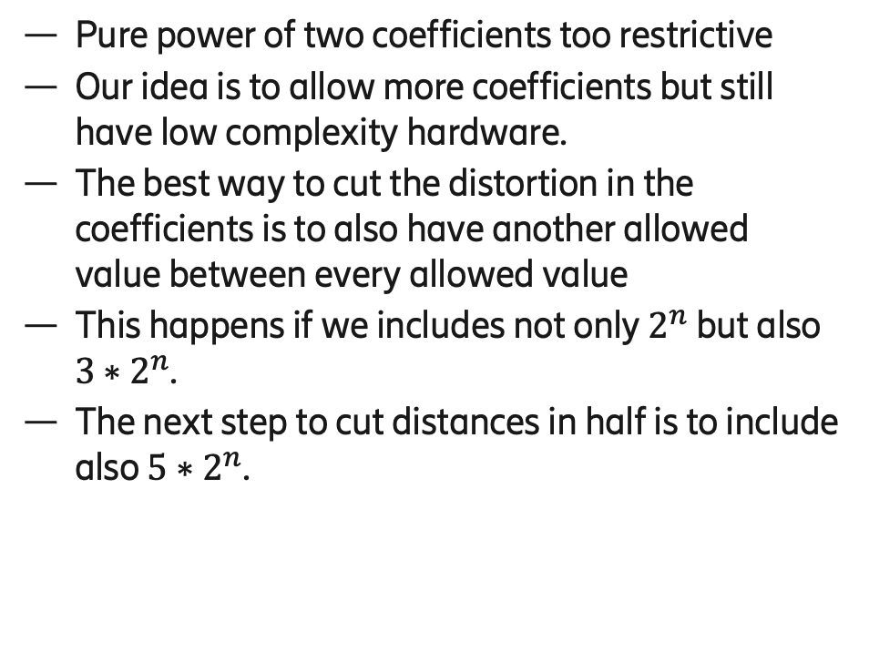
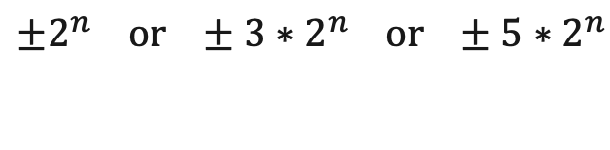
Idea
$$±2^{n}$$
Pure power of two coefficients too restrictive
Our idea is to allow more coefficients but still have low complexity hardware.
The best way to cut the distortion in the coefficients is to also have another allowed value between every allowed value
This happens if we includes not only $2^{n}$ but also $3∗2^{n}$.
The next step to cut distances in half is to include also $5∗2^{n}$.
$${±2^{n} or ±3∗2}^{n} or ±5∗2^{n}$$

Slide 20

Multiplication by 3 is very cheap
We can write $3∗g$as
  $$2∗g+g$$

Slide 21
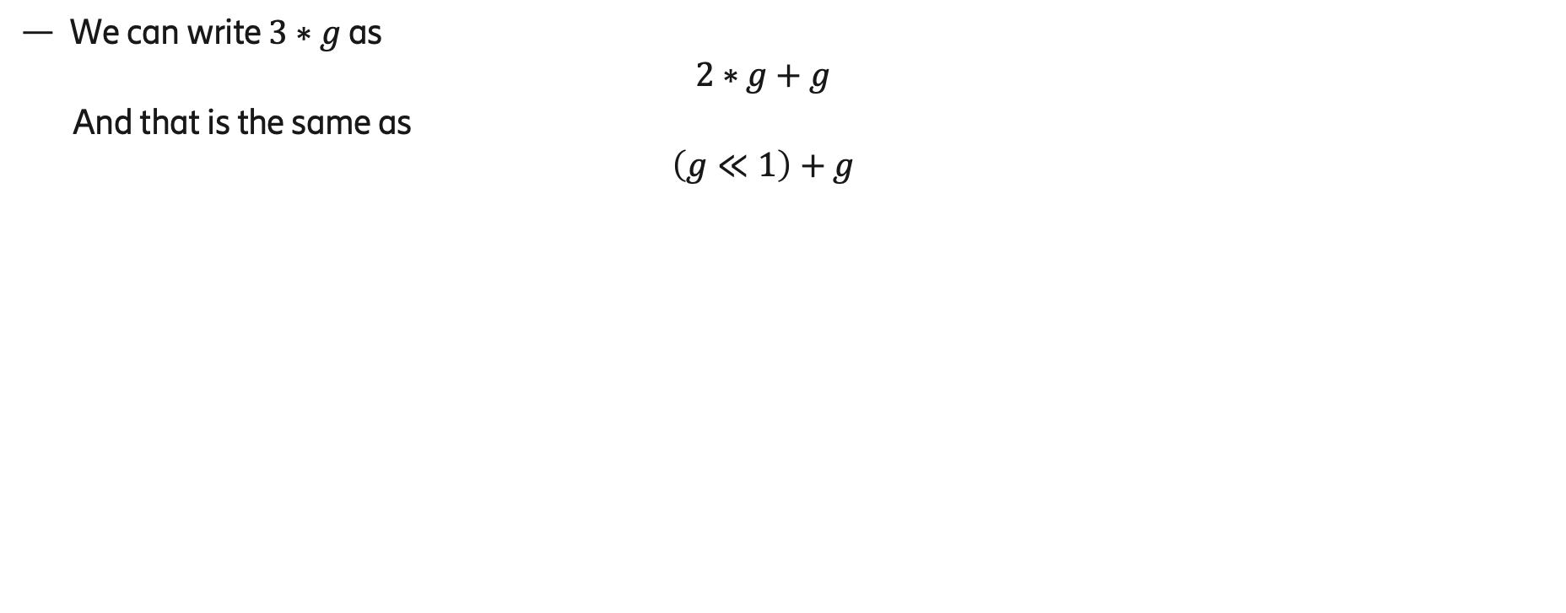
Multiplication by 3 is very cheap
We can write $3∗g$as
  $$2∗g+g$$
  And that is the same as
  $$\left(g≪1\right)+g$$

Slide 22
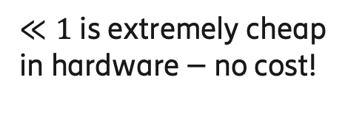
Multiplication by 3 is very cheap
$≪1$ is extremely cheap
in hardware – no cost!
We can write $3∗g$as
  $$2∗g+g$$
  And that is the same as
  $$\left(g≪1\right)+g$$
input bits
0
output bits

Slide 23
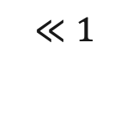

Multiplication by 3 is very cheap
$≪1$ is extremely cheap
in hardware – no cost!
We can write $3∗g$as
  $$2∗g+g$$
  And that is the same as
  $$\left(g≪1\right)+g$$
input bits
0
$$g$$
$$≪1$$
output bits
$$+$$

Slide 24
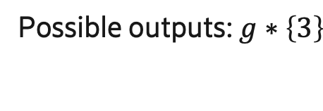
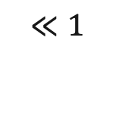
Multiplication by 3 is very cheap
$$g$$
$$≪1$$
$$+$$
Possible outputs: $g∗\left\{3\right\}$

Slide 25
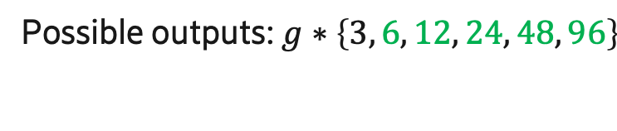
Multiplication by 3 is very cheap
$$g$$
$$≪1$$
shift
s0
steps
$$+$$
Possible outputs: $g∗\left\{3, 6, 12, 24, 48, 96\right\}$

Slide 26
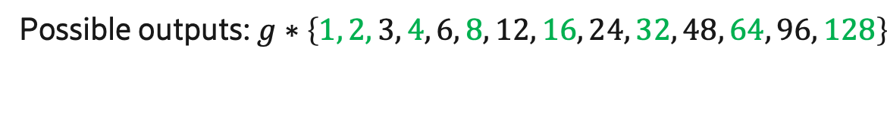
Multiplication by 3 is very cheap
condi-
tional
zero out
$$g$$
$$≪1$$
shift
s0
steps
$$+$$
Possible outputs: $g∗\left\{1, 2, 3, 4, 6, 8, 12, 16, 24, 32, 48, 64, 96, 128\right\}$

Slide 27
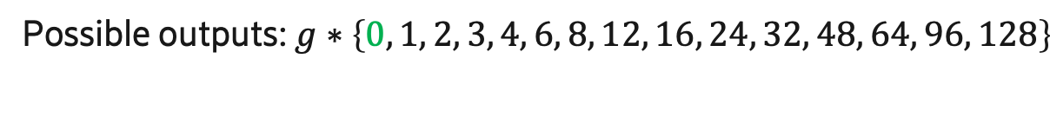
Multiplication by 3 is very cheap
condi-
tional
zero out
$$g$$
$$≪1$$
shift
s0
steps
$$+$$
condi-
tional
zero out
Possible outputs: $g∗\left\{0, 1, 2, 3, 4, 6, 8, 12, 16, 24, 32, 48, 64, 96, 128\right\}$

Slide 28
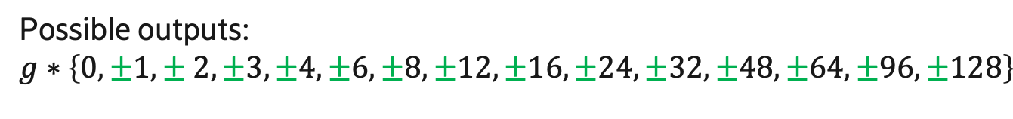
Multiplication by 3 is very cheap
condi-
tional
zero out
$$g$$
$$≪1$$
condi-
tional
negate
shift
s0
steps
$$+$$
condi-
tional
zero out
Possible outputs:
$$g∗\left\{0, ±1,± 2, ±3, ±4, ±6, ±8, ±12, ±16, ±24, ±32, ±48, ±64, ±96,±128\right\}$$

Slide 29
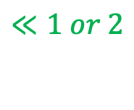
Multiplication by 3 or 5 is also very cheap
condi-
tional
zero out
$$g$$
$$≪1 or 2$$
condi-
tional
negate
shift
s0
steps
$$+$$
condi-
tional
zero out
Possible outputs:
$$g∗\left\{0, ±1,± 2, ±3, ±4,±5,±6, ±8,±10,±12, ±16,±20,±24, ±32,±40,±48, ±64,±80,±96,±128\right\}$$

Slide 30
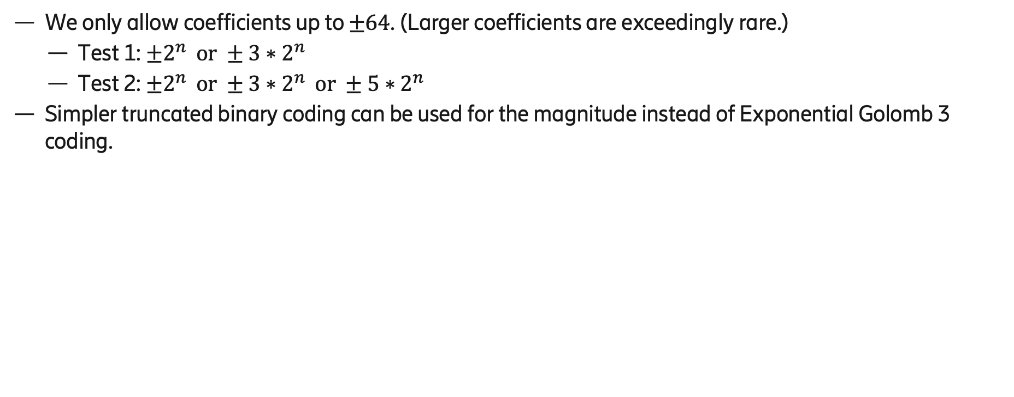
Coding of coefficients
We only allow coefficients up to $±64$. (Larger coefficients are exceedingly rare.)
  Test 1: ${±2^{n} or ±3∗2}^{n}$
  Test 2: ${±2^{n} or ±3∗2}^{n} or ±5∗2^{n}$
Simpler truncated binary coding can be used for the magnitude instead of Exponential Golomb 3 coding.
magnitude | index | index bits | sign bit | number of bits
0 | 0 | 0000 |  | 4
1 | 1 | 0001 | 0/1 | 5
2 | 2 | 0010 | 0/1 | 5
3 | 3 | 0011 | 0/1 | 5
4 | 4 | 0100 | 0/1 | 5
5 | 5 | 0101 | 0/1 | 5
6 | 6 | 0110 | 0/1 | 5
8 | 7 | 0111 | 0/1 | 5
10 | 8 | 1000 | 0/1 | 5
12 | 9 | 1001 | 0/1 | 5
16 | 10 | 1010 | 0/1 | 5
20 | 11 | 1011 | 0/1 | 5
24 | 12 | 1100 | 0/1 | 5
32 | 13 | 1101 | 0/1 | 5
40 | 14 | 1110 | 0/1 | 5
48 | 15 | 11110 | 0/1 | 6
64 | 16 | 11111 | 0/1 | 6
magnitude | index | index bits | sign bit | number of bits
0 | 0 | 000 |  | 3
1 | 1 | 001 | 0/1 | 4
2 | 2 | 010 | 0/1 | 4
3 | 3 | 0110 | 0/1 | 5
4 | 4 | 0111 | 0/1 | 5
6 | 5 | 1000 | 0/1 | 5
8 | 6 | 1001 | 0/1 | 5
12 | 7 | 1010 | 0/1 | 5
16 | 8 | 1011 | 0/1 | 5
24 | 9 | 1100 | 0/1 | 5
32 | 10 | 1101 | 0/1 | 5
48 | 11 | 1110 | 0/1 | 5
64 | 12 | 1111 | 0/1 | 5
Test 1
Test 2

Slide 31
Specification changes (test 2)
Replacing Exponential-Golomb code 3 with truncated binary coding (and the same for chroma):
The decoding of the magnitude changes the following part of the specification text:
The variable filtCoeff[ sfIdx ][ j ] with sfIdx = 0..alf_luma_num_filters_signalled_minus1, j = 0..11 is initialized as follows:
filtCoeff[ sfIdx ][ j ] = AlfApsCoeffMap[ alf_luma_coeff_abs_idx[ sfIdx ][ j ] ] * (90)
( 1 − 2 * alf_luma_coeff_sign[ sfIdx ][ j ] )
AlfApsCoeffMap = { 0, 1, 2, 3, 4, 5, 6, 8, 10, 12, 16, 20, 24, 32, 40, 48, 64 }
for( sfIdx = 0; sfIdx <= alf_luma_num_filters_signalled_minus1; sfIdx++ ) {
for( j = 0; j < 12; j++ ) {
alf_luma_coeff_abs_idx[ sfIdx ][ j ] | uek(v) tb(v)
if( alf_luma_coeff_abs_idx[ sfIdx ][ j ] )
alf_luma_coeff_sign[ sfIdx ][ j ] | u(1)
}
}

Slide 32
Quantizing also the fixed filter table
(test 2):
AlfFixFiltCoeff = (92)
{ { 0, 0, 2, −3, 1, −4, 1, 7, −1, 1, −1, 5}
{ 0, 0, 2, −3, 1, −4, 1, 6, −1, 1, −1, 5}
{ 0, 0, 0, 0, 0, −1, 0, 1, 0, 0, −1, 2}
{ 0, 0, 0, 0, 0, 0, 0, 1, 0, 0, 0, 0}
{ 0, 0, 0, 0, 0, 0, 0, 0, 0, 0, −1, 1}
{ 2, 2, −7, −3, 0, −5, 13, 22, 12, −3, −3, 17}
{ 2, 2, -6, -3, 0, -5, 12, 20, 12, -3, -3, 16}
{−1, 0, 6, −8, 1, −5, 1, 23, 0, 2, −5, 10}
{-1, 0, 6, -8, 1, -5, 1, 24, 0, 2, -5, 10}
{ 0, 0, −1, −1, 0, −1, 2, 1, 0, 0, −1, 4}
{ 0, 0, 3, −11, 1, 0, −1, 35, 5, 2, −9, 9}
{ 0, 0, 3, -10, 1, 0, -1, 32, 5, 2, -8, 8}
. . .
},

Slide 33
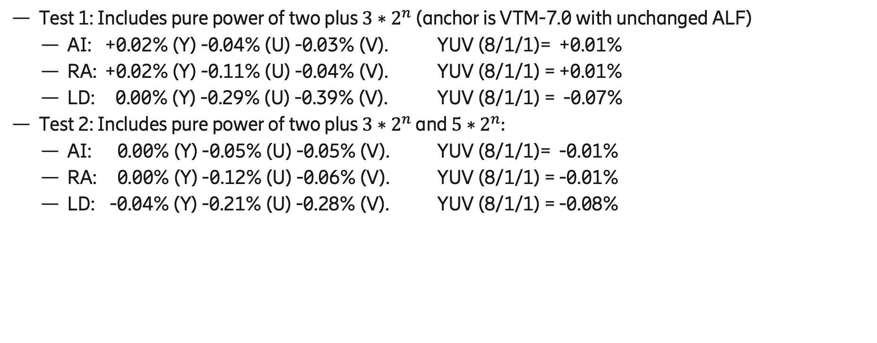
Results
Test 1: Includes pure power of two plus $3∗2^{n}$ (anchor is VTM-7.0 with unchanged ALF)
  AI: +0.02% (Y) -0.04% (U) -0.03% (V). YUV (8/1/1)= +0.01%
  RA: +0.02% (Y) -0.11% (U) -0.04% (V). YUV (8/1/1) = +0.01%
  LD: 0.00% (Y) -0.29% (U) -0.39% (V). YUV (8/1/1) = -0.07%
Test 2: Includes pure power of two plus $3∗2^{n}$ and $5∗2^{n}:$
  AI: 0.00% (Y) -0.05% (U) -0.05% (V). YUV (8/1/1)= -0.01%
  RA: 0.00% (Y) -0.12% (U) -0.06% (V). YUV (8/1/1) = -0.01%
  LD: -0.04% (Y) -0.21% (U) -0.28% (V). YUV (8/1/1) = -0.08%

Slide 34
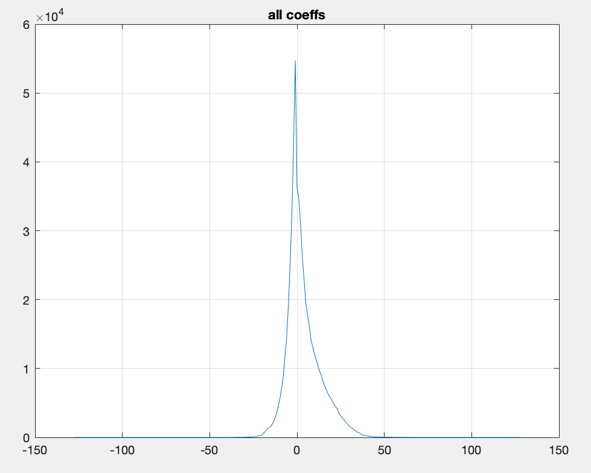
Why do we get zero BDR penalty?
Coefficients are very close to zero anyway.

Slide 35
Why do we get zero BDR penalty?
Coefficients are very close to zero anyway.
Over 60% of coefficients are in [-6, 6] where test 2 has the same quantization step as the anchor.

Slide 36
Why do we get zero BDR penalty?
Coefficients are very close to zero anyway.
Over 60% of coefficients are in [-6, 6] where test 2 has the same quantization step as the anchor.
Over 80% of the coefficients are in [-13, 13] where test 2 has a quantization step at most 2x that of the anchor.

Slide 37
Why do we get zero BDR penalty?
Coefficients are very close to zero anyway.
Over 60% of coefficients are in [-6, 6] where test 2 has the same quantization step as the anchor.
Over 80% of the coefficients are in [-13, 13] where test 2 has a quantization step just 2x that of the anchor.
Merging two filters is also a form of quantization – one could argue that merging is a much harsher form of quantization.
Since the coefficients are now cheaper, less merging is necessary: 10% and 17% more filter sets are being signaled (test2).

Slide 38
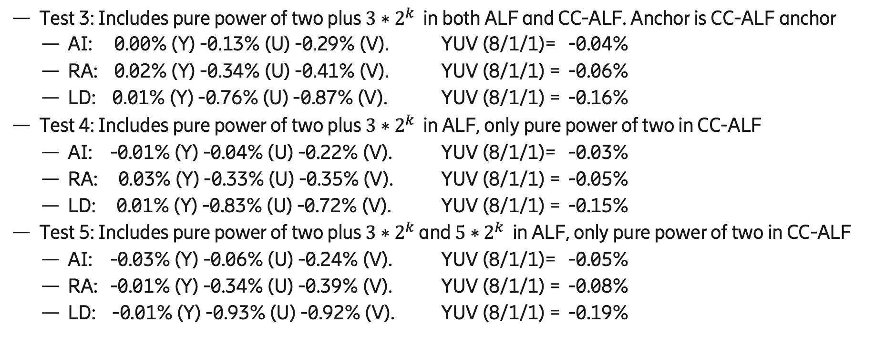
Combinations with CC-ALF (JVET-Q0165 which is a DC neutral version of CE5-2.1)
Test 3: Includes pure power of two plus $3∗2^{k}$ in both ALF and CC-ALF. Anchor is CC-ALF anchor
  AI: 0.00% (Y) -0.13% (U) -0.29% (V). YUV (8/1/1)= -0.04%
  RA: 0.02% (Y) -0.34% (U) -0.41% (V). YUV (8/1/1) = -0.06%
  LD: 0.01% (Y) -0.76% (U) -0.87% (V). YUV (8/1/1) = -0.16%
Test 4: Includes pure power of two plus $3∗2^{k}$ in ALF, only pure power of two in CC-ALF
  AI: -0.01% (Y) -0.04% (U) -0.22% (V). YUV (8/1/1)= -0.03%
  RA: 0.03% (Y) -0.33% (U) -0.35% (V). YUV (8/1/1) = -0.05%
  LD: 0.01% (Y) -0.83% (U) -0.72% (V). YUV (8/1/1) = -0.15%
Test 5: Includes pure power of two plus $3∗2^{k}$ and $5∗2^{k}$ in ALF, only pure power of two in CC-ALF
  AI: -0.03% (Y) -0.06% (U) -0.24% (V). YUV (8/1/1)= -0.05%
  RA: -0.01% (Y) -0.34% (U) -0.39% (V). YUV (8/1/1) = -0.08%
  LD: -0.01% (Y) -0.93% (U) -0.92% (V). YUV (8/1/1) = -0.19%

Slide 39
Proposal: Adopt test 2
We propose restricting the ALF coefficients (luma and chroma) to {0, ±1, ±2, ±3, ±4, ±5, ±6 ±8, ±10, ±12, ±16, ±20, ±24, ±32, ±40, ±48, ±64} (test2).
Features:
  Simplified multiplications, allowing for significant surface area savings in hardware implementations. Also reduces power consumption.
  No average loss in luma-BDR or chroma-BDR
  Exponential-Golomb-3 coding in HLS replaced by simpler truncated binary coding
Straightforward implementation – compatible with existing low-level processing implementations (new coefficients are a subset of previous coefficients).

Slide 40
Test 1, All Intra
YUV BDR = 0.01%
 | Over VTM-7.0
 | Y | U | V | EncT | DecT
Class A1 | 0.01% | 0.00% | 0.04% | 100% | 100%
Class A2 | 0.04% | 0.03% | 0.03% | 100% | 99%
Class B | 0.02% | -0.07% | -0.06% | 100% | 100%
Class C | -0.02% | -0.07% | -0.07% | 99% | 100%
Class E | 0.05% | -0.05% | -0.05% | 101% | 98%
Overall | 0.02% | -0.04% | -0.03% | 100% | 100%
Class D | -0.02% | 0.09% | 0.05% | 101% | 102%
Class F | -0.02% | -0.09% | -0.08% | 100% | 99%

Slide 41
Test 1, Random Access
YUV BDR = 0.01%
 | Over VTM-7.0
 | Y | U | V | EncT | DecT
Class A1 | 0.01% | -0.16% | -0.03% | 101% | 101%
Class A2 | 0.05% | -0.01% | 0.01% | 101% | 99%
Class B | 0.04% | -0.06% | -0.06% | 100% | 100%
Class C | 0.00% | -0.20% | -0.06% | 98% | 99%
Class E
Overall | 0.02% | -0.11% | -0.04% | 100% | 100%
Class D | -0.03% | -0.30% | -0.06% | 98% | 99%
Class F | -0.06% | -0.19% | -0.10% | 98% | 100%

Slide 42
Test 1, Low delay B
YUV BDR = -0.07%
 | Over VTM-7.0
 | Y | U | V | EncT | DecT
Class A1
Class A2
Class B | 0.03% | -0.53% | -0.24% | 101% | 97%
Class C | -0.03% | -0.34% | -0.60% | 101% | 100%
Class E | -0.01% | 0.17% | -0.38% | 99% | 98%
Overall | 0.00% | -0.29% | -0.39% | 101% | 99%
Class D | -0.13% | 0.31% | 0.11% | 100% | 101%
Class F | -0.13% | -0.48% | -0.18% | 100% | 101%

Slide 43
Test 1, Low delay P
YUV BDR = -0.04%
 | Over VTM-7.0
 | Y | U | V | EncT | DecT
Class A1
Class A2
Class B | 0.01% | 0.08% | -0.17%
Class C | 0.03% | -0.38% | -0.56%
Class E | -0.03% | -0.24% | -0.32%
Overall | 0.01% | -0.15% | -0.34%
Class D | -0.10% | -0.35% | 0.71%
Class F | -0.02% | -0.37% | 0.29%

Slide 44
Test 2, All Intra
YUV BDR = -0.01%
 | Over VTM-7.0
 | Y | U | V | EncT | DecT
Class A1 | 0.00% | 0.00% | 0.00% | 102% | 99%
Class A2 | 0.02% | 0.01% | 0.00% | 102% | 97%
Class B | 0.00% | -0.08% | -0.07% | 100% | 100%
Class C | -0.03% | -0.09% | -0.09% | 101% | 101%
Class E | 0.00% | -0.06% | -0.06% | 102% | 101%
Overall | 0.00% | -0.05% | -0.05% | 101% | 100%
Class D | -0.02% | 0.04% | 0.00% | 100% | 100%
Class F | -0.03% | -0.09% | -0.12% | 100% | 101%

Slide 45
Test 2, Random Access
YUV BDR = -0.01%
 | Over VTM-7.0
 | Y | U | V | EncT | DecT
Class A1 | 0.00% | -0.02% | -0.02% | 98% | 100%
Class A2 | 0.01% | 0.05% | 0.05% | 97% | 100%
Class B | 0.01% | -0.16% | -0.02% | 99% | 100%
Class C | -0.01% | -0.27% | -0.23% | 98% | 99%
Class E
Overall | 0.00% | -0.12% | -0.06% | 98% | 100%
Class D | -0.05% | -0.32% | -0.09% | 99% | 99%
Class F | -0.01% | -0.06% | -0.09% | 105% | 101%

Slide 46
Test 2, Low delay B
YUV BDR = -0.08%
 | Over VTM-7.0
 | Y | U | V | EncT | DecT
Class A1
Class A2
Class B | -0.03% | -0.24% | -0.03% | 101% | 99%
Class C | 0.01% | -0.36% | -0.15% | 100% | 102%
Class E | -0.13% | 0.05% | -0.86% | 100% | 100%
Overall | -0.04% | -0.21% | -0.28% | 100% | 100%
Class D | 0.01% | -0.25% | -0.44% | 100% | 102%
Class F | -0.14% | -0.25% | -0.03% | 99% | 100%

Slide 47
Test 2, Low delay P
YUV BDR = -0.02%
 | Over VTM-7.0
 | Y | U | V | EncT | DecT
Class A1 | 0.00% | -0.02% | -0.02%
Class A2 | 0.01% | 0.05% | 0.05%
Class B | 0.01% | -0.16% | -0.02%
Class C | -0.01% | -0.27% | -0.23%
Class E
Overall | 0.00% | -0.12% | -0.06%
Class D | -0.05% | -0.32% | -0.09%
Class F | -0.01% | -0.06% | -0.09%

Slide 48
Test 3 vs CE5 anchor, All Intra
YUV BDR = -0.04%
 | Over CE5 anchor
 | Y | U | V | EncT | DecT
Class A1 | 0.00% | -0.02% | -0.13% | 101% | 99%
Class A2 | 0.04% | -0.55% | -0.40% | 98% | 101%
Class B | 0.01% | -0.04% | -0.12% | 101% | 100%
Class C | -0.06% | -0.17% | -0.25% | 95% | 102%
Class E | 0.03% | 0.06% | -0.72% | 98% | 97%
Overall | 0.00% | -0.13% | -0.29% | 99% | 100%
Class D | -0.02% | -0.13% | -0.44% | 96% | 101%
Class F | -0.06% | -0.12% | -0.16% | 100% | 100%

Slide 49
Test 3 vs CE5 anchor, Random Access
YUV BDR = -0.06%
 | Over CE5 anchor
 | Y | U | V | EncT | DecT
Class A1 | 0.01% | -0.25% | -0.31% | 99% | 99%
Class A2 | 0.08% | -0.27% | -0.33% | 99% | 99%
Class B | 0.04% | -0.37% | -0.48% | 98% | 100%
Class C | -0.05% | -0.42% | -0.44% | 98% | 101%
Class E
Overall | 0.02% | -0.34% | -0.41% | 98% | 100%
Class D | -0.06% | -0.55% | -0.50% | 99% | 100%
Class F | -0.05% | -0.31% | -0.34% | 106% | 98%

Slide 50
Test 3 vs CE5 anchor, Low delay B
YUV BDR = -0.16%
 | Over CE5 anchor
 | Y | U | V | EncT | DecT
Class A1
Class A2
Class B | 0.00% | -0.96% | -0.49% | 100% | 100%
Class C | 0.00% | -0.48% | -0.79% | 103% | 98%
Class E | 0.03% | -0.81% | -1.62% | 100% | 101%
Overall | 0.01% | -0.76% | -0.87% | 101% | 100%
Class D | -0.05% | -1.36% | -0.69% | 97% | 100%
Class F | -0.07% | -0.50% | 0.17% | 103% | 100%

Slide 51
Test 4 vs CE5 anchor, All Intra
YUV BDR = -0.03%
 | Over CE5 anchor
 | Y | U | V | EncT | DecT
Class A1 | 0.00% | 0.03% | -0.05% | 99% | 100%
Class A2 | 0.04% | -0.42% | -0.29% | 97% | 100%
Class B | 0.00% | 0.06% | -0.01% | 98% | 101%
Class C | -0.07% | -0.15% | -0.22% | 91% | 102%
Class E | 0.01% | 0.25% | -0.67% | 91% | 101%
Overall | -0.01% | -0.04% | -0.22% | 95% | 101%
Class D | -0.02% | -0.15% | -0.48% | 93% | 101%
Class F | -0.07% | -0.02% | -0.04% | 99% | 100%

Slide 52
Test 4 vs CE5 anchor, Random Access
YUV BDR = -0.05%
 | Over CE5 anchor
 | Y | U | V | EncT | DecT
Class A1 | 0.02% | -0.26% | -0.27% | 97% | 99%
Class A2 | 0.08% | -0.20% | -0.24% | 99% | 102%
Class B | 0.05% | -0.36% | -0.36% | 97% | 98%
Class C | -0.04% | -0.45% | -0.47% | 98% | 101%
Class E
Overall | 0.03% | -0.33% | -0.35% | 98% | 100%
Class D | -0.06% | -0.54% | -0.42% | 99% | 101%
Class F | -0.03% | -0.22% | -0.33% | 108% | 101%

Slide 53
Test 4 vs CE5 anchor, Low delay B
YUV BDR = -0.15%
 | Over CE5 anchor
 | Y | U | V | EncT | DecT
Class A1
Class A2
Class B | 0.00% | -0.82% | -0.26% | 101% | 100%
Class C | 0.00% | -0.43% | -0.74% | 101% | 99%
Class E | 0.04% | -1.38% | -1.47% | 98% | 99%
Overall | 0.01% | -0.83% | -0.72% | 100% | 100%
Class D | -0.05% | -1.01% | -0.54% | 98% | 101%
Class F | -0.10% | -0.35% | -0.37% | 101% | 101%

Slide 54
Test 5 vs CE5 anchor, All Intra
YUV BDR = -0.05%
 | Over CE5-anchor
 | Y | U | V | EncT | DecT
Class A1 | -0.01% | 0.04% | -0.07% | 97% | 100%
Class A2 | 0.02% | -0.46% | -0.29% | 98% | 101%
Class B | -0.02% | 0.05% | -0.04% | 99% | 98%
Class C | -0.08% | -0.18% | -0.25% | 95% | 100%
Class E | -0.04% | 0.23% | -0.69% | 96% | 100%
Overall | -0.03% | -0.06% | -0.24% | 97% | 100%
Class D | -0.02% | -0.19% | -0.53% | 96% | 98%
Class F | -0.08% | -0.06% | -0.06% | 98% | 100%

Slide 55
Test 5 vs CE5 anchor, Random Access
YUV BDR = -0.08%
 | Over CE5-anchor
 | Y | U | V | EncT | DecT
Class A1 | -0.01% | -0.24% | -0.17% | 100% | 99%
Class A2 | 0.01% | -0.23% | -0.31% | 100% | 101%
Class B | 0.00% | -0.35% | -0.52% | 98% | 99%
Class C | -0.03% | -0.50% | -0.46% | 99% | 100%
Class E
Overall | -0.01% | -0.34% | -0.39% | 99% | 100%
Class D | -0.05% | -0.55% | -0.31% | 99% | 100%
Class F | -0.04% | -0.19% | -0.32% | 107% | 97%

Slide 56
Test 5 vs CE5 anchor, Low delay B
YUV BDR = -0.19%
 | Over CE5-anchor
 | Y | U | V | EncT | DecT
Class A1
Class A2
Class B | -0.03% | -0.83% | -0.58% | 98% | 102%
Class C | 0.02% | -0.57% | -0.79% | 99% | 102%
Class E | -0.01% | -1.57% | -1.65% | 99% | 101%
Overall | -0.01% | -0.93% | -0.92% | 99% | 101%
Class D | -0.08% | -1.69% | -1.17% | 98% | 102%
Class F | -0.13% | -0.53% | -0.24% | 102% | 101%

Slide 57
Thank you!

Slide 59
Combination with other standards
In AVS2, there is a form of ALF similar to the one in VVC.
Argument has been made that they have multipliers that can be reused.
However, these multipliers are smaller:
  AVS2: [-64, 63] x [0, 1023]
  VVC: [-127, 127] x [-2046, 2046] need about 140% of the area of a AVS2 multiplier
A multiplier in between can do both AVS2 and our solution:
  AVS2 / JVET-Q0167: [-64, 63] x [-2046, 2046]
  Including special case for a coefficient of +64 we need about 130% of the area of a AVS2 multiplier
Hence:
  Still saves area (from 140% to 130%)
  Also saves power (similar amount)

Slide 60








Extracting parameters during decoding of coefficients (test 1)
$$s1$$
Happens during decoding (max once per CTU):
  n = alf_luma_coeff_sign[ sfIdx ][ j ];
  idx = alf_luma_coeff_abs_idx[ sfIdx ][ j ];
  k_0 = idx & 1
  k_1 = (idx < 2 ? 0 : 1);
  s_1 = s_from_idx[idx >> 1];
where
  s_from_idx[17] = {0 0 1 2 3 4 5};
$$n$$
$$k1$$
$$g$$
zero
out
$$≪$$
$$+$$
neg
$$≪$$
zero
out
$$k0$$

Slide 61

Extracting parameters during decoding of coefficients (test 2)
$$s1$$
Happens during decoding (max once per CTU):
  n = alf_luma_coeff_sign[ sfIdx ][ j ];
  idx = alf_luma_coeff_abs_idx[ sfIdx ][ j ];
  k_0 = (idx < 2 ? idx : 1-thirdtab((idx-2) +1) );
  k_1 = (idx < 3 ? 0 : 1);
  s_0 = (idx < 2 ? 0 : thirdtab((idx-3) + 1) );
  s_1 = s_from_idx[idx];
where
  thirdtab[17] = {0 0 1 0 0 1 0 0 1 0 0 1 0 0 1 0 0};
  s_from_idx[17] = {0 0 1 0 1 0 1 2 1 2 3 2 3 4 3 4 5};
thirdtab = [0 0 1 0 0 1 0 0 1 0 0 1 0 0 1 0 0];
s_from_idx = [0 0 1 0 1 0 1 2 1 2 3 2 3 4 3 4 5];
$$s0$$
$$n$$
$$k1$$
$$g$$
zero
out
$$≪$$
$$+$$
neg
$$≪$$
zero
out
$$k0$$

Slide 62
Worst and best sequences (test2):
AI:
  Worst: Parkrunning +0.06%
  Best: BaskedballDrill -0.09%
RA:
  Worst: Parkrunning +0.05%
  Best: BaskedballPass: -0.15%
LD:
  Worst: RaceHorses (class D): +0.17%
  Best: Johnny: -0.27%

