Slide 1
JVET-P1001: Non-CE5: Chroma QP derivation fix for deblocking filter (Combination of JVET-P0105 and JVET-P0539)
Anand Meher Kotra, Semih Esenlik, Biao Wang, Han Gao, Elena Alshina

Slide 2
Background
ChromaQP mapping table in VTM-6.0
  Chroma QP table is signaled in the SPS (no default Chroma QP table)
  Separate Chroma QP mapping tables for Cb, Cr, and JointCb-Cr
  When JointCb-Cr mode value is 2, scaling process uses QP mapping value from JointCb-Cr table
Chroma Deblocking In VTM-6.0
  Unlike HEVC deblocking, VTM-6.0 has a longer tap Chroma deblocking filter
  Uses the Chroma QP value to make deblocking decisions for Cb and Cr
  Chroma QP is derived by taking the average of luma QP values of both blocks and then maps it to a Chroma QP using Chroma QP table
    The variable Qp_{C} is derived as follows:
      qPi = Clip3( 0, 63, ( ( Qp_{Q} + Qp_{P} + 1 ) >> 1 ) + cQpPicOffset )
      Qp_{C} = ChromaQpTable[ cIdx − 1 ][ qPi ]

Slide 3
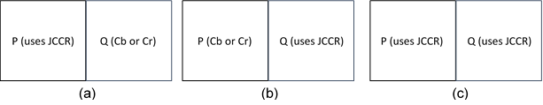
Problem
Chroma QP derivation in deblocking does not consider the case when a given Chroma block may use Joint Cb-Cr mode.
When a given block is coded using Joint Cb-Cr mode, the Chroma QP mapping should use the JointCb-Cr Chroma QP mapping table instead of Cb or Cr Chroma QP mapping table
  Deblocking process should also reflect similar process as used in scaling process for transform coefficients
  If not, incorrect Chroma QP might be derived, resulting in incorrect decisions
Figure 1. Block P and/or Block Q might be coded with Joint Cb-Cr mode

Slide 4
Solution
Step 1:
  Perform the Chroma QP mapping process for each block P and Q separately
  During the mapping process check if the given block uses Joint Cb-Cr mode and apply the respective mapping table
Step 2:
  Once the Chroma QP values are mapped, use the average of both the Chroma QP values as the final Chroma QP value.

Slide 5
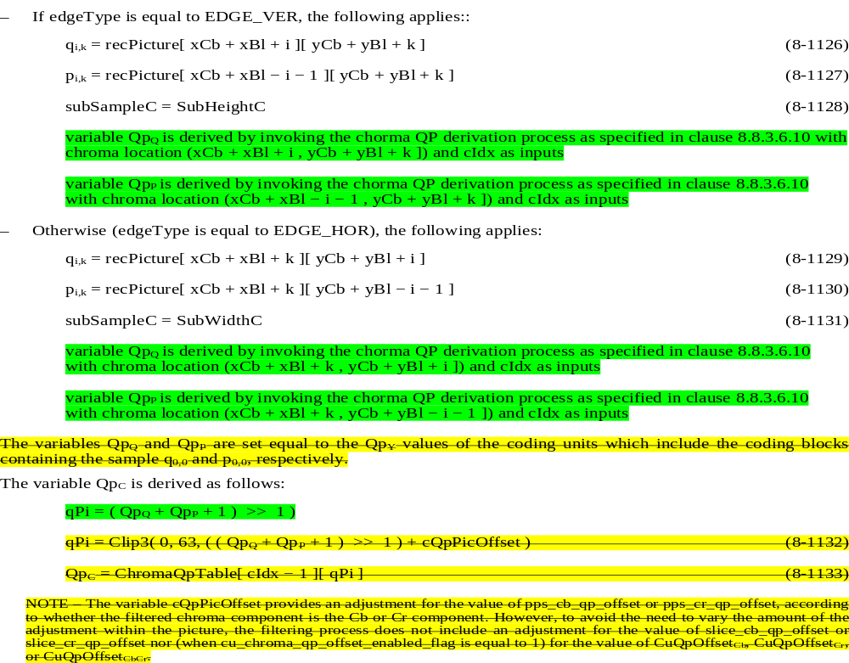
Specification text changes (solution 1)
8.8.3.6.3 Decision process for chroma block edges

Slide 6
Specification text changes (solution 1)
8.8.3.6.10 Quantization parameter derivation process for chroma coding blocks
This process is only invoked when ChromaArrayType is not equal to 0.
Inputs to this process are:
A chroma coding block containing a given chroma sample location (xCb, yCb )
a variable cIdx specifying the colour component index of the given chroma coding block,
Output of this process is a quanization parmater qP of the coding block contiaing the sample (xCb, yCb )
if TuCResMode[ xCb ][ yCb ] is equal to 2, the following applies:
qP = Qp_{CbCr} (8‑952)
cQpPicOffset is set equal to pps_joint_cbcr_qp_offset
Otherwise, if cIdx is equal to 1, the following applies:
qP = Qp_{Cb} (8‑953)
Otherwise (cIdx is equal to 2), the following applies:
qP = Qp_{Cr} (8‑954)
qP = Clip3( 0, 63, qP + cQpPicOffset )
NOTE – The variable cQpPicOffset provides an adjustment for the value of pps_cb_qp_offset or pps_cr_qp_offset, according to whether the filtered chroma component is the Cb or Cr component. However, to avoid the need to vary the amount of the adjustment within the picture, the filtering process does not include an adjustment for the value of slice_cb_qp_offset or slice_cr_qp_offset nor (when cu_chroma_qp_offset_enabled_flag is equal to 1) for the value of CuQpOffset_{Cb}, CuQpOffset_{Cr}, or CuQpOffset_{CbCr}.
NOTE – The variables Qp_{CbCr} , Qp_{Cb} , Qp_{Cr} are derived as in section 8.7.1(Derivation process for quantization parameters)

Slide 7
Specification text changes (solution 2)
8.8.3.6.3 Decision process for chroma block edges
…
The variables Qp_{Q} and Qp_{P} are set equal to the Qp_{Y} values of the coding units which include the coding blocks containing the sample q_{0,0} and p_{0,0}, respectively.
The variable Qp_{C} is derived as follows:
qPi = Clip3( 0, 63, ( ( Qp_{Q} + Qp_{P} + 1 ) >> 1 ) + cQpPicOffset ) (8‑1132)
Qp_{C} = ChromaQpTable[ cIdx − 1 ][ qPi ] (8‑1133)
The variables Qp_{Q} and Qp_{P} are set equal to Qp′_{CbCr} − QpBdOffset_{C} when TuCResMode[ xCb ][ yCb ] is equal to 2, Qp′_{Cb} − QpBdOffset_{C} when cIdx is equal to 1; Qp′_{Cr} − QpBdOffset_{C} when when cIdx is equal to 0, of the coding units which include the coding blocks containing the sample q_{0,0} and p_{0,0}, respectively.
Qp_{C} = ( Qp_{Q} + Qp_{P} + 1 ) >> 1

Slide 8
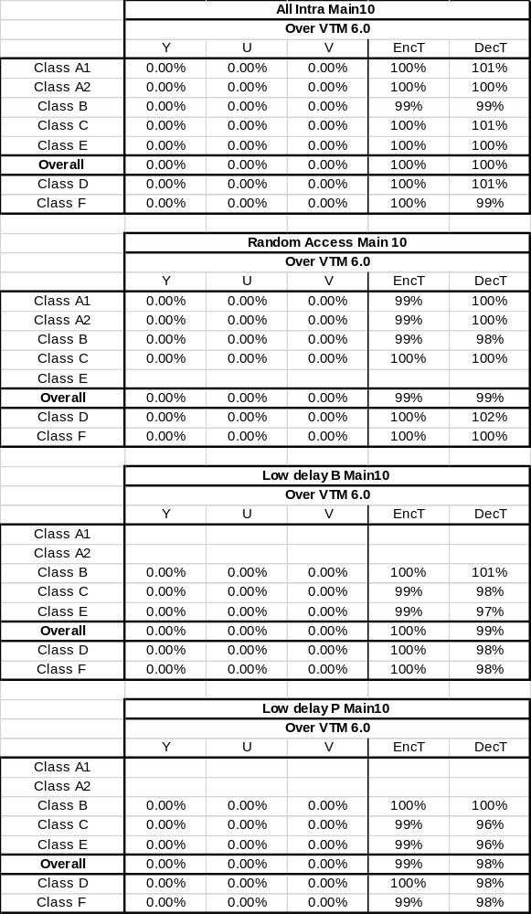
CTC
*in the results pps_joint_cbcr_qp_offset is treated as 0

Slide 9
Conclusion
Modified Chroma QP derivation considering the case when a block uses Joint Cb-Cr is proposed
On top of VTM-6.0, no BD-Rate change is observed, as the mapping tables are same for Cb, Cr and Joint Cb-Cr
We propose to adopt the suggested Chroma QP derivation

Slide 10
Thank You
www.huawei.com

