Slide 1
Non-CE3: Simplified MIP with power-of-two offset
JVET 16th
T. Biatek, A. K. Ramasubramonian, G. Van der Auwera and M. Karczewicz

Slide 2
Addressed issue
Current MIP:
  Offset values are used during the MIP process, and stored into a table
  VVC-wd6 MIP process includes reading the offset value and performing multiplication
  This proposal:
  Simplify the specification and remove offset table
  Propose single power-of-two offset value per MipSizeId
  Replace offset multiplication with a shift

Slide 3
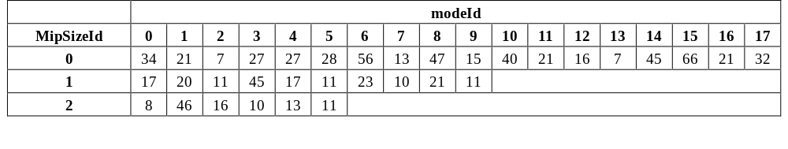

Proposal – Aspect 1
Aspect 1: Offset alignment
  VVC-wd6 offset table:
  It is proposed to remove offset table and replace it with power-of-two values:
  Matrices weights are aligned accordingly:
$$Offset\left(MipSizeId\right)=2^{6−MipSizeId}$$
$$Weight\left[x\right]\left[y\right]=Clip_{7b}\left(Weight\left[x\right]\left[y\right]+\left(2^{6−MipSizeId}−sO\right)\right)$$

Slide 4
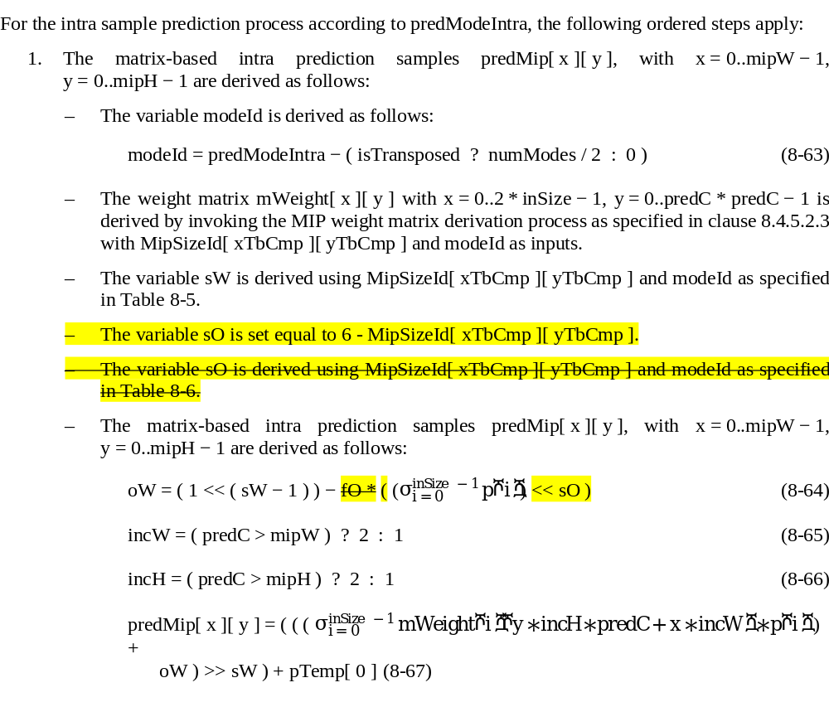
Proposal – Aspect 2
Aspect 2: replace offset multiplication with a shift for each MIP predicted sample

Slide 5
Test conditions
Performance is assessed on CTC
Tweaking matrices for 4x4 blocks can be harmful at low bitrate → Low QP CTC are tested.
As MIP matrices are learned on an external dataset, tweaking matrices can be harmful on other sequences:
  Outside-CTC sequences are tested
  OpenImages (JVET-O0551) and DIV2K* datasets
    OpenImages → 613 1080p-10b pictures
    DIV2K → 715 1080p-10b pictures
* E. Augustsson and R. Timotfe, “NTIRE 2017 Challenge on Single Image Super-Resolution: Dataset and Study”, IEEE Conference on Computer Vision and Pattern Recognition (CVPR), July 2017.

Slide 6
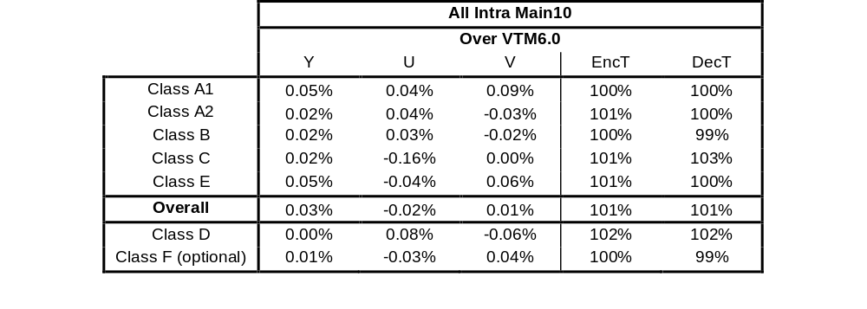
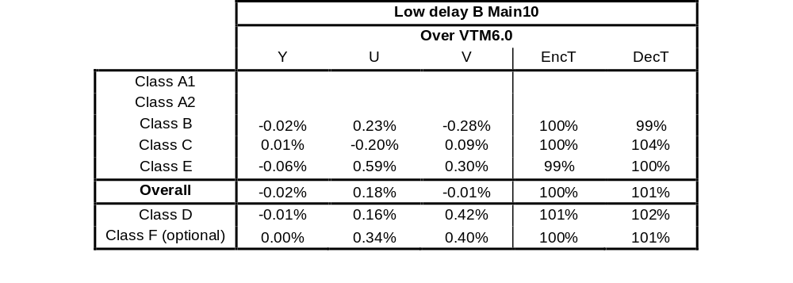
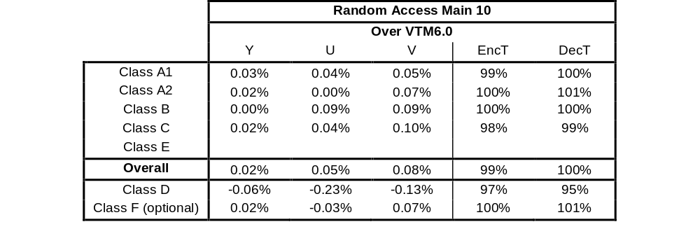
CTC performance

Slide 7
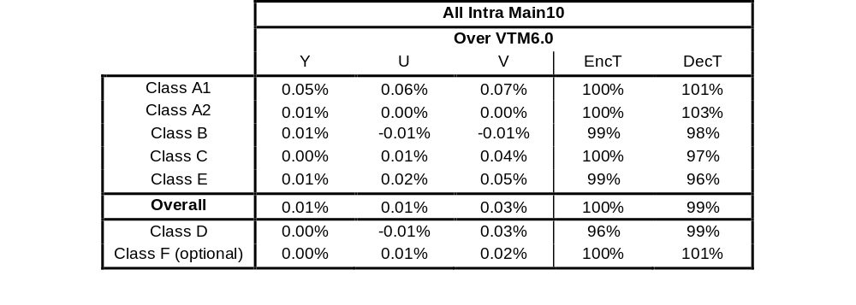
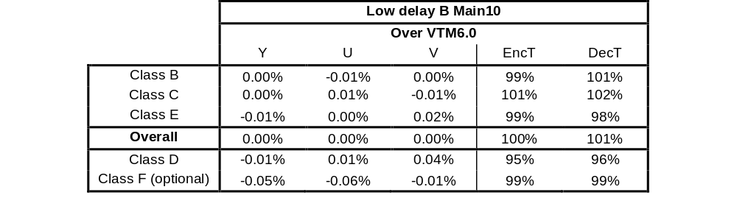
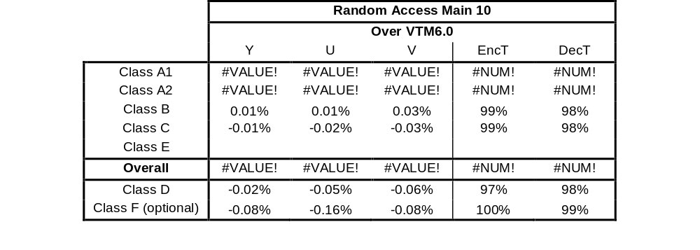
Low-QP CTC performance

Slide 8
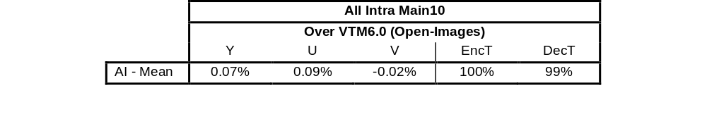

OpenImages/DIV2K performance

Slide 9
Conclusion
This contribution proposes to remove the MIP offset tables and replaces offset multiplication with a shift. This simplifies both the specification and the prediction process. Simulation results show negligible losses on CTC, low-QP and OpenImages/DIV2K datasets. It is suggested to adopt the proposed changes into the next VVC specification.
Thanks to Ericsson for crosscheck

