Slide 1
AHG12/Non-CE5: Extending slice boundary processing for adaptive loop filter for raster scanned slices
Nan Hu, Vadim Seregin, Muhammed Coban, Adarsh Krishnan Ramasubramonian, Marta Karczewicz

Slide 2
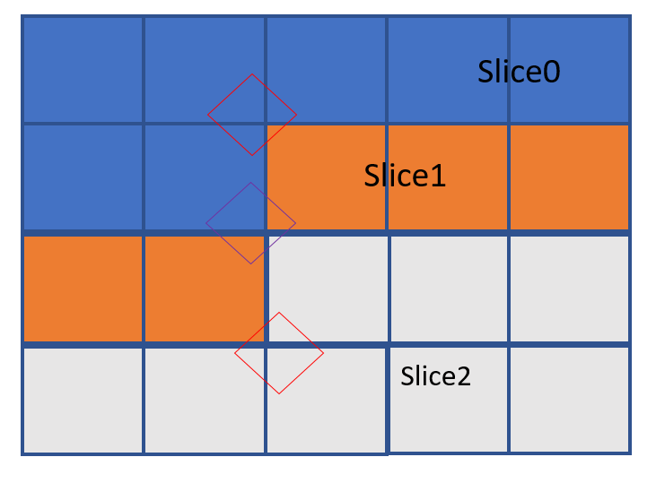
ALF for corner pixels of raster scanned slices
Source sample text

Slide 3
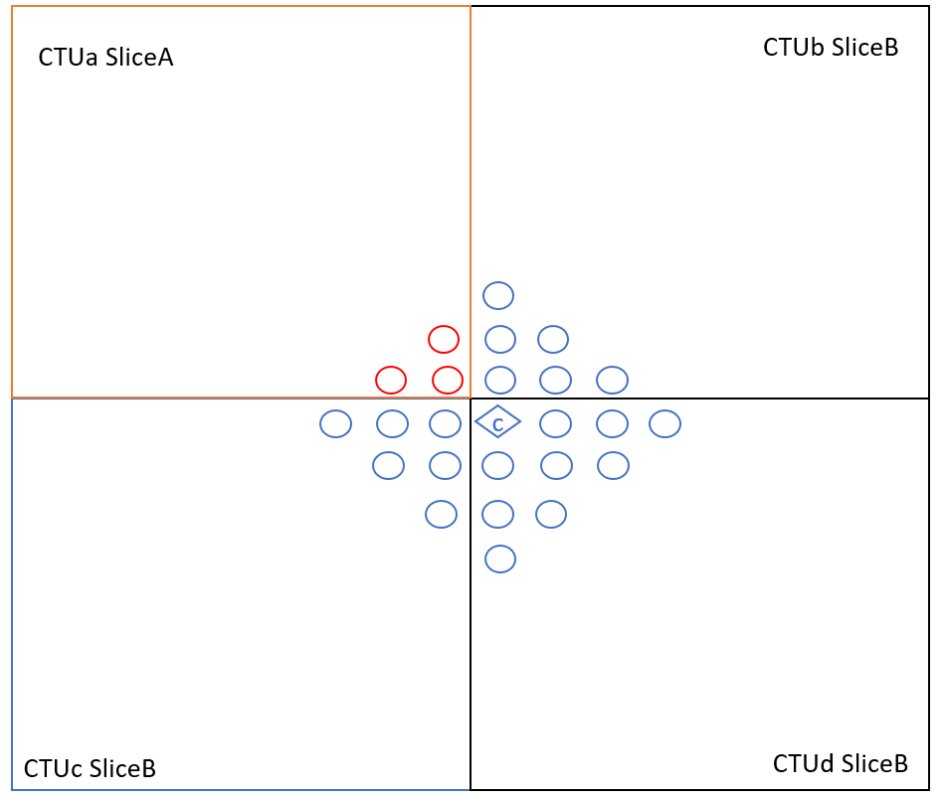
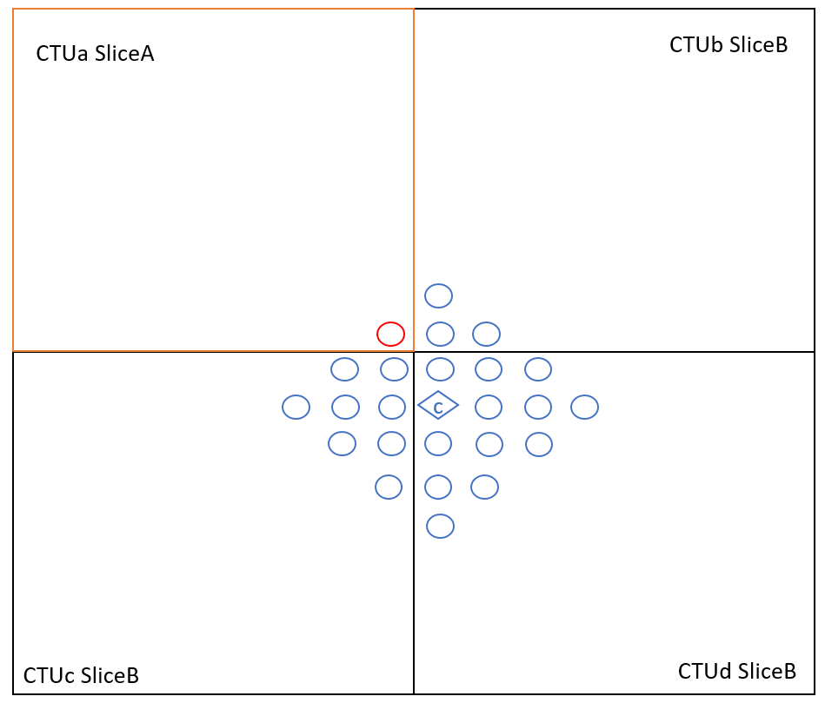
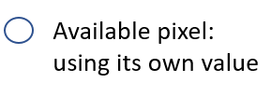
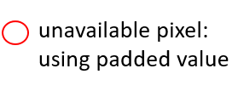
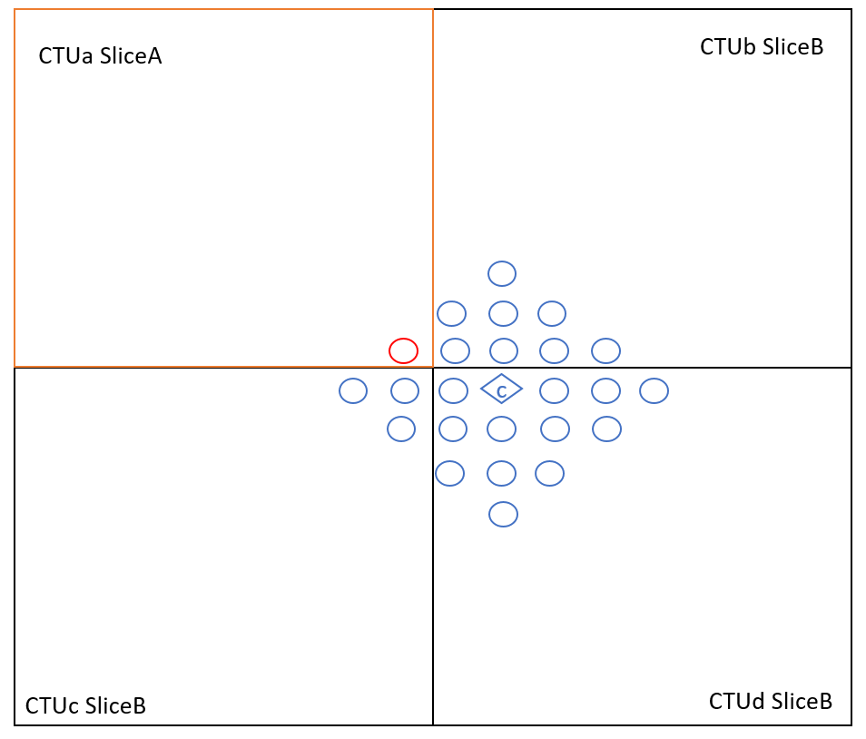
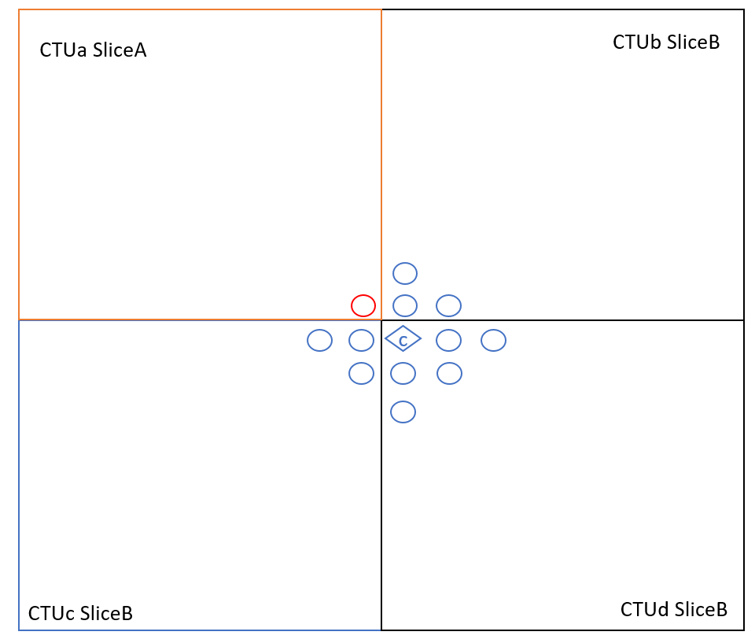
ALF for corner pixels of raster scanned slices
Filtering
Conditions:
Luma: x – ctbX + y – ctbY < 2
Chroma: x – ctbX + y – ctbY < 1

Slide 4
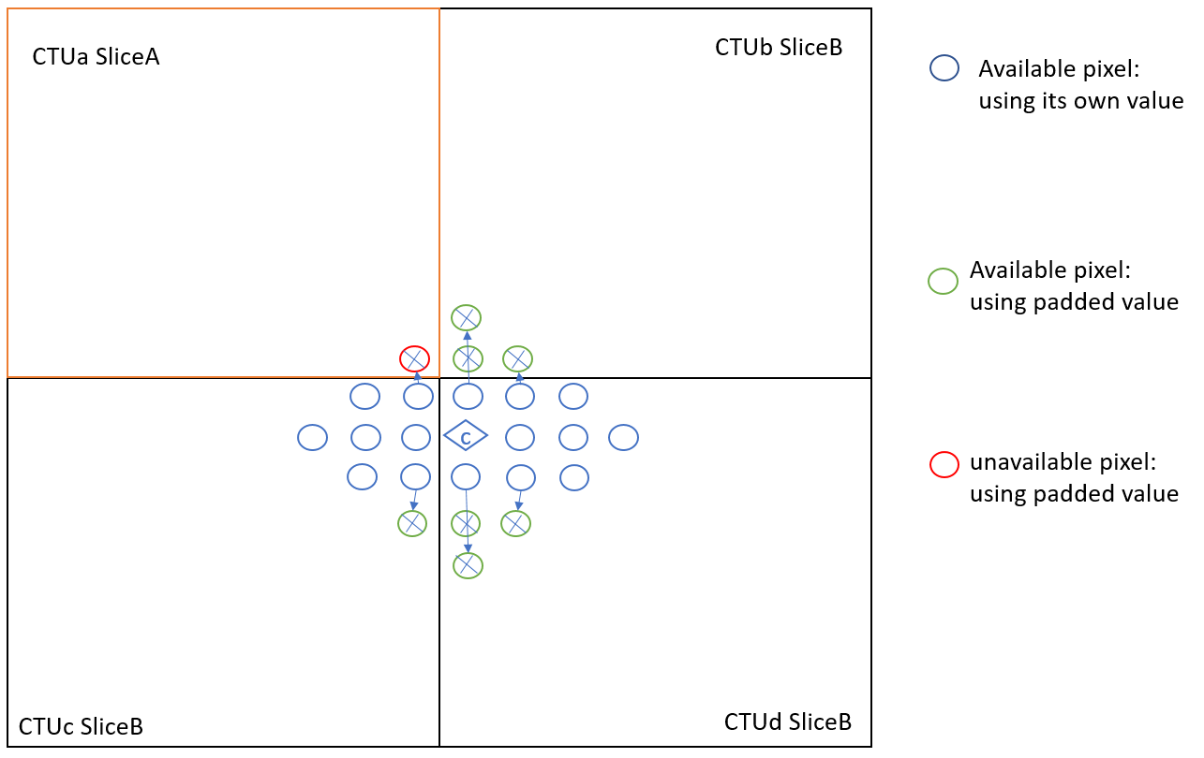
ALF for corner pixels of raster scanned slices
Filtering: Extended to cases supported by spec

Slide 5
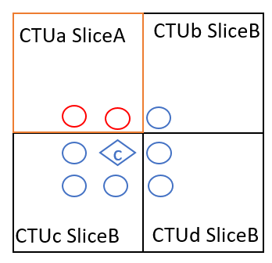
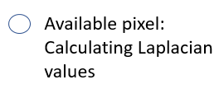
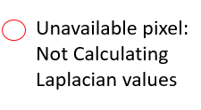
ALF for corner pixels of raster scanned slices
Laplacian values for a pixel

Slide 6
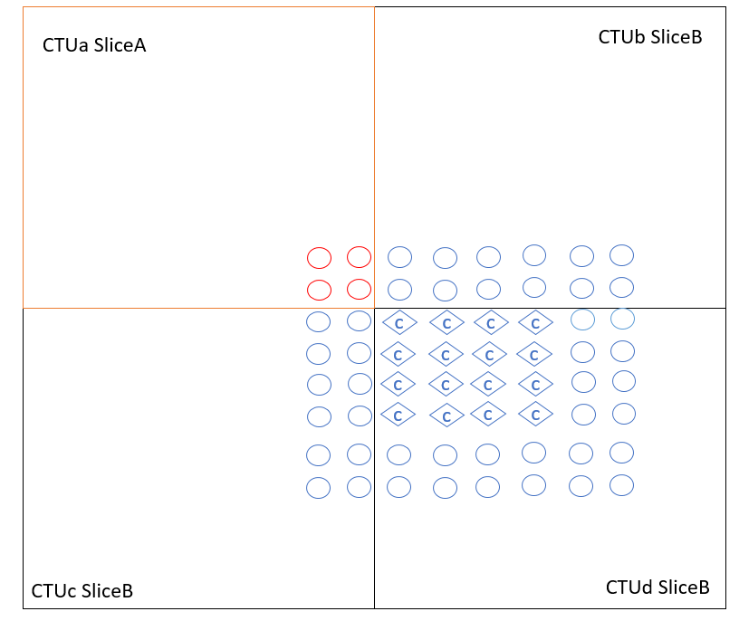
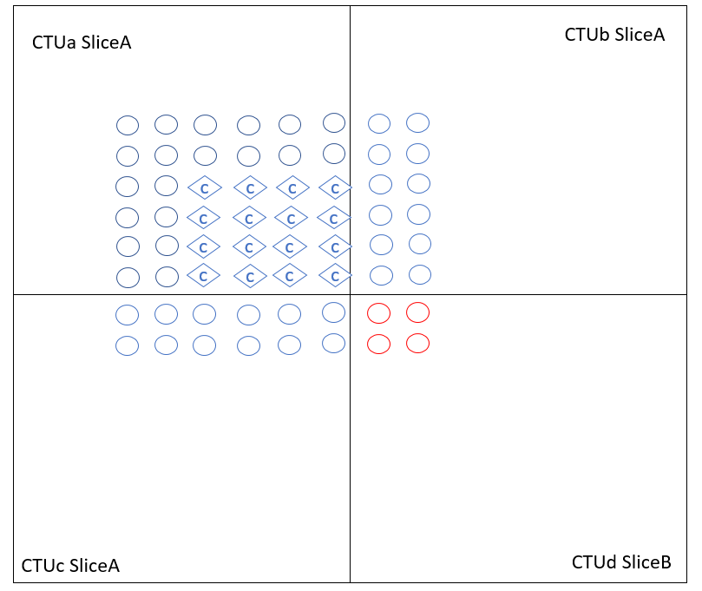
ALF for corner pixels of raster scanned slices
Classification
Condition: position of top-left sample
of a 4x4 block is the top-left sample of
current CTB
Condition: distance of position of top-left sample
of a 4x4 block to the bottom-right sample of
current CTB is <= 8

Slide 7
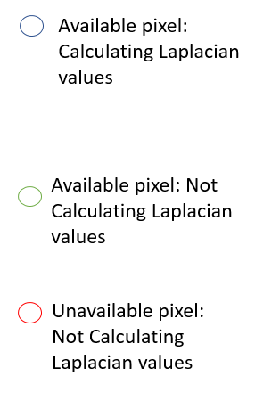
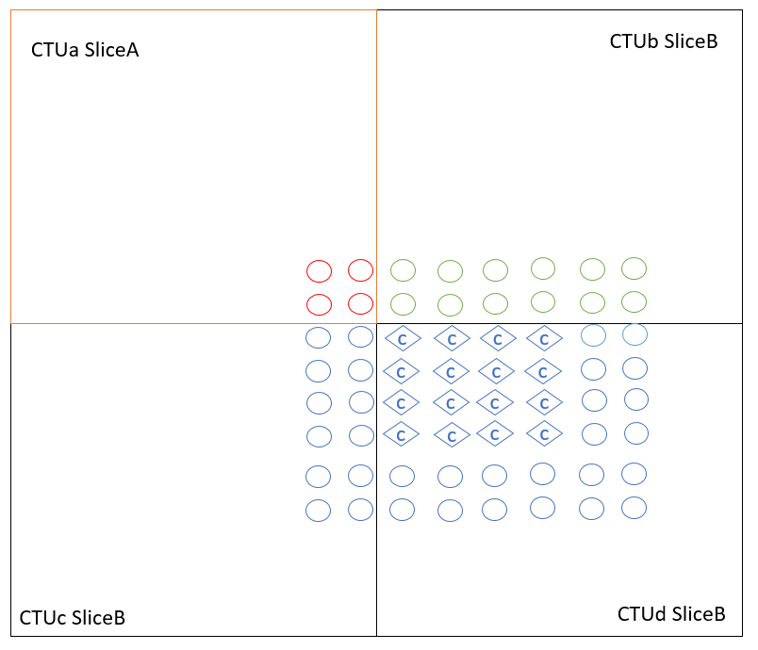
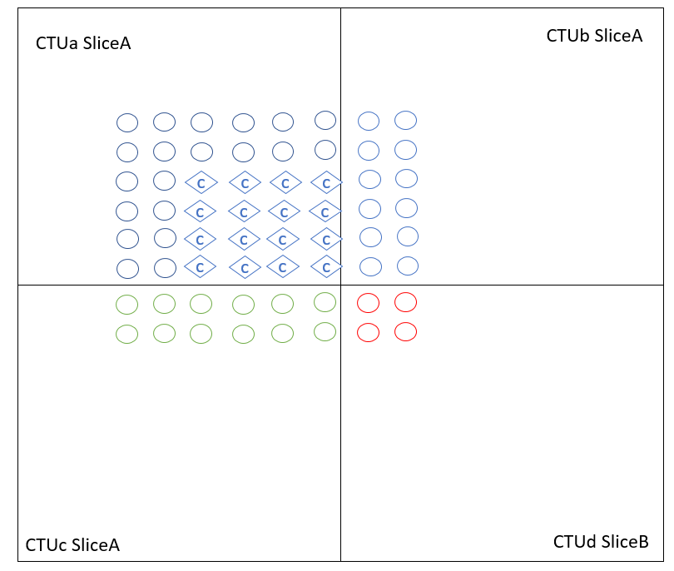
ALF for corner pixels of raster scanned slices
Classification: Extended to cases supported by spec

