Slide 1
JVET-P0533
CE4-related: Motion vector rounding in enabled hpelIfIdx
Y. Kidani, K. Kawamura, K. Unno and S. Naito
KDDI Corp. (KDDI Research Inc.)

Slide 2
Summary
In the previous meeting, half-pel interpolation filter (HPEL-IF) was adopted to improve coding gain.
In the current design, HPEL-IF is determined by hpelIfIdx and motion vector reference position (MV-pos.) which are inherited in merge mode.
MV-pos., however, may shift from half-pel position if pair-wise average merge mode, MMVD, or DMVR are used.
Motion vector rounding in enabled hpelIfIdx is proposed if pair-wise average merge mode, MMVD or DMVR are used.
Results show overall luma BD-rate 0.01%/0.01% for RA/LDB over VTM6.

Slide 3
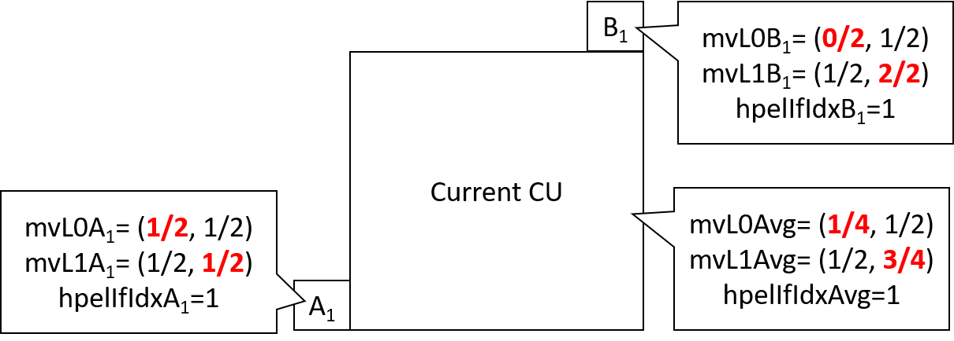
Problem Statement
HPEL-IF is applied when hpelIfIdx is valid and MV-pos. locates at half-pel.
In merge mode, hpelIfIdx and MV-pos. are inherited from existing CUs.
Even though hpelIfIdx is valid, MV-pos. may shift from half-pel positon if pair-wise average merge, MMVD or DMVR used.
This mismatch causes two problems as follows:
  The mismatch will drift to following CUs from the current CU.
  Different characteristic’s interpolation filters may be applied for bi-pred. inter blocks or in x and y directions.

Slide 4
Proposal
Motion vector rounding in enabled hpelIfIdx is proposed.
  MV-pos. is rounded to half-pel if MV-pos. shifts from half-pel by pair-wise average merge, MMVD or DMVR.
The rounding processes are as follows:
  Pair-wise average merge mode: Same as AMVR.
  MMVD: Adding hpelIfIdx into MmvdDistance table. (Table 7-20 in spec.)
  DMVR: Same as AMVR. It is noted that the non-rounded motion vector is inherited to following CUs to avoid the dependency between blocks.
mmvd_distance_idx | MmvdDistance
 | slice_fpel_mmvd_disenabled_flag = = 0 && hpelIfIdx = = 0 | slice_fpel_mmvd_disenabled_flag = = 0 && hpelIfIdx = = 1 | slice_fpel_mmvd_disenabled_flag = = 1
0 | 1 | 2 | 4
1 | 2 | 4 | 8
2 | 4 | 8 | 16
3 | 8 | 16 | 32
4 | 16 | 32 | 64
5 | 32 | 64 | 128
6 | 64 | 128 | 256
7 | 128 | 256 | 512

Slide 5
Results
Proposal is implemented on top of VTM6.
 | RA over VTM6 |  |  |  |  | LDB over VTM5
 | Y | U | V | EncT | DecT | Y | U | V | EncT | DecT
Class A1 | 0.01% | 0.03% | 0.02% | 100% | 100%
Class A2 | 0.03% | 0.09% | 0.07% | 100% | 100%
Class B | 0.01% | 0.09% | 0.05% | 100% | 100% | 0.01% | -0.05% | -0.13% | 100% | 100%
Class C | 0.00% | 0.03% | -0.03% | 100% | 100% | -0.02% | 0.17% | 0.25% | 100% | 101%
Class E |  |  |  |  |  | 0.06% | 0.05% | 0.25% | 100% | 101%
Overall | 0.01% | 0.06% | 0.02% | 100% | 100% | 0.01% | 0.05% | 0.09% | 100% | 101%
Class D | -0.01% | -0.07% | 0.05% | 100% | 100% | -0.01% | 0.55% | -0.30% | 100% | 101%
Class F | 0.00% | 0.03% | 0.01% | 100% | 101% | 0.05% | 0.27% | 0.19% | 100% | 101%

Slide 6
Conclusion
Motion vector rounding in enabled hpelIfIdx is proposed.
Results show overall BD-rates and runtime are almost same as VTM6
    RA: BD-rate (Y/U/V) 0.01%/0.06%/0.02%, Runtime (EncT/DecT) 100%/100%
    LDB: BD-rate (Y/U/V) 0.01%/0.05%/0.09%, Runtime (EncT/DecT) 100%/101%
Suggest to adopt the proposal to WD/VTM.
Thanks for LGE cross checking.

