Slide 1
JVET-P0517
Support of adaptive color transform for 444 video coding in VVC
Xiaoyu Xiu, Yi-Wen Chen, Tsung-chuan Ma, Hong-Jheng Jhu, Xianglin Wang

Slide 2
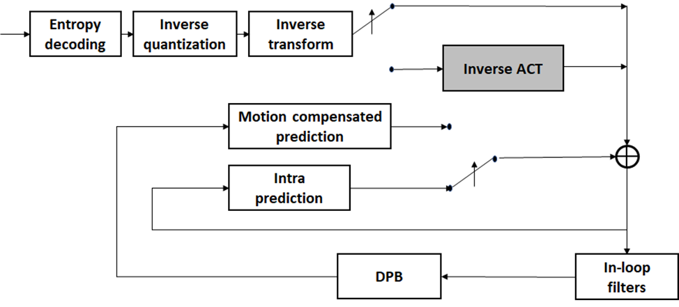
Summary of proposal
Proposal
  Implement the HEVC ACT into the VVC framework to enhance the efficiency of 444 video coding
  YCgCo color space
  The color space conversion is carried out in residual domain

Slide 3
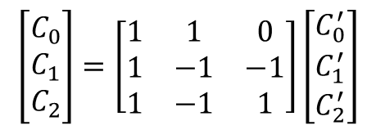
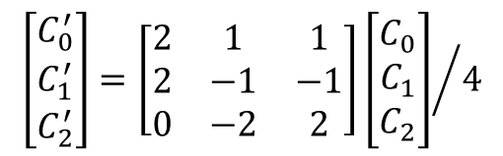
Proposal
Color space conversion
  The YCgCo color space is used for color space conversion
$$\left[\begin{matrix}C_{0}^{′} \\ C_{1}^{′} \\ C_{2}^{′}\end{matrix}\right]=\left[\begin{matrix}2 & 1 & 1 \\ 2 & −1 & −1 \\ 0 & −2 & 2\end{matrix}\right]{\left[\begin{matrix}C_{0} \\ C_{1} \\ C_{2}\end{matrix}\right]}/4$$
$$\left[\begin{matrix}C_{0} \\ C_{1} \\ C_{2}\end{matrix}\right]=\left[\begin{matrix}1 & 1 & 0 \\ 1 & −1 & −1 \\ 1 & −1 & 1\end{matrix}\right]\left[\begin{matrix}C_{0}^{′} \\ C_{1}^{′} \\ C_{2}^{′}\end{matrix}\right]$$
Forward
Inverse
  QP adjustments of (-5, -5, -3) are applied to compensate the dynamic changes of residuals before and after color transform
Signaling
  For inter and IBC modes, ACT flag is only signaled when at least one non-zero coefficient exists in current CU, as indicated by CU root CBF
  For intra mode, ACT is enabled when the chroma mode is DM

Slide 4
Proposal
Additional change over HEVC ACT
  The ACT enabling/disabling flag is moved from TU- to CU-level
  Disabling the ACT for the cases where not all residuals of three components are available
    Separate-tree partition
    ISP mode

Slide 5
Simulations
Implemented on top of VTM-6.0
CE8 test conditions: IBC, PLT, BDPCM and interHash enabled
Separate-tree is OFF
 | All Intra
 | G/Y | B/U | R/V
RGB, text & graphics with motion, 1080p & 720p | -6.2% | -2.8% | -4.0%
RGB, mixed content, 1440p & 1080p | -11.6% | -5.8% | -5.7%
RGB, Animation, 720p | -8.1% | -4.5% | -2.9%
RGB, camera captured, 1080p | -11.6% | -1.4% | -3.3%
YUV, text & graphics with motion, 1080p & 720p | 0.2% | 0.1% | 0.1%
YUV, mixed content, 1440p & 1080p | 0.0% | 0.1% | 0.1%
YUV, Animation, 720p | 0.0% | 0.0% | 0.0%
YUV, camera captured, 1080p | 0.0% | 0.0% | 0.0%
Enc Time[%] | 104%
Dec Time[%] | 97%
Random Access
G/Y | B/U | R/V
-8.8% | -4.2% | -5.6%
-18.1% | -10.4% | -10.2%
-14.5% | -8.5% | -7.9%
-25.3% | -9.1% | -14.5%
0.1% | 0.1% | 0.2%
0.0% | 0.2% | 0.0%
0.0% | 0.0% | -0.1%
0.1% | 0.3% | 0.1%
104%
98%
Low delay B
G/Y | B/U | R/V
-11.9% | -6.8% | -7.8%
-24.9% | -14.3% | -13.9%
-23.1% | -9.2% | -8.6%
-33.9% | -12.0% | -19.0%
0.3% | 0.2% | 0.6%
0.1% | 1.2% | 0.5%
0.0% | 0.4% | 0.7%
0.1% | 0.2% | 0.2%
107%
101%

Slide 6
Simulations
Implemented on top of VTM-6.0
CE8 test conditions: IBC, PLT, BDPCM and interHash enabled
Separate-tree is ON
 | Random Access
 | G/Y | B/U | R/V
RGB, text & graphics with motion, 1080p & 720p | -4.9% | -2.6% | -3.3%
RGB, mixed content, 1440p & 1080p | -6.7% | -4.1% | -3.9%
RGB, Animation, 720p | -9.0% | -4.2% | -5.4%
RGB, camera captured, 1080p | -23.3% | -8.7% | -14.2%
YUV, text & graphics with motion, 1080p & 720p | 0.0% | 0.0% | 0.0%
YUV, mixed content, 1440p & 1080p | 0.1% | 0.3% | 0.2%
YUV, Animation, 720p | 0.1% | 0.0% | 0.1%
YUV, camera captured, 1080p | 0.1% | 0.0% | 0.0%
Enc Time[%] | 103%
Dec Time[%] | 98%
Low delay B
G/Y | B/U | R/V
-10.7% | -6.4% | -7.2%
-16.4% | -9.8% | -9.4%
-22.1% | -8.7% | -8.2%
-33.7% | -11.9% | -19.0%
0.3% | 0.2% | 0.4%
0.1% | 0.3% | 0.2%
0.0% | 0.3% | 0.7%
0.1% | 0.1% | -0.1%
106%
99%

Slide 7
Thank you

