Slide 1
Non-CE8: Constraints on IBC reference block locations
(JVET-P0454)
X. Xu, X. Li, S. Liu (Tencent)
2019/10

Slide 2
Summary
Currently in VVC CD text/VTM-6.0,
  A virtual buffer concept is adopted to indicate the availability of IBC reference samples
  Decoded block vector will go through modulo operation to point into the virtual buffer
  Some undesirable cases are now supported
In this contribution, two methods are proposed to remove those cases
It is asserted that with the proposed methods, a reference block will not contain discontinued reference samples

Slide 3
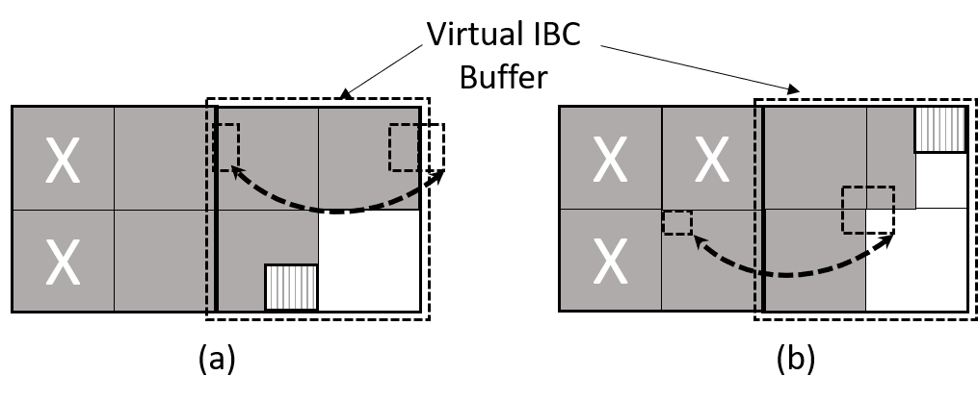
Undesirable cases supported by the current VTM decoder
Currently in VVC CD text/VTM-6.0, a reference block for IBC mode can be generated such that:
  The samples in the ref block are not continuous (case (a) and (b))
  Some part of the reference block may come from left CTU while others come from current CTU (case (b))
  The number of VPDU access is up to 4 (case (b))

Slide 4
Proposed methods
Method 1: limit the reference block location to be within the same VPDU
  Max number of VPDU access is reduced to 1
  Remove the possibility of discontinued reference block
Method 2: limit the reference block location to disallow horizontal wrap-around and to disallow having reference samples from more than 1 CTU when CTU size is 128x128
  Max number of VPDU access remains the same
  Remove the possibility of discontinued reference block

Slide 5
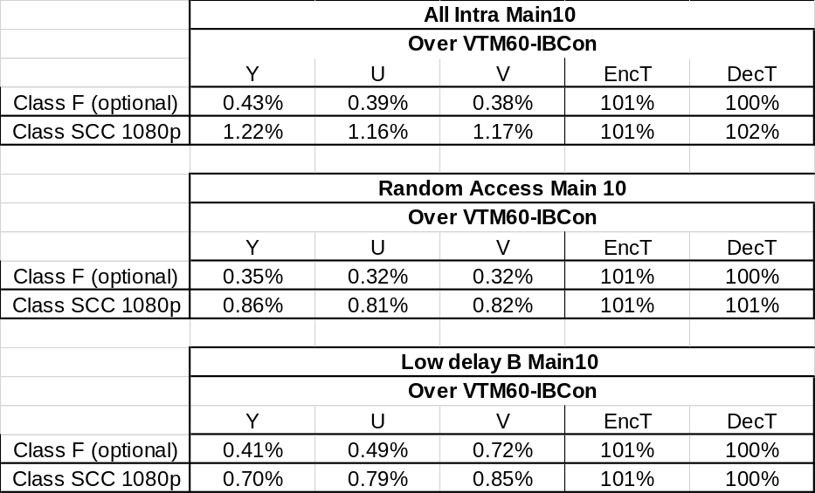
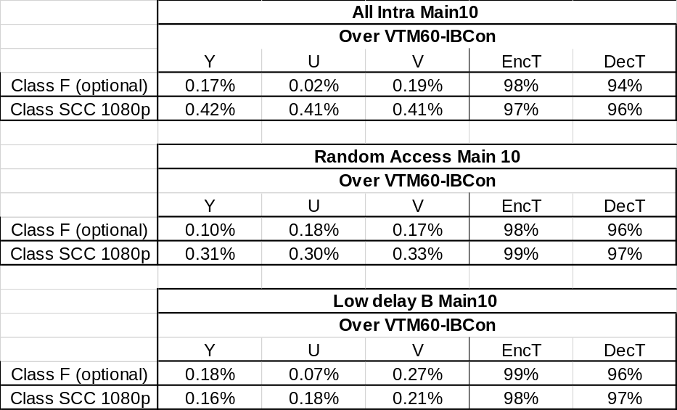
Results
Method 1 Method 2

Slide 6
Conclusion
Two methods are suggested to limit the location of reference block inside the IBC virtual buffer
  In method 1, all samples should be from the same VPDU. The BD rate change is 1.22% for TGM AI
  In method 2, all samples should be from the same CTU. The BD rate change is 0.42% for TGM AI
The proposed changes are asserted to be more friendly for implementation and ease the effort for conformance tests
It is recommended to include one of the two methods into the specification
Thanks Kwai for performing the crosscheck!

Slide 7
Method 1
Performance with various CTU sizes
CTU128
CTU64
 | All Intra Main10
 | Over VTM60-IBCon
 | Y | U | V | EncT | DecT
Class F (optional) | 0.43% | 0.39% | 0.38% | 101% | 100%
Class SCC 1080p | 1.22% | 1.16% | 1.17% | 101% | 102%
 | Random Access Main 10
 | Over VTM60-IBCon
 | Y | U | V | EncT | DecT
Class F (optional) | 0.35% | 0.32% | 0.32% | 101% | 100%
Class SCC 1080p | 0.86% | 0.81% | 0.82% | 101% | 101%
 | All Intra Main10
 | Over VTM60-IBCon CTU64
 | Y | U | V | EncT | DecT
Class F (optional) | 0.49% | 0.38% | 0.51% | 102% | 100%
Class SCC 1080p | 1.28% | 1.23% | 1.25% | 101% | 100%
 | Random Access Main 10
 | Over VTM60-IBCon CTU64
 | Y | U | V | EncT | DecT
Class F (optional) | 0.34% | 0.24% | 0.22% | 100% | 99%
Class SCC 1080p | 1.05% | 0.98% | 0.90% | 100% | 100%

Slide 8
Method 1
Performance vs. IBC off
VTM-6.0
Proposed Method 1
 | All Intra Main10
 | Over VTM60-IBCoff
 | Y | U | V | EncT | DecT
Class F (optional) | -11.05% | -10.98% | -10.96% | 163% | 101%
Class SCC 1080p | -30.71% | -29.46% | -29.47% | 142% | 98%
 | Random Access Main 10
 | Over VTM60-IBCoff
 | Y | U | V | EncT | DecT
Class F (optional) | -8.98% | -8.81% | -9.08% | 112% | 100%
Class SCC 1080p | -17.50% | -17.17% | -17.50% | 111% | 99%
 | Low delay B Main10
 | Over VTM60-IBCoff
 | Y | U | V | EncT | DecT
Class F (optional) | -4.99% | -4.87% | -5.50% | 115% | 100%
Class SCC 1080p | -10.14% | -10.80% | -11.12% | 117% | 96%
 | All Intra Main10
 | Over VTM60-IBCoff
 | Y | U | V | EncT | DecT
Class F (optional) | -10.71% | -10.68% | -10.67% | 166% | 101%
Class SCC 1080p | -29.89% | -28.67% | -28.66% | 144% | 100%
 | Random Access Main 10
 | Over VTM60-IBCoff
 | Y | U | V | EncT | DecT
Class F (optional) | -8.71% | -8.56% | -8.83% | 113% | 100%
Class SCC 1080p | -16.80% | -16.50% | -16.83% | 112% | 99%
 | Low delay B Main10
 | Over VTM60-IBCoff
 | Y | U | V | EncT | DecT
Class F (optional) | -4.62% | -4.39% | -4.85% | 116% | 100%
Class SCC 1080p | -9.51% | -10.09% | -10.37% | 118% | 96%

Slide 9
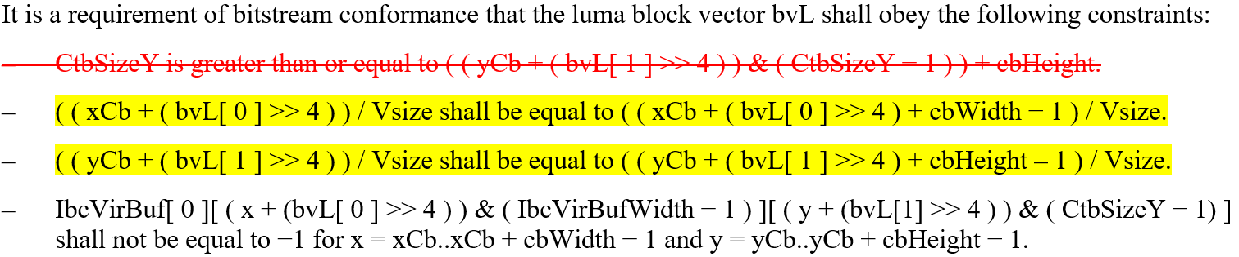
Text change for method 1
The top-left corner and bottom-right corner of the reference block shall be inside the same VPDU region in the virtual buffer

Slide 10
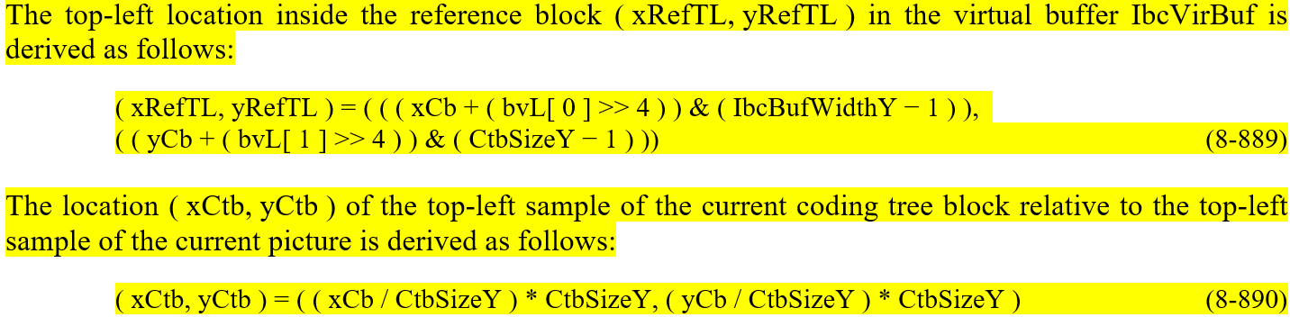
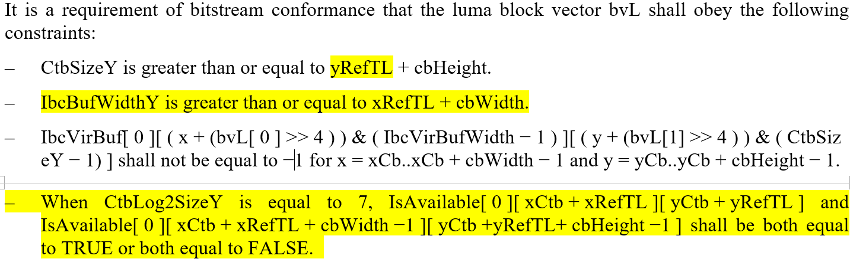
Text changes for method 2

