Slide 1

JVET-P0436: AHG15: On CU Adaptive Chroma QP Offset Signaling
J. Zhao, S. Paluri S. Kim
LG ELECTRONICS

Slide 2
Introduction
This contribution proposes changes to fix the following 2 issues:
Unnecessary signaling of CU chroma QP offset in the case of DUAL_TREE_LUMA
Chroma QP offset signaling is inconsistent with the luma QP availability at VPDU level

Slide 3
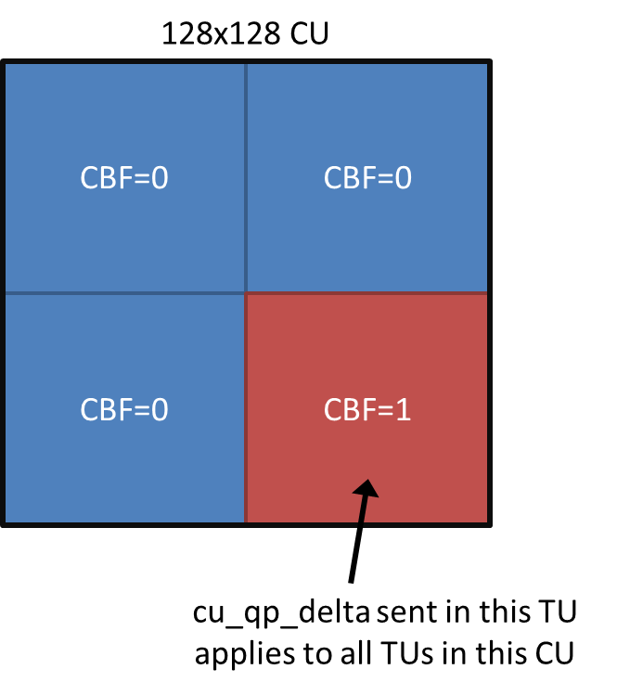
Background
The followings were adopted in July meeting:
  CU level Chroma QP offset signaling (JVET-O1168)
  cu_qp_delta signalling is modified to facilitate VPDU-level processing, i.e. for CU larger than 64x64, cu_qp_delta is sent with the first TU, regardless of whether that first TU has any non-zero CBF or not. (JVET-O0046)
  Benefit: for large block, earlier TUs with cbf==0 don’t have to wait to later TU to get QP to start processing
From JVET-O0046

Slide 4
QP related syntaxes in transform_unit
transform_unit( x0, y0, tbWidth, tbHeight, treeType, subTuIndex, chType ) { | Descriptor
….
if( ( CbWidth[ chType ][ x0 ][ y0 ] > 64 | | CbHeight[ chType ][ x0 ][ y0 ] > 64 | | tu_cbf_luma[ x0 ][ y0 ] | | tu_cbf_cb[ x0 ][ y0 ] | | tu_cbf_cr[ x0 ][ y0 ] ) && treeType != DUAL_TREE_CHROMA ) {
if( cu_qp_delta_enabled_flag && !IsCuQpDeltaCoded ) {
cu_qp_delta_abs | ae(v)
if( cu_qp_delta_abs )
cu_qp_delta_sign_flag | ae(v)
}
}
if( ( tu_cbf_cb[ x0 ][ y0 ] | | tu_cbf_cr[ x0 ][ y0 ] ) {
if( cu_chroma_qp_offset_enabled_flag && !IsCuChromaQpOffsetCoded) {
cu_chroma_qp_offset_flag | ae(v)
if( cu_chroma_qp_offset_flag && chroma_qp_offset_list_len_minus1 > 0 )
cu_chroma_qp_offset_idx | ae(v)
}
}

Slide 5
Issues 1 and Proposed Fixes:
No need to signal cu_chroma_qp_offset_xxx in the case of DUAL_TREE_LUMA
Suggested to fix this unnecessary signalling by add this condition in transform_unit
Note that this condtion is already around cu_chroma_qp_offset_xxx in palette_coding
transform_unit( x0, y0, tbWidth, tbHeight, treeType, subTuIndex, chType ) { | Descriptor
….
if( ( tu_cbf_cb[ x0 ][ y0 ] | | tu_cbf_cr[ x0 ][ y0 ]) && treeType != DUAL_TREE_LUMA ) {
if( cu_chroma_qp_offset_enabled_flag && !IsCuChromaQpOffsetCoded) {
cu_chroma_qp_offset_flag | ae(v)
if( cu_chroma_qp_offset_flag && chroma_qp_offset_list_len_minus1 > 0 )
cu_chroma_qp_offset_idx | ae(v)
}
}
The highlighted texts are the proposed changes.

Slide 6
Issues 2 and Proposed Fixes:
For CU > 64x64, luma delta QP is signalled with first TU regardless of cbf so that QP is available at VPDU level.
But Chroma QP offset still may be not be available at VPDU level. This is inconsistent with the luma QP VPDU availability.
Propose to add similar condition to Chroma:
transform_unit( x0, y0, tbWidth, tbHeight, treeType, subTuIndex, chType ) {
….
if( ( CbWidth[ chType ][ x0 ][ y0 ] > 64 | | CbHeight[ chType ][ x0 ][ y0 ] > 64 | | tu_cbf_luma[ x0 ][ y0 ] | | tu_cbf_cb[ x0 ][ y0 ] | | tu_cbf_cr[ x0 ][ y0 ] ) && treeType != DUAL_TREE_CHROMA ) {
if( cu_qp_delta_enabled_flag && !IsCuQpDeltaCoded ) {
cu_qp_delta_abs
if( cu_qp_delta_abs )
cu_qp_delta_sign_flag
}
}
if(( CbWidth[ chType ][ x0 ][ y0 ] > 64 | | CbHeight[ chType ][ x0 ][ y0 ] > 64 ) | | ( tu_cbf_cb[ x0 ][ y0 ] | | tu_cbf_cr[ x0 ][ y0 ] ) ) {
if( cu_chroma_qp_offset_enabled_flag && !IsCuChromaQpOffsetCoded) {
cu_chroma_qp_offset_flag
if( cu_chroma_qp_offset_flag && chroma_qp_offset_list_len_minus1 > 0 )
cu_chroma_qp_offset_idx
}
}

Slide 7
Combined Syntax Changes:
transform_unit( x0, y0, tbWidth, tbHeight, treeType, subTuIndex, chType ) { | Descriptor
….
if( ( CbWidth[ chType ][ x0 ][ y0 ] > 64 | | CbHeight[ chType ][ x0 ][ y0 ] > 64 | | tu_cbf_luma[ x0 ][ y0 ] | | tu_cbf_cb[ x0 ][ y0 ] | | tu_cbf_cr[ x0 ][ y0 ] ) && treeType != DUAL_TREE_CHROMA ) {
if( cu_qp_delta_enabled_flag && !IsCuQpDeltaCoded ) {
cu_qp_delta_abs | ae(v)
if( cu_qp_delta_abs )
cu_qp_delta_sign_flag | ae(v)
}
}
if( ( CbWidth[ chType ][ x0 ][ y0 ] > 64 | | CbHeight[ chType ][ x0 ][ y0 ] > 64 | | tu_cbf_cb[ x0 ][ y0 ] | | tu_cbf_cr[ x0 ][ y0 ] ) && treeType != DUAL_TREE_LUMA) {
if( cu_chroma_qp_offset_enabled_flag && !IsCuChromaQpOffsetCoded) {
cu_chroma_qp_offset_flag | ae(v)
if( cu_chroma_qp_offset_flag && chroma_qp_offset_list_len_minus1 > 0 )
cu_chroma_qp_offset_idx | ae(v)
}
}
The highlighted texts are the proposed changes.
Propose to adopt these changes

Slide 8
Conclusion
Proposes small changes to fix:
Unnecessary signaling of CU chroma QP offset in the case of DUAL_TREE_LUMA
Chroma QP offset signaling is inconsistent with the luma QP availability at VPDU level

Slide 9
Additional Slides

Slide 10
QP related syntaxes in palette_coding
palette_coding( x0, y0, cbWidth, cbHeight, startComp, numComps ) { | Descriptor
…..
if( treeType != DUAL_TREE_CHROMA && palette_escape_val_present_flag ) {
if( cu_qp_delta_enabled_flag && !IsCuQpDeltaCoded ) {
cu_qp_delta_abs | ae(v)
if( cu_qp_delta_abs )
cu_qp_delta_sign_flag | ae(v)
}
}
if( treeType != DUAL_TREE_LUMA && palette_escape_val_present_flag ) {
if( cu_chroma_qp_offset_enabled_flag && !IsCuChromaQpOffsetCoded ) {
cu_chroma_qp_offset_flag | ae(v)
if( cu_chroma_qp_offset_flag )
cu_chroma_qp_offset_idx | ae(v)
}
}
……
}

