Slide 1
JVET-P0409 CE1-related: Enable PROF for RPR
J. Chen, R.-L. Liao, J. Luo, Y. Ye (Alibaba)
2019/10/4

Slide 2
Problem statement
In VTM 6.0
  PROF is disabled when the size of the reference picture is different from the current picture.
In VVC draft 6
  Although PROF is not explicitly disabled when the size of the reference picture is different from the current one, the scaling factor is not considered when calculating the gradient of the prediction block boundary sample.
Simply disabling PROF in RPR case losses the potential coding performance of PROF.

Slide 3
Proposed method
To improve the coding performance of RPR coding, it is proposed to enable PROF when size of reference picture is different from current picture.
Three methods are proposed to enable PROF without increasing the memory bandwidth

Slide 4
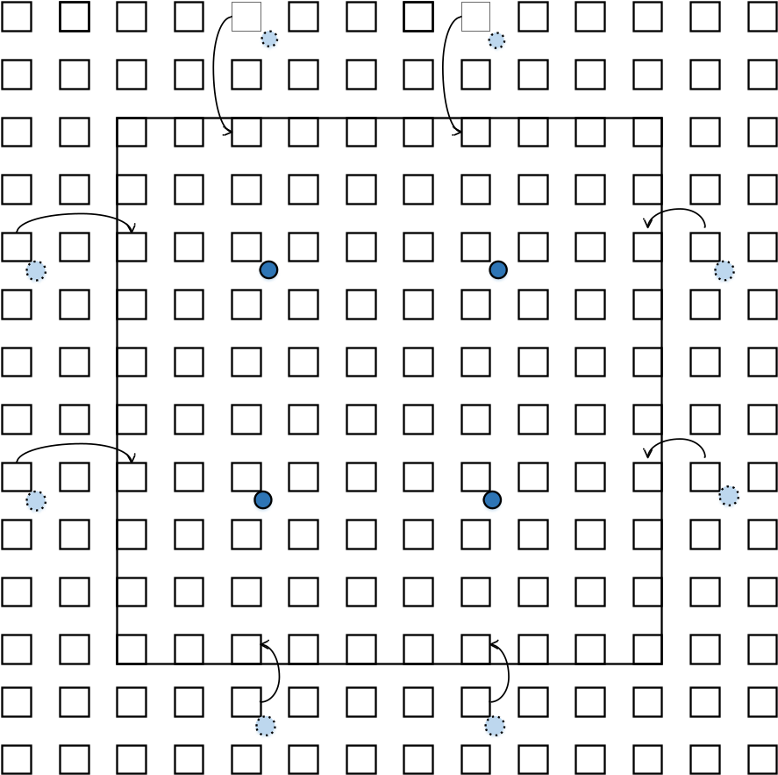
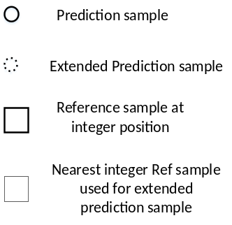
Method 1
extend each side of prediction block by one sample in current picture domain
calculate the position of the extended samples in the reference picture and round to the nearest integer sample
clip the nearest integer reference sample within the reference sample area which is used for prediction block interpolation
Use clipped integer reference sample for gradient calculation of prediction block boundary sample
Add clip operation to avoid bandwidth increase
Reference sample area used for predictor interpolation

Slide 5
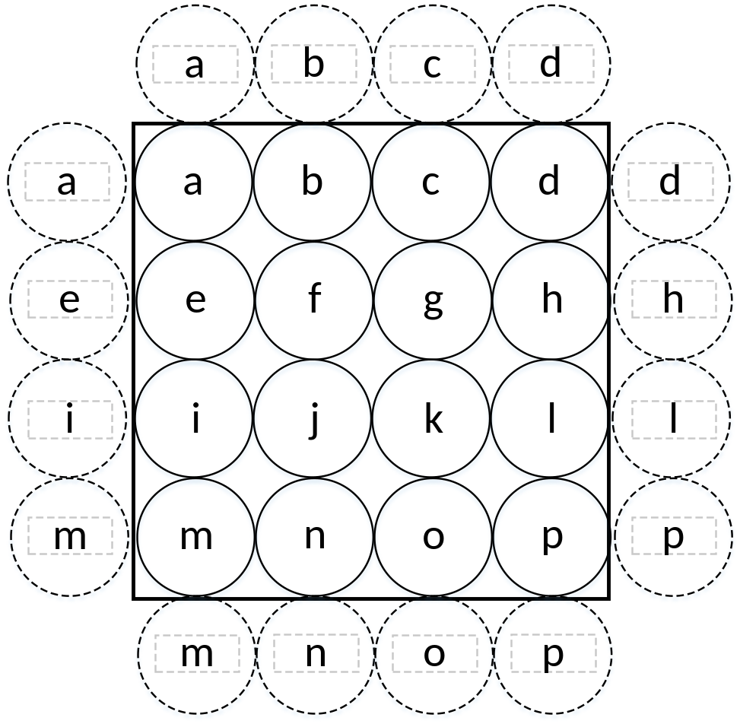
Method 2
Pad each boundary of prediction block by one sample
Use padded sample for gradient calculation of prediction block boundary sample
No need to fetch additional reference samples

Slide 6
Method 3
If(scaling ratio <=2)
extend each side of prediction block by one sample in current picture domain
Don’t apply PROF
calculate the position of the extended samples in the reference picture and round to the nearest integer sample
Use clipped integer reference sample for gradient calculation of prediction block boundary sample
Follow the current design of PROF, no specific changes

Slide 7
Coding performance – Method 1 & 3
2x scaling
 |  | Low delay B (PSNR1)
 |  | Over CE1 anchor
 | Y | U | V | EncT | DecT
Class A1 | - | - | - | - | -
Class A2 | - | - | - | - | -
Class B | -0.07% | 0.21% | 0.07% | 101% | 101%
Class C | -0.15% | -0.17% | -0.07% | 100% | 100%
Class E | -0.04% | -0.32% | -0.62% | 101% | 100%
Overall | -0.09% | -0.05% | -0.15% | 100% | 100%
Class D | -0.02% | -0.28% | -0.40% | 100% | 101%
Class F | -0.28% | -0.14% | -0.27% | 100% | 100%
 |  | Low delay B (PSNR2)
 |  | Over CE1 anchor
 | Y | U | V | EncT | DecT
Class A1 | - | - | - | - | -
Class A2 | - | - | - | - | -
Class B | -0.09% | 0.17% | 0.09% | 101% | 101%
Class C | -0.10% | -0.18% | 0.07% | 100% | 100%
Class E | 0.02% | -0.19% | -0.70% | 101% | 100%
Overall | -0.07% | -0.04% | -0.11% | 100% | 100%
Class D | -0.03% | -0.22% | -0.39% | 100% | 101%
Class F | -0.21% | -0.21% | -0.15% | 100% | 100%
1.5x scaling
 |  | Low delay B Main10 (PSNR1)
 |  | Over CE1 anchor
 | Y | U | V | EncT | DecT
Class A1 | - | - | - | - | -
Class A2 | - | - | - | - | -
Class B | -0.07% | 0.09% | -0.20% | 101% | 101%
Class C | 0.01% | -0.16% | -0.22% | 100% | 100%
Class E | -0.05% | 0.84% | 0.67% | 101% | 100%
Overall | -0.04% | 0.20% | 0.01% | 100% | 100%
Class D | 0.02% | 0.48% | -0.02% | 101% | 100%
Class F | -0.35% | -0.32% | -0.62% | 101% | 100%
 |  | Low delay B (PSNR2)
 |  | Over CE1 anchor
 | Y | U | V | EncT | DecT
Class A1 | - | - | - | - | -
Class A2 | - | - | - | - | -
Class B | -0.07% | 0.14% | -0.17% | 101% | 101%
Class C | -0.02% | -0.28% | -0.26% | 100% | 100%
Class E | 0.07% | 0.82% | 0.64% | 101% | 100%
Overall | -0.02% | 0.17% | 0.00% | 100% | 100%
Class D | 0.02% | 0.62% | -0.12% | 101% | 100%
Class F | -0.26% | -0.25% | -0.53% | 101% | 100%

Slide 8
Coding performance – Method 2
2x scaling
 |  | Low delay B (PSNR1)
 |  | Over CE1 anchor
 | Y | U | V | EncT | DecT
Class A1 | - | - | - | - | -
Class A2 | - | - | - | - | -
Class B | -0.04% | 0.19% | 0.17% | 101% | 101%
Class C | -0.11% | -0.14% | 0.00% | 100% | 100%
Class E | -0.20% | -0.42% | -0.66% | 101% | 101%
Overall | -0.11% | -0.07% | -0.09% | 101% | 100%
Class D | 0.01% | 0.33% | -0.30% | 101% | 100%
Class F | 0.00% | 0.29% | 0.32% | 100% | 99%
 |  | Low delay B (PSNR2)
 |  | Over CE1 anchor
 | Y | U | V | EncT | DecT
Class A1 | - | - | - | - | -
Class A2 | - | - | - | - | -
Class B | -0.05% | 0.14% | 0.23% | 101% | 101%
Class C | -0.07% | -0.08% | -0.01% | 100% | 100%
Class E | -0.12% | -0.46% | -0.66% | 101% | 101%
Overall | -0.08% | -0.08% | -0.07% | 101% | 100%
Class D | 0.03% | 0.30% | -0.37% | 101% | 100%
Class F | 0.01% | 0.13% | 0.21% | 100% | 99%
1.5x scaling
 |  | Low delay B Main10 (PSNR1)
 |  | Over CE1 anchor
 | Y | U | V | EncT | DecT
Class A1 | - | - | - | - | -
Class A2 | - | - | - | - | -
Class B | -0.04% | 0.20% | 0.20% | 101% | 101%
Class C | -0.01% | -0.09% | -0.12% | 101% | 101%
Class E | -0.11% | 0.56% | 0.47% | 101% | 100%
Overall | -0.05% | 0.19% | 0.16% | 101% | 100%
Class D | 0.03% | 0.44% | 0.46% | 100% | 101%
Class F | 0.31% | 0.19% | 0.35% | 101% | 99%
 |  | Low delay B (PSNR2)
 |  | Over CE1 anchor
 | Y | U | V | EncT | DecT
Class A1 | - | - | - | - | -
Class A2 | - | - | - | - | -
Class B | -0.05% | 0.23% | 0.26% | 101% | 101%
Class C | -0.04% | -0.20% | -0.10% | 101% | 101%
Class E | 0.04% | 0.44% | 0.38% | 101% | 100%
Overall | -0.02% | 0.14% | 0.17% | 101% | 100%
Class D | 0.01% | 0.52% | 0.39% | 100% | 101%
Class F | 0.35% | 0.08% | 0.54% | 101% | 99%

Slide 9
Summary
Three methods are proposed to enable PROF in RPR case without memory bandwidth increase
  Method 1 clip the nearest integer reference sample to guarantee no additional reference sample to be fetched
  Method 2 direct pad the prediction block boundary samples, no additional reference samples are needed
  Method 3 only apply PROF when scaling ratio <=2 so that no additional reference sample are needed even without clipping
All the methods straightforward extend the current PROF design to support RPR with slight changes to avoid memory bandwidth increase.
It is suggested to enable PROF in RPR case with the proposed method

