Slide 1
JVET-P0348: AhG17: On BT/TT flag signalling
T.Poirier, F. Le Léannec, F. Urban, F. Galpin

Slide 2
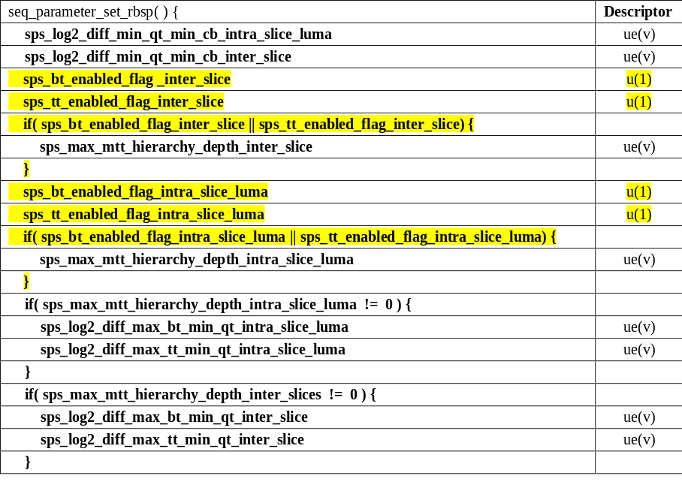
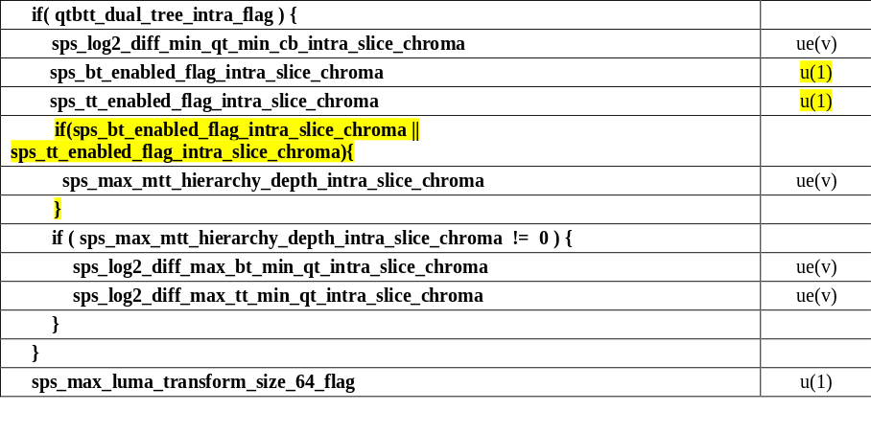
Add BT and TT splits enabling flags
(Inter_slice, intra_slice_luma and intra_slice_chroma)

Slide 3
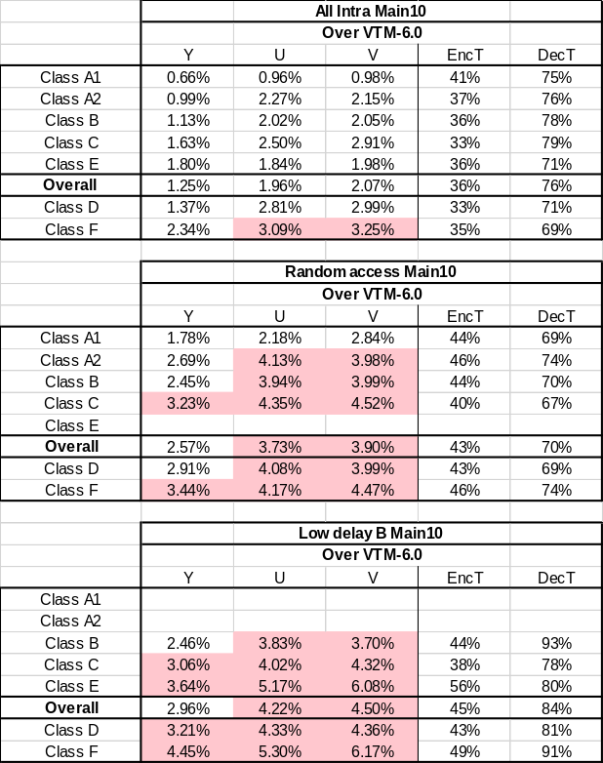
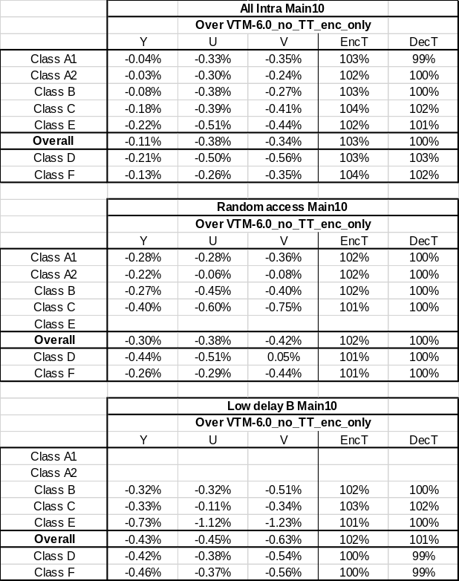
Example of TT split disabling
TT split disabling at encoder TT normative disabling vs encoder only

