Slide 1
JVET-P0328
AHG10: Performance of the GOP-based temporal filter in VTM-6.1
Jack Enhorn
Rickard Sjöberg
Jacob Ström
Per Wennersten
Ericsson Research
Jack Enhorn
Ericsson Research
2019-10-10

Slide 2
Introduction
GOP-based temporal filter JVET-O0549 adopted in Gothenburg
The algorithm was implemented and tested in VTM-6.1
Filtering applied for every 8th frame in RA using
  if (POC % 16 == 0)
  s₀ = 1.5
  else if (POC % 8 == 0)
  s₀ = 0.95
Filtering applied for ever 4th frame in LD
  s₀ = 0.40
The filtered pictures are used for encoding and original unfiltered pictures are used for BD-rate calculation

Slide 3
Objective results RA
 | Random Access
 | Over VTM-6.1
 | Y | U | V | EncT | DecT
Class A1 | -2,34% | -6,12% | -4,71% | 93% | 93%
Class A2 | -5,04% | -9,41% | -9,62% | 92% | 98%
Class B | -5,86% | -7,86% | -8,22% | 94% | 95%
Class C | -1,82% | -3,38% | -3,57% | 98% | 96%
Class E
Overall | -3,91% | -6,63% | -6,56% | 94% | 95%
Class D | 0,27% | -3,69% | -3,44% | 99% | 97%
Class F | -0,21% | -0,72% | -0,92% | 107% | 100%
 | Random access from JVET-O0549-v2
 | Over VTM-5.0
 | Y | U | V | EncT | DecT
Class A1 | -1.93% | -6.65% | -4.20% | 93% | 99%
Class A2 | -4.84% | -11.53% | -11.00% | 91% | 94%
Class B | -5.68% | -8.26% | -8.63% | 95% | 100%
Class C | -0.89% | -2.16% | -2.33% | 101% | 98%
Class E
Overall | -3.49% | -6.96% | -6.53% | 95% | 98%
Class D | -0.56% | -2.34% | -2.46% | 100% | 103%
Class F | -0.23% | -1.05% | -0.96% | 106% | 99%

Slide 4
Objective results LD-B
 | Low delay B
 | Over VTM-6.1
 | Y | U | V | EncT | DecT
Class A1
Class A2
Class B | -1,35% | -1,54% | -3,03% | 95% | 95%
Class C | 0,05% | -0,11% | -0,50% | 97% | 96%
Class E | -1,66% | -2,50% | -3,00% | 95% | 94%
Overall | -0,96% | -1,30% | -2,18% | 96% | 95%
Class D | 0,66% | -0,44% | -0,46% | 98% | 93%
Class F | 0,27% | 0,75% | 1,35% | 104% | 105%
 | Low delay B from JVET-O0549-v2
 | Over VTM-5.0
 | Y | U | V | EncT | DecT
Class A1
Class A2
Class B | -1.45% | -1.57% | -3.24% | 99% | 96%
Class C | 0.13% | 0.28% | -0.17% | 102% | 101%
Class E | -1.76% | -2.70% | -3.32% | 97% | 100%
Overall | -1.00% | -1.24% | -2.24% | 99% | 99%
Class D | 0.63% | -0.31% | -0.04% | 101% | 101%
Class F | 0.26% | 0.51% | 0.65% | 102% | 98%

Slide 5
Objective results LD-P
 | Low delay P
 | Over VTM-6.1
 | Y | U | V | EncT | DecT
Class A1
Class A2
Class B | -2,04% | -1,96% | -3,14% | 95% | 95%
Class C | -0,15% | -0,18% | -0,43% | 95% | 96%
Class E | -2,33% | -2,93% | -3,09% | 94% | 93%
Overall | -1,48% | -1,61% | -2,23% | 95% | 95%
Class D | 0,45% | -0,17% | -0,57% | 96% | 93%
Class F | 0,23% | 0,32% | 0,45% | 97% | 96%
 | Low delay P from JVET-O0549-v2
 | Over VTM-5.0
 | Y | U | V | EncT | DecT
Class A1
Class A2
Class B | -2.10% | -2.29% | -3.84% | 99% | 101%
Class C | -0.04% | -0.09% | 0.01% | 101% | 102%
Class E | -2.34% | -3.85% | -4.73% | 102% | 107%
Overall | -1.47% | -1.95% | -2.78% | 101% | 103%
Class D | 0.59% | -0.53% | -0.66% | 105% | 104%
Class F | 0.26% | 1.97% | 0.84% | 103% | 102%

Slide 6
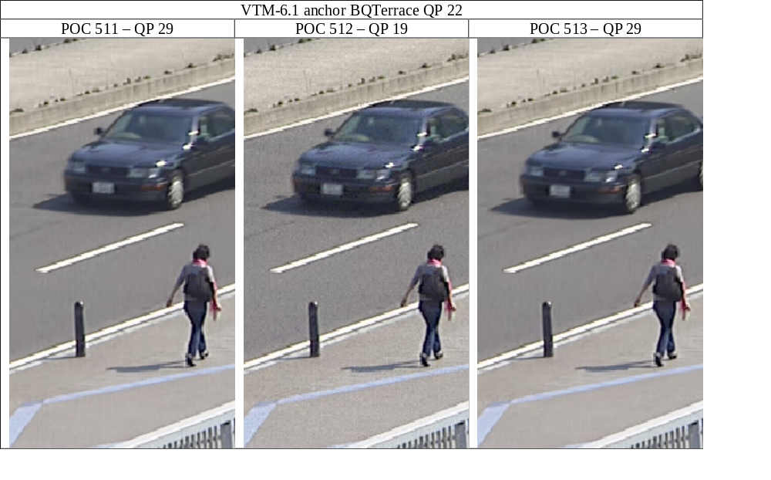
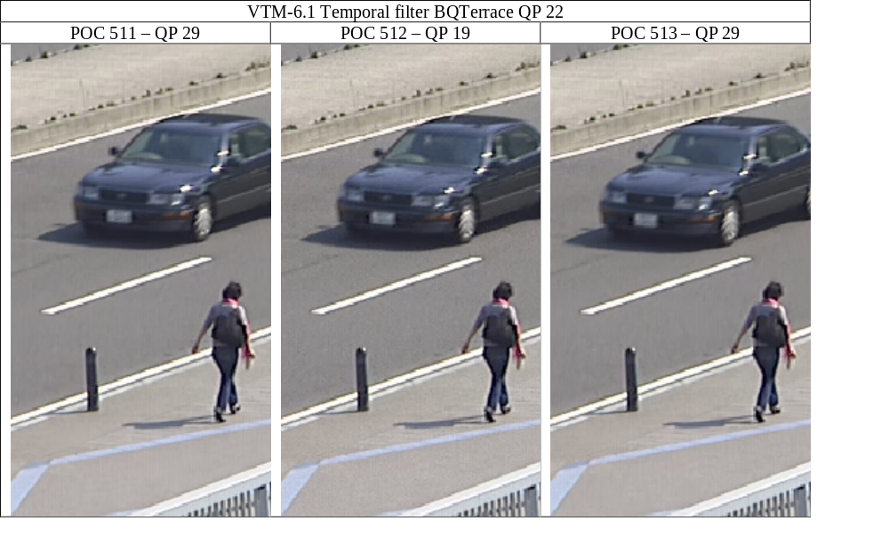
Subjective results
Reduced difference in noise level between pictures, less ”intra pulsing”
Demo on subjective performance were held on Thursday 2019-10-10 16:00-17:00, about 15 people attended

