Slide 1
Non-CE3: Simplified MIP with reduced memory footprint
JVET 16th
T. Biatek, A. K. Ramasubramonian, G. Van der Auwera and M. Karczewicz

Slide 2
Addressed issue
Current MIP:
  Non-optimal use of memory as some matrices are only used without transposed input
  Substantial memory footprint (4.5KB)→ 34 matrices with associated offset/shift vectors
  This proposal:
  Significantly reduces MIP memory footprint by 50% → 2.25KB
  Make memory usage optimal → full MIP modes transposition
  Simplify specification, usage of fixed-length code

Slide 3
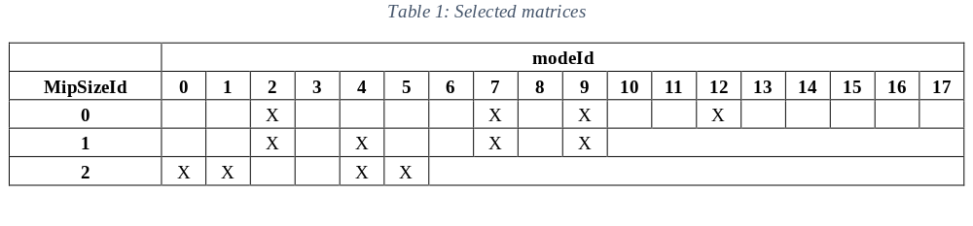
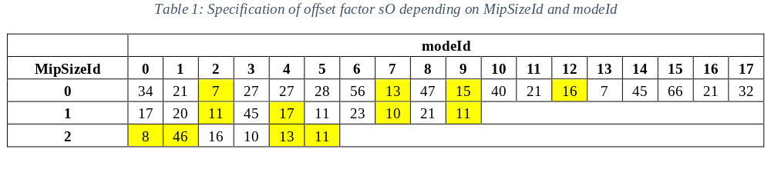
Proposal – Aspect 1
Aspect 1: Matrices set reduction and offset alignment
  Statistical study on non-CTC dataset to only keep most efficient matrices
  For selected matrices, a single offset value is selected
    Largest offset is used for weights alignment → 46
    Weight alignment is performed on other matrices:
$$Weight\left[x\right]\left[y\right]=Clip_{7b}\left(Weight\left[x\right]\left[y\right]+\left(46−sO\right)\right)$$

Slide 4
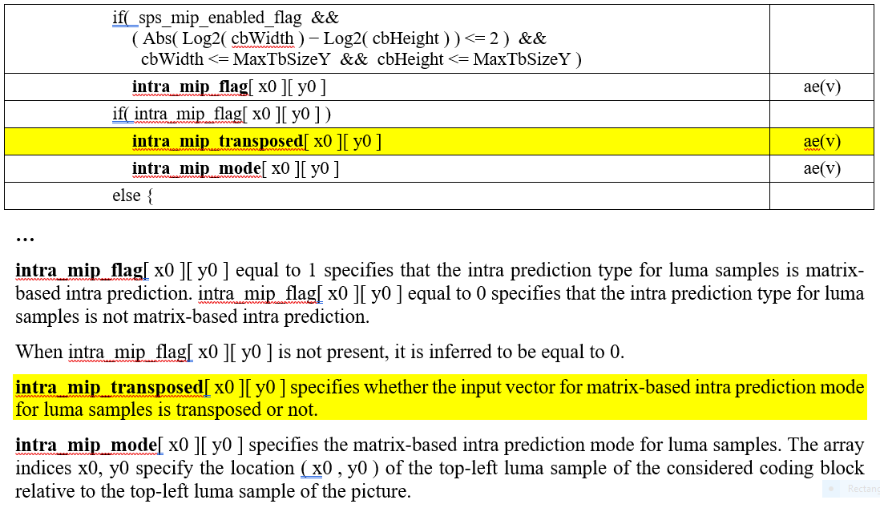
Proposal – Aspect 2
Aspect 2: Generalized input vector transposition
  To increase matrices diversity, MIP input vector transposition is generalized
  A new flag is introduced to have clean design and fixed length coding is generalized
bypass 1 bin
bypass 2 bins

Slide 5
Test conditions
Performance is assessed on CTC
Removing matrices for 4x4 blocks can be harmful at low bitrate → Low QP CTC are tested.
As MIP matrices are learned on an external dataset, removing matrices can be harmful on other sequences:
  Outside-CTC sequences are tested
  OpenImages (JVET-O0551) and DIV2K* datasets
    OpenImages → 613 1080p-10b pictures
    DIV2K → 715 1080p-10b pictures
Memory saving is also evaluated
* E. Augustsson and R. Timotfe, “NTIRE 2017 Challenge on Single Image Super-Resolution: Dataset and Study”, IEEE Conference on Computer Vision and Pattern Recognition (CVPR), July 2017.

Slide 6
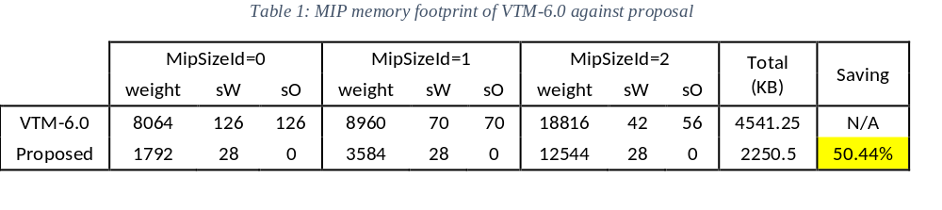
Memory saving
Proposal provides 50% storage reduction
Memory footprint is reduced from 4.5 KB to 2.25KB

Slide 7
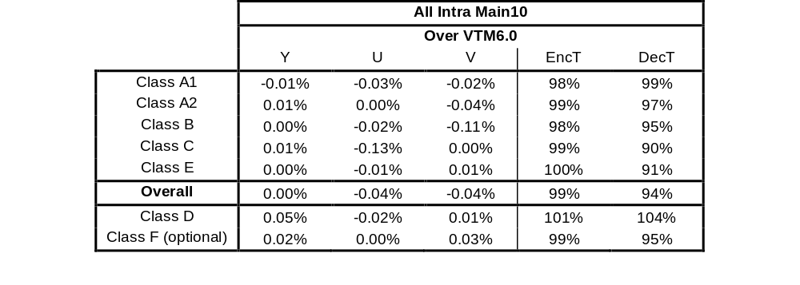
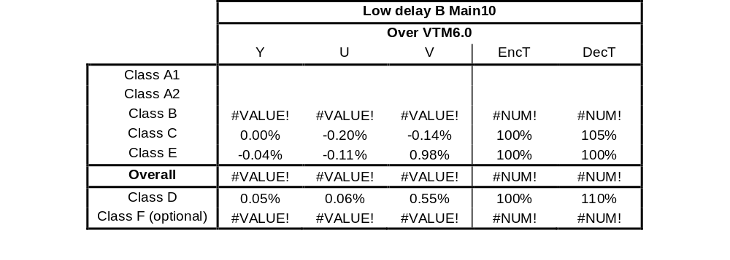
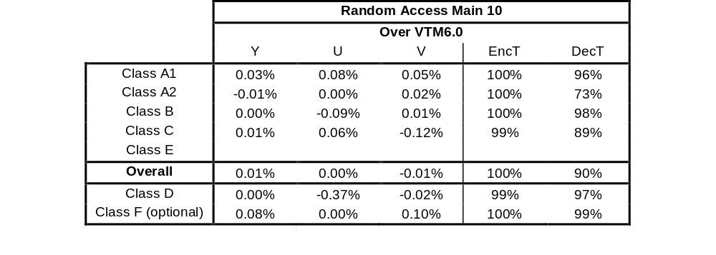
CTC performance

Slide 8
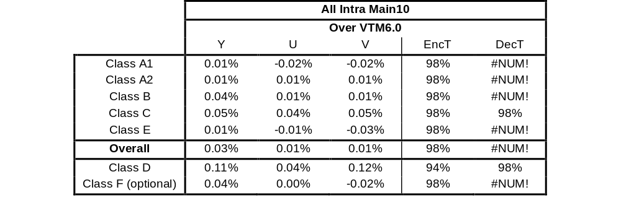
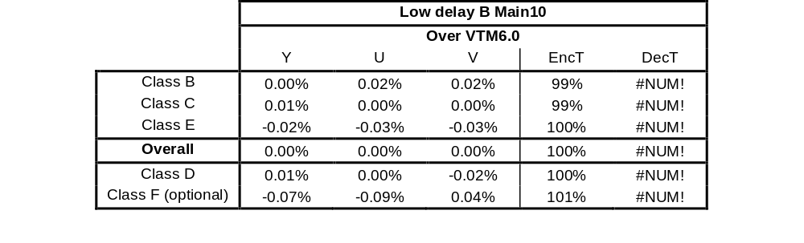
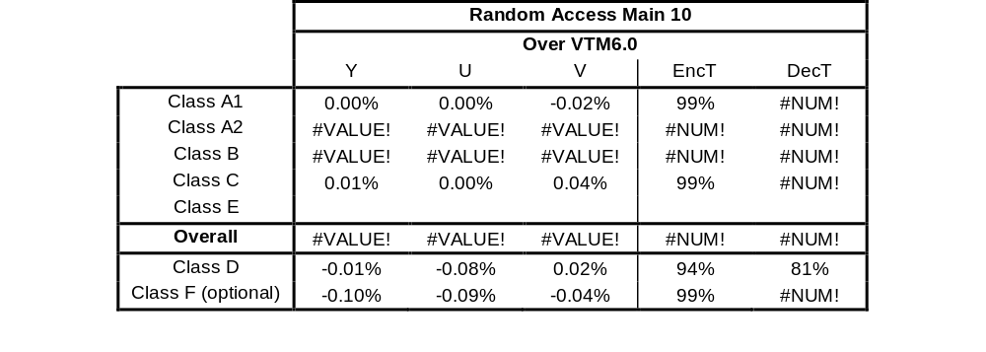
Low-QP CTC performance

Slide 9
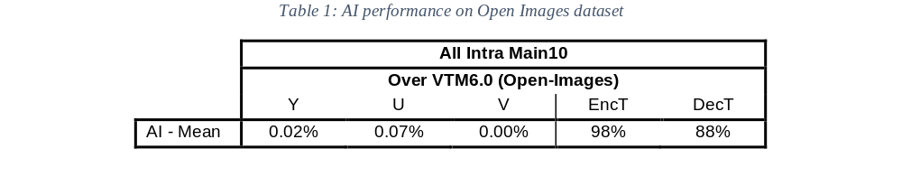
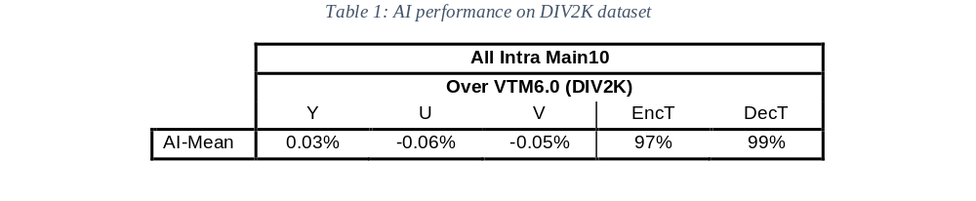
OpenImages/DIV2K performance

Slide 10
Conclusion
This contribution proposes a simplified MIP design with reduced memory footprint. Extended simulations results show that substantial memory saving (50%) is achieved for small loss. In addition, substantial specification simplification is achieved.
Thanks to InterDigital for crosscheck

