Slide 1
JVET-P0106: AHG16/CE5-Related: Simplifications for Cross Component Adaptive loop filter
Anand Meher Kotra, Semih Esenlik, Biao Wang, Han Gao, Elena Alshina

Slide 2
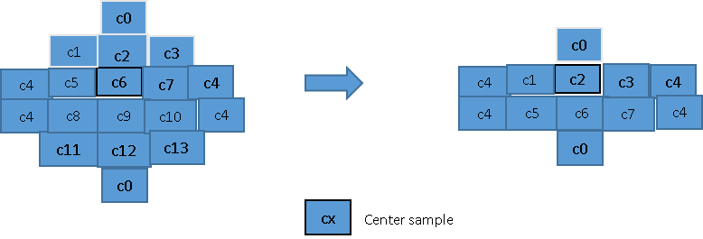
Overview
To reduce the computational complexity of CCALF (CE 5-2), the filter shape is proposed to be changed as shown in the figure below.
Advantage:
  Number of filter coefficients is changed from 14 to 8
  Line buffer requirement is reduced by 1 line

Slide 3
Results
Test | AI |  |  |  | RA |  |  |  | LDB
 | YUV | Y | U | V | YUV | Y | U | V | YUV | Y | U | V
Anchor: VTM-6.0 Test: JVET-P0106 with ChromaQPoffset | -0.35% | -1.01% | 1.49% | 3.09% | -0.71% | -1.16% | 0.88% | 1.22% | -0.76% | -0.51% | -2.53% | 2.09%
Anchor: VTM-6.0 Test: JVET-P0106 without ChromaQPoffset | -1.17% | 0.11% | -6.99% | -5.55% | -1.82% | 0.18% | -10.11% | -9.51% | -2.45% | 0.14% | -14.65% | -10.92%
Anchor: CE5-2.1 Test: JVET-P0106 with ChromaQPoffset | 0.1% | -0.02% | 0.73% | 0.54% | 0.1% | 0.00% | 0.65% | 0.66% | 0.3% | 0.02% | 1.68% | 1.23%
YUV is computed by (8Y + U + V) /10

Slide 4
Conclusion
Modified CCALF filter shape with 8 filter coefficients instead of 14 as proposed in CE 5-2
  Line buffer requirement also reduced by 1 line
  Around 0.1% BD-Rate loss for RA configuration
Thanks to Mediatek for cross check JVET-P0847
Suggested to be studied along with the other CCALF complexity reduction proposals.

Slide 5
Thank You
www.huawei.com

