Slide 1
JVET-O0803: Non-CE5: Unified design for longer tap deblocking line buffer reduction
Anand Meher Kotra, Semih Esenlik, Biao Wang, Han Gao, Elena Alshina

Slide 2
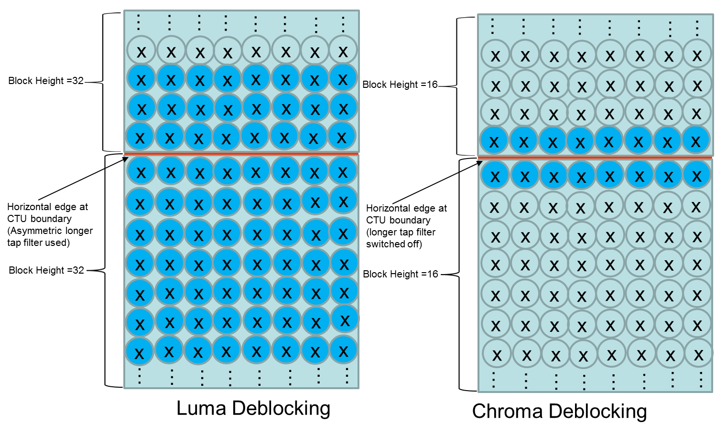
VTM-5.0 Luma and Chroma deblocking at horizontal CTU boundaries
Longer tap deblocking in VTM-5.0 changes 3 samples on either side of the edge (3 + 3) when the size of both blocks adjacent to the edge is >=8 samples
Due to line buffer restrictions of 2 lines, Chroma longer tap deblocking is completely switched off and only the weak filter (1 + 1) can be used, whereas for Luma deblocking longer tap asymmetric filter (3 + 7) is used.
For large blocks at the horizontal Chroma CTU boundaries, still sufficient blocking artifacts might still remain (especially for 4:2:2 and 4:4::4 content)

Slide 3
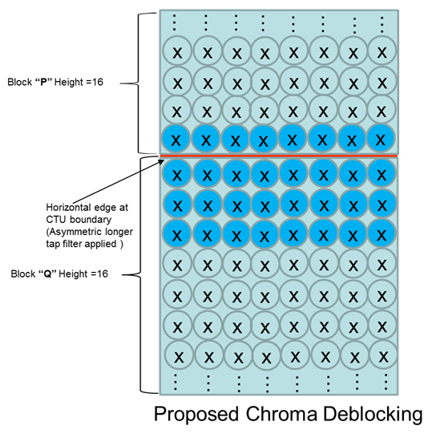
Proposal
Proposal is to use an asymmetric longer tap filter (1 + 3) also at the Chroma CTU boundaries to more efficiently remove the blocking artifacts.

Slide 4
Simple change to filtering decision
For the longer tap filter decision, the original filter equations are as follows:
dp0 = Abs( p_{2,0} − 2 * p_{1,0} + p_{0,0} ) (8‑1092)
dp1 = Abs( p_{2,1} − 2 * p_{1,1} + p_{0,1} ) (8‑1093)
dq0 = Abs( q_{2,0} − 2 * q_{1,0} + q_{0,0} ) (8‑1094)
dq1 = Abs( q_{2,1} − 2 * q_{1,1} + q_{0,1} ) (8‑1095)
At the horizontal CTU boundaries the modified longer tap filter decisions are as follows: (p_{2,0,} p_{2,1} are simply replaced with p_{1,0} and p_{1,1}), only dp0 and dp1 are changed
dp0 = Abs( p_{21,0} − 2 * p_{1,0} + p_{0,0} ) (8‑1092)
dp1 = Abs( p_{21,1} − 2 * p_{1,1} + p_{0,1} ) (8‑1093)

Slide 5
Modified filtering equations
The original longer tap filtering equations for Chroma longer tap deblocking are as follows:
p₀′ = Clip3( p₀ − t_{C}, p₀ + t_{C}, ( p₃ + p₂ + p₁ + 2 * p₀ + q₀ + q₁ + q₂ + 4 ) >> 3 ) (8‑1151)
p₁′ = Clip3( p₁ − t_{C}, p₁ + t_{C}, ( 2 * p₃ + p₂ + 2 * p₁ + p₀ + q₀ + q₁ + 4 ) >> 3 ) (8‑1152)
p₂′ = Clip3( p₂ − t_{C}, p₂ + t_{C}, ( 3 * p₃ + 2 * p₂ + p₁ + p₀ + q₀ + 4 ) >> 3 ) (8‑1153)
q₀′ = Clip3( q₀ − t_{C}, q₀ + t_{C}, ( p₂ + p₁ + p₀ + 2 * q₀ + q₁ + q₂ + q₃ + 4 ) >> 3 ) (8‑1154)
q₁′ = Clip3( q₁ − t_{C}, q₁ + t_{C}, ( p₁ + p₀ + q₀ + 2 * q₁ + q₂ + 2 * q₃ + 4 ) >> 3 ) (8‑1155)
q₂′= Clip3( q₂ − t_{C}, q₂ + t_{C}, ( p₀ + q₀ + q₁ + 2 * q₂ + 3 * q₃ + 4 ) >> 3 ) (8‑1156)
At the horizontal CTU boundaries the modified longer tap deblocking equations are as follows:
p₀′ = Clip3( p₀ − t_{C}, p₀ + t_{C}, ( p₃ + p₂ + 3 * p₁ + 2 * p₀ + q₀ + q₁ + q₂ + 4 ) >> 3 ) (8‑1151)
p₁′ = Clip3( p₁ − t_{C}, p₁ + t_{C}, ( 2 * p₃ + p₂ + 2 * p₁ + p₀ + q₀ + q₁ + 4 ) >> 3 ) (8‑1152)
p₂′ = Clip3( p₂ − t_{C}, p₂ + t_{C}, ( 3 * p₃ + 2 * p₂ + p₁ + p₀ + q₀ + 4 ) >> 3 ) (8‑1153)
q₀′ = Clip3( q₀ − t_{C}, q₀ + t_{C}, ( p₂ + 2 * p₁ + p₀ + 2 * q₀ + q₁ + q₂ + q₃ + 4 ) >> 3 ) (8‑1154)
q₁′ = Clip3( q₁ − t_{C}, q₁ + t_{C}, ( p₁ + p₀ + q₀ + 2 * q₁ + q₂ + 2 * q₃ + 4 ) >> 3 ) (8‑1155)
q₂′= Clip3( q₂ − t_{C}, q₂ + t_{C}, ( p₀ + q₀ + q₁ + 2 * q₂ + 3 * q₃ + 4 ) >> 3 ) (8‑1156)

Slide 6

VTM-5.0, ALF OFF, LDB, Candlelight 4:4:4, frame no: 123

Slide 7

Proposal, LDB, Candlelight 4:4:4, frame no: 123

Slide 8
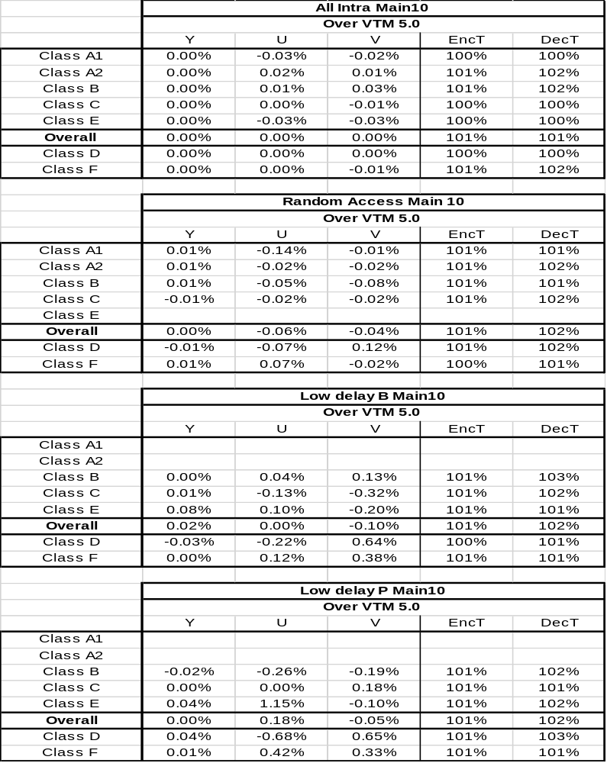
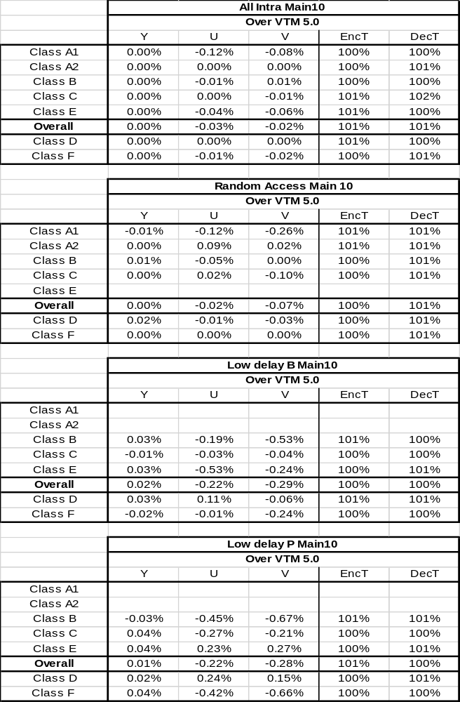
CTC
ALF OFF

Slide 9
Conclusion
Propose to switch on the longer tap filter ( 1+ 3) version at the horizontal Chroma CTB boundary.
No major BD-Rate impact.
Specification text changes are attached along with the contribution
Suggest to be adopted as it is a unification of deblocking design for Luma and Chroma
Thanks to MediaTek for crosscheck (JVET-O0809)

Slide 10
Thank You
www.huawei.com

