Slide 1
CE8-related: Modulo operations for IBC block vectors
(JVET-O0482)
X. Xu, X. Li, S. Liu (Tencent)
2019/07

Slide 2
Summary
Currently in VVC WD-5.0/VTM-5.0,
  A set of constraints are set to make sure the IBC BV points to an area that has been reconstructed
  Another set of constraints are set to make sure the IBC BV points to available reference area
    Note: some region that has been reconstructed may not be used due to memory requirement
In this contribution, the second part of the constraints are converted into formative BV derivation process
It is asserted that by doing this, it is easier for the encoder to generate conformant bitstreams

Slide 3
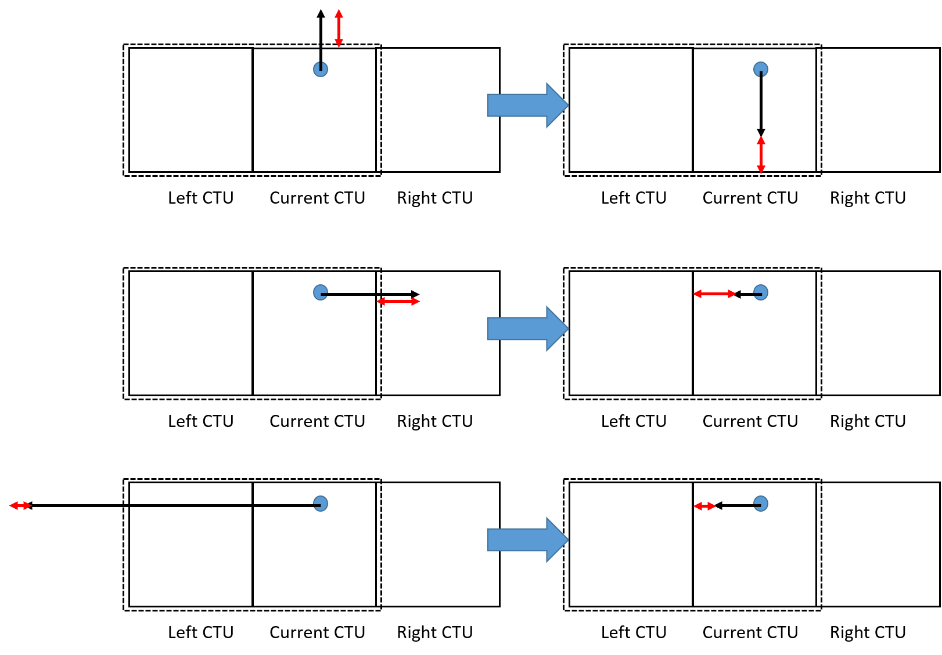
Proposed method
When the BV falls into the currently allowed search range (current CTU or left CTU)
  No change applied to the decoded BV
Otherwise,
  A modulo operation is applied such that the BV is mapped into the current CTU

Slide 4
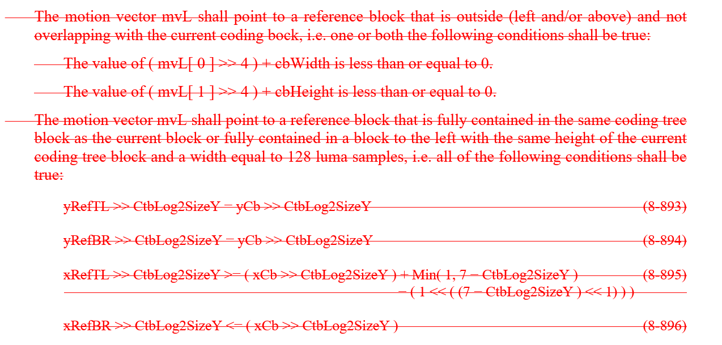
Proposed Spec. changes (1)

Slide 5
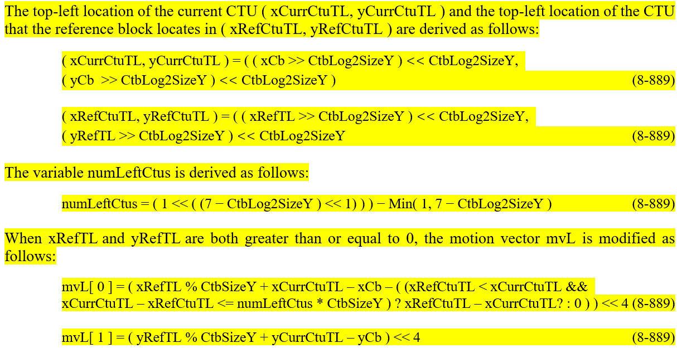
Proposed Spec. changes (2)

Slide 6
Conclusion
In this proposal,
  Some IBC BV range constraints are converted into formative BV derivation modifications
  The related range constraints become not necessary and can be removed
  No coding performance changes were observed
The proposed changes are asserted to be more friendly for the encoder to generate standard compliant bitstream
It is recommended to include these changes into the specification

