Slide 1
JVET-N0325
CE9-related: improvement on bi-directional optical flow (BDOF)
Xiaoyu Xiu, Yi-Wen Chen, Tsung-chuan Ma, Xianglin Wang

Slide 2
Introduction
The BDOF design in the VVC working draft
  Enhancing both the granularity and accuracy of bi-prediction based on 4x4 subblocks
  Different numbers of bit-wise right shifts are applied to calculate sample gradients, the difference between L0 and L1 predictions and the summation of L0 and L1 gradients

Slide 3
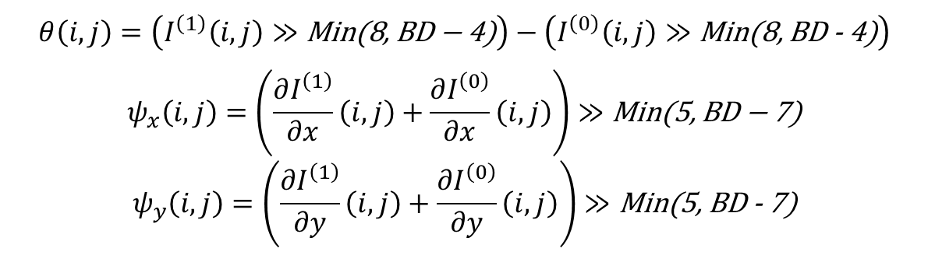
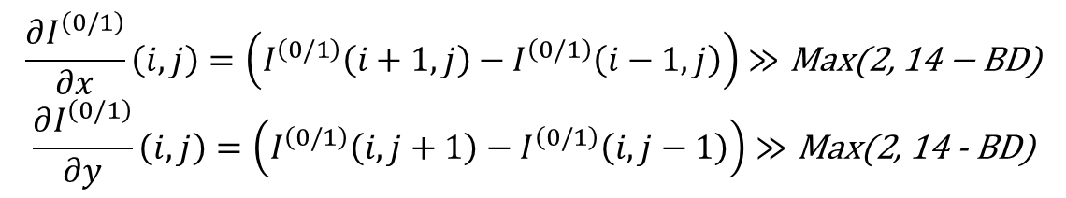
Introduction
Gradient derivation
$$\frac{∂I^{\left(0/1\right)}}{∂x}\left(i, j\right)=\left(I^{\left(0/1\right)}\left(i+1, j\right)−I^{\left(0/1\right)}\left(i−1, j\right)\right)≫\text{Max}\text{(2, 14 − }\text{BD}\text{)}$$
$$\frac{∂I^{\left(0/1\right)}}{∂y}\left(i, j\right)=\left(I^{\left(0/1\right)}\left(i, j+1\right)−I^{\left(0/1\right)}\left(i, j−1\right)\right)≫\text{Max}\text{(2, 14 - }\text{BD}\text{)}$$
Correlation parameter calculation
$$θ\left(i,j\right)=\left(I^{\left(1\right)}\left(i, j\right)≫\text{Min}\text{(8, }\text{BD}\text{ − 4)}\right)−\left(I^{\left(0\right)}\left(i, j\right)≫\text{Min}\text{(8, }\text{BD}\text{ - 4)}\right)$$
$$ψ_{x}\left(i,j\right)=\left(\frac{∂I^{\left(1\right)}}{∂x}\left(i, j\right)+\frac{∂I^{\left(0\right)}}{∂x}\left(i, j\right)\right)≫\text{Min}\text{(5, }\text{BD}\text{ − 7)}$$
$$ψ_{y}\left(i,j\right)=\left(\frac{∂I^{\left(1\right)}}{∂y}\left(i, j\right)+\frac{∂I^{\left(0\right)}}{∂y}\left(i, j\right)\right)≫\text{Min}\text{(5, }\text{BD}\text{ - 7)}$$

Slide 4
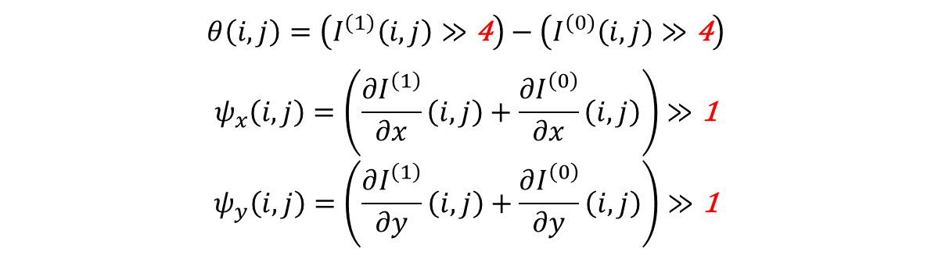
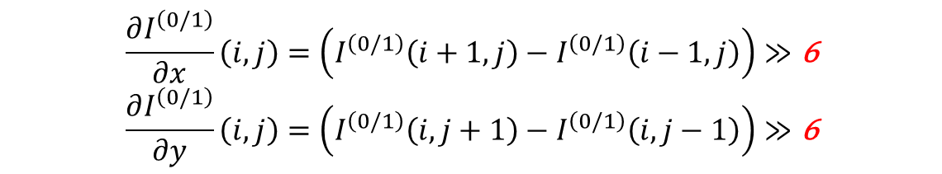
Proposal
Propose to unify all the bitwise shift operations of the BDOF by extending the right shifts of internal 8-bit for internal 10-bit and 12-bit
Gradient derivation
$$\frac{∂I^{\left(0/1\right)}}{∂x}\left(i, j\right)=\left(I^{\left(0/1\right)}\left(i+1, j\right)−I^{\left(0/1\right)}\left(i−1, j\right)\right)≫\text{6}$$
$$\frac{∂I^{\left(0/1\right)}}{∂y}\left(i, j\right)=\left(I^{\left(0/1\right)}\left(i, j+1\right)−I^{\left(0/1\right)}\left(i, j−1\right)\right)≫\text{6}$$
Correlation parameter calculation
$$θ\left(i,j\right)=\left(I^{\left(1\right)}\left(i, j\right)≫\text{4}\right)−\left(I^{\left(0\right)}\left(i, j\right)≫\text{4}\right)$$
$$ψ_{x}\left(i,j\right)=\left(\frac{∂I^{\left(1\right)}}{∂x}\left(i, j\right)+\frac{∂I^{\left(0\right)}}{∂x}\left(i, j\right)\right)≫\text{1}$$
$$ψ_{y}\left(i,j\right)=\left(\frac{∂I^{\left(1\right)}}{∂y}\left(i, j\right)+\frac{∂I^{\left(0\right)}}{∂y}\left(i, j\right)\right)≫\text{1}$$

Slide 5
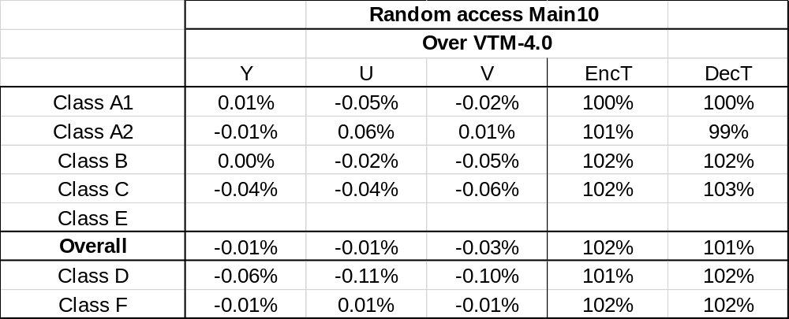
Simulation results
CTC results

Slide 6
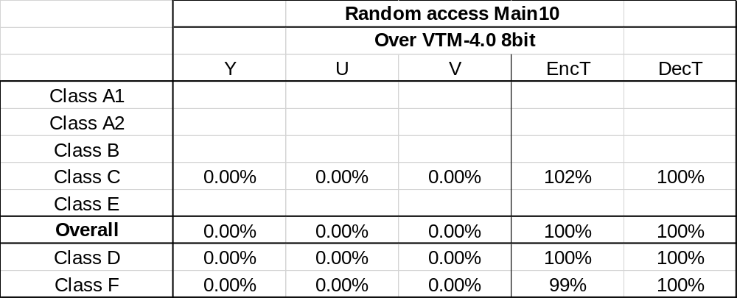
Simulation results
8-bit simulation results
  CTC plus InternalBitDepth = 8

Slide 7
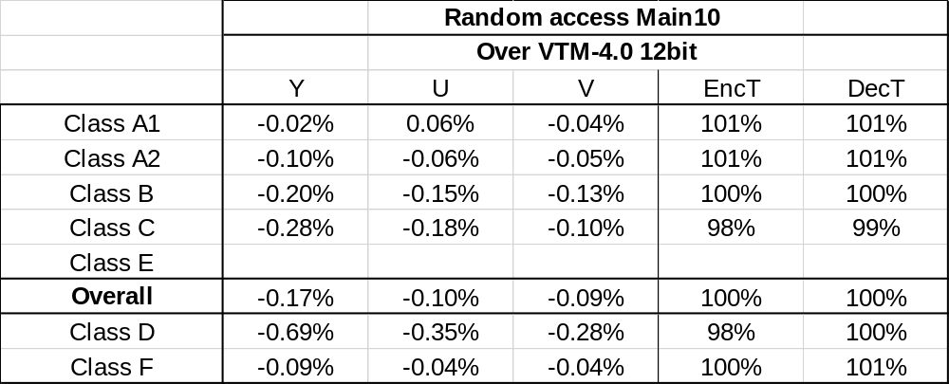
Simulation results
12-bit simulation results
  CTC plus InternalBitDepth = 12
  Reshape LUT bugfix in merge request 330

Slide 8
Thank you

