Slide 1

AHG2: Regarding HMVP Table Size
J. Zhao, S. Kim
LG ELECTRONICS

Slide 2

Introduction
This proposal reports that in VVC3, the HMVP table size can be changed from 6 to 5 without any RD performance change.
This issue has already been noted in AHG2 report
  JVET-M0002 AHG report: Draft text and test model algorithm description editing (AHG2)
  “ Max. number of HMVP candidates is 6 but never used and thus can be reduced to 5”

Slide 3
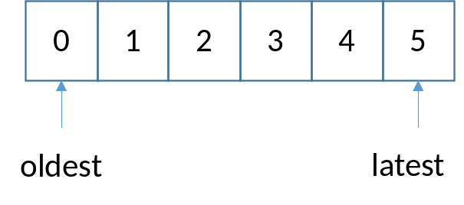

Why no impact?
  It is because the 6th entry of the HMVP table is never used.
    In VVC3, max merge list size MaxNumMergeCand is 6.
    HMVP table is pruned during update, no two entries in the table are the same. The latest entry is always added to the end.
    When adding HMVP candidate to the merge list, at most 5 HMVP candidates are added.
  Therefore the HMVP table size can be changed to 5 without impact RD coding performance.
  This reduces the number of redundancy check by 1 during HMVP table update.

Slide 4
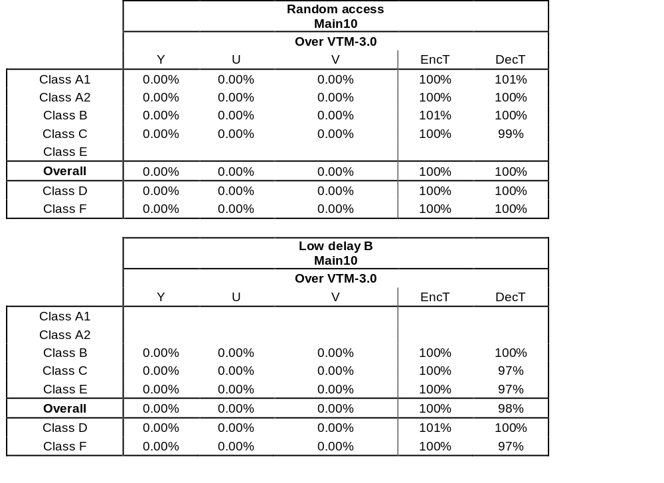
Results
In VTM3, change MAX_NUM_HMVP_CANDS = 5.
Results are identical to VTM3.
Thanks InterDigital for Cross-checking.

