Slide 1
JVET-M0311
CE2-related: Memory bandwidth reduction for affine mode with less dependency
Jingya Li, Ru-Ling Liao Chong Soon Lim

Slide 2
Introduction
Simplification of CE2.4.2: memory bandwidth reduction for affine
Control point is used as center MV instead of 1st sub-block MV to calculate MV constrained region for affine mode
Reduced dependency in calculating MV of 1st sub-block and other sub-blocks
0.03% loss in RA, 0.01% loss in LB

Slide 3
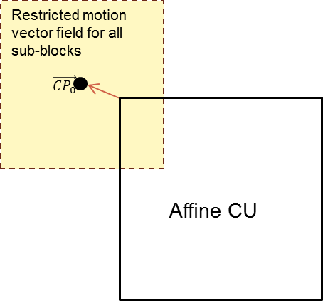
Restrict motion vector field for affine
Sub-block MV range:
  Min_x = ((CP0_x-H)>>4<<4)
  Max_x = ((CP0_x+H)>>4<<4) + 31
  Min_y = ((CP0_y-V)>>4<<4)
  Max_y = ((CP0_y+V)>>4<<4) + 31
Motion vector exceeding the field is clipped

Slide 4
Simulation results
Negligible loss for the proposed simplification
Random Access | CE2.4.2 constrained MV for affine mode |  |  |  |  | CE2.4.2 + using control point MV (proposed)
Main 10 | Y | U | V | EncT | DecT | Y | U | V | EncT | DecT
Class A1 | 0.01% | -0.06% | 0.08% | 101% | 100% | 0.04% | 0.02% | -0.02% | 100% | 97%
Class A2 | 0.03% | 0.01% | 0.02% | 101% | 100% | 0.05% | 0.15% | 0.16% | 100% | 96%
Class B | 0.01% | 0.04% | 0.08% | 101% | 99% | 0.02% | 0.11% | -0.01% | 100% | 96%
Class C | -0.01% | -0.01% | 0.00% | 102% | 102% | 0.03% | 0.07% | 0.10% | 100% | 98%
Overall | 0.01% | 0.00% | 0.05% | 101% | 100% | 0.03% | 0.09% | 0.05% | 100% | 97%
Class D | 0.01% | -0.03% | 0.09% | 101% | 98% | 0.03% | 0.12% | 0.03% | 100% | 98%
Class F | 0.03% | -0.02% | 0.04% | 101% | 98% | 0.03% | -0.03% | 0.02% | 100% | 98%
Low delay B | CE2.4.2 constrained MV for affine mode |  |  |  |  | CE2.4.2 + using control point MV (proposed)
Main 10 | Y | U | V | EncT | DecT | Y | U | V | EncT | DecT
Class B | 0.03% | -0.20% | 0.09% | 101% | 100% | 0.05% | -0.11% | -0.18% | 99% | 99%
Class C | 0.03% | 0.25% | 0.18% | 101% | 101% | 0.01% | 0.07% | 0.26% | 100% | 100%
Class E | -0.03% | -0.22% | -0.14% | 101% | 101% | -0.05% | 0.24% | -0.12% | 100% | 100%
Overall | 0.01% | -0.05% | 0.07% | 101% | 100% | 0.01% | 0.04% | -0.01% | 100% | 100%
Class D | 0.03% | -0.08% | -0.10% | 100% | 103% | 0.02% | 0.09% | 0.58% | 100% | 100%
Class F | 0.00% | -0.15% | 0.99% | 101% | 100% | 0.03% | 0.37% | 0.32% | 100% | 99%

Slide 5
Conclusions
Using control point as center to calculate MV field for affine
Removing dependency of affine sub-blocks
0.03% loss in RA, 0.01% loss in LB
It is suggested to adopt this proposal to VVC

Slide 6
Acknowledgments
Thank Kwai for
cross-checking

Slide 7
How to calculate motion vector field?
Background: memory bandwidth for 8×8 bi-pred. inter CU
luma: (8+7)×(8+7)×2 = 450
Target:
worst case memory bandwidth
memory bandwidth for 8×8 bi-pred. inter CU
≤
To achieve the target, memory bandwidth for M×N sized CU shall not exceeds M×N/64×450
This leads to equation:
(M+2×H+7)×(N+2×V+7)×K = M×N/64×450
* K=1 for uni-prediction and K=2 for bi-prediction
* The value of H shall be equal to V
* Noted that H and V values are adaptive to CU size

Slide 8
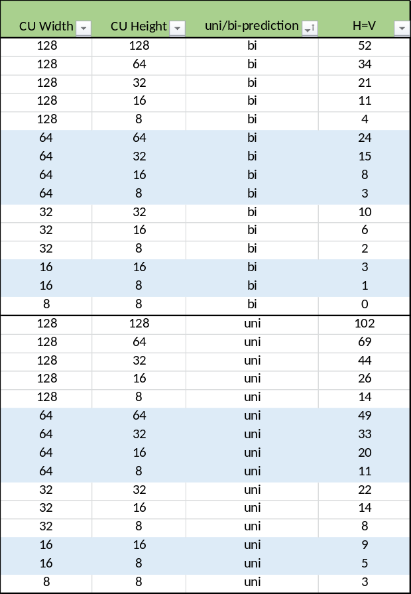
Motion vector field for each CU size

