Slide 1
JVET-M0282
CE2.2.8: Affine Motion Vector Pruning
A. Robert - Technicolor
January 2019

Slide 2
Motivation
  VTM-3:
    In Affine AMVP and Affine Merge coding modes, motion predictor lists are constructed.
    But in the current reference software, almost all pruning has been removed and some predictor redundancy can be observed
  Goal of this contribution:
    Reduce predictor redundancies
    Harmonize motion predictor lists construction

Slide 3
Affine AMVP coding mode
List | Affine AMVP
Candidates type | -> Spatial inherited Affine A0/A1 + unscaled + rounding ¼-pel -> Spatial inherited Affine B0/B1/B2 + unscaled + rounding ¼-pel - Pruned spatial inherited cand - Spatial LT B2/B3/A2 + unscaled + rounding ¼-pel - Spatial RT B1/B0 + unscaled + rounding ¼-pel - Spatial LB A1/A0 + unscaled + rounding ¼-pel -> Virtual Affine with {LT,RT,LB}/{LT,RT} + pruned all -> Translational with pruned LB, RT, LT -> Translational with TMVP C0/C1 -> Fulfill with zero Affine
list size/total nb of possible candidates | 2 / 2+1+3+1+2 = 9 for each ref pic
Nb comparison mv refidx total int | 3+3+3+0+0 = 0+9 = 9 for each ref pic (x4) 0 18
  Adopted last meeting:
    Remove all pruning
    Get only 2 spatial inherited like in AMVP
  Proposed uniformization with AMVP
    2 spatial inherited predictor are pruned together
    Virtual predictor is pruned
    Simple and early pruning of the virtual translational predictors
      If v_{LT} and v_{RT} exist and are equal, then v_{RT} is set invalid
      If v_{LT} and v_{LB} exist and are equal or v_{RT} and v_{LB} exist and are equal, then v_{LB} is set invalid
  → 18 integer comparisons per ref frame (12 AMVP)

Slide 4
Affine Merge coding mode
List | Affine merge
Candidates type | - Spatial A1 - Spatial B1 + pruned A1 - Spatial B0 + pruned B1 - Spatial A0 + pruned A1 -> ATMVP -> Spatial inherited Affine A0/A1 -> Spatial inherited Affine B0/B1/B2 - Pruned spatial inherited cand - Spatial LT B2/B3/A2 - Spatial RT B1/B0 - Spatial LB A1/A0 - TMVP RB C0 -> Virtual Affine with pruned {LT,RT,LB}, {LT,RT,RB}, {LT,LB,RB}, {RT,LB,RB}, {LT,RT}, {LT,LB} -> Fulfill with zero Affine
list size/total nb of possible candidates | 5 / 1+2+6+5 = 14
Nb comparison mv refidx total int | 3*2+3*2+(4*2+2)*2+0 = 26+6 = 32 3*2+1*2+(4*2+2)*2+0 = 26+2 = 28 78 92
  Adopted last meeting:
    Reduced pruning to only virtual predictors (same reference frame but different MVs)
  Proposed uniformization with Affine AMVP
    2 spatial inherited predictor are pruned together
    Consider zero Affine predictor in the RDO
  → 14 integer comparisons more (+15%)

Slide 5
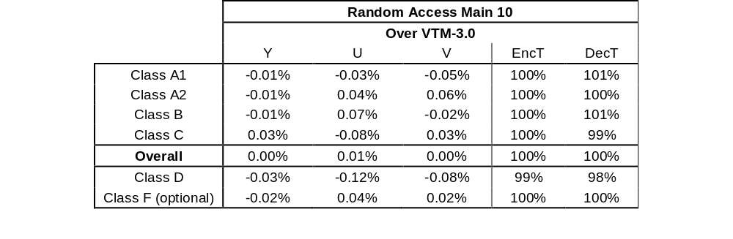
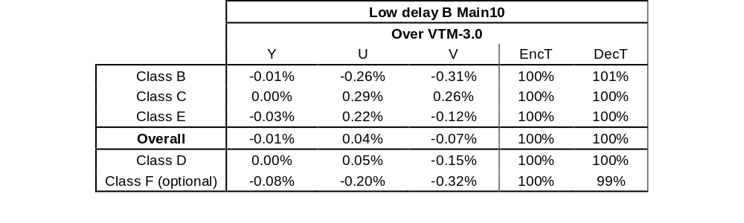
Simulation Results
  Results over VTM-3.0:
    Affine AMVP uniformization

Slide 6

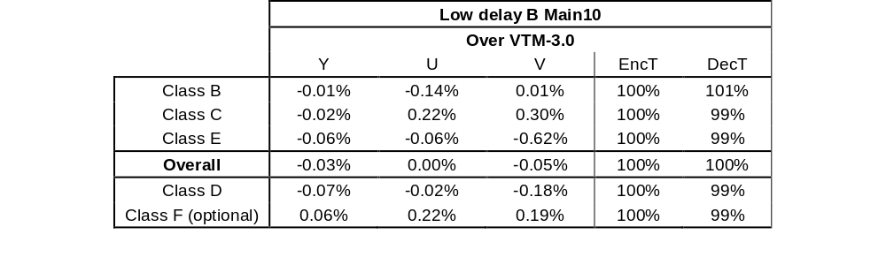
Simulation Results
  Results over VTM-3.0:
    Affine Merge uniformization

Slide 7
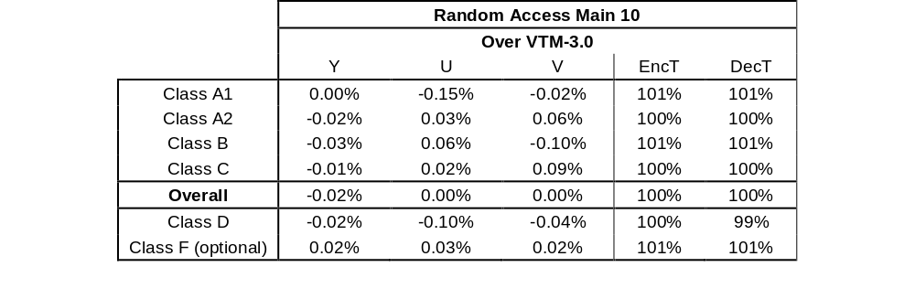
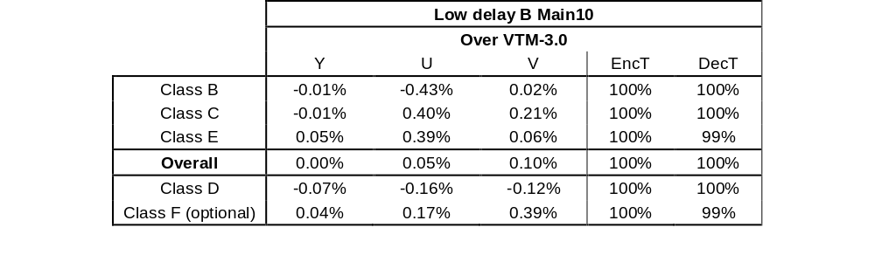
Simulation Results
  Results over VTM-3.0:
    Proposed Affine AMVP + Affine Merge

Slide 8

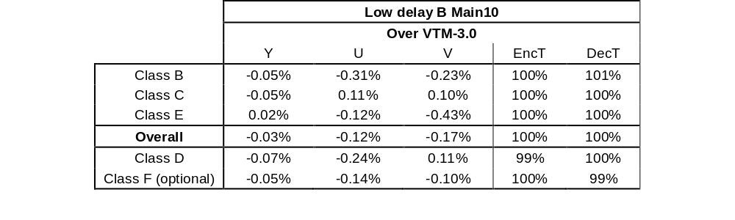
Simulation Results
  Results over VTM-3.0:
    Proposed Affine uniformization + CE4.1.5 (JVET-M0281)

