Slide 1
CE4: Modification on History-based Motion Vector Prediction
Yu Han, Wei-Jung Chien, Chun-Chi Chen, Han Huang, Chao-Hsiung Hung, Yan Zhang, Marta Karczewicz

Slide 2
Abstract
This contribution presents modifications on History-based Motion Vector Prediction (HMVP) mode:
    Remove redundancy check from HMVP table update;
    Set the size of HMVP table to 10, and pick one out of every 3 to add in the merge list;
    Partial pruning when adding HMVP in the merge list;
Pairwise candidates generation not using HMVP predictors.
    Remove the dependency between pairwise and HMVP.
Sub tests:
    CE4.1.2.a, first 3 HMVPs pruned by left and above spatial candidates and pairwise not using HMVP predictors, achieved 0.03% loss in RA case;
    CE4.1.2.b, first 2 HMVPs pruned by left and above spatial candidates and pairwise not using HMVP predictors, achieved 0.03% loss in RA case;

Slide 3
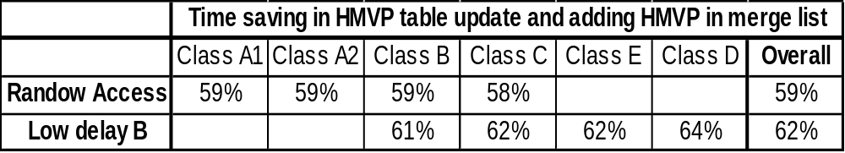
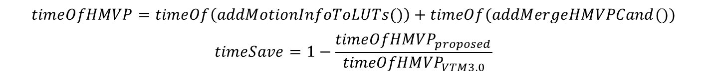
Technical description
Complexity analysis of HMVP mode is shown as below under CTC:
    The runtime saving for HMVP table update and adding HMVP to merge list is as below. In the decoder side, comparing with VTM3.0, sub test CE4.1.2.b achieved 59% time saving in RA case, achieved 62% time saving in LB case;
    Without redundancy check, the HMVP table can be easily implemented in circle buffer which is hardware friendly design
    Number of pruning reduction.
$$timeOfHMVP=timeOf\left(addMotionInfoToLUTs()\right)+timeOf(addMergeHMVPCand())$$
$$timeSave=1−\frac{{timeOfHMVP}_{proposed}}{{timeOfHMVP}_{VTM3.0}}$$
 | stage number | pruning number
VTM3.0 | 1+4=5 | 4+(4+3+2+1)=14
CE4.1.2.a | 3 | 2+2+2=6
CE4.1.2.b | 2 | 2+2=4

Slide 4
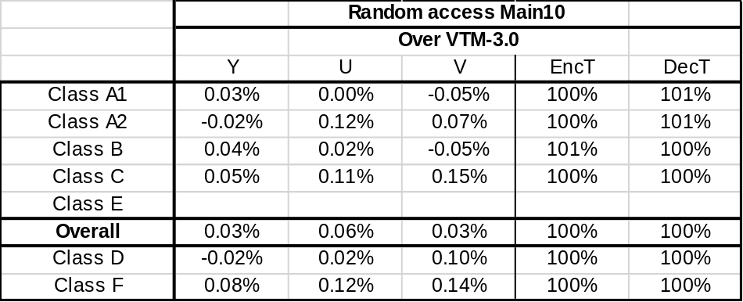
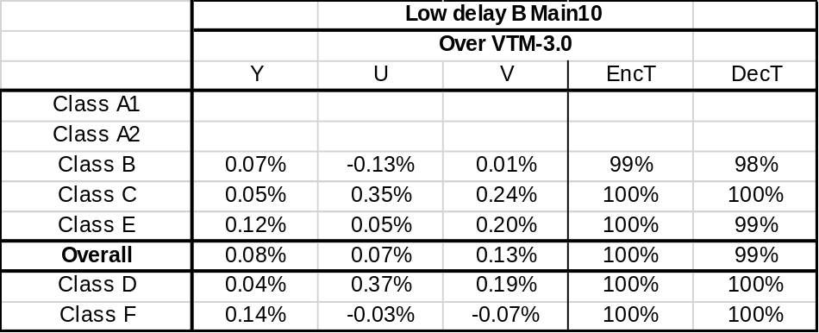
Simulation results
Merge list equal to 6. Thanks MediaTek for crosschecking.
CE4.1.2.a, first 3 HMVPs pruned by left and above spatial candidates and pairwise not using HMVP predictors

Slide 5

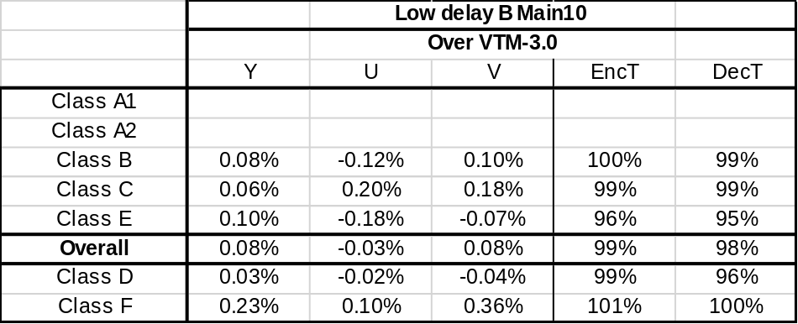
Simulation results
Merge list equal to 6. Thanks MediaTek for crosschecking.
CE4.1.2.b, first 2 HMVPs pruned by left and above spatial candidates and pairwise not using HMVP predictors

Slide 6
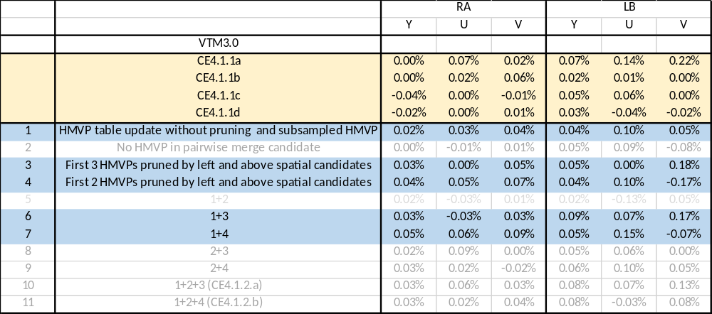
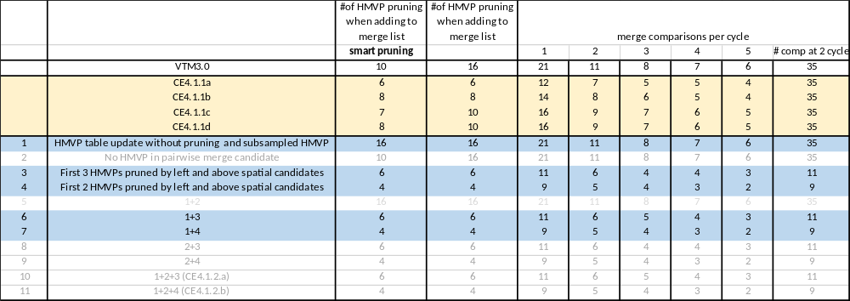
Supplement tests

