Slide 1
CE7-related: reduced local neighbourhood usage for transform coeffs coding
JVET-M0107
Jan. 2019
F. Le Léannec, Y. Chen

Slide 2
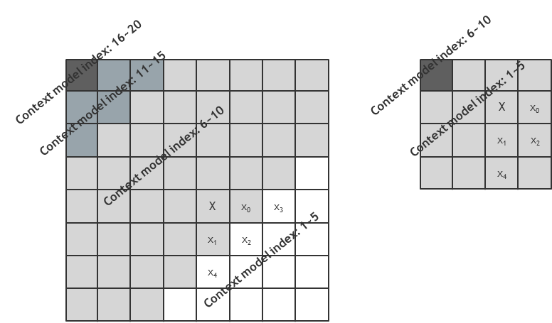
JVET-M0107: reduced local neighborhood usage for residual coding
  Context modelling in VTM-3.0
    significance flag (90 = 54 + 36 models): ctxIdSig = f( diag, sumAbs1, state )
    parity flag (32 = 21 + 11 models): ctxIdPar = f( diag, sumAbs1 − numSig)
      For chroma: ctxIdPar = 1 + min( sumAbs1 – numSig, 4 ) + ( diag == 0 ? 5 : 0 )
    greater1 flag (32 = 21 + 11 models): ctxIdGt1 = ctxIdPar
    greater2 flag (32 = 21 + 11 models): ctxIdGt2 = ctxIdPar

Slide 3
JVET-M0107: reduced local neighborhood usage for residual coding
  Proposed method 1:
    local neighborhood removed in second chroma TB region (x+y>0)
      ctxIdPar = 1 + diag == 0 ? ( 1 + min( sumAbs1 – numSig, 4 ) ) : 0
    single context to code the gt1_flag, par_flag and gt2_flag bins, for chroma coeffs with (x+y>0)
    3 contexts used, i.e. one for gt1, par and gt2 bins => -12 contexts over VTM-3.0.
Context model index: 16~20
Context model index: 2~6
X
x₀
x₃
Context model index: 11~15
x₁
x₂
x₄
Context model index: 1
Context model index: 6~10
X
x₀
x₃
x₁
x₂
Context model index: 1~5
x₄

Slide 4
JVET-M0107: reduced local neighborhood usage for residual coding
  Proposed method 2
    local neighborhood removed in both chroma TB regions (x+y>0 and x+y=0)
    single context used for bins gt1_flag, par_flag and gt2_flag, in each chroma TB region.
    -24 contexts over VTM-3.0.
x₀
Context model index: 2
Context model index: 16~20
X
X
Context model index: 11~15
x₁
Context model index: 1
Context model index: 6~10
X
x₀
x₃
x₁
x₂
Context model index: 1~5
x₄

Slide 5
JVET-M0107: reduced local neighborhood usage for residual coding
  Proposed method 3 (on top of method 2)
    In luma TB region (x+y=0): neighborhood for bins gt1, par and gt2 reduced to below and right coeffs
    Context offset (sumAbs1 − numSig) clipped between 0 and 1
    9 more suppressed contexts over method 2 ➔ 33 contexts removed overall
Context model index: 16~17
Context model index: 2
X
Context model index: 11~15
Context model index: 1
Context model index: 6~10
X
x₀
x₃
x₁
x₂
Context model index: 1~5
x₄

Slide 6
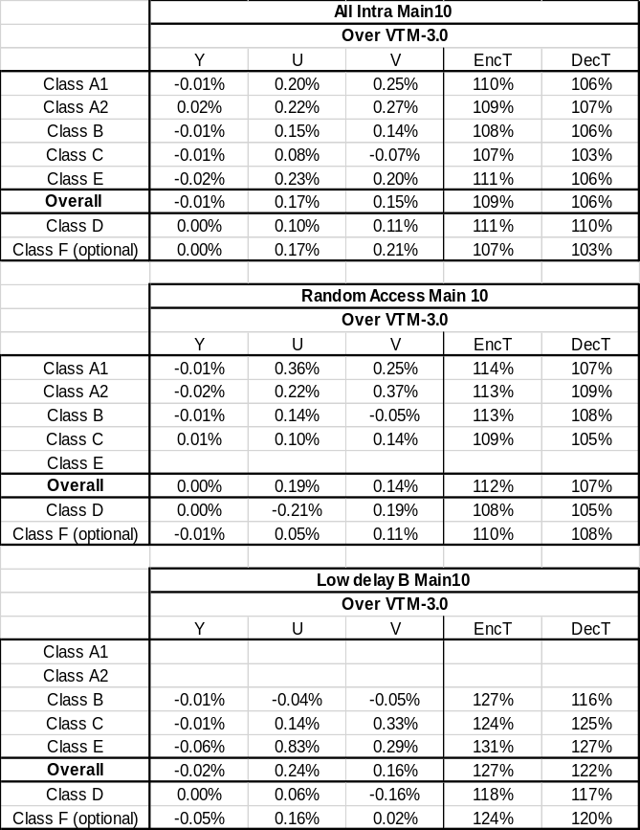
JVET-M0107: reduced local neighborhood usage for residual coding
  Method 1 result:

Slide 7
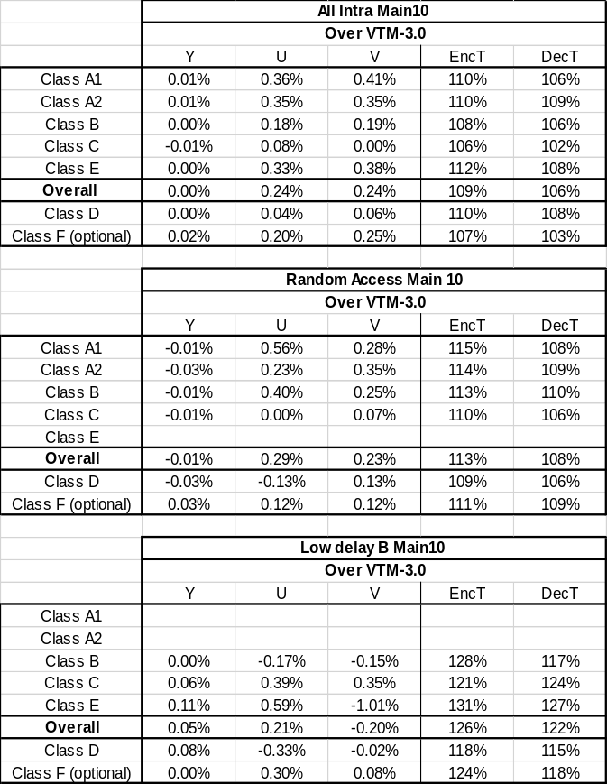
JVET-M0107: reduced local neighborhood usage for residual coding
  Method 2 result:

Slide 8
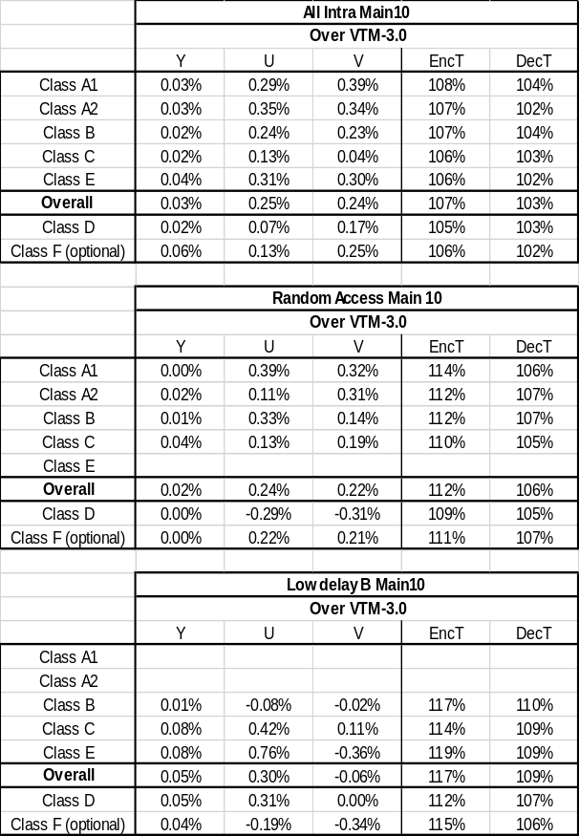
JVET-M0107: reduced local neighborhood usage for residual coding
  Method 3 result:

Slide 9
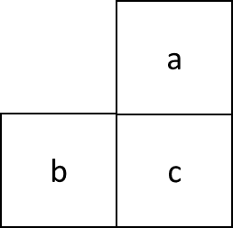
JVET-M0107: reduced local neighborhood usage for residual coding
  Methods 1, 2 and 3 can be combined with an improved entropy coding of pred_mode_flag (method 4)
  Method 4:
    In VTM-3.0, the CU-level pred_mode_flag syntax element uses a single context.
    Here, 2 additional contexts are introduced to code this bin:
      ctxId = (a available and intra?1:0)+(b available and intra?1:0)
      where a and b are the top and left neighboring CU of current CU

Slide 10
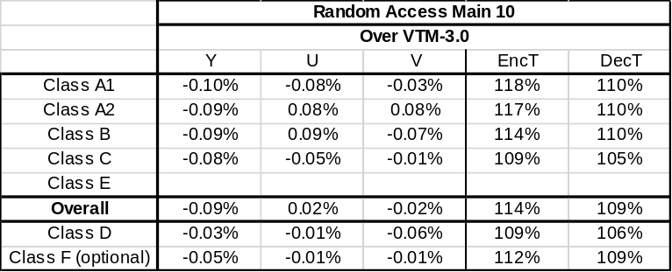
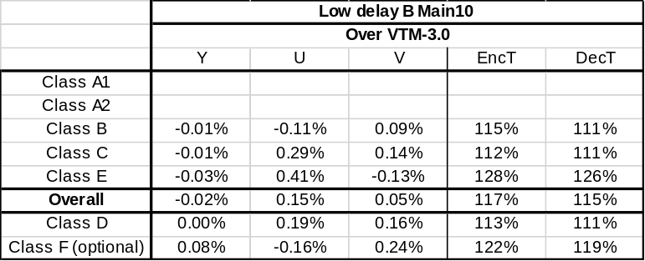
JVET-M0107: reduced local neighborhood usage for residual coding
  Methods 1, 2 and 3 can be combined with an improved entropy coding of pred_mode_flag (method 4)
  Method 4:
    In VTM-3.0, the CU-level pred_mode_flag syntax element uses a single context.
    Here, 2 additional contexts are introduced to code this bin:
      ctxId = (a available and intra?1:0)+(b available and intra?1:0)
      where a and b are the top and left neighboring CU of current CU

Slide 11
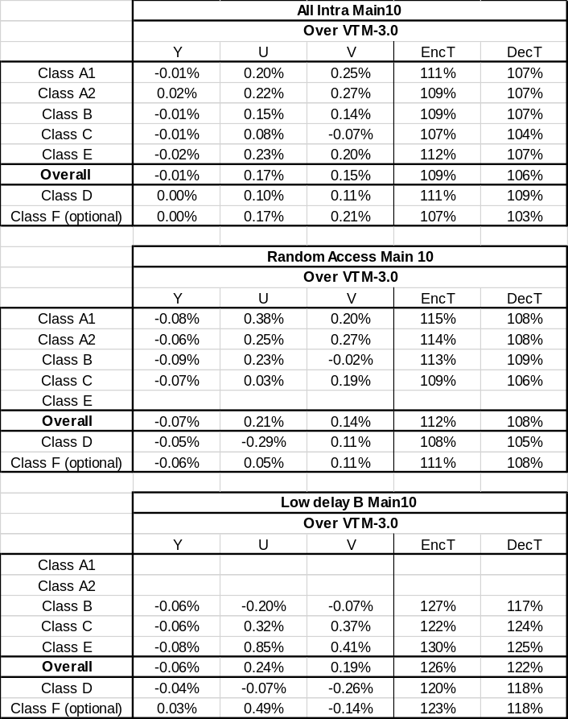
JVET-M0107: reduced local neighborhood usage for residual coding
  Method 1 + Method 4 result:

Slide 12
JVET-M0107: reduced local neighborhood usage for residual coding
  Method 1 + Method 4 result:

Slide 13
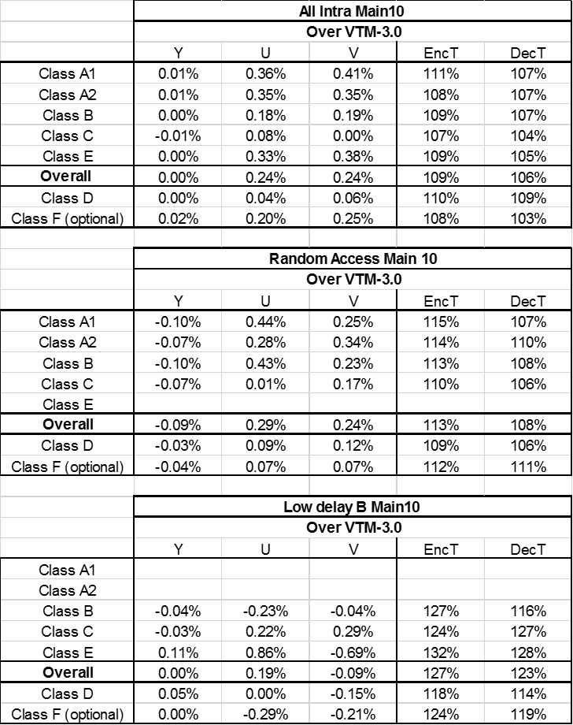
JVET-M0107: reduced local neighborhood usage for residual coding
  Method 2 + Method 4 result:

Slide 14
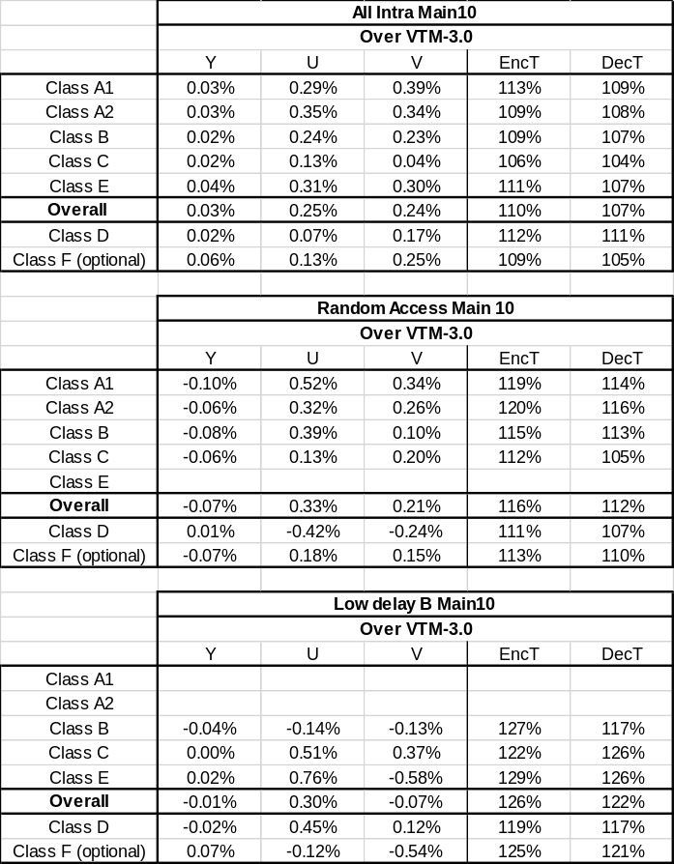
JVET-M0107: reduced local neighborhood usage for residual coding
  Method 3 + Method 4 result:

Slide 15
JVET-M0107: reduced local neighborhood usage for residual coding
  Conclusion
    Propose to reduce the complexity of the residual coding and the number of CABAC contexts in the same time
    Remove the neighborhood usage for gt1_flag, par_flag and gt2_flag, in some diagonal-based regions of chroma TBs (methods 1 and 2).
    Reduce the local neighborhood to 2 elements for the lowest frequency luma coeff, for the context modelling of gt1_flag, par_flag and gt2_flag (method 3)
    Combine with an improved coding of pred_mode_flag ➔ better trade-off between BD-rate and number of contexts
    We thank Tencent for cross-checking
Proposed method | Nb contexts/VTM-3.0 | RA (Y/Cb/Cr)
1 | -12 | 0.00%/0.19%/0.14%
2 | -24 | -0.01%/0.29%/0.23%
3 | -33 | 0.02% / 0.24% / 0.22%
1 + 4 | -10 | -0.07% / 0.21% / 0.14%
2 + 4 | -22 | -0.09% / 0.29% / 0.24%
3 + 4 | -31 | -0.07% / 0.33% / 0.21%

