Slide 1
(JVET-M0064)
Non-CE3:
CCLM table reduction and bit range control
Yukinobu Yasugi, Frank Bossen and Eiichi Sasaki
Sharp

Slide 2
Problem statement
VTM3.0 CCLM uses simplified min-max method. However two kind of complexity still exists in deviration.
  Size of division tables:
    g_aucLMDivTableLow[512]: Floor( 2³² / diff ) – Floor( 2¹⁶ / diff ) * 2¹⁶
    g_aucLMDivTableHigh[512]: Floor( 2¹⁶ / diff )
    Total table size >= 16896 bits
  Maximum bit width in multiplication:
    Gradient (a): 27 bits (internalBitDepth = 10 bits)
      Worst case: -1023 * 65536 = -67043328
      Note – ‘a’ is shifted by 1 bit to right after multiplication for 10-bit data
    Intercept (b): 36 bits
      Worst case: 1023 * (-67043328>>1) = -34292662272

Slide 3
Proposal1
Remove DivTableLow
  Table size: 512 * 16 = 8192 bits
  No impact on performance

Slide 4
Proposal2
Replace DivTableHigh (65536/diff) with significand table
  Exponents (exp) are easily derived from diff values
  Use only 4 most significant digits
    3bits per entry since MSB is always equal to 1
    Table size: 512 * 3 = 1536 bits
  No impact on performance
4-bit significand
65536 / diff = 0b ＊ 2^{exp}
1
?
?
?
MSB

Slide 5
Proposal3 (related to Proposal2)
Use part of significand table instead of full table
  We found significands of inverted numbers can be derived from other part of the table
    it has kind of repeating structure; 1/(2*diff) = 1/diff * 1/2
  Use only 16 entries of significand table
    Table size: 16 * 3 = 48 bits
  No impact on performance
{ 0, 7, 6, 5, 5, 4, 4, 3, 3, 2, 2, 1, 1, 1, 1, 0 }

Slide 6
Other benefit of Proposal3
Using only significand also reduces multiplication complexity
  a = DivTable * (maxC - minC) >> shift
  a = significand * (maxC - minC) >> shift
max. 17 bits
(65536)
11 bits
4 bits
11 bits

Slide 7
Proposal4
‘a’ will be represented with smaller 5-bit significand and exponent as a consequences of Proposal2
  a = a_{s} << k
Small significand reduces multiply complexity
We use diff and diffC to derive exponent k
5-bit significand
  PredC[][] = (a * Y[][] ) >> 16
b = minC – ( ( a * minY ) >> 16 )
27 bits
10 bits
27 bits
10 bits
  PredC[][] = (a_{s} * Y[][]) >> k
b = minC – ( ( as * minY ) >> k )
5 bits
10 bits
5 bits
10 bits

Slide 8
Proposal5
Restriction of the range of ‘a’ and ‘b’
  Gradient a is represented by 5-bit significand and exponent k
  b = minC – ( ( a_{s} * minY ) >> k )
    Negative k means a left shift, it makes the range of b too large.
  k is restricted to be greater than 0
    Gradient a is restricted to [ -15/2 .. 15/2 ]
    ( ( a * minY ) >> k ) does not exceeds 15 bits.
    Intercept b and predSamplesC are also restricted
    to 15 bits.
  No impact on performance
C
a
Y
b

Slide 9
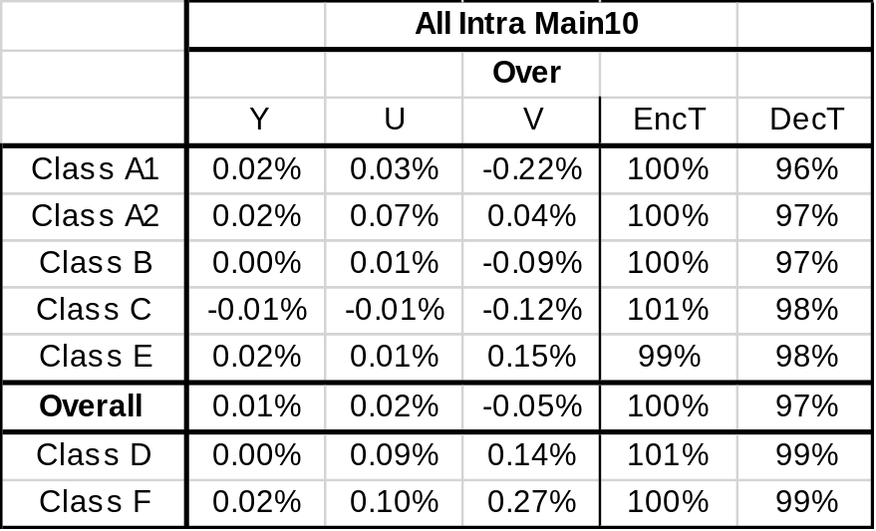
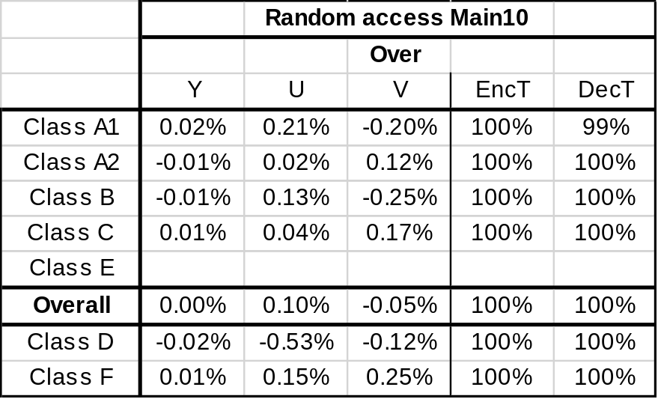
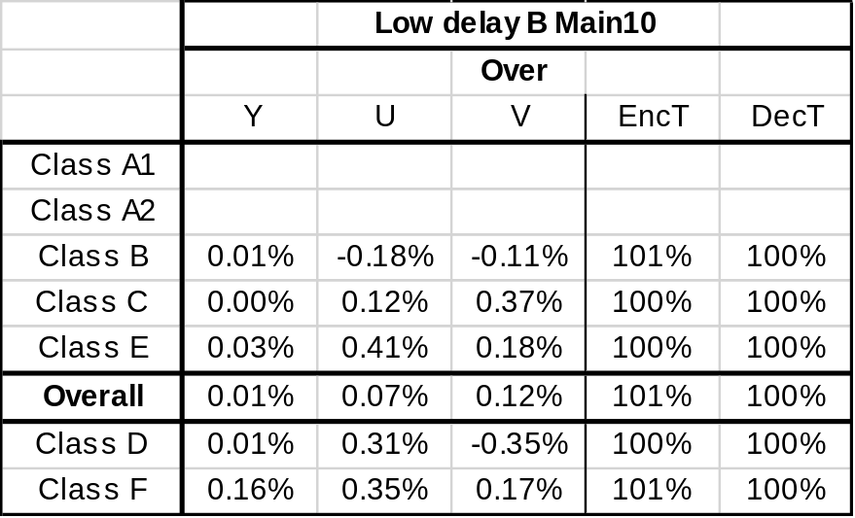
Experimental results
No impact on BD-rate performance and processing time.
Thank MediaTek for cross-checking

Slide 10
Conclusion
A method is proposed to reduce the table size and bit width of multiplication for LM Chroma.
  3 bit * 16 element = 48 bits
  { 0, 7, 6, 5, 5, 4, 4, 3, 3, 2, 2, 1, 1, 1, 1, 0 }
  Maximum bit width of multiplication = 5 bits * 10 bits
The proposed method has no impact on BD-rate performance and processing time
We recommend to include the proposed method to the next version of WD and VTM.

Slide 11
Proposed working draft (1)
This is just a fix
The variables a, b, and k are derived as follows:
    If numSampL is greater thanequal to 0, and numSampT is greater thanequal to 0, the following applies:
k = 0 (8‑150)
a = 0 (8‑151)
b = 1 << ( BitDepth_{C} − 1) (8‑152)
    Otherwise, the following applies:
if ( diff == 0 ) {
a = 0
b = minC
} else {

Slide 12
Proposed working draft (2)
Derivation part
diff = maxY − minY, diffC = maxC − minC
x = Floor( Log2( diff ) )
normDiff = (diff << 4 >> x ) & 15
x += ( normDiff != 0 ) ? 1 : 0
y = Floor( Log2( Abs( diffC ) ) ) + 1
a = ( diffC * (DivSigTable[ normDiff ] | 8 ) + 2^{y-1} ) >> y
k = 3 + x - y
if ( k < 1 ) {
k = 1
a = Sign(a) * 15
}
b = minC - ( ( a * minY ) >> k )
The array DivSigTable [ ] is specified as follows:
DivSigTable [ ] = { 0, 7, 6, 5, 5, 4, 4, 3, 3, 2, 2, 1, 1, 1, 1, 0 } (8-xxx)
16 entry significand( Proposal 3)
normDIff = 0..15
4-bit significand ( Proposal 2)
DivSigTable | 8 is 4 bits
k is derived from diff (i.e. x) and diffC (i.e. y) (Proposal 4)
k is restricted to be greater than 0
( Proposal 5)
48bit table( Proposal 2, 3)

Slide 13
Proposed working draft (3)
Prediction part
The prediction samples predSamples[ x ][ y ] with x = 0..nTbW − 1, y = 0.. nTbH − 1 are derived as follows:
predSamples[ x ][ y ] = Clip1C( ( ( pDsY[ x ][ y ] * a ) >> k ) + b ) (8‑161)
5-bit significand

Slide 15
Proposal (example)
diff = maxY – minY = 9
normDiff = (9 << 4 >> x) &15 = 18 &15 = 2 x = Floor(Log2(diff)) = 3
normalized Diff (4 bits)
table[2]
    table[normDiff] = { 0, 7, 6, 5, 5, 4, 4, 3, 3, 2, 2, 1, 1, 1, 1, 0 }
4-bit significands of 1/normDiff
without MSB
+8 (MSB)
a = (diffC * 14 + round) >> shift, shift: bit width of Abs(diffC)
11 bits * 4 bits
b = minC – (( a * minY ) >> k ), k: exponent of a
(with restriction k>=1
to reduce the range of b)
5 bits * 10 bits

