Slide 1
JVET-L0591
CE9-related: A simplified design of bi-directional optical flow (BIO)
Xiaoyu Xiu, Yuwen He, Yan Ye
InterDigital Communications, Inc.
Chen-Yen Lai, Yu-Chi Su, Tzu-Der Chunag, Ching-Yeh Chen, Yu-Wen Huang, Shaw-Min Lei
October, 2018

Slide 2
Introduction
The BIO design in the BMS-2.1
  Enhancing both the granularity and the accuracy of the motion vectors (MVs) at motion compensation (MC)
Complexity issues of the current BIO:
  The implementation requires large multiplier and high bit-widths for intermediate parameters
  The interpolation of extended samples significantly increase the worst-case complexity, e.g., multiplications and additions
  Proposal
  BIO bit-width control (JVET-L0256): 15-bit multiplier and intermediate value are within 32-bit
  Three BIO complexity reduction methods: making the BIO worst-case complexity at the same level as that of regular bi-prediction
  Disable the BIO for the Wx4 CUs, 4x8 CUs and sub-block modes (affine, ATMVP)

Slide 3
BIO bit-width analysis
The extreme bit-width
  It happens at the calculation of the vertical motion refinement
$$v_{y}=clip3\left(−{th}_{BIO},{th}_{BIO},−\left(\left(S_{6}−v_{x}S_{2}\right)≫\left\lfloor \log_{2}\left(S_{5}+r\right)\right\rfloor \right)\right)$$
42-bit
9-bit
33-bit
  The BMS2.1 BIO needs 33-bit multiplier and maximal bit-width of 43-bit for intermediates

Slide 4
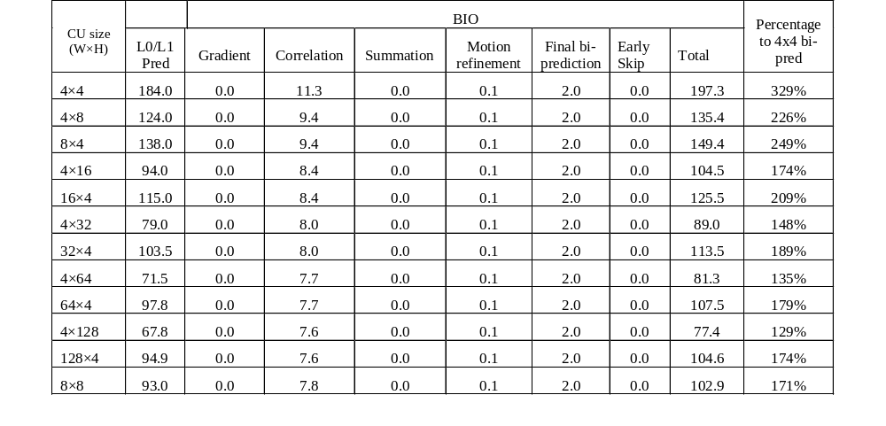
BIO complexity analysis
The BIO worst-case complexity
  The peak complexity increase comes from 4x4 bi-pred
  The number of multiplication is 353% of that of 4x4 bi-prediction.

Slide 5
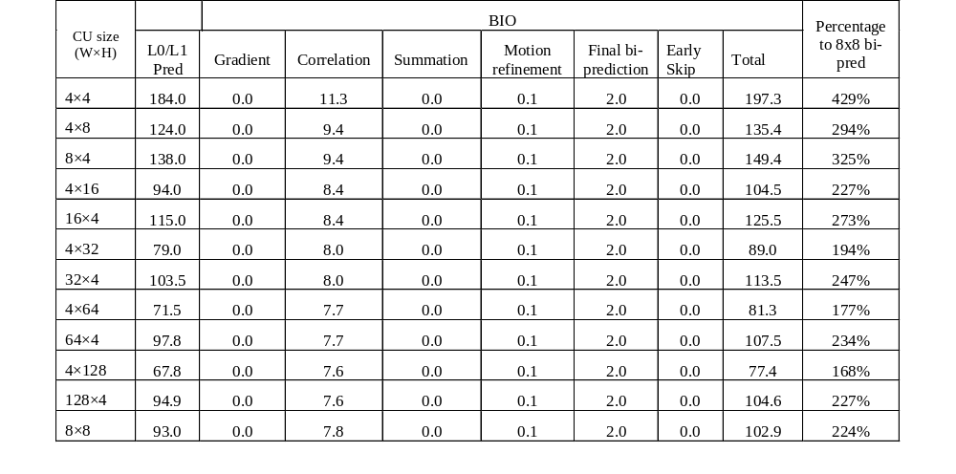
BIO complexity analysis
The BIO worst-case complexity
  The peak complexity increase come from 4x4 bi-pred
  The number of multiplication is 429% of that of 8x8 bi-prediction.

Slide 6
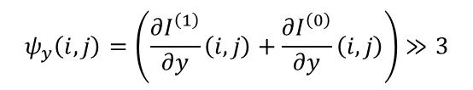
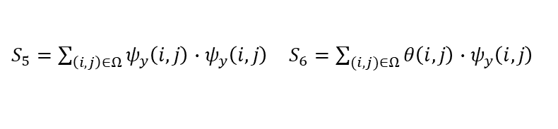
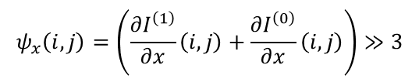
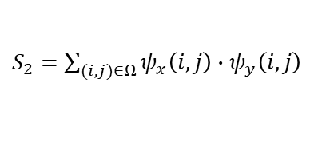
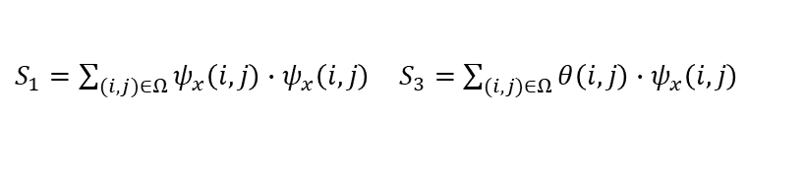

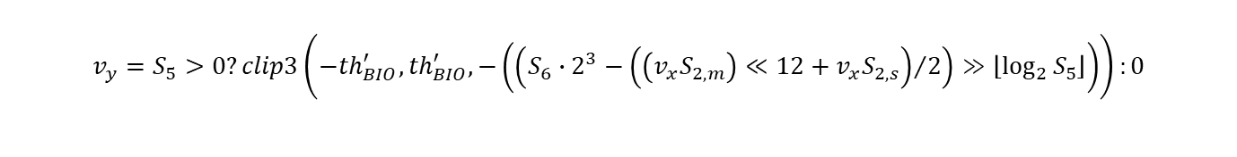
Bit-width control in JVET-L0256
Introduce additional right shifts to some BIO parameters for reducing overall internal bit-width
$$ψ_{x}\left(i,j\right)=\left(\frac{∂I^{\left(1\right)}}{∂x}\left(i, j\right)+\frac{∂I^{\left(0\right)}}{∂x}\left(i, j\right)\right)≫3$$
$$ψ_{y}\left(i,j\right)=\left(\frac{∂I^{\left(1\right)}}{∂y}\left(i, j\right)+\frac{∂I^{\left(0\right)}}{∂y}\left(i, j\right)\right)≫3$$
$$θ\left(i,j\right)=\left(I^{\left(1\right)}\left(i, j\right)≫6\right)−\left(I^{\left(0\right)}\left(i, j\right)≫6\right)$$
Remove internal bit-width increase in the original BIO in BMS-2.1
$S_{1}=\sum_{(i,j)∈Ω}{ψ_{x}\left(i,j\right)}∙ψ_{x}\left(i,j\right)$ $S_{3}=\sum_{(i,j)∈Ω}{θ\left(i,j\right)}∙ψ_{x}\left(i,j\right)$
$S_{2}=$ $\sum_{(i,j)∈Ω}{ψ_{x}\left(i,j\right)∙ψ_{y}\left(i,j\right)}$
$S_{5}=\sum_{\left(i,j\right)∈Ω}{ψ_{y}\left(i,j\right)}∙ψ_{y}\left(i,j\right)$ $S_{6}=\sum_{(i,j)∈Ω}{θ\left(i,j\right)}∙ψ_{y}\left(i,j\right)$
Modify the derivation of the motion refinement
$$v_{x}=S_{1}>0?clip3\left(−{th}_{BIO}^{′},{th}_{BIO}^{′},−\left(\left(S_{3}∙2^{3}\right)≫\left\lfloor \log_{2}{S_{1}}\right\rfloor \right)\right):0$$
$$v_{y}=S_{5}>0?clip3\left(−{th}_{BIO}^{′},{th}_{BIO}^{′},−\left(\left(S_{6}∙2^{3}−{\left(\left(v_{x}S_{2,m}\right)≪12+v_{x}S_{2,s}\right)}/2\right)≫\left\lfloor \log_{2}{S_{5}}\right\rfloor \right)\right):0$$

Slide 7

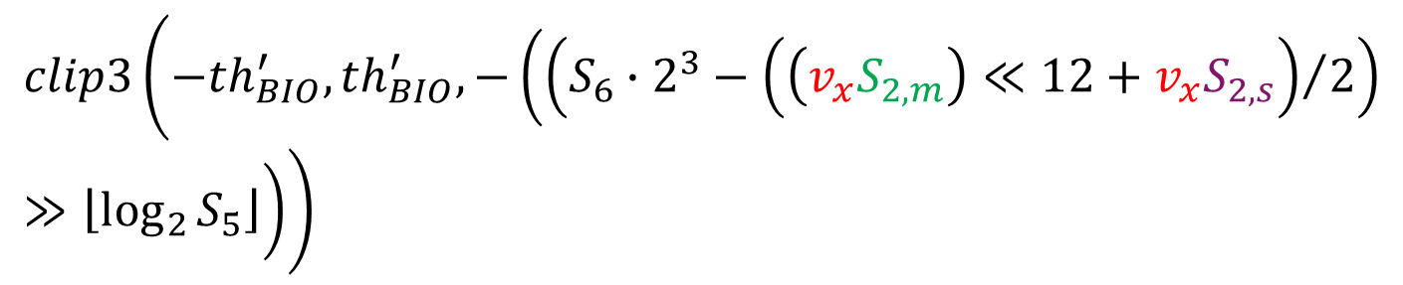
Bit-width control in JVET-L0256
The extreme bit-width
  It happens at the calculation of the vertical motion refinement
$$v_{y}=$$
$$clip3\left(−{th}_{BIO}^{′},{th}_{BIO}^{′},−\left(\left(S_{6}∙2^{3}−{\left(\left(v_{x}S_{2,m}\right)≪12+v_{x}S_{2,s}\right)}/2\right)≫\left\lfloor \log_{2}{S_{5}}\right\rfloor \right)\right)$$
4-bit
15-bit
4-bit
12-bit
  15-bit multiplier is guaranteed
  The internal bit-width of the whole BIO process does not exceed 32-bit

Slide 8
Complexity reduction options in the proposal
 | Number of extended samples | How to generate extended samples? | Gradient padding | Modified gradient calculation
Option 1 | 1 | 8-tap | Yes | No
Option 2 | 1 | Integer reference sample | Yes | No
Option 3 | 0 | N/A | Yes | The gradients of CU boundary samples are modified

Slide 9
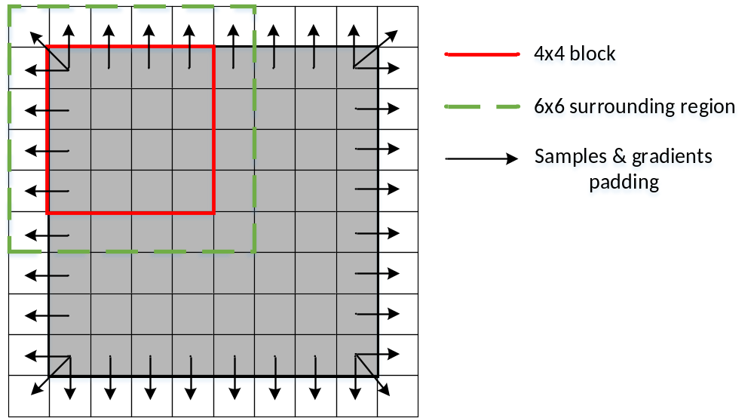
BIO complexity reduction (Option #1)
Reduce the number of extended samples from two rows/columns in BMS2.1 to one single row/column on each CU boundary
The same 8-tap filters are used for generating the samples inside the CU and in extended region
  Pad the sample values and gradients of CU boundary positions to extended positions
  Disable the BIO for the Wx4 CUs, 4x8 CUs and sub-block modes (affine, ATMVP)

Slide 10
BIO complexity reduction (Option #2)
Reduce the number of extended samples to one single row/column on each CU boundary
Use integer reference samples (w/o interpolation) as extended samples
  Pad the sample values and gradients of CU boundary positions to extended positions
  Disable the BIO for the Wx4 CUs, 4x8 CUs and sub-block modes (affine, ATMVP)
Integer reference samples
8-tap filter

Slide 11
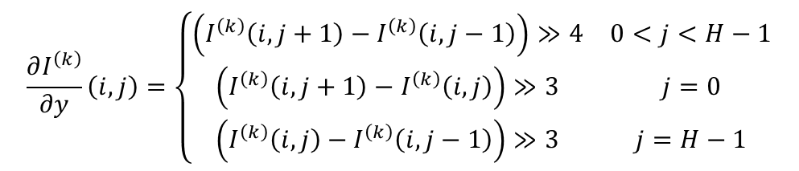
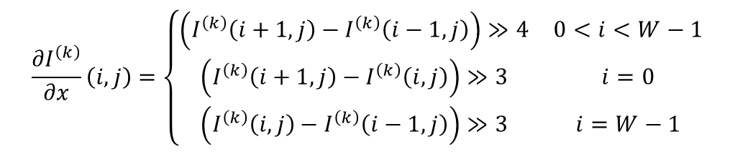
BIO complexity reduction (Option #3)
Only use the samples inside the CU area for the BIO derivation
Modified gradient calculation method for sample positions on CU boundaries
  Pad the sample values and gradients of CU boundary positions to extended positions
$$\frac{∂I^{\left(k\right)}}{∂x}\left(i, j\right)=\left\{\begin{matrix}\left(I^{\left(k\right)}\left(i+1, j\right)−I^{\left(k\right)}\left(i−1, j\right)\right)≫4 & 0<i<W−1 \\ \left(I^{\left(k\right)}\left(i+1, j\right)−I^{\left(k\right)}\left(i, j\right)\right)≫3 & i=0 \\ \left(I^{\left(k\right)}\left(i, j\right)−I^{\left(k\right)}\left(i−1, j\right)\right)≫3 & i=W−1\end{matrix}\right.$$
$$\frac{∂I^{\left(k\right)}}{∂y}\left(i, j\right)=\left\{\begin{matrix}\left(I^{\left(k\right)}\left(i, j+1\right)−I^{\left(k\right)}\left(i, j−1\right)\right)≫4 & 0<j<H−1 \\ \left(I^{\left(k\right)}\left(i, j+1\right)−I^{\left(k\right)}\left(i, j\right)\right)≫3 & j=0 \\ \left(I^{\left(k\right)}\left(i, j\right)−I^{\left(k\right)}\left(i, j−1\right)\right)≫3 & j=H−1\end{matrix}\right.$$

Slide 12
Summary complexity analysis
 | Worst case block size | Is worst case block size with BIO? | % of 4x4 bi-pred in terms of multi | % of 8x8 bi-pred in terms of multi
Option 1 | 8x8 | Yes | 129% | 168%
Option 2 | Wx4 | No | 100% | 130%
Option 3 | Wx4 | No | 100% | 130%

Slide 13
Simulation results
Anchor: BMS-2.1 with VTM configuration
Test | Y | U | V | Enc | Dec
BMS-2.1 BIO | -1.41% | -0.58% | -0.40% | 103% | 119%
Method #1 | -1.29% | -0.53% | -0.35% | 102% | 105%
Method #2 | -1.24% | -0.48% | -0.37% | 101% | 102%
Method #3 | -1.17% | -0.47% | -0.32% | 101% | 103%
13
© 2018 InterDigital, Inc. All Rights Reserved.

Slide 14
Backup slides
14
© 2018 InterDigital, Inc. All Rights Reserved.

Slide 15
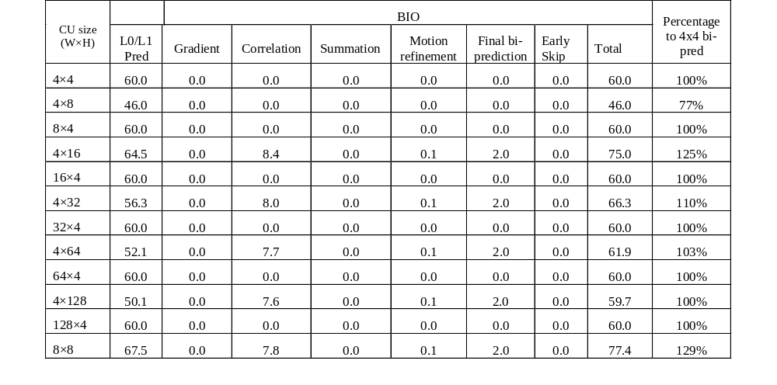
Complexity analysis of Option #1
  The peak complexity increase comes from 8x8 bi-pred
  The number of multiplication is 129% of that of 4x4 bi-prediction.

Slide 16

Complexity analysis of Option #1
  The peak complexity increase comes from 8x8 bi-pred
  The number of multiplication is 168% of that of 8x8 bi-prediction.

Slide 17

Complexity analysis of Option #2
  The peak complexity increase comes from bi-pred of Wx4 CUs
  The number of multiplication is 100% of that of 4x4 bi-prediction

Slide 18
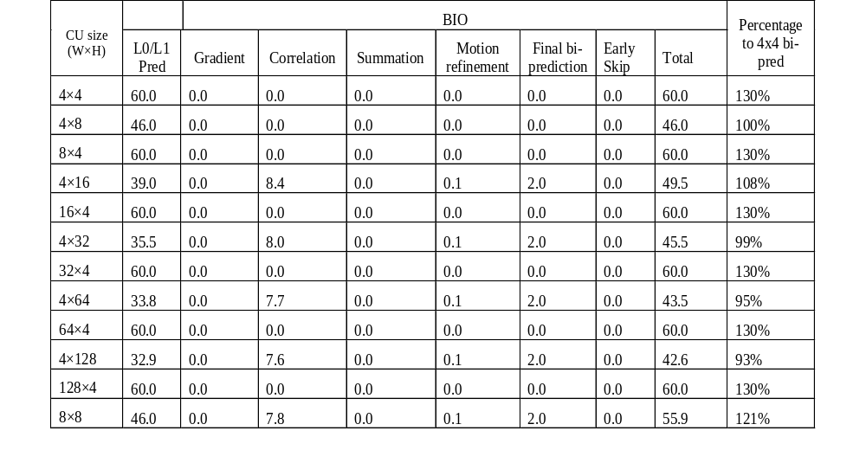
Complexity analysis of Option #2
  The peak complexity increase comes from bi-pred of Wx4 CUs
  The number of multiplication is 130% of that of 8x8 bi-prediction

Slide 19
Complexity analysis of Optiom #3
  The peak complexity increase comes from bi-pred of Wx4 CUs
  The number of multiplication is 100% of that of 4x4 bi-prediction

Slide 20
Complexity analysis of Option #3
  The peak complexity increase comes from bi-pred of Wx4 CUs
  The number of multiplication is 130% of that of 8x8 bi-prediction

