Slide 1
CE15-related: Palette predictor list enhancement
(JVET-L0451)
J. Ye, X. Li, X. Xu, and S. Liu
2018/10

Slide 2
Introduction
In CE15.2 [1], the HEVC palette predictor list is used when encoding the palette table entry.
  The palette predictor list stores the previously coded palette entries as predictor to the current block palette.
  This list is updated after each palette mode CU.
  The latest palette is inserted at the beginning and the entries from the farthest CUs in scan order are discarded if the list size exceeds the maximum palette predictor size.

Slide 3
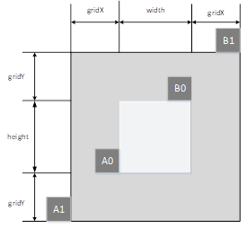
Proposed method (1)
Derive the spatial palette predictor
  Adjacent neighboring and non-adjacent
  neighboring are both checked.
  The non-adjacent candidates are in a
  virtual box surrounding the current block as the Fig on right
    gridX = width gridY = height
  2 rounds search, search order is A0->B0->A1->B1
  If the neighboring block is palette mode, the palette table entries are inserted into the spatial palette predictor if it is not the same as existing entries.
Combine the spatial palette predictor and the SCC palette predictor

Slide 4
Proposed method (2)
Combine the spatial palette predictor and the SCC palette predictor
  spatial palette predictor (front, dark blue)+ SCC palette predictor(back, light blue)
  New predictor list
  The new predictor list size cannot exceed the maximum palette predictor size
  When inserting the SCC palette predictor entries, will do the pruning (no duplicate entries).

Slide 5
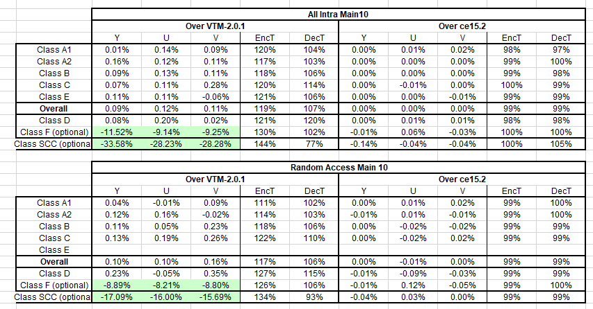
Performance
Anchor 1: VTM 2.0.1, anchor 2: CE15.2

Slide 6
Conclusion
It is proposed to combine the spatial palette predictor with HEVC SCC palette predictor.
It reports -0.14%,-0.04%, and -0.04% luma and chroma BD rate changing for AI configuration on class SCC over CE 15.2.
It is recommended to further study this contribution in CE.
Thanks Alibaba for crosschecking!

Slide 7
Thank you!

