Slide 1
JVET-L0342: CE3-related: Classification-based mean value for CCLM coefficients derivation
X. Ma, F. Mu, H. Yang, J. Chen
Huawei Technologies Co., Ltd

Slide 2
Main points
Linear model coefficients derived based on classification-based mean value
  Luma template samples are classified into two classes, based on the mean value of them.
  Get two luma mean values of the two luma classes, and two chroma mean values.
  Get the model coefficients.

Slide 3
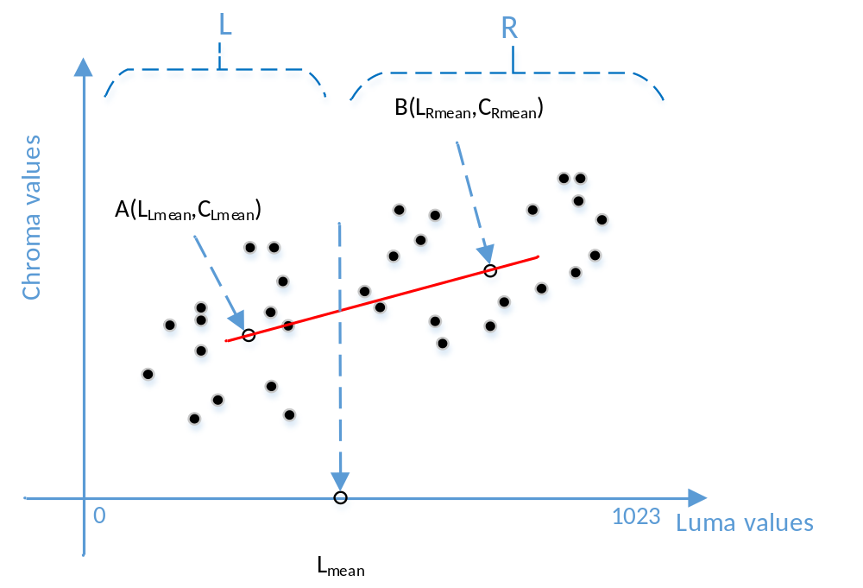

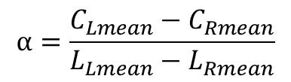
Proposed method
Steps:
  Get two classes
  Get two luma mean value;
  Get two chroma mean value.
$$α=\frac{C_{Lmean}−C_{Rmean}}{L_{Lmean}−L_{Rmean}}$$
$$β=C_{Lmean}−α∗L_{Lmean}$$

Slide 4
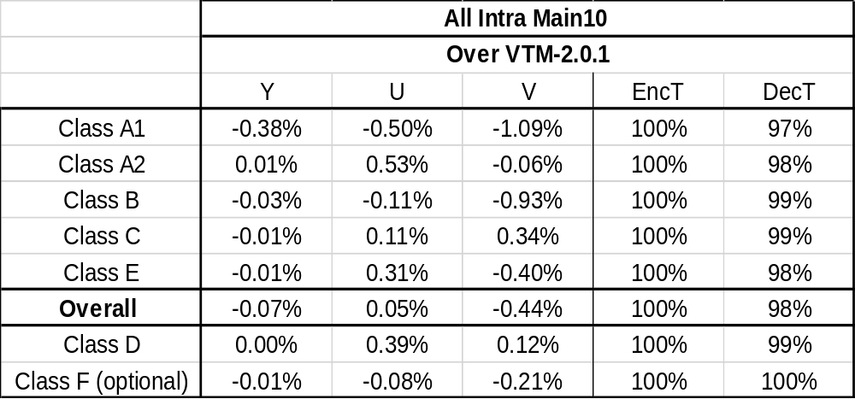
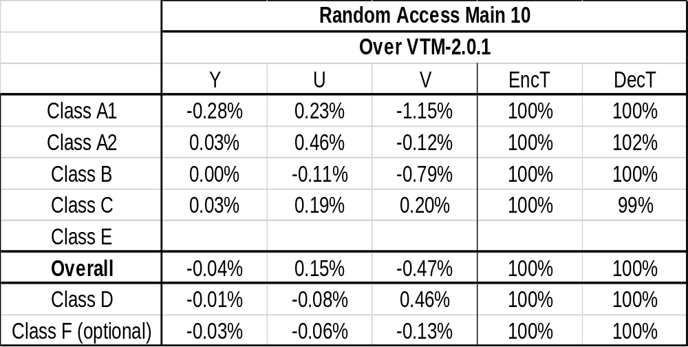
Experimental results (1/3)
 |  | Random Access Main 10
 |  | Over VTM-2.0.1
 |  | Y | U | V | EncT | DecT
Class A | Tango2 | -0.15% | 0.68% | -1.51% | 100% | 100%
 | FoodMarket4 | 0.00% | 0.49% | -0.84% | 100% | 100%
 | Campfire | -0.69% | -0.49% | -1.11% | 100% | 101%
 | CatRobot1 | 0.00% | -0.20% | -0.72% | 100% | 101%
 | DaylightRoad2 | 0.03% | 1.56% | 0.36% | 100% | 102%
 | ParkRunning3 | 0.05% | 0.03% | 0.01% | 101% | 102%
Class B | MarketPlace | 0.00% | -0.38% | -3.85% | 100% | 100%
 | RitualDance | 0.05% | 0.24% | -2.16% | 100% | 100%
 | Cactus | 0.02% | 0.64% | 0.37% | 100% | 101%
 | BasketballDrive | -0.01% | -0.35% | 0.57% | 100% | 100%
 | BQTerrace | -0.07% | -0.72% | 1.12% | 100% | 101%
Anchor: VTM2.0.1
  AI: -0.07%, 0.05%, -0.44%.
  RA: -0.04%, 0.15%, -0.47%
    Campfire: -0.69%, -0.49%, -1.11%
    Tango2: -0.15%, 0.68%, -1.51%

Slide 5
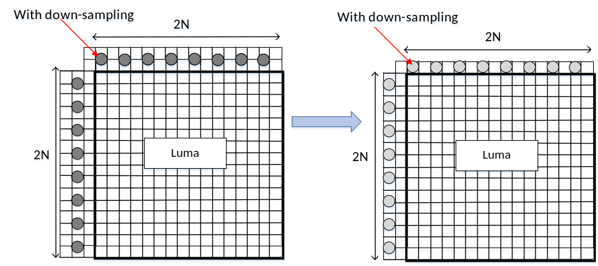
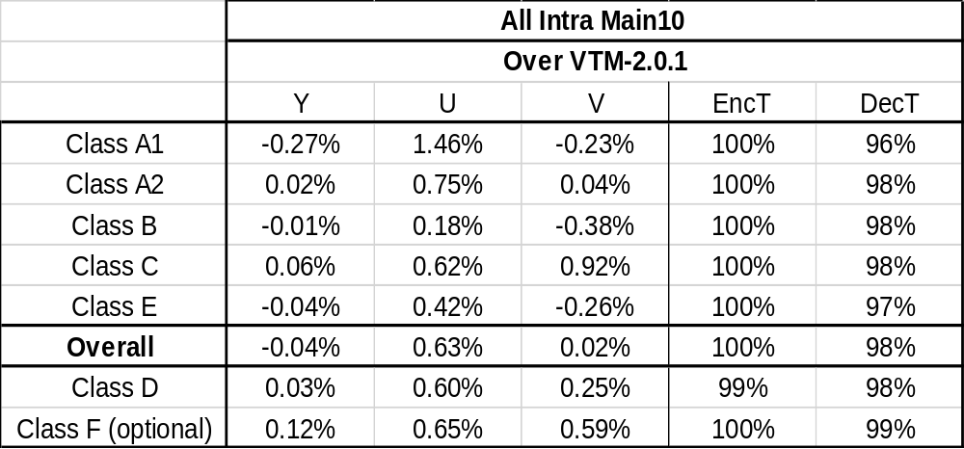
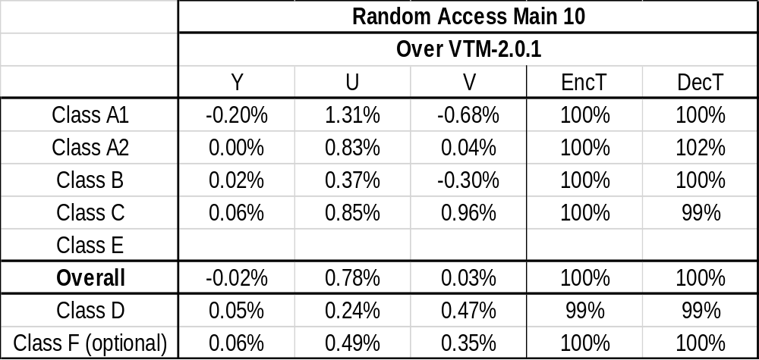
Experimental results (2/3)
Template luma samples
  6-taps->2taps(left),3-taps(top)
  1 top line(the first), 1 left column(the second)
Anchor: VTM2.0.1
  AI: -0.04%, 0.63%, 0.02%.
  RA: -0.02%, 0.78%, 0.03%

Slide 6
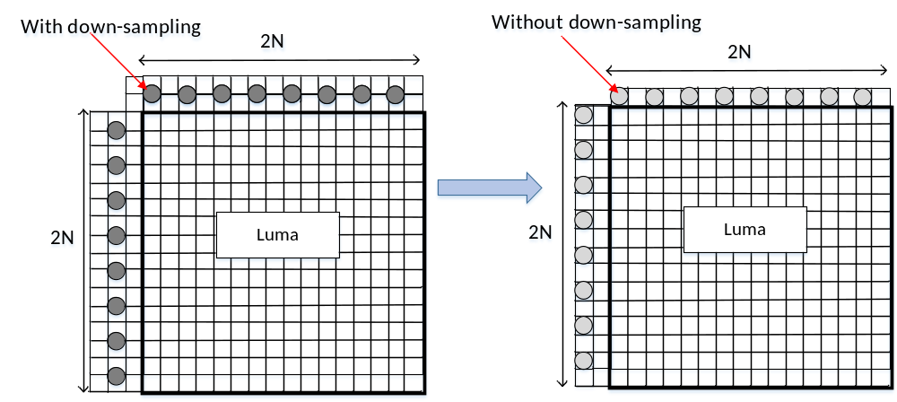
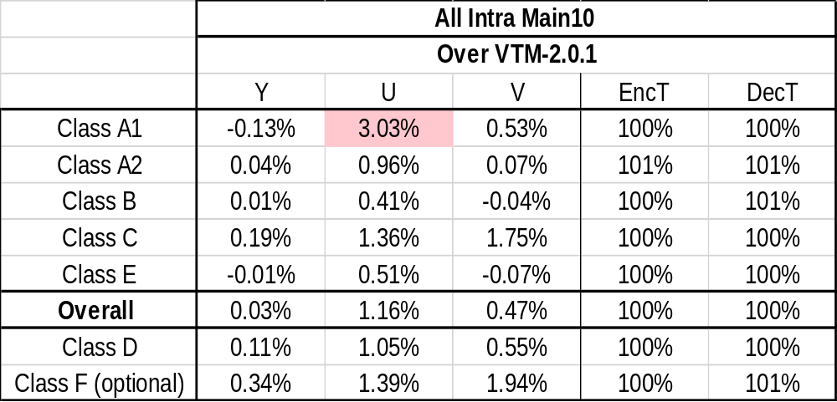

Experimental results (3/3)
Template luma samples
  No down-sampling filtering.
  1 top line(the first), 1 left column(the second)
Anchor: VTM2.0.1
  AI: 0.03%, 1.16%, 0.47%.
  RA: 0.03%, 1.23%, 0.47%

Slide 7
Summary
Thank Bytedance for cross-checking
 | AI |  |  | RA
 | Y | U | V | Y | U | V
Mean Based | -0.07% | 0.05% | -0.44% | -0.04% | 0.15% | -0.47%
Mean Based (1 line,1 Column) | -0.04% | 0.63% | 0.02% | -0.02% | 0.78% | 0.03%
Mean Based (1 line,1 Column, no down-sampling) | 0.03% | 1.16% | 0.47% | 0.03% | 1.23% | 0.47%

