Slide 1
CE3-related : Simplified MDMS
(JVET-L0139)
Jangwon Choi (jangwon84.choi@lge.com)

Slide 2
Summary
Propose simplified MDMS (multiple DM signaling)
  Chroma intra candidate modes (five or three) are derived from the two DM point only
  Only one context model is used in the binarization of chroma intra modes
Experimental results
Crosscheck : TEST1 - KDDI(JVET-L0594)
TEST2 - Huawei
 | All Intra Main10
 | Over VTM-2.0.1
 | Y | U | V | EncT | DecT
Class A1 | -0.07% | -0.61% | -0.66% | 99% | 99%
Class A2 | -0.09% | -0.86% | -0.82% | 100% | 99%
Class B | -0.07% | -0.92% | -1.04% | 99% | 99%
Class C | -0.07% | -0.98% | -0.89% | 99% | 99%
Class E | -0.18% | -1.52% | -1.63% | 99% | 99%
Overall | -0.09% | -0.97% | -1.00% | 99% | 99%
Class D | -0.06% | -0.53% | -0.95% | 99% | 95%
 | All Intra Main10
 | Over VTM-2.0.1
 | Y | U | V | EncT | DecT
Class A1 | -0.06% | -0.11% | -0.35% | 97% | 98%
Class A2 | -0.07% | -0.27% | -0.34% | 96% | 98%
Class B | -0.07% | -0.41% | -0.43% | 98% | 98%
Class C | -0.08% | -0.29% | -0.06% | 97% | 101%
Class E | -0.16% | -0.77% | -0.68% | 98% | 98%
Overall | -0.09% | -0.37% | -0.36% | 97% | 99%
Class D | -0.08% | 0.05% | -0.26% | 96% | 94%
five chroma candidate mode
three chroma candidate mode

Slide 3
Introduction
The MDMS (multiple DM modes signaling) method was proposed in JVET-D0111
  10 point search and 40 pruning check in the worst case
  Unary binarization with 5 context models
Require simplification for the hardware implementation
 | VTM2 | MDMS
Number of pruning (or condition) check | 4 | 40
Number of luma DM point access | 1 | 5
Number of chroma neighbor spatial access | 0 | 5
Number of context models | 1 | 5
Complexity analysis of VTM2 and MDMS

Slide 4
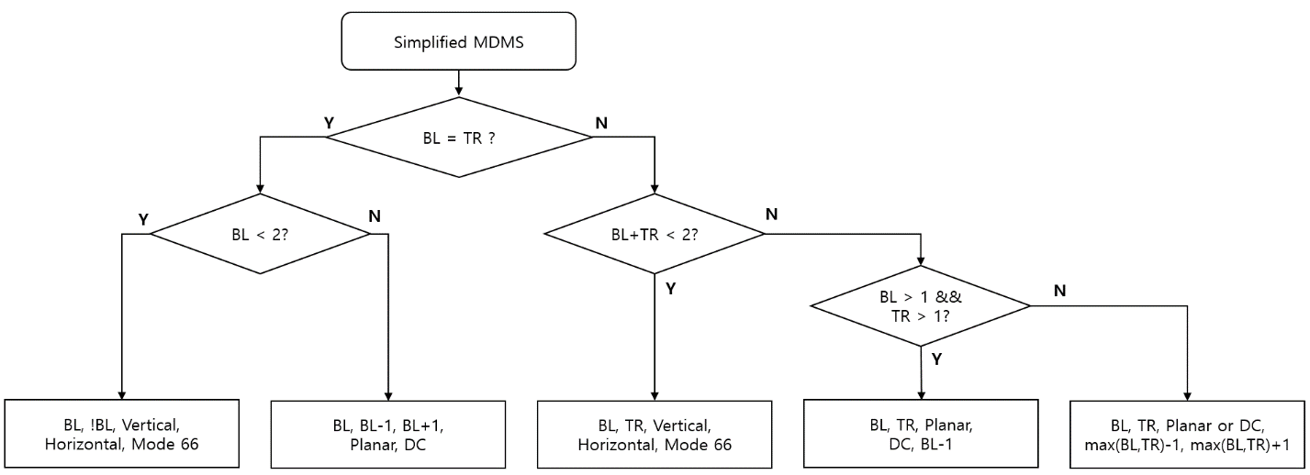
Proposed method
A simplified MDMS
  Five chroma intra candidate modes are constructed with the two DM points (BL, and TR)
  The chroma intra candidate mode list is generated as follows :
TR
BL
luma block
chroma block

Slide 5
Proposed method
A simplified MDMS
  The binarization of 5 chroma intra modes is same as in VTM2
  Algorithm complexity is slightly increased compare to the VTM2
 | Binarization |  | Number of context model
 | JEM MDMS | Proposed method | JEM MDMS | Proposed method
Chroma candidate mode 1 | 0 | 0 | 1 | 1
Chroma candidate mode 2 | 10 | 100 | 1 | 0
Chroma candidate mode 3 | 110 | 101 | 1 | 0
Chroma candidate mode 4 | 1110 | 110 | 1 | 0
Chroma candidate mode 5 | 11110 | 111 | 1 | 0
Total number of context models |  |  | 5 | 1
 | VTM2 | Proposed method | MDMS
Number of pruning (or condition) check | 4 | 5 | 40
Number of luma DM point accesses | 1 | 2 | 5
Number of chroma neighbor spatial accesses | 0 | 0 | 5
Number of context models | 1 | 1 | 5
Complexity analysis of VTM2, MDMS, and proposed method

Slide 6
Proposed method
A simplified MDMS
 | Max number of Luma DM point to access | Max number of neighbors to access | Max layers of if conditions | Max number of comparison operator | Max number of logical operators | Max number of assignment operators | Max number of increments | Max number of bit operation | Number of Context modeling for MPM coding | number of full RDO checks | Has LUT? | LUT size | Compression performance (Y/U/V BD-rates) for AI configuration
VTM2 | 1 | 0 | 1 | 4 | 0 | 9 | 0 | 0 | 2 | 6 | N | 0 | anchor
MDMS | 5 | 5 | 4 | 39 | 28 | 80 | 5 | 2 | 6 | 6 | Y | 68 | -0.2%/-1.09%/-1.08%
proposed | 2 | 0 | 3 | 5 | 1 | 18 | 2 | 2 | 2 | 6 | N | 0 | -0.09%/-0.97%/-1.00%

Slide 7
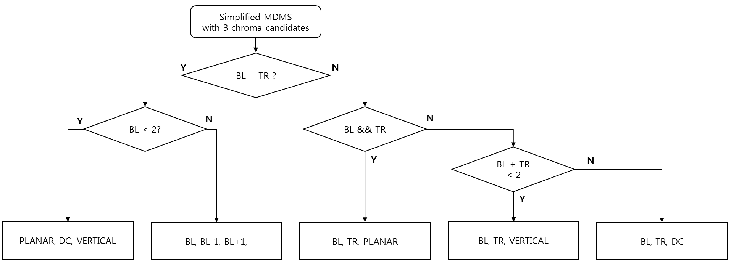
Proposed method
A simplified MDMS with 3 candidate modes
binarization | Number of context model
0 | 1
10 | 0
11 | 0
 |  | Max number of Luma DM point to access | Max number of neighbors to access | Max layers of if conditions | Max number of comparison operator | Max number of logical operators | Max number of assignment operators | Max number of increments | Max number of bit operation | Number of Context modeling for MPM coding | number of full RDO checks | Has LUT? | LUT size
VTM2 |  | 1 | 0 | 1 | 4 | 0 | 9 | 0 | 0 | 2 | 6 | N | 0
MD MS |  | 5 | 5 | 4 | 39 | 28 | 80 | 5 | 2 | 6 | 6 | Y | 68
JVET-L0139 | 5 mode | 2 | 0 | 3 | 5 | 1 | 18 | 2 | 2 | 2 | 6 | N | 0
JVET-L0139 | 3 mode | 2 | 0 | 2 | 3 | 1 | 13 | 2 | 2 | 2 | 4 | N | 0

Slide 8
Experimental results
Tool-on test in VTM2.0.1
TEST1 : 5 chroma mode
 | All Intra Main10
 | Over VTM-2.0.1
 | Y | U | V | EncT | DecT
Class A1 | -0.07% | -0.61% | -0.66% | 99% | 99%
Class A2 | -0.09% | -0.86% | -0.82% | 100% | 99%
Class B | -0.07% | -0.92% | -1.04% | 99% | 99%
Class C | -0.07% | -0.98% | -0.89% | 99% | 99%
Class E | -0.18% | -1.52% | -1.63% | 99% | 99%
Overall | -0.09% | -0.97% | -1.00% | 99% | 99%
Class D | -0.06% | -0.53% | -0.95% | 99% | 95%
 | Random Access Main 10
 | Over VTM-2.0.1
 | Y | U | V | EncT | DecT
Class A1 | -0.06% | -0.39% | -0.41% | 100% | 101%
Class A2 | -0.02% | -0.71% | -0.56% | 99% | 100%
Class B | 0.03% | -1.08% | -1.18% | 100% | 100%
Class C | 0.03% | -0.92% | -0.68% | 100% | 100%
Class E
Overall | 0.00% | -0.83% | -0.77% | 100% | 100%
Class D | 0.00% | -1.06% | -0.61% | 99% | 94%

Slide 9
Experimental results
Tool-on test in VTM2.0.1
TEST2 : 3 chroma mode
 | All Intra Main10
 | Over VTM-2.0.1
 | Y | U | V | EncT | DecT
Class A1 | -0.06% | -0.11% | -0.35% | 97% | 98%
Class A2 | -0.07% | -0.27% | -0.34% | 96% | 98%
Class B | -0.07% | -0.41% | -0.43% | 98% | 98%
Class C | -0.08% | -0.29% | -0.06% | 97% | 101%
Class E | -0.16% | -0.77% | -0.68% | 98% | 98%
Overall | -0.09% | -0.37% | -0.36% | 97% | 99%
Class D | -0.08% | 0.05% | -0.26% | 96% | 94%
 | Random Access Main 10
 | Over VTM-2.0.1
 | Y | U | V | EncT | DecT
Class A1 | -0.03% | 0.01% | -0.21% | 98% | 99%
Class A2 | 0.02% | -0.12% | -0.25% | 97% | 98%
Class B | 0.04% | -0.51% | -0.46% | 98% | 99%
Class C | 0.08% | -0.41% | -0.24% | 98% | 99%
Class E
Overall | 0.03% | -0.30% | -0.31% | 98% | 99%
Class D | 0.06% | -0.48% | -0.17% | 98% | 94%

Slide 10
Conclusion
To reduce the complexity of the MDMS, simplified MDMS is proposed
This method can reduce the complexity of the MDMS similar to the current VTM2

