Slide 1
JVET-J0021 – Description of SDR, HDR and 360° video coding technology proposal by Qualcomm and Technicolor – low and high complexity versions

Slide 2
Overview
New tools introduced comparing to JEM:
  New partition types: Triple-Tree and Asymmetric Binary Tree.
  Sign Prediction (-0.5% for Constrained Set 1).
  Motion Compensated Padding (-0.3% for Constrained Set 1).
Decoder side motion vector refinement (JVET-E0052) tool from JEM is not included.
Number of JEM tools modified:
  Bilateral or template matching refinement is done for one candidate identified by signalled merge index. Sub-block level refinement for template matching and bilateral refinement is removed.
  AMVP number of initial motion candidates is reduced from 15 to 2.
  Other tools – smaller modification to improve performance, reduce complexity.
HM anchors |  |  |  |  | JEM anchors
BD-rate PSNR |  |  | Time variation |  | BD-rate PSNR |  |  | Time variation
Y | U | V | Enc | Dec | Y | U | V | Enc | Dec
-43.08% | -44.38% | -46.05% | 1180% | 639% | -15.53% | -3.66% | -5.97% | 148% | 84%
-39.72% | -42.80% | -43.94% | 369% | 646% | -10.26% | 0.05% | -1.65% | 46% | 85%
High complexity
Low complexity
Constrained Set 1 Results

Slide 3
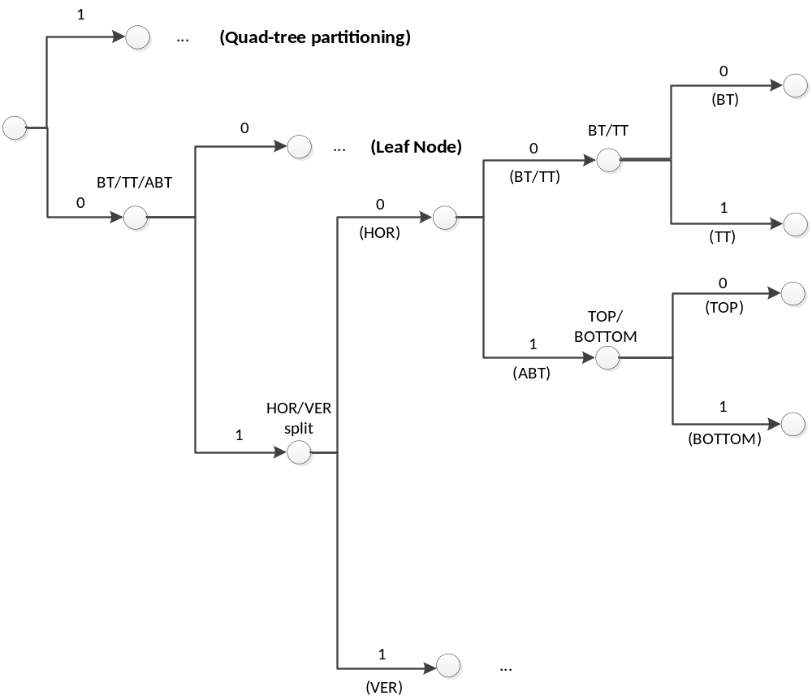
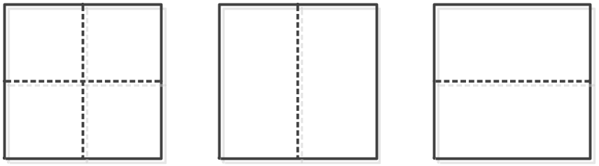
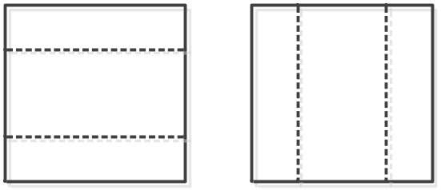
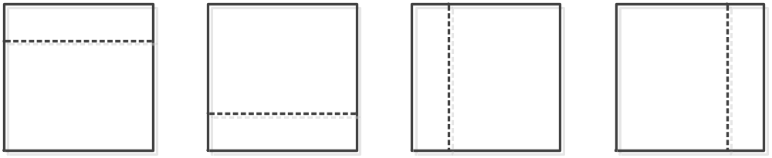
Partitioning
JVET-D0117, JVET-D0064
Nine types of partitions supported.
Quadtree
Binary Tree
Triple Tree
Asymmetric Tree (ABT)

Slide 4
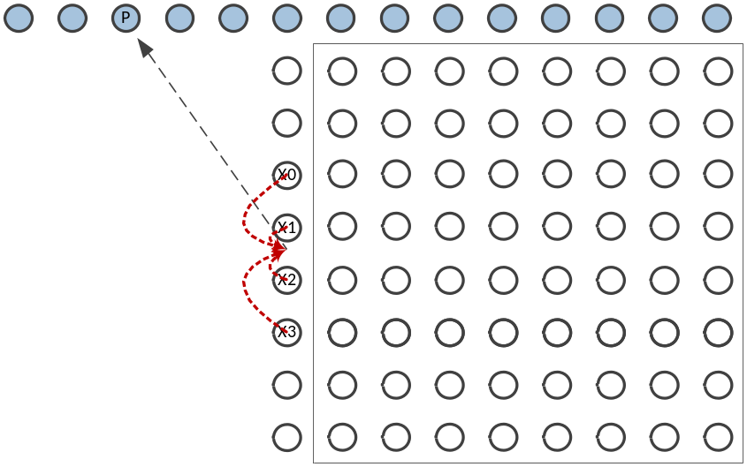
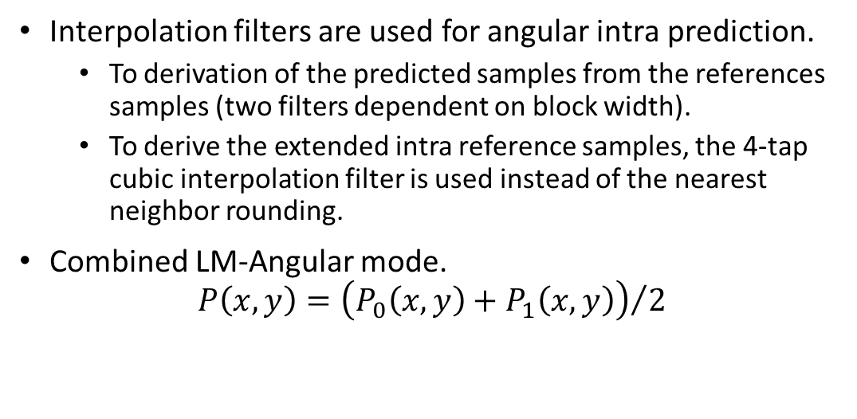
Intra Prediction
JVET-D0113, JVET-D0119, JVET-D0110
The number of intra modes in a block can vary between 35, 67, or 131 modes, depending on the block size.
The two nearest reference lines are used except for planar, DC, horizontal and vertical modes. For each angular mode two predictor blocks are generated, each based on one reference line, and a weighted predictor (3,1) is used as the final one.
Intra prediction is based on unfiltered or filtered multi-line references.
  5-tap bilateral filter is used to generate the filtered reference, which reduces noise while preserving edges.
Interpolation filters are used for angular intra prediction.
  To derivation of the predicted samples from the references samples (two filters dependent on block width).
  To derive the extended intra reference samples, the 4-tap cubic interpolation filter is used instead of the nearest neighbor rounding.
Combined LM-Angular mode.
$$P\left(x,y\right)={\left(P_{0}\left(x,y\right)+P_{1}\left(x,y\right)\right)}/2$$

Slide 5
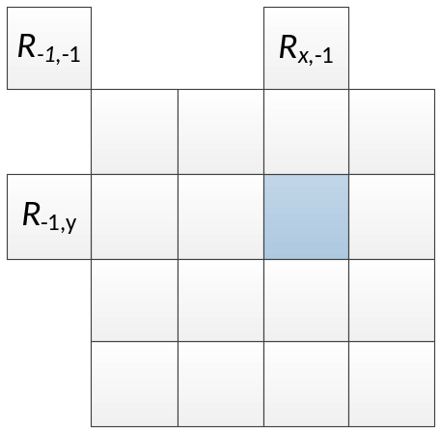
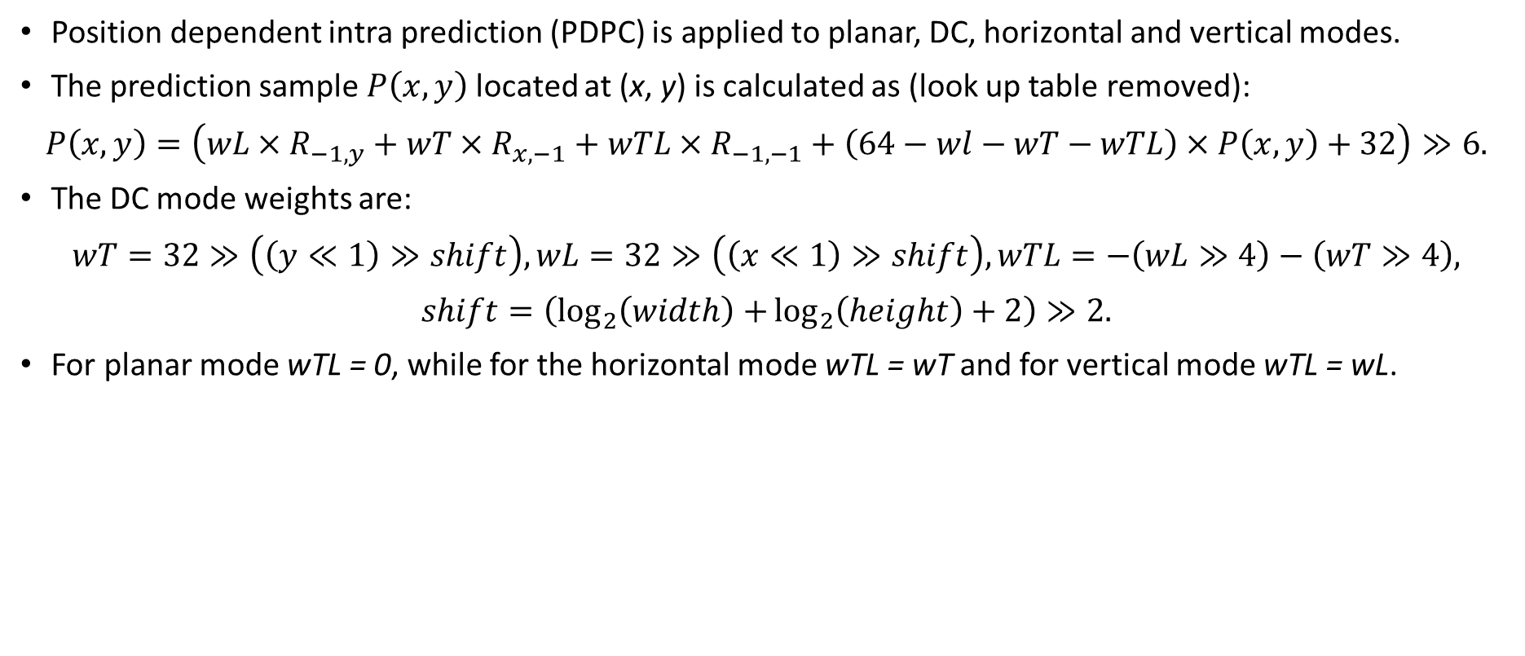
Intra Prediction
JVET-H0057
Position dependent intra prediction (PDPC) is applied to planar, DC, horizontal and vertical modes.
The prediction sample $P\left(x,y\right)$ located at (x, y) is calculated as (look up table removed):
$$P\left(x,y\right)=\left(wL×R_{−1,y}+wT×R_{x,−1}+wTL×R_{−1,−1}+\left(64−wl−wT−wTL\right)×P\left(x,y\right)+32\right)≫6.$$
The DC mode weights are:
$$wT=32≫\left(\left(y≪1\right)≫shift\right), wL=32≫\left(\left(x≪1\right)≫shift\right), wTL=−\left(wL≫4\right)−\left(wT≫4\right),$$
$$shift=\left(\log_{2}\left(width\right)+\log_{2}\left(height\right)+2\right)≫2.$$
For planar mode wTL = 0, while for the horizontal mode wTL = wT and for vertical mode wTL = wL.

Slide 6
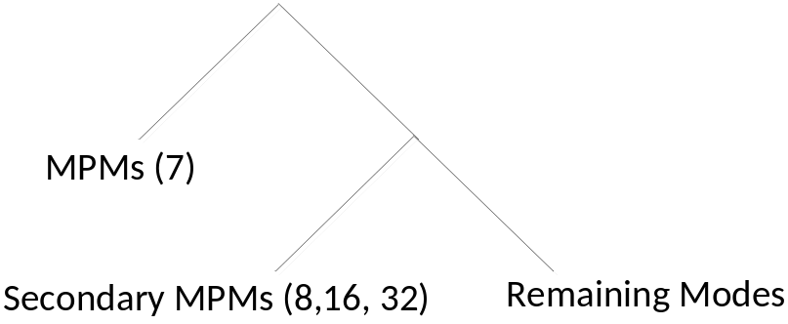
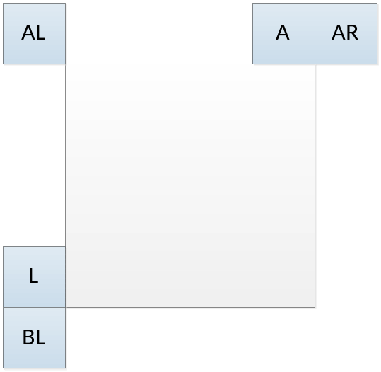
Intra Prediction Mode Coding
JVET-D0114, JVET-G0060
Most Probable Mode (MPM).
  Left (L), Above (A), Planar, Below-Left (BL), Above-Right (AR), Above-Left (AL), and DC.
    Left and Above order can be swapped for rectangular blocks – probability of different modes depends on the shape of the blocks.
  Adding ±1 to the angular modes already included into the MPM list.
  Default modes: VER_IDX, HOR_IDX, 2, etc.
Secondary MPMs.
  Adding an offset ±1, ±2, ±3, … to the MPM modes.
  Default modes.
Chroma mode coding same as in JEM.
Modifications of Intra tools bring 1.2% rate reduction (CTC conditions).

Slide 7
















Inter Mode
A decoder-side motion refinement method, Template Matching (TM), is used to derive the motion vector predictor for the inter mode.
  The two HEVC AMVP candidates are checked and the candidate which leads to the smaller cost (SAD) is selected as the starting point.
  A local search based on template matching around the starting point is performed and the MV which results in the minimum matching cost is selected as the MVP. Weighted TM is used.
Weights
$${w′}_{1}$$
$${w′}_{2}$$
$${w′}_{3}$$
$${w′}_{4}$$
$$w_{1}$$
$$w_{2}$$
$$w_{3}$$
$$w_{4}$$
$${w′}_{1}$$
$${w′}_{2}$$
$${w′}_{3}$$
$${w′}_{4}$$
$$w_{1}$$
$$w_{2}$$
$$w_{3}$$
$$w_{4}$$

Slide 8
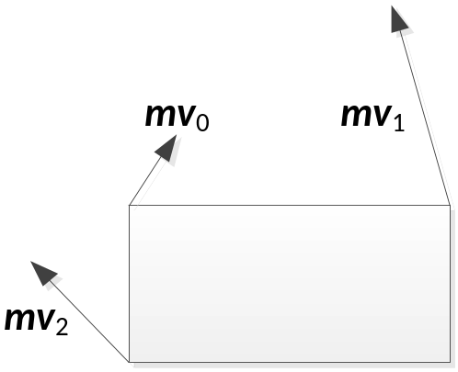
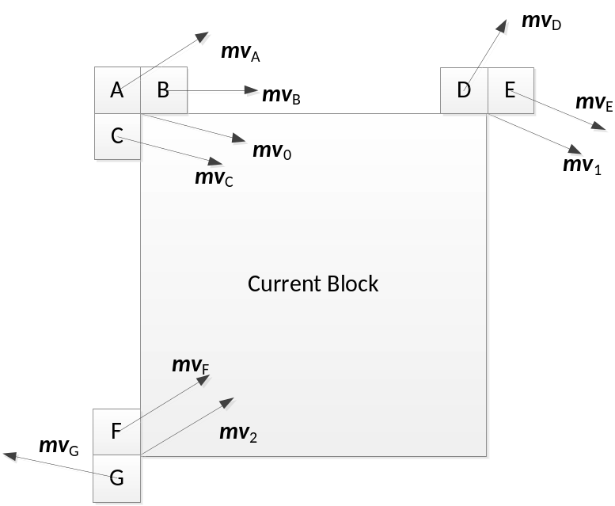
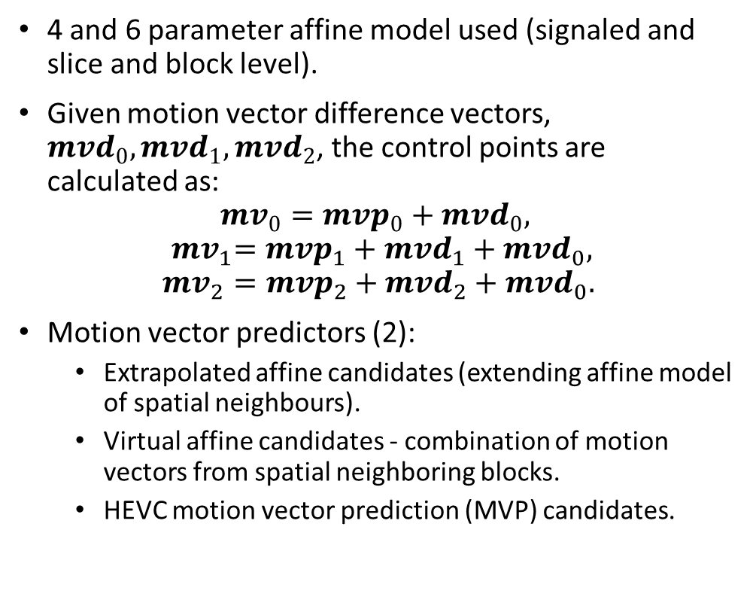
Affine Motion Vector Prediction
4 and 6 parameter affine model used (signaled and slice and block level).
Given motion vector difference vectors, ${mvd}_{0}, {mvd}_{1}, {mvd}_{2}$, the control points are calculated as:
$${mv}_{0}={mvp}_{0}+{mvd}_{0},$$
$${ mv}_{1}={mvp}_{1}+{mvd}_{1}+{mvd}_{0},$$
$${mv}_{2}={mvp}_{2}+{mvd}_{2}+{mvd}_{0}.$$
Motion vector predictors (2):
  Extrapolated affine candidates (extending affine model of spatial neighbours).
  Virtual affine candidates - combination of motion vectors from spatial neighboring blocks.
  HEVC motion vector prediction (MVP) candidates.

Slide 9
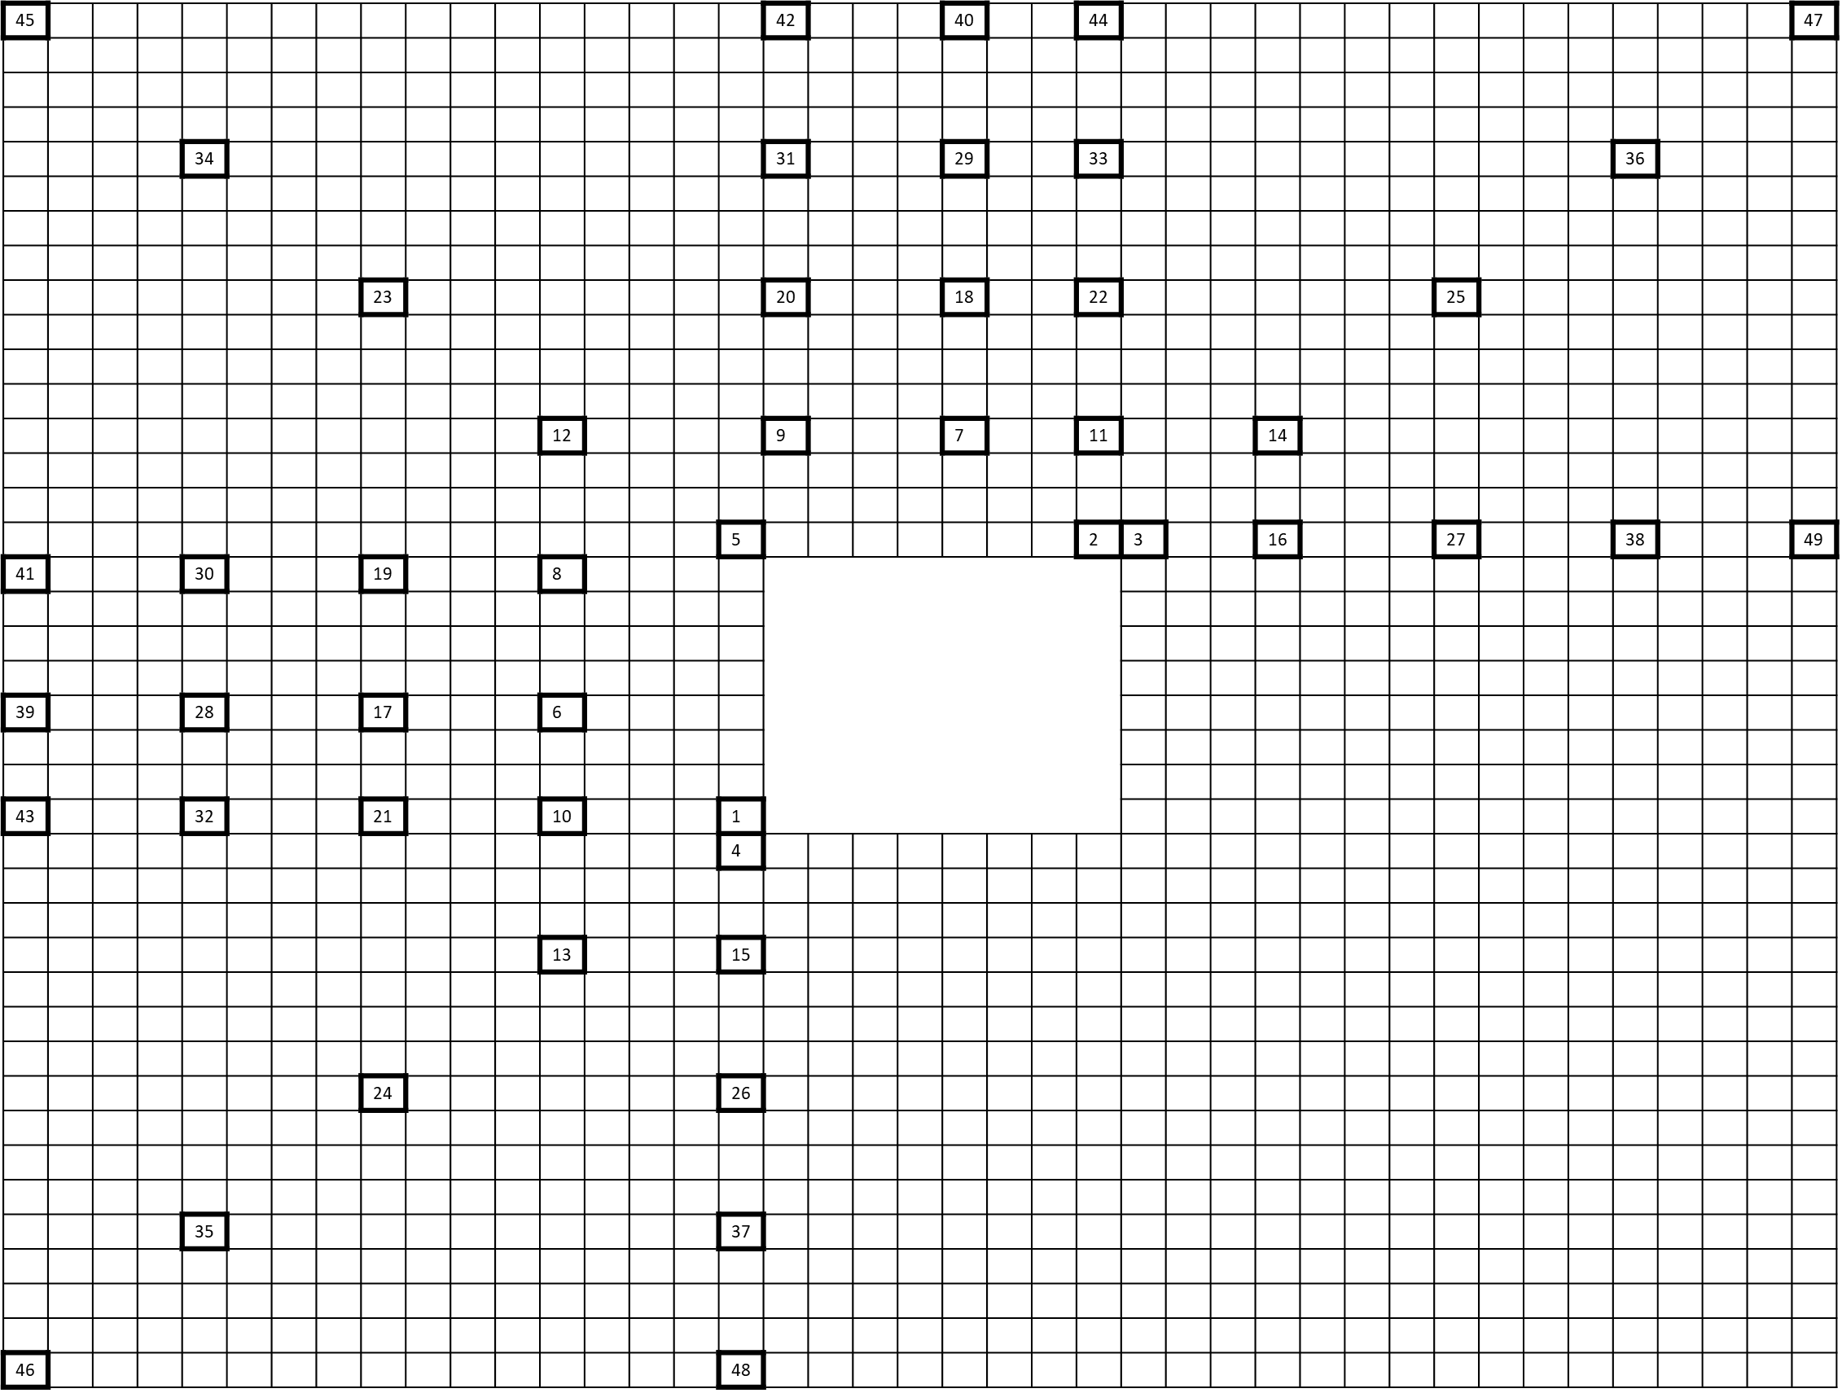
Merge Mode with Bilateral Matching
Merge candidates (19):
  Spatial candidates for blocks 1-4.
  Extrapolated affine candidates for blocks 1-4.
  ATMVP, STMVP.
  Virtual affine candidate.
  Spatial candidate (block 5).
  Extrapolated affine candidate (block 5).
  Temporal candidate (derived as in HEVC).
  Non-adjacent spatial candidate followed by extrapolated affine candidate (blocks 6 to 49).
  Combined candidates, zero candidates.
Bilateral Matching maybe applied only to the signaled candidate.
  Excluded candidates: uni-directional, ATMVP, STMVP, affine and candidates using IC mode; MV difference between the selected and any of the previous candidates is smaller than threshold.
  The sub-block level refinement is removed.

Slide 10
Merge Mode with Template Matching
Merge candidates (4):
  Spatial candidates (blocks 1- 5).
  Temporal candidates.
  Non-adjacent spatial candidates (block 6 - 49).
  Combined candidates.
  Zero candidates.
For the first four spatial candidates, the bi-prediction ones are inserted before the ones with uni-prediction.
After the merge candidates list is constructed, all the uni-prediction are converted into bi-prediction candidates by mirroring the available MV.
The Template Matching refinement is applied only to the merge candidate signalled to the decoder.

Slide 11
Primary and Secondary Transforms
JVET-C0022, JVET-D0126
Primary Transform:
  In addition to AMT transforms used in JEM (DCT-2, DCT-5, DCT-8, DST-1, and DST-7) two more cores are added.
    Intra: DST-4 and identity transform,
    Inter: KLT-1 and KLT-2.
  Intra: 7 transform sets, where each set has 4 transform pairs, are defined.
    Assignment of each of the 7 transform sets is based on different intra prediction mode and block size.
    The first entry in the transform pair determines vertical transform, and the second one the horizontal transform.
    For block sizes up to 16x16 identity transform is used if transform index is equal to 3 and the distance between intra mode and horizontal (vertical) mode smaller than predefine threshold.
  Inter:
{(KLT-1, KLT-1), (KLT-1, KLT-2), (KLT-2, KLT-1), (KLT-2, KLT-2)} → 16x16 and smaller
{(DCT-8, DCT-8), (DCT-8, DST-7), (DST-7, DCT-8), (DST-7, DST-7)}
NSST can be applied and signaled only when AMT flag is equal to 0 or AMT transform index is equal to 0.

Slide 12
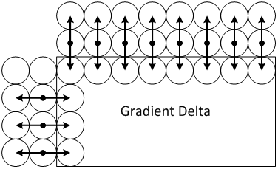
Sign Prediction
JVET-D0031
A context coded bin is signaled to indicate whether a coefficient sign is equal to the sign which minimizes the cost function.
  E.g., if two signs are predicted, for all possible combination of sign values, (+, +), (+, –), (–, +), (–, –), the cost function is calculated and the combination with the minimum cost is selected.
Cost function
  Calculate reconstructed residual for both negative and positive sign combinations.
    The reconstructed residual is derived based on the prestored elemental residuals multiplied by coefficient magnitude and accumulated for all coefficients for which sign is predicted.
  Cost function is defined as discontinuity measure across block boundary.
$$cost=\sum_{x=0}^{w}{\left|\left(−R_{x,−1}+2R_{x,0}−P_{x,1}\right)−r_{x,1}\right|+ }\sum_{y=o}^{h}{\left|\left(−R_{−1,y}+2R_{0,y}−P_{1,y}\right)−r_{1,y}\right| }$$

Slide 13
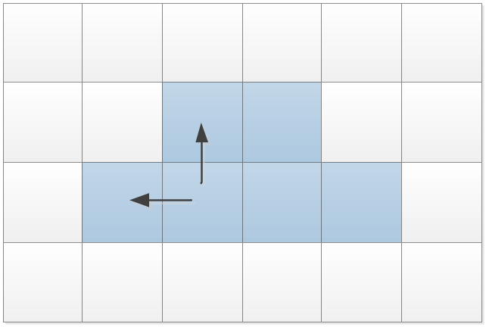
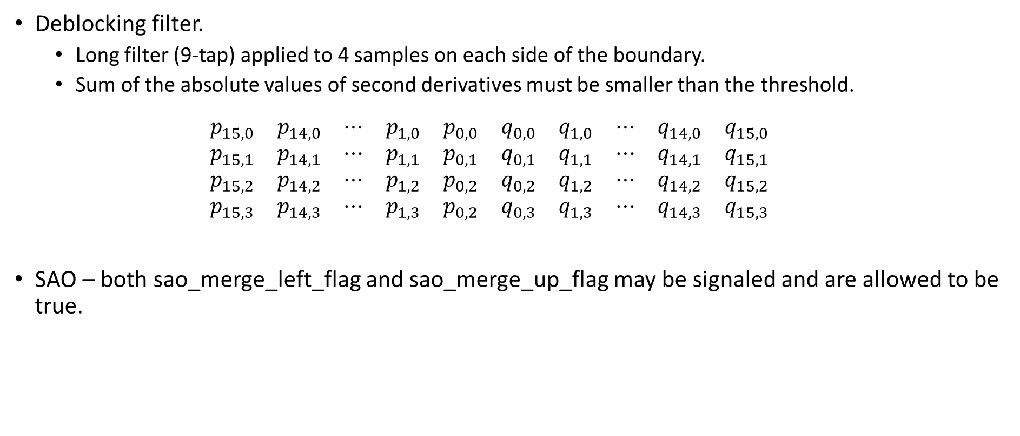
In-Loop Filters
Deblocking filter.
  Long filter (9-tap) applied to 4 samples on each side of the boundary.
  Sum of the absolute values of second derivatives must be smaller than the threshold.
  $$\begin{matrix}p_{15,0} & p_{14,0} & ⋯ & p_{1,0} & p_{0,0} & q_{0,0} & q_{1,0} & ⋯ & q_{14,0} & q_{15,0} \\ p_{15,1} & p_{14,1} & ⋯ & p_{1,1} & p_{0,1} & q_{0,1} & q_{1,1} & ⋯ & q_{14,1} & q_{15,1} \\ p_{15,2} & p_{14,2} & ⋯ & p_{1,2} & p_{0,2} & q_{0,2} & q_{1,2} & ⋯ & q_{14,2} & q_{15,2} \\ p_{15,3} & p_{14,3} & ⋯ & p_{1,3} & p_{0,2} & q_{0,3} & q_{1,3} & ⋯ & q_{14,3} & q_{15,3}\end{matrix}$$
SAO – both sao_merge_left_flag and sao_merge_up_flag may be signaled and are allowed to be true.

Slide 14
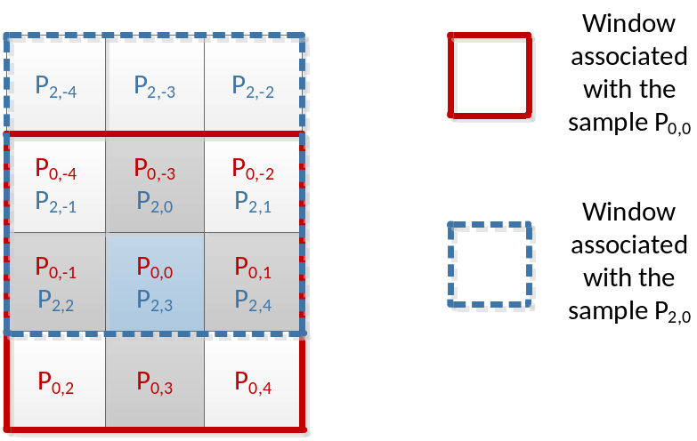
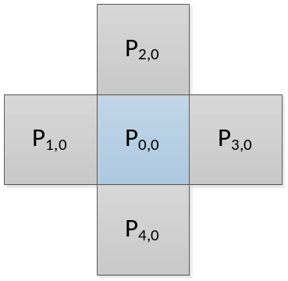
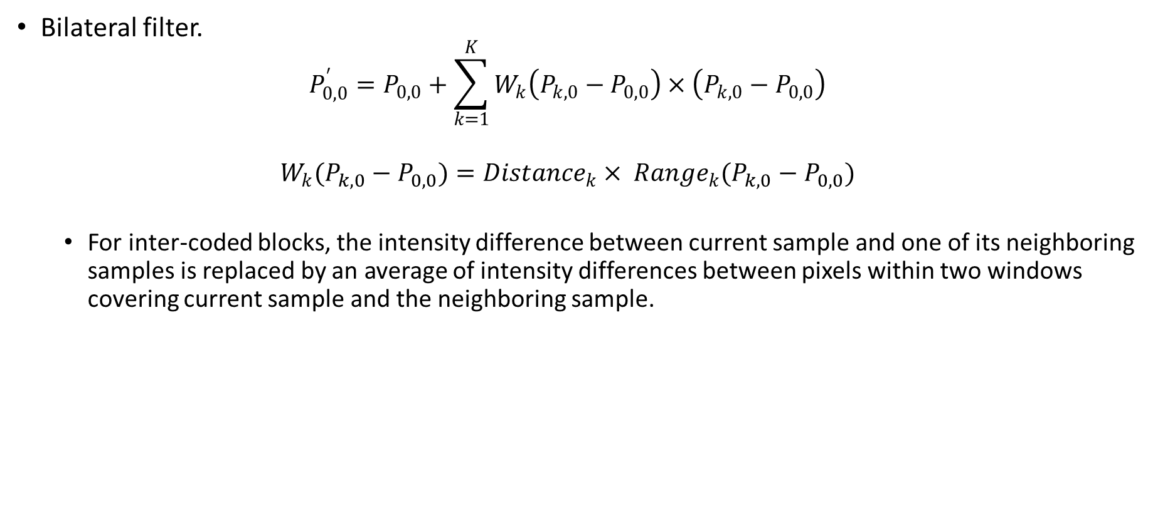
In-Loop Filters
Bilateral filter.
  $$P_{0, 0}^{′}=P_{0, 0}+\sum_{k=1}^{K}{W_{k}\left(P_{k, 0}−P_{0, 0}\right)×\left(P_{k, 0}−P_{0, 0}\right)}$$
  $$W_{k}(P_{k, 0}−P_{0, 0})={Distance}_{k}× {Range}_{k}(P_{k, 0}−P_{0, 0})$$
  For inter-coded blocks, the intensity difference between current sample and one of its neighboring samples is replaced by an average of intensity differences between pixels within two windows covering current sample and the neighboring sample.

Slide 15
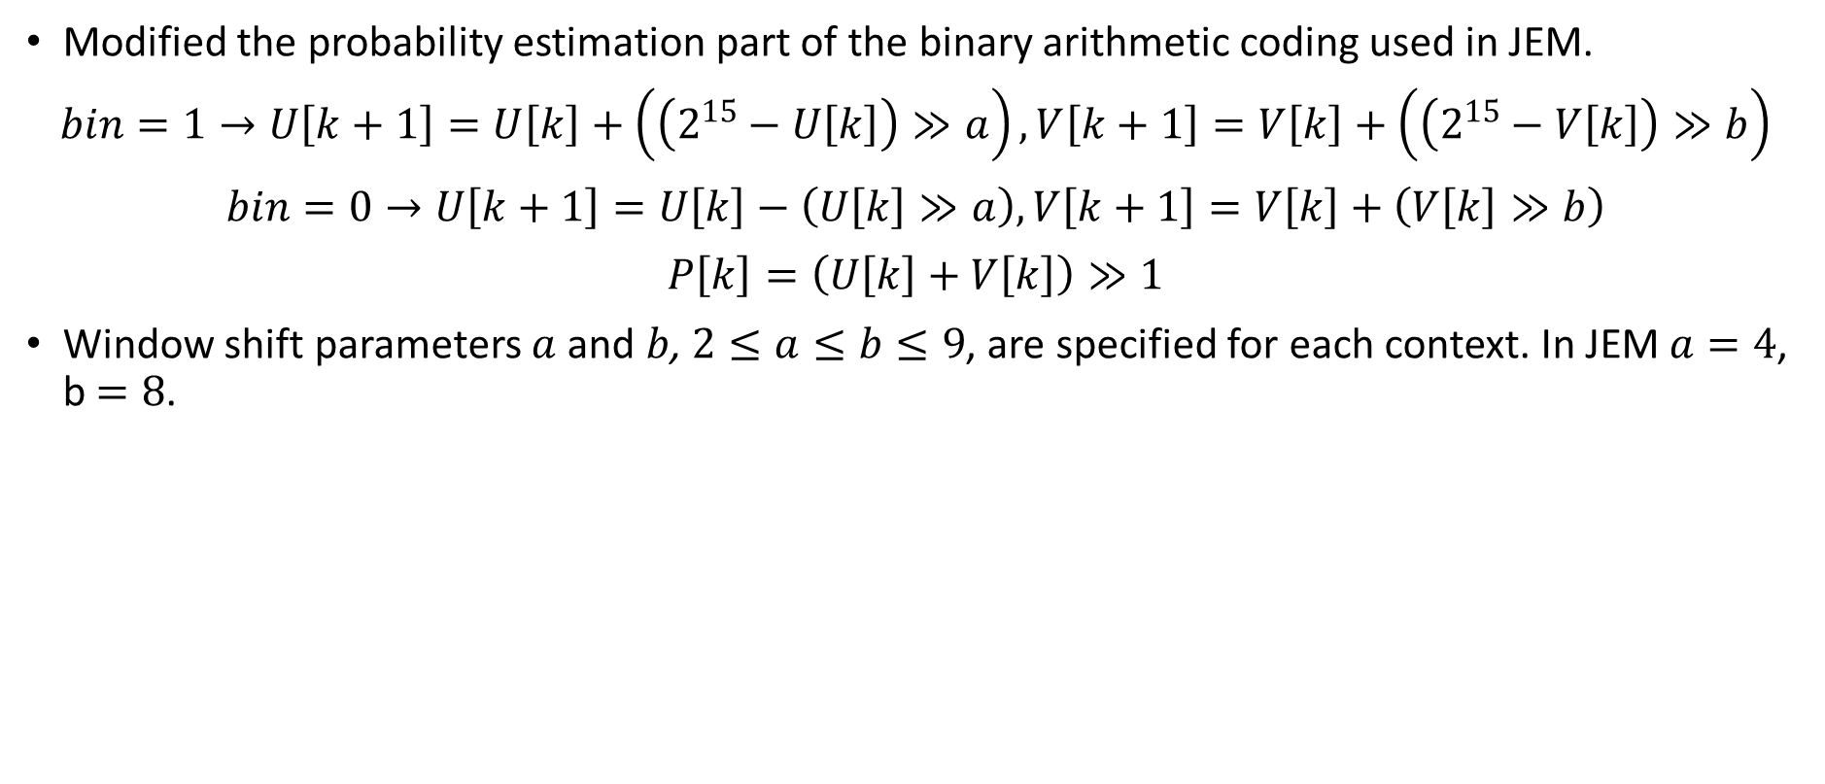
Arithmetic Coding Engine
JVET-G0112, JVET-E0119
Modified the probability estimation part of the binary arithmetic coding used in JEM.
$$bin=1→U\left[k+1\right]=U\left[k\right]+\left(\left(2^{15}−U\left[k\right]\right)≫a\right), V\left[k+1\right]=V\left[k\right]+\left(\left(2^{15}−V\left[k\right]\right)≫b\right)$$
$$bin=0→U\left[k+1\right]=U\left[k\right]−\left(U\left[k\right]≫a\right), V\left[k+1\right]=V\left[k\right]+\left(V\left[k\right]≫b\right)$$
$$P\left[k\right]=\left(U\left[k\right]+V\left[k\right]\right)≫1$$
Window shift parameters $a$ and $b$, $2≤a≤b≤9$, are specified for each context. In JEM $a=4$, b $=8$.

Slide 16
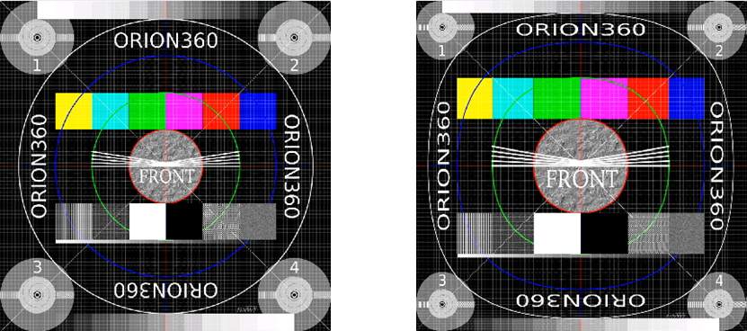
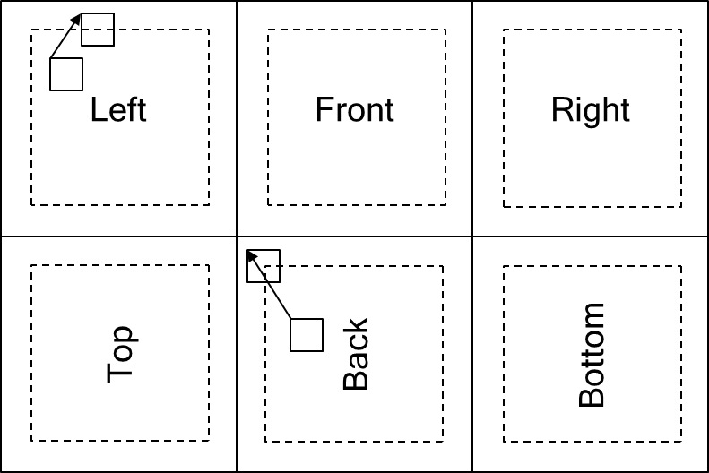
360 Video
JVET-F0025,JVET-G0058
Adjusted Cubemap Projection (ACP) used.
The padding is added to the reconstructed cube faces and is symmetric around each cube face with width 64 samples.
  The padded samples are obtained based on the ACP geometry and nearest-neighbor rounding.
  The reconstructed ACP pictures are padded one time prior to in-loop filtering.
  The padded reconstructed ACP pictures are sequentially processed by the deblocking filter, SAO and ALF before storage as reference pictures.
Motion compensated padding and OBMC for blocks on the boundary between top and bottom row of cube faces are disabled.

Slide 17
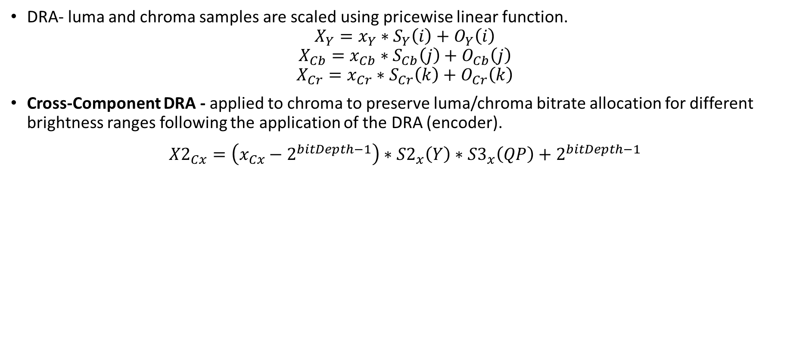
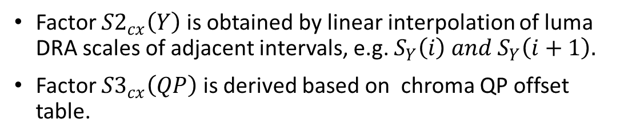
HDR Video
DRA- luma and chroma samples are scaled using pricewise linear function.
$$X_{Y}=x_{Y}∗S_{Y}\left(i\right)+O_{Y}\left(i\right)$$
$$X_{Cb}=x_{Cb}∗S_{Cb}\left(j\right)+O_{Cb}\left(j\right)$$
$$X_{Cr}=x_{Cr}∗S_{Cr}\left(k\right)+O_{Cr}\left(k\right)$$
Cross-Component DRA - applied to chroma to preserve luma/chroma bitrate allocation for different brightness ranges following the application of the DRA (encoder).
$${X2}_{Cx}=\left(x_{Cx}−2^{bitDepth−1}\right)∗{S2}_{x}\left(Y\right)∗{S3}_{x}\left(QP\right)+2^{bitDepth−1}$$
Factor ${S2}_{cx}\left(Y\right)$ is obtained by linear interpolation of luma DRA scales of adjacent intervals, e.g. $S_{Y}\left(i\right) and S_{Y}\left(i+1\right).$
Factor ${S3}_{cx}\left(QP\right)$ is derived based on chroma QP offset table.

Slide 18
SDR Results – Constraint Set 1
High complexity configuration (QTBT+TT+ABT).
Anchor: HM
 | Y | U | V
UHD | -46.98% | -42.07% | -45.58%
HD | -39.18% | -46.69% | -46.52%
Average | -43.08% | -44.38% | -46.05%
Enc Time | 1180%
Dec Time | 639%
Anchor: JEM
 | Y | U | V
UHD | -18.20% | -1.86% | -7.25%
HD | -12.85% | -5.47% | -4.69%
Average | -15.53% | -3.66% | -5.97%
Enc Time | 148%
Dec Time | 84%
Low complexity configuration (QTBT).
Anchor: HM
 | Y | U | V
UHD | -43.37% | -41.24% | -43.38%
HD | -36.08% | -44.36% | -44.50%
Average | -39.72% | -42.80% | -43.94%
Enc Time | 370%
Dec Time | 646%
Anchor: JEM
 | Y | U | V
UHD | -12.34% | 0.87% | -2.99%
HD | -8.19% | -0.77% | -0.30%
Average | -10.26% | 0.05% | -1.65%
Enc Time | 46%
Dec Time | 85%

Slide 19
Partitioning Only Results
Partitioning only results for Constraint Set 1 relative to HM anchor.
 | Y | U | V
UHD | -17.67% | -10.18% | -11.56%
HD | -10.86% | -12.55% | -15.50%
Average | -14.27% | -11.36% | -13.53%
Enc Time | 75%
Dec Time | 110%
 | Y | U | V
UHD | -20.52% | -14.56% | -16.41%
HD | -14.25% | -17.99% | -20.45%
Average | -17.38% | -16.27% | -18.43%
Enc Time | 145%
Dec Time | 112%
Partitioning: QTBT
Partitioning: QTBT+TT
 | Y | U | V
UHD | -21.44% | -16.18% | -18.26%
HD | -15.31% | -19.91% | -22.74%
Average | -18.38% | -18.05% | -20.50%
Enc Time | 214%
Dec Time | 111%
Partitioning: QTBT+TT (high complexity)

Slide 20
SDR Results (Limited Tools) – Constraint Set 1
Low complexity configuration (QTBT).
Anchor: HM
 | Y | U | V
UHD | -43.37% | -41.24% | -43.38%
HD | -36.08% | -44.36% | -44.50%
Average | -39.72% | -42.80% | -43.94%
Enc Time | 370%
Dec Time | 646%
Anchor: JEM
 | Y | U | V
UHD | -12.34% | 0.87% | -2.99%
HD | -8.19% | -0.77% | -0.30%
Average | -10.26% | 0.05% | -1.65%
Enc Time | 46%
Dec Time | 85%
Low complexity configuration (QTBT) with OBMC, BIO, TM disabled and CTU limited to 128.
Anchor: HM
 | Y | U | V
UHD | -41.51% | -39.89% | -40.94%
HD | -33.37% | -42.40% | -42.28%
Average | -37.44% | -41.14% | -41.61%
Enc Time | 268%
Dec Time | 320%
Anchor: JEM
 | Y | U | V
UHD | -8.06% | 5.51% | 2.33%
HD | -3.39% | 5.14% | 5.69%
Average | -5.72% | 5.32% | 4.01%
Enc Time | 36%
Dec Time | 43%

Slide 21
SDR Results (Limited Tools) – Constraint Set 1
High complexity configuration (QTBT+TT+ABT).
Anchor: HM
 | Y | U | V
UHD | -46.98% | -42.07% | -45.58%
HD | -39.18% | -46.69% | -46.52%
Average | -43.08% | -44.38% | -46.05%
Enc Time | 1180%
Dec Time | 639%
Anchor: JEM
 | Y | U | V
UHD | -18.20% | -1.86% | -7.25%
HD | -12.85% | -5.47% | -4.69%
Average | -15.53% | -3.66% | -5.97%
Enc Time | 148%
Dec Time | 84%
High complexity configuration (QTBT+TT) with OBMC, BIO, TM disabled and CTU limited to 128.
Anchor: HM
 | Y | U | V
UHD | -43.52% | -42.95% | -44.34%
HD | -35.54% | -46.01% | -45.96%
Average | -39.53% | -44.48% | -45.15%
Enc Time | 585%
Dec Time | 324%
Anchor: JEM
 | Y | U | V
UHD | -11.34% | 0.00% | -3.38%
HD | -6.59% | -1.32% | -0.83%
Average | -8.97% | -0.66% | -2.10%
Enc Time | 78%
Dec Time | 44%

Slide 22
SDR Results – Constraint Set 2
High complexity configuration (QTBT+TT).
Anchor: HM
 | Y | U | V
Average-HD | -33.74% | -51.94% | -53.10%
Enc Time | 969%
Dec Time | 607%
Anchor: JEM
 | Y | U | V
Average | -12.65% | -17.40% | -19.95%
Enc Time | 120%
Dec Time | 91%
Low complexity configuration (QTBT).
Anchor: HM
 | Y | U | V
Average | -31.69% | -48.95% | -50.44%
Enc Time | 449%
Dec Time | 610%
Anchor: JEM
 | Y | U | V
Average | -9.87% | -11.73% | -14.88%
Enc Time | 56%
Dec Time | 91%

Slide 23
360 Results – Constraint Set 1
The ACP projection used in the proposal is configured to 1280x1280 for all sequences.
High complexity configuration (QTBT+TT+ABT).
Anchor: HM
 | E2E WS-PSNR
 | Y | U | V
Average-HD | -38.1% | -57.4% | -60.0%
Enc Time | 1060%
Dec Time | 686%
Anchor: JEM
 | E2E WS-PSNR
 | Y | U | V
Average | -19.4% | -26.4% | -28.7%
Enc Time | 133%
Dec Time | 90%
Low complexity configuration (QTBT).
Anchor: HM
 | E2E WS-PSNR
 | Y | U | V
Average | -35.3% | -55.0% | -57.3%
Enc Time | 302%
Dec Time | 705%
Anchor: JEM
 | E2E WS-PSNR
 | Y | U | V
Average | -15.7% | -21.9% | -23.4%
Enc Time | 38%
Dec Time | 93%
Increase in encoding/decoding times comparing to SDR is mainly due to use of 360Lib 5.0 functions for performing geometric padding around cube faces.

Slide 24
HDR Results – Constraint Set 1
High complexity configuration (QTBT+TT+ABT).
Anchor: HM
 | PSNRL100 | DE100
HDR-A | -37.5% | -61.8%
HDR-B | -41.3% | -36.8%
Average | -39.9% | -46.2%
Enc Time | 1023%
Dec Time | 515%
Anchor: JEM
 | PSNRL100 | DE100
HDR-A | -10.1% | -17.0%
HDR-B | -18.8% | -0.7%
Average | -15.6% | -6.8%
Enc Time | 146%
Dec Time | 62%
Low complexity configuration (QTBT).
Anchor: HM
 | PSNRL100 | DE100
HDR-A | -34.9% | -59.8%
HDR-B | -38.8% | -30.0%
Average | -37.3% | -41.2%
Enc Time | 313%
Dec Time | 514%
Anchor: JEM
 | PSNRL100 | DE100
HDR-A | -6.4% | -12.1%
HDR-B | -15.2% | 10.7%
Average | -11.9% | 2.1%
Enc Time | 45%
Dec Time | 62%

Slide 25
Software
Software based on redesign of JEM.
Reduced encoder complexity. With structure-only tests (QTBT), encoder runtime with structure only is slightly faster (75%) than HM-16 while providing -14.27% (Y) rate reduction.
Optimized memory usage.
  The used memory of encoding the largest resolution at the highest target rate point in CS1 is: HM – 1.96 GB; JEM – 6.1 GB, this proposal – 2.7 GB.
  The used memory of decoding the largest resolution at the highest target rate point in CS1 is: HM – 991 MB; JEM – 1.28 GB; this proposal – 587 MB;
Simplified macro structure. Methods associated with each coding tool are encapsulated under one macro.
  Support for structure-only test setting where all new coding tools can be disabled to fall back to HM tools plus new structure.
Two-dimensional coordinate system is used to indicate the location of a block instead of z-scan ordering.

