Slide 1
AHG8: Influence of coding size on objective gain in 360-degree video CTC (JVET-G0057)
Geert Van der Auwera, Muhammed Coban, Marta Karczewicz
(Qualcomm)

Slide 2
Introduction
JVET 360-degree video CTC:
  Original ERP input sequences are first converted into reduced resolution projection format to be coded.
  4K ERP inputs: size of the coded pictures is 75% of the samples of the 4K input size.
  8K ERP inputs: only 25% of the samples of the 8K input size.
  ERP anchor follows same size constraints.
This contribution studies the impact of the coding size on the objective metrics for the 8K inputs.
  ERP anchor size is set equal to tested coding size.
For the studied projections (CMP, ACP, RSP, SSP), it is reported that the objective gain decreases significantly with increasing coding size.

Slide 3
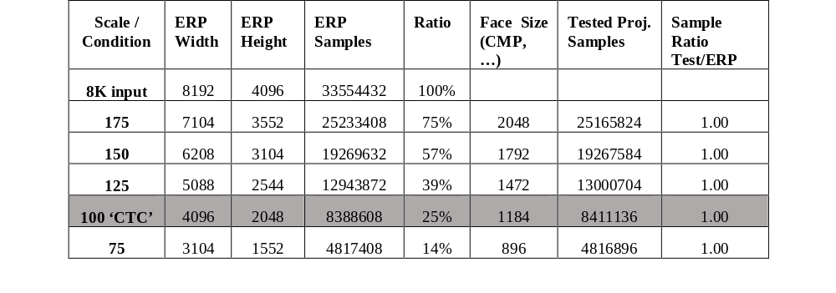
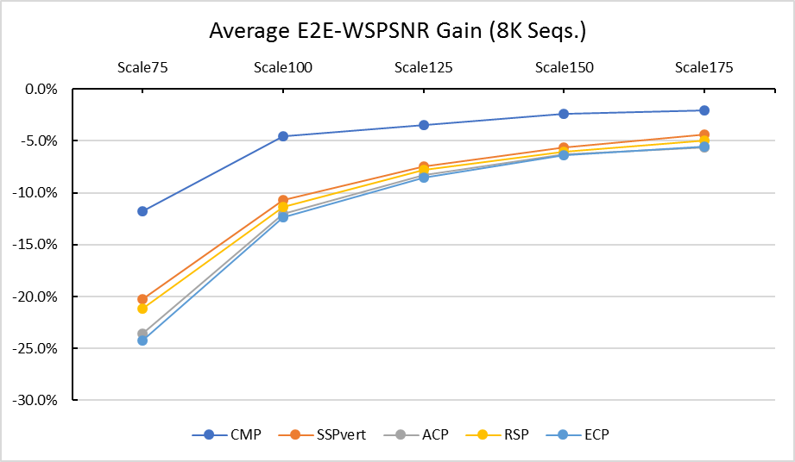
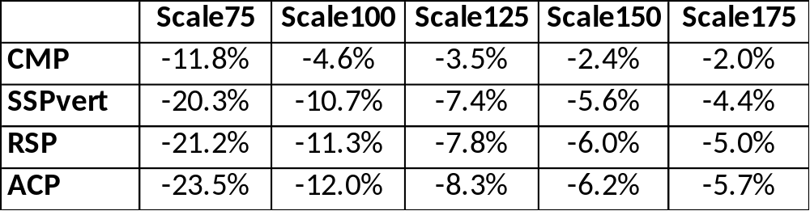
Results and Observations
8K ERP inputs
‘Scale 100’ is current CTC
Gain decreases with increasing coding size and appears to stabilize
Results use E2E WS-PSNR metric; observations consistent with other metrics

Slide 4
Conclusion
JVET 360-degree video CTC: 8K inputs are converted to a coding size that is 25% of the input size for both anchor and tested projection format.
Variations of this coding size were studied and it was observed that the coding gain varies significantly for the tested projection formats and decreases with increasing coding size.
Therefore, the coding results for 8K inputs that are reported per CTC are for the specific CTC size only.
It is suggested to reconsider the CTC coding size for 8K inputs by adding a second larger coding size or by modifying it; for example, 75% of the 8K input size to be consistent with coding size of 4K inputs.

Slide 5
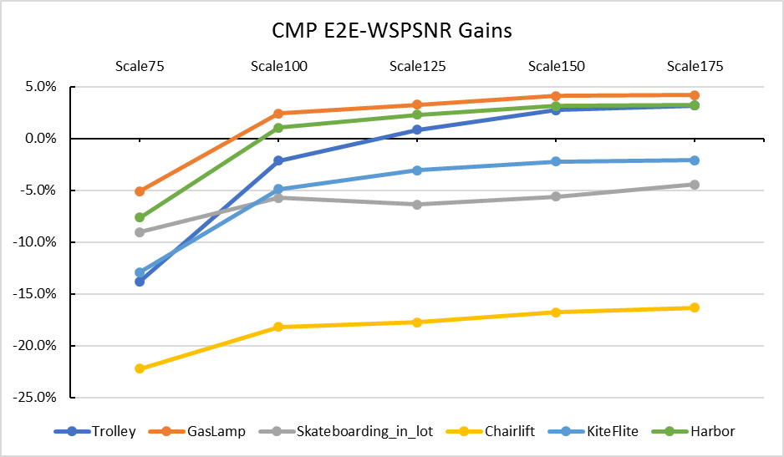
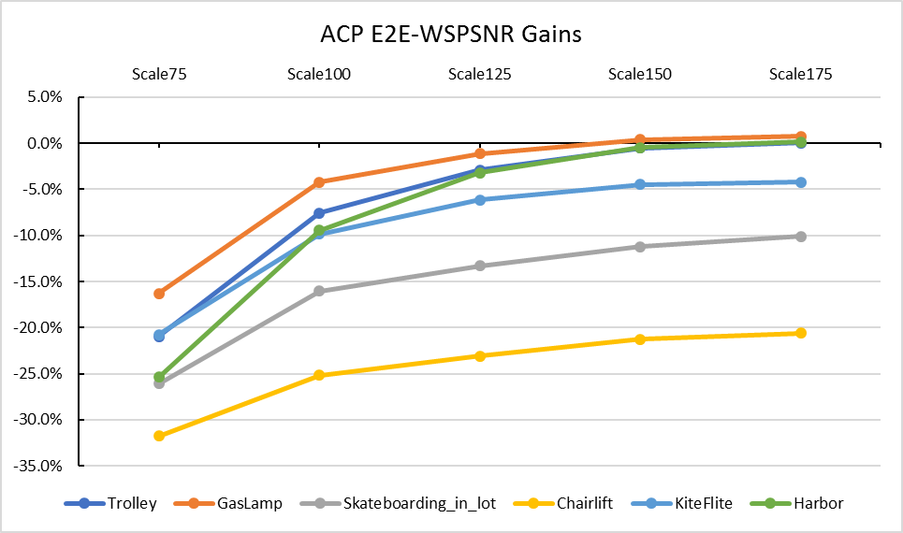
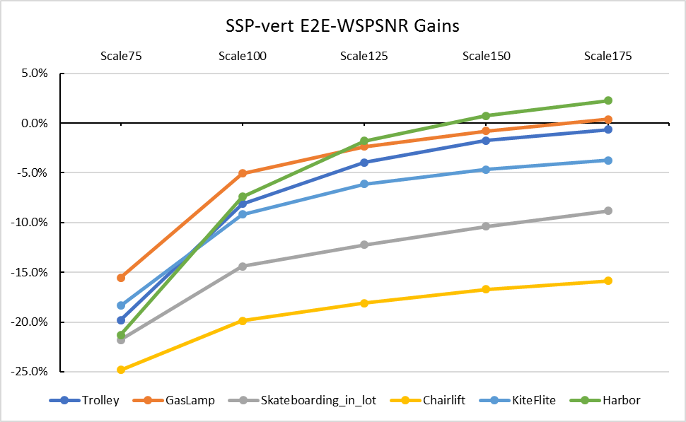
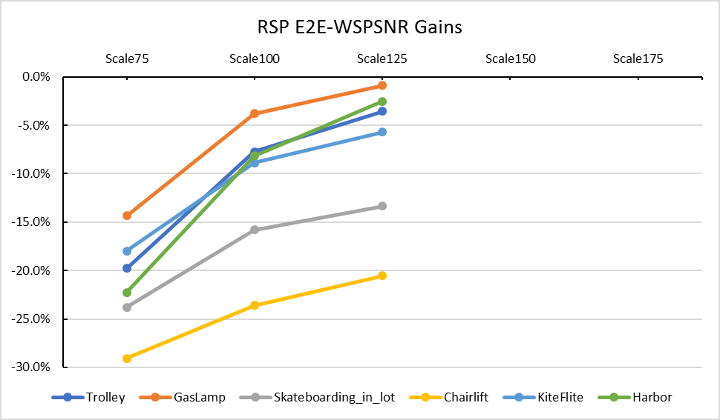
Backup

