Slide 1
F0096: Division free bilateral filtering
Jacob Ström, Kenneth Andersson, Per Wennersten, Martin Pettersson, Jack Enhorn and Rickard Sjöberg
Ericsson Research

Slide 2
Background
During the weekend, when the bilateral filter was discussed, it was requested to have a division-free implementation of JVET-F0034 test 2 demonstrated. It was also concluded that the smaller division-lookup-table (division-LUT) of about 1 kB was preferred. This contribution is a response to these requests.

Slide 3
Outline
To minimize the division LUT, nominator and denominator should be small.
Nominator is made small by using a differential form of the calculation (bit-exact)
Denominator is made small by excluding filtering for inter blocks of size 16x16 and larger
Result: Division is converted to multiplication (15 bits times 13 bits) with a division table of 576 bytes
BDR numbers:
  -0.4% / -0.5% / -0.5% / -0.5% for AI / RA / LD / LDP
  (-0.4% / -0.5% / -0.5% / -0.6%) previously

Slide 4
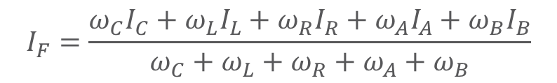
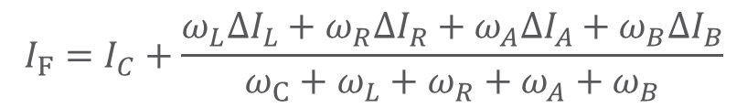
differential form
$$I_{F}=\frac{ω_{C}I_{C}+ω_{L}I_{L}+ω_{R}I_{R}+ω_{A}I_{A}+ω_{B}I_{B}}{ω_{C}+ω_{L}+ω_{R}+ω_{A}+ω_{B}}$$
Regular form
$$I_{F}=I_{C}+\frac{ω_{L}ΔI_{L}+ω_{R}ΔI_{R}+ω_{A}ΔI_{A}+ω_{B}ΔI_{B}}{ω_{C}+ω_{L}+ω_{R}+ω_{A}+ω_{B}}$$
Differential form (equivalent)

Slide 5
bdr numbers
-0.4% / -0.5% / -0.5% / -0.5% for AI / RA / LD / LDP
EE2 test2 (JVET-F0034) were
  -0.4% / -0.5% / -0.5% / -0.6%

Slide 6
SUMMARY
brute force
417792 bytes
test 1
56178
2202 bytes of LUT for bilateral filter coefficients
567 extra bytes of LUT for division-free version
BDR numbers:
      -0,4% / -0,5% / -0,5% / -0,5% (AI/RA/LDB/LDP)
Also:
  Division can be replaced by a multiplication + shift
  Decoding run times have decreased
    JVET-E0032: 5% / 3% / 5% / 3% (AI/RA/LDB/LDP)
    now: (F0096): 3% / 1% / 0% / 0%
  Encoding run times have also decreased
    JVET-E0032: 7% / 3% / 5% / 4%
    JVET-F0034: 6% / 3% / 2% / 3%
test 2
2202

Slide 7


