Slide 1
JVET-E0075/JCTVC-Z0025
Spherical rotation orientation SEI for coding of 360 video
Jill Boyce, Qian Xu

Slide 2
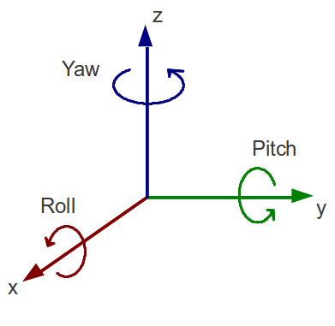
Overview
  Coding efficiency can be improved by applying rotation before encoding and after decoding for some Equirectangular projection (ERP) 360º video sequences
  For HEVC and AVC, an SEI message can be used to convey rotation parameters (pitch, yaw, roll)
    Conceptually similar to HEVC and AVC display orientation SEI message for normal rectangular video, expanded for 360º video
  For JEM, either an SEI message or picture parameter set can be used
    Similar to contributions JVET-E0050 and JVET-E0061

Slide 3
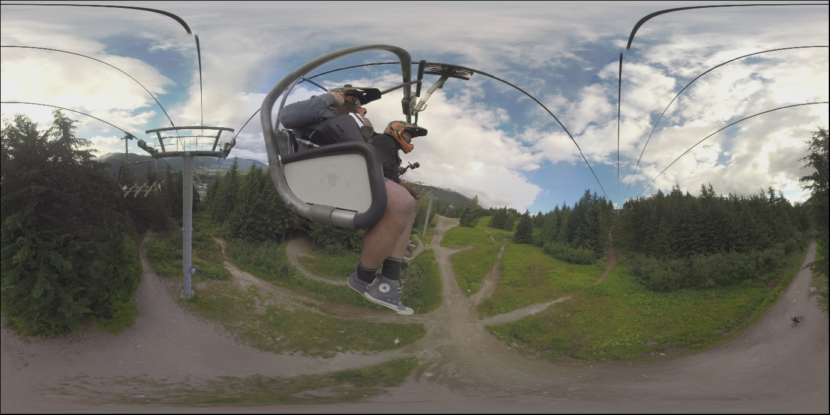
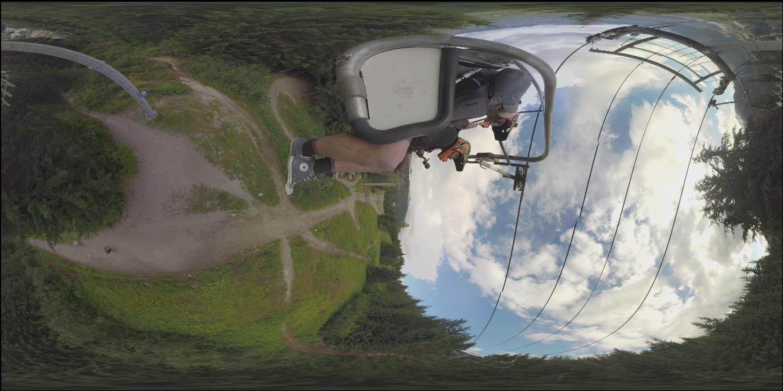
Example rotation
original
(79, 12, 0) rotation

Slide 4
Encoder algorithm
Non-normative automatic encoder algorithm developed
  HM16.14 software made available with JCTVC-Z0025 contribution
Activity measure for 4x4 CTU regions calculated based on modes and motion vectors of first pass encoding
Decide whether to rotate or not
Preproc algorithm is 2-6% of encoder runtime for HM16.14 QP=22 (unoptimized software)
When rotating, find most static areas, and move them to north and south poles
Second pass encode after applying rotation

Slide 5
Experimental results – HM16.14 WS-PSNR
2 of 10 sequences selected rotation
ERP rotation vs. ERP | WS-PSNR (End to End)
 | Y | U | V
Train | 0.0% | 0.0% | 0.0%
Skateboarding_trick | 0.0% | 0.0% | 0.0%
Skateboarding_in_lot | 0.0% | 0.0% | 0.0%
Chairlift | -17.8% | -8.8% | -10.3%
KiteFlite | 0.0% | 0.0% | 0.0%
Harbor | 0.0% | 0.0% | 0.0%
PoleVault | 0.0% | 0.0% | 0.0%
AerialCity | 0.0% | 0.0% | 0.0%
DrivingInCity | 0.0% | 0.0% | 0.0%
DrivingInCountry | -10.8% | -15.3% | -15.9%
Overall | -2.9% | -2.4% | -2.6%

Slide 6
Experimental results – HM16.14 Additional Metrics
ERP rotation vs. ERP | S-PSNR-NN |  |  | WS-PSNR |  |  | S-PSNR-I |  |  | CPP-PSNR
 | Y | U | V | Y | U | V | Y | U | V | Y | U | V
Train | 0.0% | 0.0% | 0.0% | 0.0% | 0.0% | 0.0% | 0.0% | 0.0% | 0.0% | 0.0% | 0.0% | 0.0%
Skateboarding _trick | 0.0% | 0.0% | 0.0% | 0.0% | 0.0% | 0.0% | 0.0% | 0.0% | 0.0% | 0.0% | 0.0% | 0.0%
Skateboarding _in_lot | 0.0% | 0.0% | 0.0% | 0.0% | 0.0% | 0.0% | 0.0% | 0.0% | 0.0% | 0.0% | 0.0% | 0.0%
Chairlift | -17.2% | -9.1% | -10.1% | -17.3% | -9.0% | -10.5% | -16.3% | -9.4% | -9.5% | -16.4% | -9.3% | -10.0%
KiteFlite | 0.0% | 0.0% | 0.0% | 0.0% | 0.0% | 0.0% | 0.0% | 0.0% | 0.0% | 0.0% | 0.0% | 0.0%
Harbor | 0.0% | 0.0% | 0.0% | 0.0% | 0.0% | 0.0% | 0.0% | 0.0% | 0.0% | 0.0% | 0.0% | 0.0%
PoleVault | 0.0% | 0.0% | 0.0% | 0.0% | 0.0% | 0.0% | 0.0% | 0.0% | 0.0% | 0.0% | 0.0% | 0.0%
AerialCity | 0.0% | 0.0% | 0.0% | 0.0% | 0.0% | 0.0% | 0.0% | 0.0% | 0.0% | 0.0% | 0.0% | 0.0%
DrivingInCity | 0.0% | 0.0% | 0.0% | 0.0% | 0.0% | 0.0% | 0.0% | 0.0% | 0.0% | 0.0% | 0.0% | 0.0%
DrivingInCountry | -11.1% | -15.2% | -15.5% | -11.3% | -15.2% | -15.7% | -11.0% | -14.8% | -15.0% | -11.3% | -14.7% | -15.0%
Overall | -2.8% | -2.4% | -2.6% | -2.9% | -2.4% | -2.6% | -2.7% | -2.4% | -2.4% | -2.8% | -2.4% | -2.5%

Slide 7
Experimental results – JEM 4.0 WS-PSNR
ERP rotation vs. ERP | WS-PSNR (End to End)
 | Y | U | V
Train | 0.0% | 0.0% | 0.0%
Skateboarding_trick | 0.0% | 0.0% | 0.0%
Skateboarding_in_lot | 0.0% | 0.0% | 0.0%
Chairlift | -12.3% | -2.3% | -3.0%
KiteFlite | 0.0% | 0.0% | 0.0%
Harbor | 0.0% | 0.0% | 0.0%
PoleVault | 0.0% | 0.0% | 0.0%
AerialCity | 0.0% | 0.0% | 0.0%
DrivingInCity | 0.0% | 0.0% | 0.0%
DrivingInCountry | -10.3% | -14.7% | -17.8%
Overall | -2.3% | -1.7% | -2.1%

Slide 8
Experimental results – JEM4.1 Additional Metrics
ERP rotation vs. ERP | S-PSNR-NN |  |  | WS-PSNR |  |  | S-PSNR-I |  |  | CPP-PSNR
 | Y | U | V | Y | U | V | Y | U | V | Y | U | V
Train | 0.0% | 0.0% | 0.0% | 0.0% | 0.0% | 0.0% | 0.0% | 0.0% | 0.0% | 0.0% | 0.0% | 0.0%
Skateboarding _trick | 0.0% | 0.0% | 0.0% | 0.0% | 0.0% | 0.0% | 0.0% | 0.0% | 0.0% | 0.0% | 0.0% | 0.0%
Skateboarding _in_lot | 0.0% | 0.0% | 0.0% | 0.0% | 0.0% | 0.0% | 0.0% | 0.0% | 0.0% | 0.0% | 0.0% | 0.0%
Chairlift | -11.4% | -2.5% | -2.7% | -11.5% | -2.2% | -3.2% | -10.3% | -2.9% | -1.8% | -10.5% | -2.7% | -2.3%
KiteFlite | 0.0% | 0.0% | 0.0% | 0.0% | 0.0% | 0.0% | 0.0% | 0.0% | 0.0% | 0.0% | 0.0% | 0.0%
Harbor | 0.0% | 0.0% | 0.0% | 0.0% | 0.0% | 0.0% | 0.0% | 0.0% | 0.0% | 0.0% | 0.0% | 0.0%
PoleVault | 0.0% | 0.0% | 0.0% | 0.0% | 0.0% | 0.0% | 0.0% | 0.0% | 0.0% | 0.0% | 0.0% | 0.0%
AerialCity | 0.0% | 0.0% | 0.0% | 0.0% | 0.0% | 0.0% | 0.0% | 0.0% | 0.0% | 0.0% | 0.0% | 0.0%
DrivingInCity | 0.0% | 0.0% | 0.0% | 0.0% | 0.0% | 0.0% | 0.0% | 0.0% | 0.0% | 0.0% | 0.0% | 0.0%
DrivingInCountry | -10.6% | -14.5% | -17.1% | -10.9% | -14.4% | -17.4% | -10.4% | -13.9% | -16.3% | -10.8% | -13.7% | -16.2%
Overall | -2.2% | -1.7% | -2.0% | -2.2% | -1.7% | -2.1% | -2.1% | -1.7% | -1.8% | -2.1% | -1.6% | -1.9%

Slide 9
Encoder + Preprocessing runtime results
HM 16.14 | preproc at QP=22 | enc + rotation | preproc + enc | Total with two-pass enc | Total w/ one-pass enc | Enc anchor | EncT | Preproc as onepass enc %
Train | 1797.70 | 81235.44 | 83033.14 | 166211.80 |  | 83178.66 | 200% | 2%
Skateboarding_trick | 2538.68 | 87834.60 | 90373.28 |  | 90373.28 | 90202.53 | 100% | 3%
Skateboarding_in_lot | 5130.91 | 91149.18 | 96280.09 |  | 96280.09 | 94048.55 | 102% | 5%
Chairlift | 3441.13 | 53238.29 | 56679.42 |  | 56679.42 | 56675.09 | 100% | 6%
KiteFlite | 2622.41 | 40853.81 | 43476.22 |  | 43476.22 | 42697.01 | 102% | 6%
Harbor | 2104.99 | 36379.08 | 38484.07 |  | 38484.07 | 37329.35 | 103% | 6%
PoleVault | 2199.90 | 37661.97 | 39861.87 |  | 39861.87 | 39071.09 | 102% | 6%
AerialCity | 1739.80 | 29575.85 | 31315.65 |  | 31315.65 | 29926.52 | 105% | 6%
DrivingInCity | 1897.58 | 32844.28 | 34741.86 |  | 34741.86 | 35367.51 | 98% | 5%
DrivingInCountry | 2120.36 | 38314.76 | 40435.12 | 85567.66 |  | 45132.54 | 190% | 5%

Slide 10
Proposed SEI Message Syntax
spherical_orientation( payloadSize ) { | Descriptor
spherical_orientation_cancel_flag | u(1)
if( !spherical_orientation_cancel_flag ) {
spherical_orientation_precision | ue(v)
spherical_orientation_yaw | se(v)
spherical_orientation_pitch | se(v)
spherical_orientation_roll | se(v)
spherical_orientation_persistence_flag | u(1)
}
}

Slide 11
Proposed semantics
spherical_orientation_yaw specifies the recommended spherical rotation of the projection mapped decoded picture along the Z-axis prior to display. The projection mapped decoded picture should be rotated along the Z-axis by 180* spherical_orientation_yaw ÷ 2spherical_orientation_precision degrees (π * spherical_orientation_yaw ÷ 2sperhical_orientation_precision radians, where π is Archimedes' constant 3.141 592 653 589 793...) in the anticlockwise direction prior to display.
spherical_orientation_pitch specifies the recommended spherical rotation of the projection mapped decoded picture along the Y-axis prior to display. The projection mapped decoded picture should be rotated along the Y-axis by 180 * spherical_orientation_pitch ÷ 2spherical_orientation_precision degrees (π * spherical_orientation_pitch ÷ 2sperhical_orientation_precision radians, in the anticlockwise direction prior to display.
spherical_orientation_roll specifies the recommended spherical rotation of the projection mapped decoded picture along the X-axis prior to display. The projection mapped decoded picture should be rotated along the X-axis by 180 * spherical_orientation_roll ÷ 2spherical_orientation_precision degrees (π * spherical_orientation_roll ÷ 2sperhical_orientation_precision radians, in the anticlockwise direction prior to display.
spherical_orientation_persistence_flag specifies the persistence of the spherical orientation SEI message for …
When the associated picture has PicOutputFlag equal to 1, the spherical orientation SEI message informs the decoder of a transformation that is recommended to be applied to a spherical mapping of the cropped decoded picture prior to display. If the omnidirectional_projectionSEI message is present in an access unit, the spherical_orientation SEI should follow it. The recommended projection mapping indicated by the omnidirectional_projection SEI should be performed first to map the cropped decoded picture to a sphere, and then the recommended spherical rotation should be applied.
spherical_orientation_cancel_flag equal to 1 indicates that the SEI message cancels the persistence of any previous spherical orientation SEI message in output order. spherical_orientation_cancel_flag equal to 0 indicates that spherical orientation information follows.
spherical_orientation_precision specifies the precision of spherical_orientation_pitch, spherical_orientation_yaw, and spherical_orientation_roll. spherical_orientation_precision shall be in the range of 0 to 15 inclusive.

Slide 12
Conclusion
Recommend to add an SEI message to indicate spherical rotation information to HEVC and AVC
  Message is independent of particular spherical projection format used
  Could be combined with omnidirectional projection information SEI (as proposed in JCTVC-Z0036) or separate
Normative behavior in PPS for JEM also proposed
Example automatic encoder algorithm & software provided to demonstrate practical for encoder to use SEI message

