Slide 1
Luma delta QP adjustment based on video statistical information
2016. 2
JCTVC-W0039
JVET-C0102

Slide 2
Contents
Luma QP adjustment
Proposed Method
Metric Results
Subjective Results

Slide 3
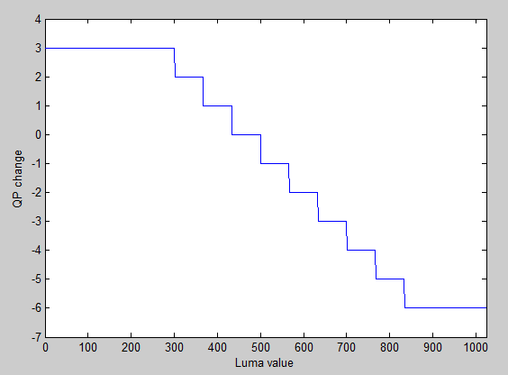
Luma QP adjustment
Luma QP adjustment
  QP adjustment based on average luminance value
  QP adjustment in CTU
    DQP = [-3 -2 -1 0 1 2 3 4 5 6]
    Luma value = [0 301 367 434 501 567 634 701 767 834]
  Improvement of average deltaE 3.5%
  Decrease performance in dark regions or sequences
    FireEater2(22.8%), MagicHour(average 17%), WarmNight(average 18%)

Slide 4
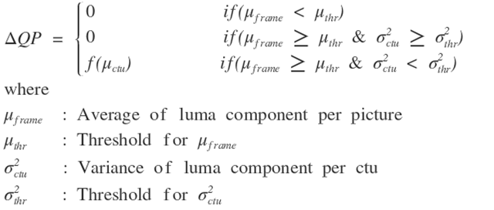
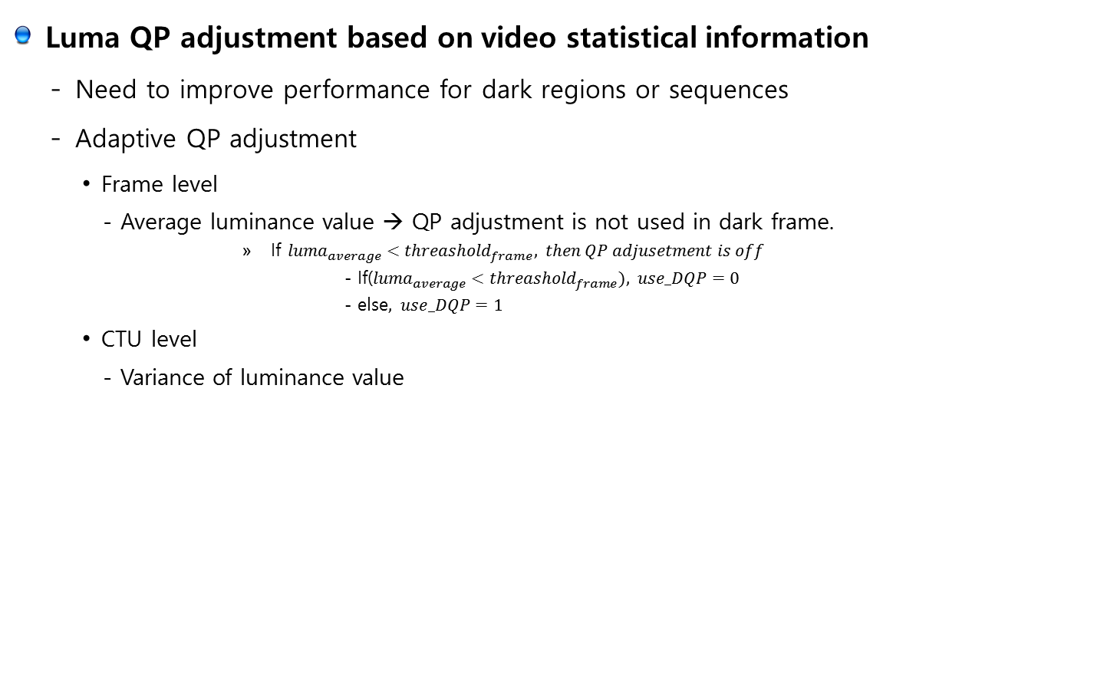
Proposed Method
Luma QP adjustment based on video statistical information
  Need to improve performance for dark regions or sequences
  Adaptive QP adjustment
    Frame level
      - Average luminance value → QP adjustment is not used in dark frame.
        If ${luma}_{average}<{threashold}_{frame}, then QP adjusetment is off$
          - If(${luma}_{average}<{threashold}_{frame}), use_DQP=0$
          - else$, use_DQP=1$
    CTU level
      - Variance of luminance value

Slide 5
Metric Results
 |  | X | Y | Z | XYZ | tOSNR- XYZ | DE100 | MD100 | PSNRL100 | PSNR Y | PSNR U | PSNR V
class A | FireEaterClip4000r1 | -12.4% | -7.6% | -14.0% | -11.2% | -18.3% | -17.6% | -1.0% | 1.6% | -5.6% | -37.4% | -46.5%
 | Market3Clip4000r2 | -2.2% | -2.0% | -1.9% | -2.0% | -0.1% | -1.3% | -95.4% | 4.3% | -2.1% | -7.4% | -33.9%
 | SunRise | -7.1% | -7.2% | -8.6% | -7.7% | -3.9% | -6.4% | -37.7% | 4.5% | -7.4% | -8.9% | -33.2%
class B | BikeSparklers cut 1 | -3.6% | -3.5% | -4.4% | -3.7% | -6.2% | -11.0% | -19.4% | -0.1% | -3.6% | -13.6% | -29.2%
 | BikeSparklers cut 2 | -2.0% | -1.9% | -2.8% | -2.1% | -4.2% | -7.2% | -15.0% | 1.1% | -2.0% | -10.9% | -16.6%
 | GarageExit | -0.6% | -0.3% | -1.7% | -1.0% | -1.2% | -5.0% | -3.6% | 1.5% | -0.4% | -6.0% | -13.9%
class C | ShowGirl2Teaser | -0.9% | 0.9% | -1.4% | -0.4% | 2.3% | -7.4% | -2.9% | 5.7% | 0.7% | -15.9% | -37.8%
class D | StEM_MagicHour cut 1 | -1.7% | 1.4% | -7.7% | -3.6% | -4.3% | -18.3% | -24.8% | 2.9% | 1.7% | -23.7% | -34.3%
 | StEM_MagicHour cut 2 | -0.4% | 1.3% | -5.6% | -2.3% | -3.3% | -15.1% | -8.3% | 2.3% | 1.4% | -19.3% | -34.7%
 | StEM_MagicHour cut 3 | -1.2% | 0.9% | -6.8% | -3.3% | -4.7% | -14.8% | 10.4% | 2.7% | 1.1% | -22.3% | -35.5%
 | StEM_WarmNight cut 1 | -2.1% | -0.1% | -5.1% | -2.7% | -3.8% | -17.3% | 0.1% | 2.1% | 0.0% | -28.7% | -36.4%
 | StEM_WarmNight cut 2 | -2.5% | 0.8% | -5.2% | -2.7% | -4.0% | -13.8% | -5.5% | 3.1% | 1.2% | -24.9% | -34.0%
class G | BalloonFestival | -0.4% | -0.1% | -1.4% | -0.8% | -0.6% | -2.5% | -17.5% | 1.4% | -0.1% | -6.9% | -11.7%
class H | EBU_04_Hurdles | -0.7% | -0.6% | -0.5% | -0.6% | -0.4% | -0.4% | 4.9% | -0.1% | -0.6% | -1.3% | -0.6%
 | EBU_06_Start | -2.1% | -1.5% | -3.0% | -2.3% | -2.2% | -4.4% | 4.1% | 0.8% | -1.5% | -8.0% | -9.5%
 | Overall | -2.7% | -1.3% | -4.7% | -3.1% | -3.7% | -9.5% | -14.1% | 2.2% | -1.2% | -15.7% | -27.2%

Slide 6
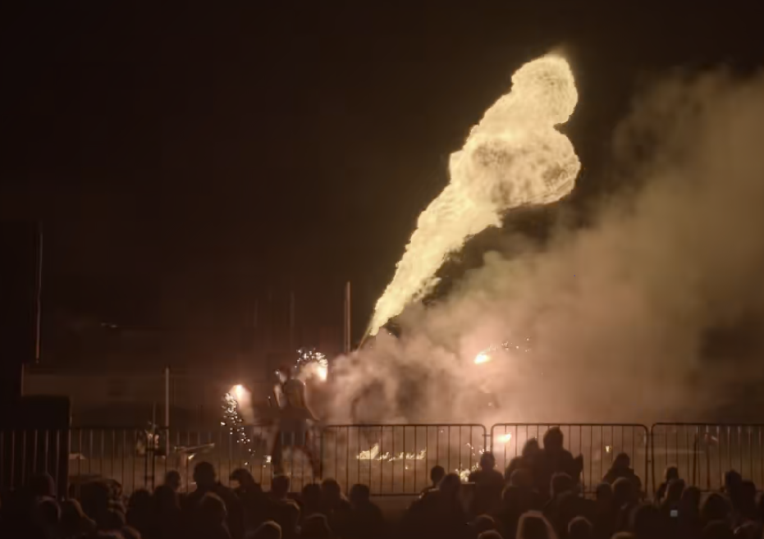


Subjective Results
FireEater BR4
Anchor v3.2 (524kbps)
Original
Proposed method (521.5kbps)

Slide 7
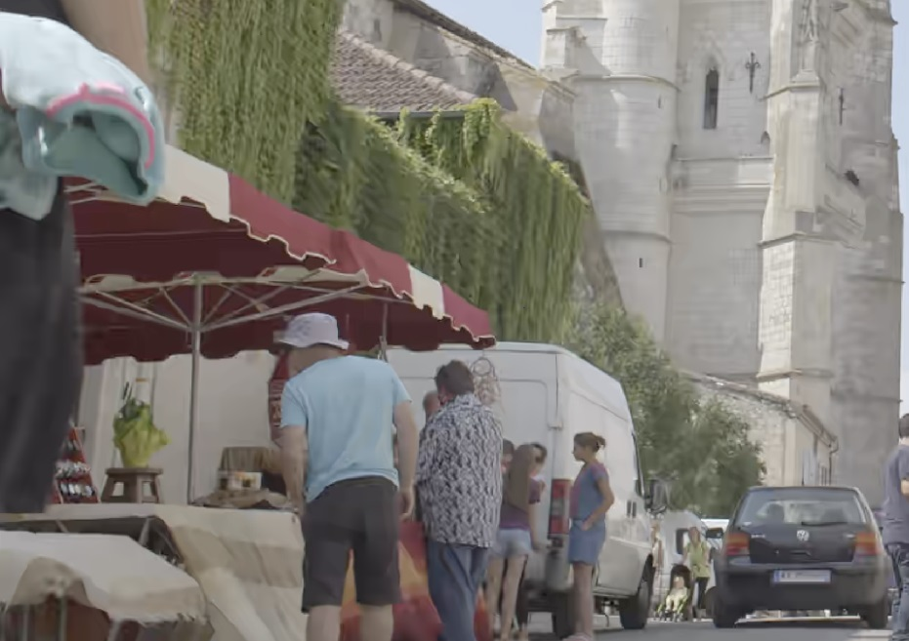


Subjective Results
Market BR4
Anchor v3.2 (1268.4kbps)
Original
Proposed method (1260.6kbps)

Slide 8
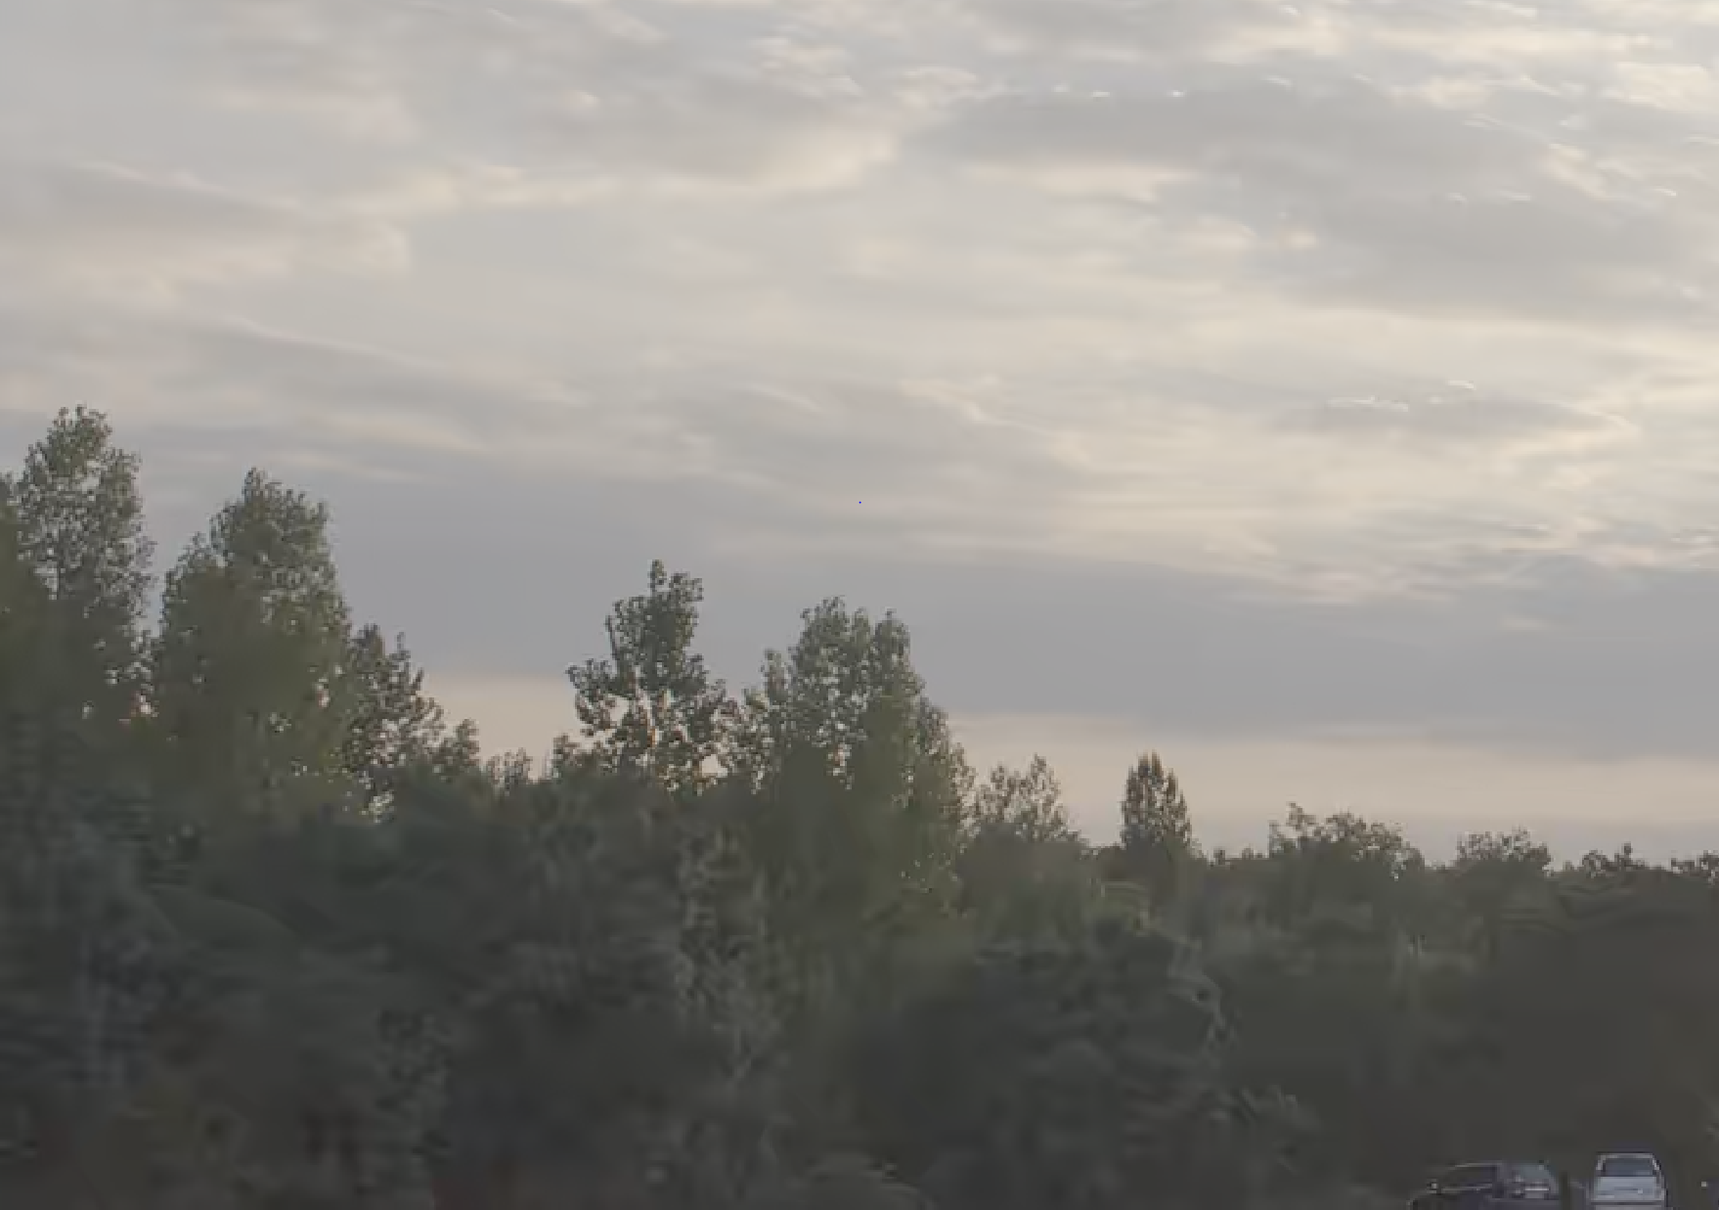
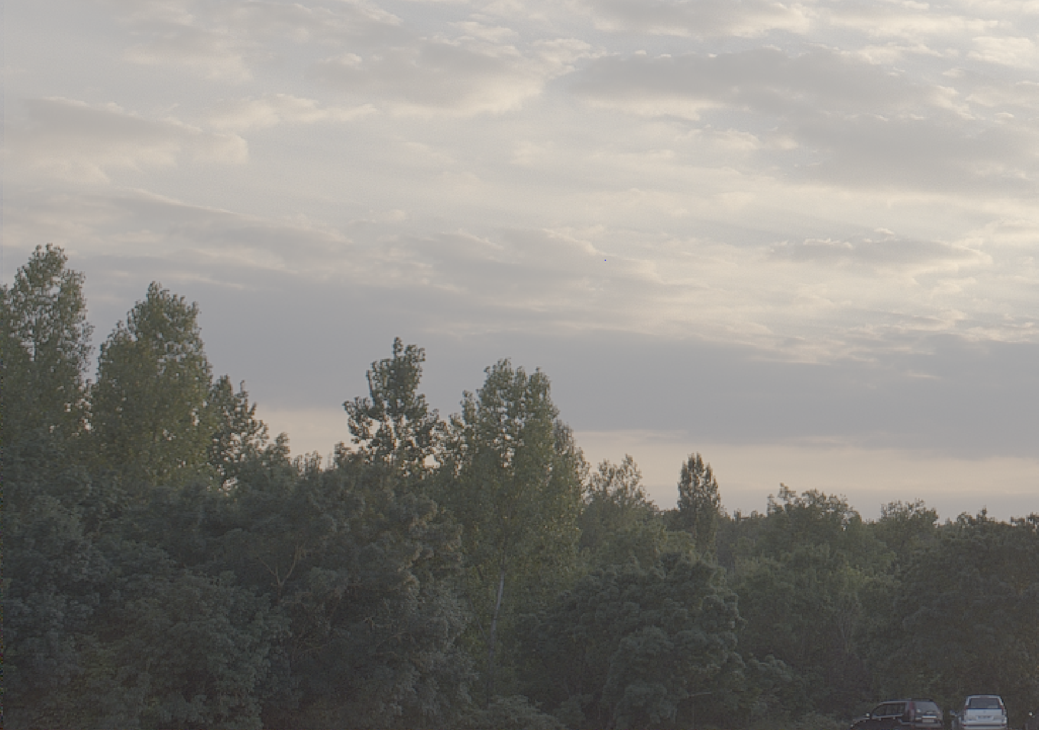
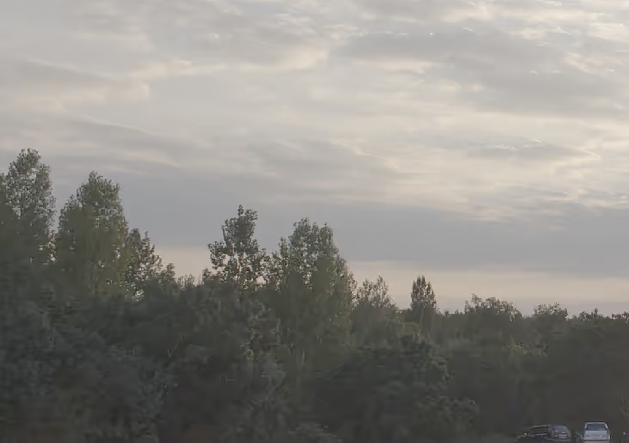
Subjective Results
Sunrise BR4
Anchor v3.2 (318.6kbps)
Original
Proposed method (314.6kbps)

Slide 9
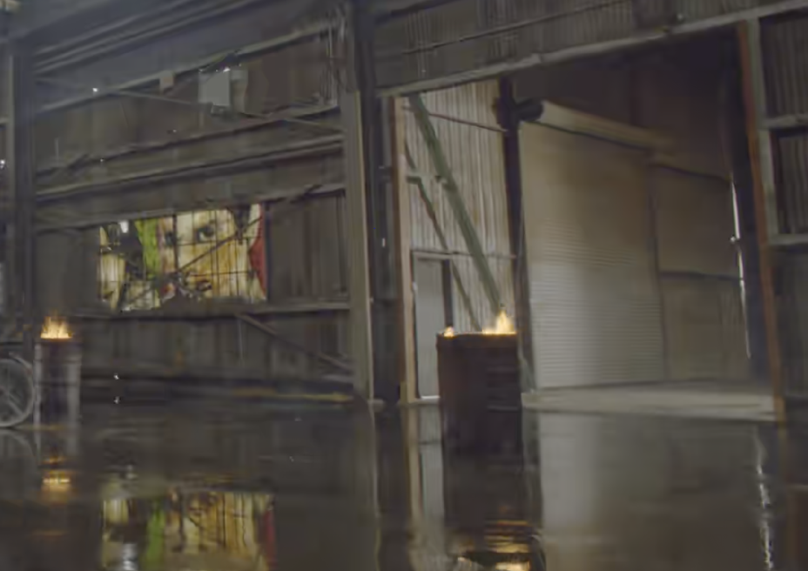
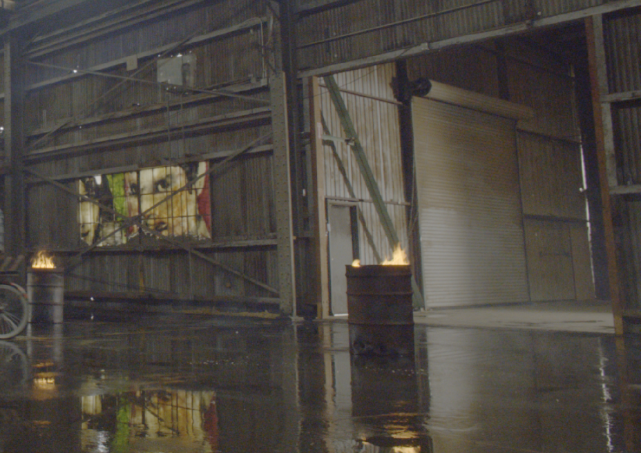
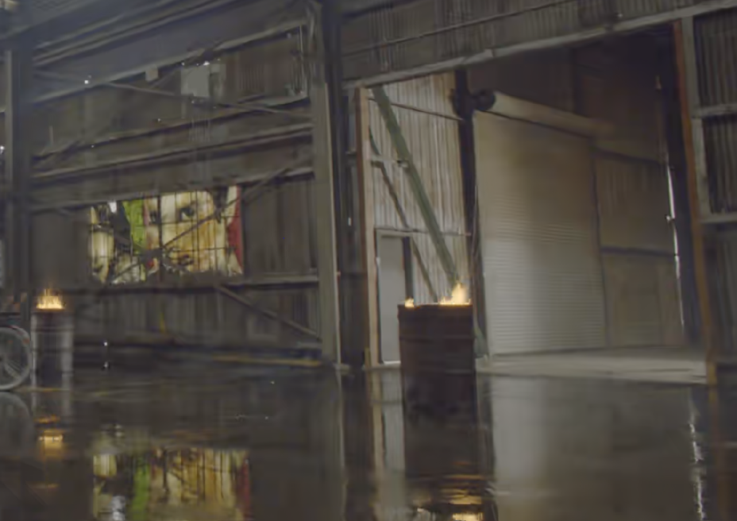
Subjective Results
BikeSparklers Cut1 BR4
Anchor v3.2 (1193.9kbps)
Original
Proposed method (1182.3kbps)

Slide 10
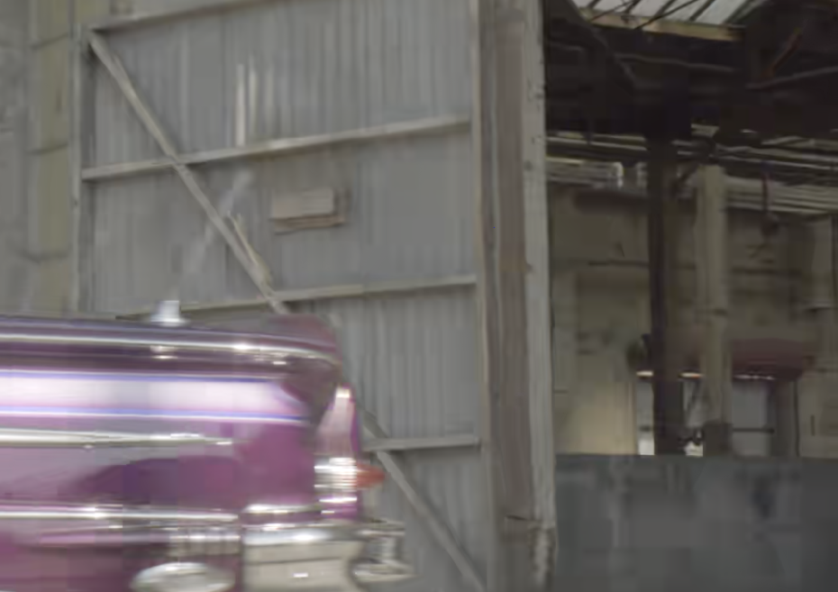

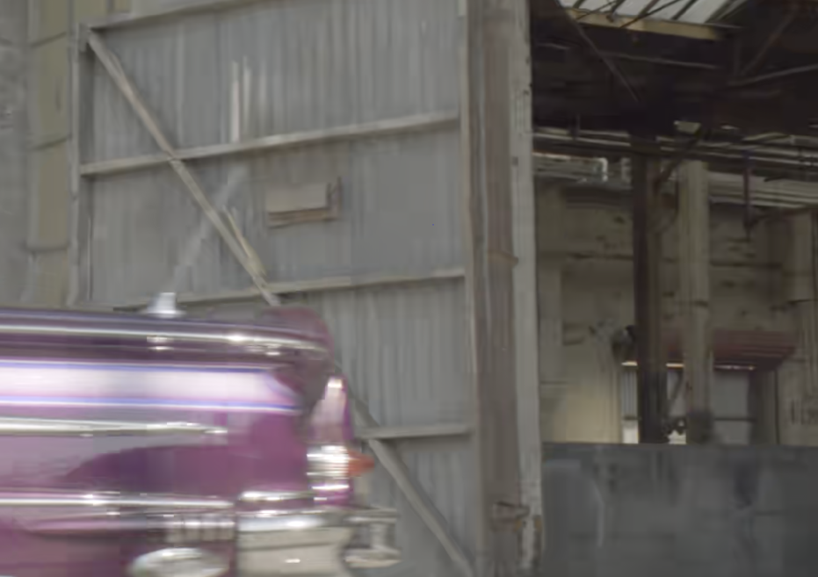
Subjective Results
GarageExit BR4
Anchor v3.2 (460.4kbps)
Original
Proposed method (456.7kbps)

Slide 11
Thank You

Slide 12
Metric Results (Only Frame level)
 |  | X | Y | Z | XYZ | tOSNR- XYZ | DE100 | MD100 | PSNRL100 | PSNR Y | PSNR U | PSNR V
class A | FireEaterClip4000r1 | -12.4% | -7.6% | -14.0% | -11.2% | -18.3% | -17.6% | -1.0% | 1.6% | -5.6% | -37.4% | -46.5%
 | Market3Clip4000r2 | 0.0% | 0.0% | 0.0% | 0.0% | 0.0% | 0.0% | 0.0% | 0.0% | 0.0% | 0.0% | 0.0%
 | SunRise | 0.0% | 0.0% | 0.0% | 0.0% | 0.0% | 0.0% | 0.0% | 0.0% | 0.0% | 0.0% | 0.0%
class B | BikeSparklers cut 1 | 0.0% | 0.0% | 0.0% | 0.0% | 0.0% | 0.0% | 0.0% | 0.0% | 0.0% | 0.0% | 0.0%
 | BikeSparklers cut 2 | 0.0% | 0.0% | 0.0% | 0.0% | 0.0% | 0.0% | 0.0% | 0.0% | 0.0% | 0.0% | 0.0%
 | GarageExit | 0.0% | 0.0% | 0.0% | 0.0% | 0.0% | 0.0% | 0.0% | 0.0% | 0.0% | 0.0% | 0.0%
class C | ShowGirl2Teaser | 0.9% | 2.2% | 3.8% | 2.3% | 3.5% | -3.4% | 6.0% | 2.4% | 2.1% | 3.2% | -23.1%
class D | StEM_MagicHour cut 1 | -1.7% | 1.4% | -7.7% | -3.6% | -4.3% | -18.3% | -24.8% | 2.9% | 1.7% | -23.7% | -34.3%
 | StEM_MagicHour cut 2 | -0.4% | 1.3% | -5.6% | -2.3% | -3.3% | -15.1% | -8.3% | 2.3% | 1.4% | -19.3% | -34.7%
 | StEM_MagicHour cut 3 | -1.2% | 0.9% | -6.8% | -3.3% | -4.7% | -14.8% | 10.4% | 2.7% | 1.1% | -22.3% | -35.5%
 | StEM_WarmNight cut 1 | -2.1% | -0.1% | -5.1% | -2.7% | -3.8% | -17.3% | 0.1% | 2.1% | 0.0% | -28.7% | -36.4%
 | StEM_WarmNight cut 2 | -2.5% | 0.8% | -5.2% | -2.7% | -4.0% | -13.8% | -5.5% | 3.1% | 1.2% | -24.9% | -34.0%
class G | BalloonFestival | 0.0% | 0.0% | 0.0% | 0.0% | 0.0% | 0.0% | 0.0% | 0.0% | 0.0% | 0.0% | 0.0%
class H | EBU_04_Hurdles | 0.0% | 0.0% | 0.0% | 0.0% | 0.0% | 0.0% | 0.0% | 0.0% | 0.0% | 0.0% | 0.0%
 | EBU_06_Start | 0.0% | 0.0% | 0.0% | 0.0% | 0.0% | 0.0% | 0.0% | 0.0% | 0.0% | 0.0% | 0.0%
 | Overall | -1.3% | -0.1% | -2.7% | -1.6% | -2.3% | -6.7% | -1.5% | 1.1% | 0.1% | -10.2% | -16.3%

