Slide 1
Decoupled Luma/Chroma Transform trees for Intra
JVET-C0039
May 2016
F.Urban, T.Poirier, F.Le Léannec

Slide 2
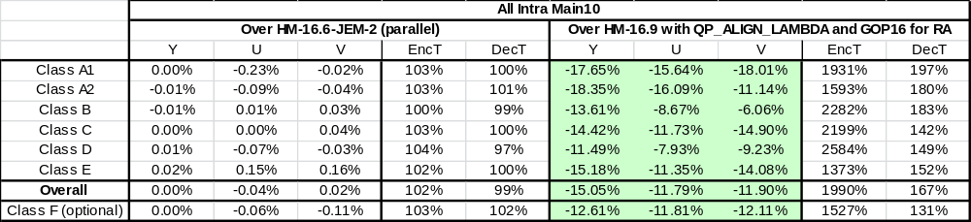
Bugfix
  Minor bugfix
    emt_cu_flag is estimated for both luma and chroma but coded only once
    Results: bugfix vs JEM2.0

Slide 3
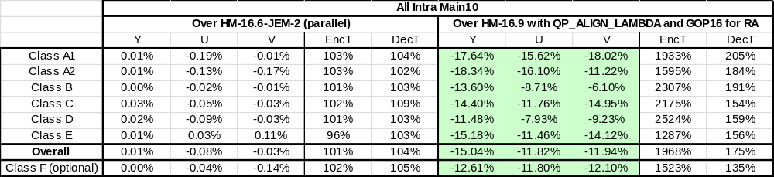
New RDO process
  JEM 2.0
    In chroma, if transform tree is subdivided, CABAC contexts are not updated after each tree block coding estimation
    Results: CABAC update + bugfix vs JEM2.0

Slide 4
Introduction
  JEM2.0
  Luma and Chroma share the same Transform Tree
Luma TUs
Chroma TUs
CTU
CU

Slide 5
Proposal
  Decoupled Luma/Chroma
  Chroma Transform Tree is a subset of the Luma Transform Tree
Luma TUs
Chroma TUs Candidates
CTU
CU
ChromaTuSplit=0
NoChromaTuSplit
ChromaTuSplit=1

Slide 6
Syntax and process
  A new split_transform_chroma_flag is coded
    Chroma Transform Tree cannot be more split than Luma Transform Tree
  Luma and Chroma Transform syntax is no more interlaced, Luma is now coded before Chroma
  Deblocking filter is modified accordingly to handle chroma TU edges

Slide 7
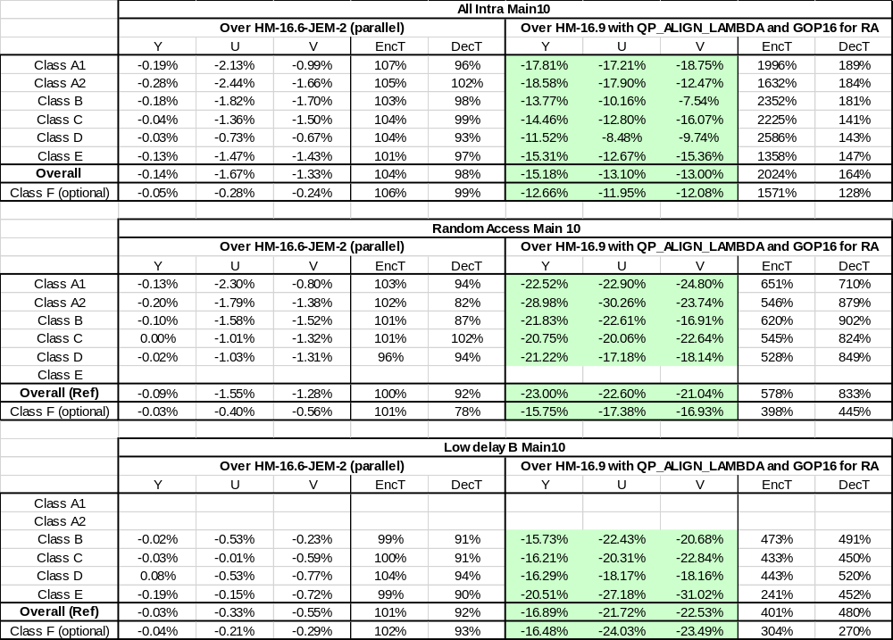
Performances of Decoupled Luma/Chroma Transform Trees for Intra vs JEM2.0

Slide 8
Performances of Decoupled Luma/Chroma Transform Trees for Intra vs bugfix+RDO
 | All Intra Main10
 | Over HM-16.6-JEM-2 (parallel) |  |  |  |  | Over HM-16.9 with QP_ALIGN_LAMBDA and GOP16 for RA
 | Y | U | V | EncT | DecT | Y | U | V | EncT | DecT
Class A1 | -0.20% | -1.95% | -0.98% | 103% | 92% | -17.81% | -17.21% | -18.75% | 1996% | 189%
Class A2 | -0.29% | -2.31% | -1.48% | 102% | 100% | -18.58% | -17.90% | -12.47% | 1632% | 184%
Class B | -0.19% | -1.80% | -1.69% | 102% | 95% | -13.77% | -10.16% | -7.54% | 2352% | 181%
Class C | -0.07% | -1.31% | -1.46% | 102% | 92% | -14.46% | -12.80% | -16.07% | 2225% | 141%
Class D | -0.04% | -0.65% | -0.64% | 102% | 90% | -11.52% | -8.48% | -9.74% | 2586% | 143%
Class E | -0.14% | -1.50% | -1.54% | 106% | 94% | -15.31% | -12.67% | -15.36% | 1358% | 147%
Overall | -0.16% | -1.60% | -1.30% | 103% | 94% | -15.18% | -13.10% | -13.00% | 2024% | 164%
Class F (optional) | -0.05% | -0.24% | -0.10% | 103% | 95% | -12.66% | -11.95% | -12.08% | 1571% | 128%

