Slide 1
JVET-B0060 – Improvements on Adaptive Loop Filter
Marta Karczewicz, Li Zhang, Wei-Jung Chien, Xiang Li

Slide 2
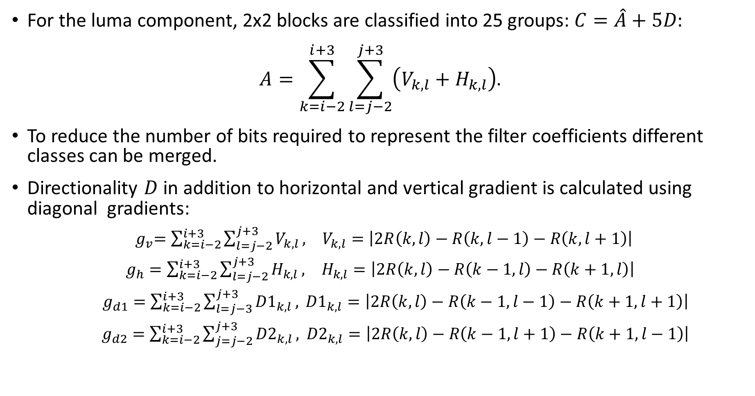
Classification
For the luma component, 2x2 blocks are classified into 25 groups: $C=\hat{A}+5D:$
$$A=\sum_{k=i−2}^{i+3}{\sum_{l=j−2}^{j+3}{\left(V_{k,l}+H_{k,l}\right).}}$$
To reduce the number of bits required to represent the filter coefficients different classes can be merged.
Directionality $D$ in addition to horizontal and vertical gradient is calculated using diagonal gradients:
${ g}_{v}=\sum_{k=i−2}^{i+3}{\sum_{l=j−2}^{j+3}{V_{k,l}}, V_{k,l}=\left|2R\left(k,l\right)−R\left(k,l−1\right)−R\left(k,l+1\right)\right|}$
$g_{h}=\sum_{k=i−2}^{i+3}{\sum_{l=j−2}^{j+3}{H_{k,l}}, H_{k,l}=\left|2R\left(k,l\right)−R\left(k−1,l\right)−R\left(k+1,l\right)\right|}$
  $g_{d1}=\sum_{k=i−2}^{i+3}{\sum_{l=j−3}^{j+3}{{D1}_{k,l}}, {D1}_{k,l}=\left|2R\left(k,l\right)−R\left(k−1,l−1\right)−R\left(k+1,l+1\right)\right|}$
  $g_{d2}=\sum_{k=i−2}^{i+3}{\sum_{j=j−2}^{j+3}{{D2}_{k,l}},} {D2}_{k,l}=\left|2R\left(k,l\right)−R\left(k−1,l+1\right)−R\left(k+1,l−1\right)\right|$

Slide 3
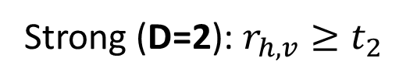
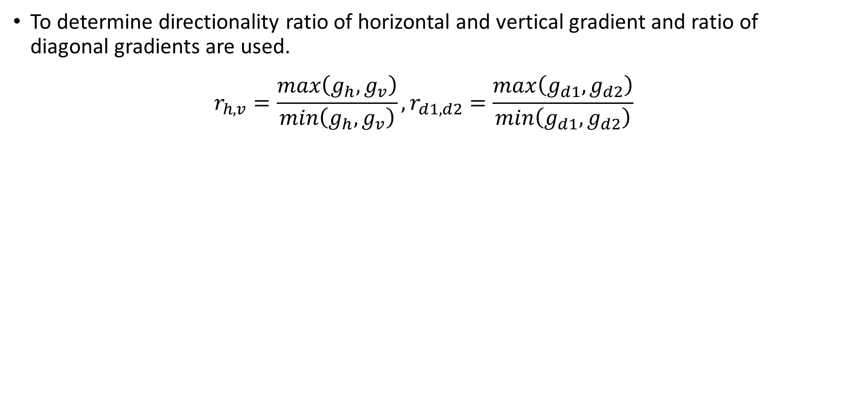
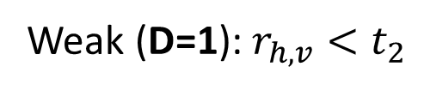
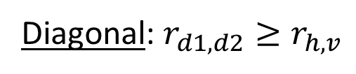
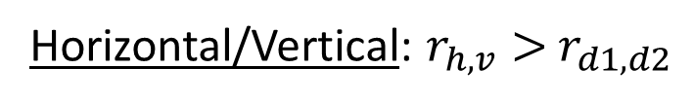
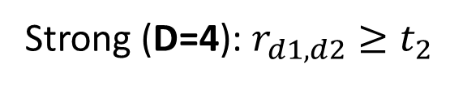
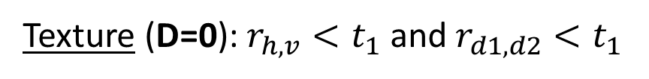
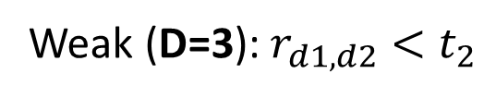
Classification
To determine directionality ratio of horizontal and vertical gradient and ratio of diagonal gradients are used.
$$r_{h,v}=\frac{max\left(g_{h},g_{v}\right)}{min\left(g_{h},g_{v}\right)},r_{d1,d2}=\frac{max\left(g_{d1},g_{d2}\right)}{min\left(g_{d1},g_{d2}\right)}$$
Texture (D=0): $r_{h,v}<t_{1}$ and $r_{d1,d2}<t_{1}$
Weak (D=3): $r_{d1,d2}<t_{2}$
Diagonal: $r_{d1,d2}≥r_{h,v}$
Strong (D=4): $r_{d1,d2}≥t_{2}$
Weak (D=1): $r_{h,v}<t_{2}$
Horizontal/Vertical: $r_{h,v}>$ $r_{d1,d2}$
Strong (D=2): $r_{h,v}≥t_{2}$

Slide 4
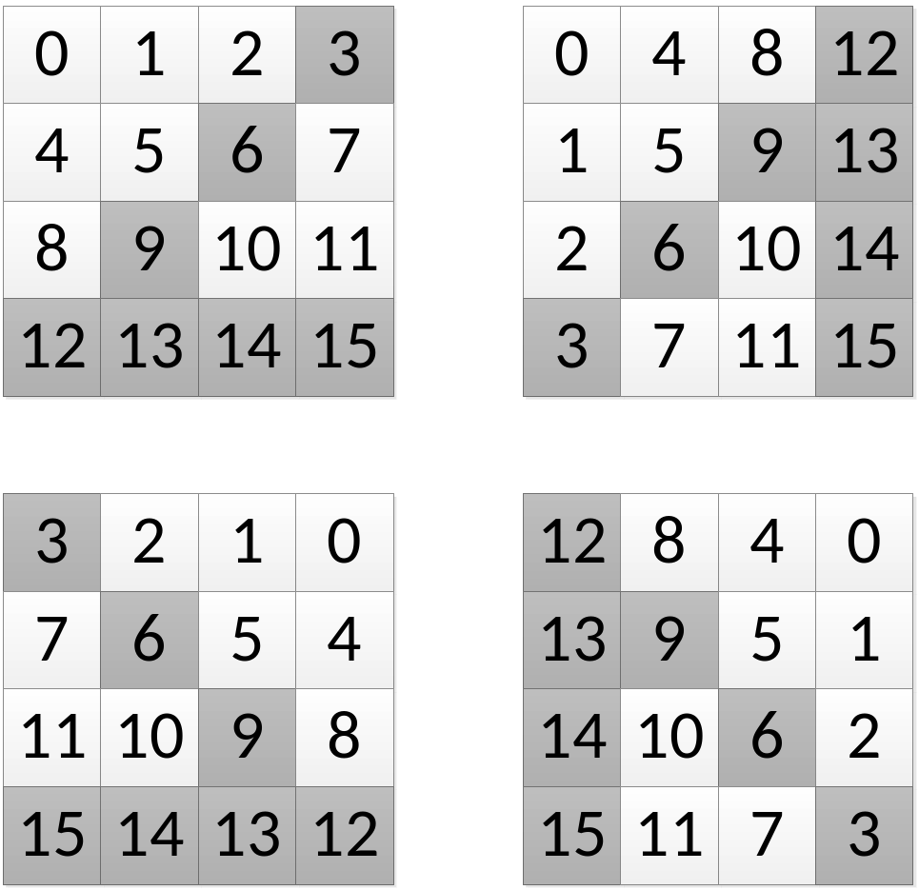


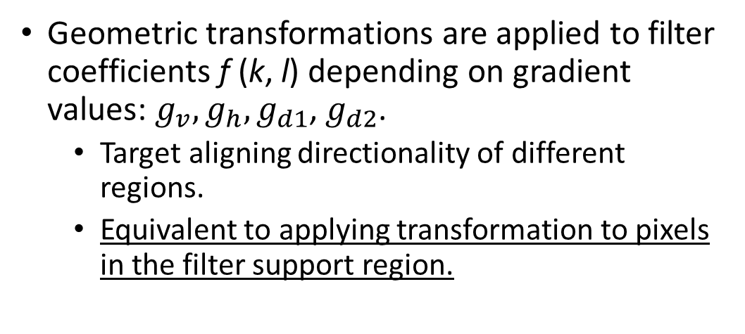



Geometric Transformation of Filter Coefficients
Geometric transformations are applied to filter coefficients f (k, l) depending on gradient values: $g_{v},g_{h},g_{d1}$, $g_{d2}$.
  Target aligning directionality of different regions.
  Equivalent to applying transformation to pixels in the filter support region.
Diagonal Flip
$$g_{d2}$$
Vertical Flip
Rotation
$$g_{h}$$
$$g_{v}$$
$$g_{d1}$$

Slide 5
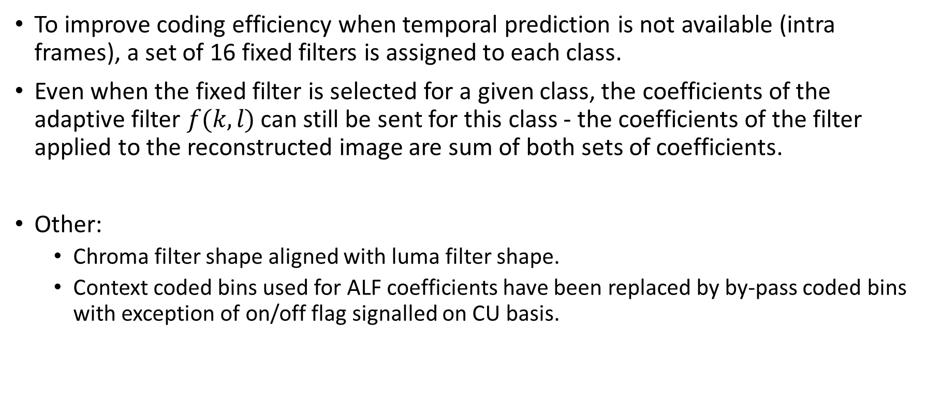
Fixed Filters and Clean Ups
To improve coding efficiency when temporal prediction is not available (intra frames), a set of 16 fixed filters is assigned to each class.
Even when the fixed filter is selected for a given class, the coefficients of the adaptive filter $f(k,l)$ can still be sent for this class - the coefficients of the filter applied to the reconstructed image are sum of both sets of coefficients.
Other:
  Chroma filter shape aligned with luma filter shape.
  Context coded bins used for ALF coefficients have been replaced by by-pass coded bins with exception of on/off flag signalled on CU basis.

Slide 6
Results
 | All Intra Main10 |  |  |  |  | Random Access Main 10
 | Y | U | V | EncT | DecT | Y | U | V | EncT | DecT
Class A | -0.6% | -0.2% | 0.3% | 92% | 108% | -1.0% | -0.1% | 0.5% | 101% | 114%
Class B | -0.8% | -0.2% | -0.7% | 93% | 109% | -1.3% | -0.2% | -0.3% | 103% | 110%
Class C | -1.9% | -0.1% | 0.0% | 95% | 107% | -1.8% | -0.1% | 0.2% | 103% | 101%
Class D | -2.1% | -0.3% | -0.3% | 98% | 109% | -2.0% | -0.6% | -0.8% | 104% | 105%
Class E | -2.4% | -1.4% | -0.8% | 92% | 105%
Overall (Ref) | -1.5% | -0.4% | -0.3% | 94% | 108% | -1.5% | -0.2% | -0.1% | 103% | 108%
 | Low delay B Main10 |  |  |  |  | Low delay P Main10
 | Y | U | V | EncT | DecT | Y | U | V | EncT | DecT
Class A
Class B | -0.9% | 1.0% | 1.1% | 103% | 107% | -1.1% | 0.7% | 0.9% | 103% | 111%
Class C | -1.2% | -0.2% | 0.6% | 102% | 103% | -1.8% | 0.0% | 0.1% | 104% | 100%
Class D | -1.7% | -0.4% | 0.0% | 104% | 110% | -2.0% | -0.3% | 0.1% | 104% | 107%
Class E | -2.0% | 1.5% | 2.2% | 102% | 106% | -3.6% | 0.2% | -0.9% | 102% | 107%
Overall (Ref) | -1.4% | 0.4% | 0.9% | 103% | 107% | -2.0% | 0.2% | 0.2% | 103% | 107%
Anchor: HM16.6 with only ALF enabled (i.e., HM16.6 JEM-1.0 with all new tools except ALF disabled).
Test: Anchor with the proposed method enabled.

Slide 7
Results
 | All Intra Main10 |  |  |  |  | Random Access Main 10
 | Y | U | V | EncT | DecT | Y | U | V | EncT | DecT
Class A | -4.8% | -2.1% | -1.8% | 111% | 144% | -7.8% | -4.6% | -5.3% | 110% | 153%
Class B | -3.3% | -2.7% | -2.5% | 111% | 140% | -6.0% | -3.7% | -2.0% | 113% | 151%
Class C | -3.8% | -3.1% | -3.7% | 110% | 132% | -4.8% | -0.5% | -1.2% | 109% | 131%
Class D | -3.0% | -3.2% | -3.6% | 115% | 126% | -5.5% | -1.0% | -1.2% | 112% | 134%
Class E | -5.8% | -6.7% | -7.0% | 114% | 137%
Overall (Ref) | -4.0% | -3.4% | -3.5% | 112% | 136% | -6.0% | -2.5% | -2.4% | 111% | 142%
 | Low delay B Main10 |  |  |  |  | Low delay P Main10
 | Y | U | V | EncT | DecT | Y | U | V | EncT | DecT
Class A
Class B | -4.3% | -1.9% | -0.7% | 109% | 135% | -9.1% | -5.1% | -3.4% | 111% | 135%
Class C | -4.4% | -0.4% | -0.3% | 107% | 117% | -5.5% | -0.3% | -0.9% | 109% | 121%
Class D | -4.4% | -0.6% | -0.3% | 109% | 120% | -4.0% | -0.5% | 0.4% | 111% | 120%
Class E | -5.4% | -1.7% | -3.3% | 111% | 113% | -9.7% | -4.5% | -7.3% | 115% | 122%
Overall (Ref) | -4.6% | -1.2% | -1.0% | 109% | 122% | -7.1% | -2.6% | -2.6% | 111% | 125%
Anchor: HM16.6 (i.e., HM16.6 JEM-1.0 with all new tools disabled).
Test: Anchor with the proposed method enabled.

Slide 8
Results
 | All Intra Main10 |  |  |  |  | Random Access Main 10
 | Y | U | V | EncT | DecT | Y | U | V | EncT | DecT
Class A | -0.6% | -0.1% | 0.2% | 99% | 107% | -0.8% | 0.0% | 1.0% | 99% | 102%
Class B | -0.6% | -0.2% | -0.4% | 99% | 107% | -0.9% | -0.1% | -0.4% | 100% | 101%
Class C | -1.4% | -0.1% | 0.1% | 100% | 105% | -1.2% | -0.1% | 0.3% | 98% | 100%
Class D | -1.5% | -0.5% | -0.6% | 100% | 110% | -1.4% | -0.3% | -0.5% | 100% | 101%
Class E | -1.9% | -1.5% | -1.6% | 98% | 106%
Overall (Ref) | -1.1% | -0.4% | -0.4% | 99% | 107% | -1.1% | -0.1% | 0.1% | 99% | 101%
 | Low delay B Main10 |  |  |  |  | Low delay P Main10
 | Y | U | V | EncT | DecT | Y | U | V | EncT | DecT
Class A
Class B | -0.6% | 1.1% | 0.8% | 100% | 102% | -0.7% | 1.2% | 0.8% | 100% | 103%
Class C | -0.7% | -0.3% | 0.3% | 98% | 100% | -1.1% | -0.1% | 0.2% | 98% | 104%
Class D | -1.3% | -0.4% | -0.1% | 100% | 103% | -1.3% | 0.2% | -0.6% | 102% | 106%
Class E | -1.3% | 0.9% | 0.5% | 102% | 101% | -2.7% | -0.1% | 0.2% | 100% | 105%
Overall (Ref) | -1.0% | 0.3% | 0.4% | 100% | 102% | -1.3% | 0.4% | 0.2% | 100% | 104%
Anchor: JEM-1.0 with ALF enabled.
Test: Anchor with the proposed method enabled.

Slide 9
Results
 | All Intra Main10 |  |  |  |  | Random Access Main 10
 | Y | U | V | EncT | DecT | Y | U | V | EncT | DecT
Class A | -3.7% | -2.4% | -3.6% | 100% | 138% | -6.1% | -7.8% | -10.9% | 102% | 110%
Class B | -2.4% | -2.3% | -2.0% | 100% | 131% | -4.8% | -4.1% | -3.0% | 102% | 104%
Class C | -2.7% | -2.5% | -2.9% | 97% | 124% | -3.6% | -1.7% | -1.8% | 101% | 100%
Class D | -2.2% | -2.4% | -2.6% | 101% | 123% | -4.0% | -1.3% | -1.7% | 102% | 101%
Class E | -4.3% | -5.3% | -5.7% | 101% | 137%
Overall (Ref) | -3.0% | -2.8% | -3.2% | 100% | 130% | -4.6% | -3.7% | -4.2% | 102% | 104%
 | Low delay B Main10 |  |  |  |  | Low delay P Main10
 | Y | U | V | EncT | DecT | Y | U | V | EncT | DecT
Class A
Class B | -4.1% | -2.9% | -2.4% | 102% | 107% | -6.2% | -2.7% | -2.5% | 102% | 116%
Class C | -4.5% | -3.3% | -3.8% | 101% | 106% | -4.3% | -2.0% | -2.6% | 101% | 111%
Class D | -4.6% | -2.1% | -1.2% | 102% | 101% | -3.4% | -0.5% | -1.0% | 104% | 111%
Class E | -4.8% | -3.3% | -2.3% | 106% | 105% | -7.6% | -4.9% | -3.7% | 104% | 110%
Overall (Ref) | -4.4% | -2.9% | -2.4% | 103% | 105% | -5.3% | -2.4% | -2.4% | 103% | 112%
Anchor: JEM-1.0 with ALF disabled.
Test: Anchor with ALF including the proposed method enabled.

