Slide 1
JVET-B0058 – Modifications on Merge Candidate Derivation
Wei-Jung Chien, Jianle Chen, Sungwon Lee, Marta Karczewicz

Slide 2
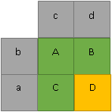
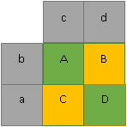
Modifications
Motion storage and merge candidate accuracy
  Increase from 1/8 pel to 1/16 pel
Pruning
  Use POC instead of RefIdx when comparing two merge candidates
  Combined bi-predictive and Zero motion vector merge candidates are pruned
  ATMVP is pruned when all sub-PU motion vectors are identical
ATMVP simplification
  Use the first merge candidate to determine where to fetch the temporal motion vector
    Remove neighboring blocks scan
  More aligned sub-PU temporal motion vector derivation
    Disallow mirror motion derivation, when
    Temporal motion vector is from co-located reference picture
    or LDC flag is on (i.e. no future frames in both reference lists)
SPMVP derivation
  Derive sub-PU motion information from 2 spatial neighbors
  and 2 temporal neighbors
JEM-1.0
Proposed change

Slide 3
Results
 | RA Main10 |  |  | LDB Main 10 |  |  | LDP Main10
 | Y | U | V | Y | U | V | Y | U | V
Class A | -1.5% | -1.5% | -1.7%
Class B | -1.7% | -1.4% | -1.4% | -1.3% | -1.3% | -1.2% | -1.2% | -1.2% | -0.9%
Class C | -1.7% | -1.8% | -2.0% | -1.7% | -2.0% | -1.8% | -1.4% | -1.7% | -1.8%
Class D | -2.0% | -1.9% | -2.0% | -1.7% | -1.9% | -1.5% | -1.4% | -1.8% | -1.0%
Class E |  |  |  | -3.3% | -3.1% | -3.4% | -3.0% | -3.3% | -3.3%
Overall | -1.7% | -1.6% | -1.7% | -1.9% | -2.0% | -1.8% | -1.6% | -1.9% | -1.6%
Enc Time[%] | 117% |  |  | 117% |  |  | 109%
Dec Time[%] | 111% |  |  | 112% |  |  | 107%
 | RA Main10 |  |  | LDB Main 10 |  |  | LDP Main10
 | Y | U | V | Y | U | V | Y | U | V
Class A | -1.8% | -1.8% | -1.9%
Class B | -2.3% | -1.6% | -1.6% | -1.8% | -1.5% | -1.3% | -2.9% | -2.1% | -1.8%
Class C | -2.3% | -2.0% | -2.2% | -2.3% | -2.0% | -2.0% | -3.6% | -2.6% | -2.8%
Class D | -2.9% | -2.4% | -2.5% | -2.8% | -2.1% | -1.7% | -4.5% | -3.2% | -2.3%
Class E |  |  |  | -3.8% | -3.9% | -4.9% | -5.3% | -5.8% | -6.0%
Overall | -2.3% | -1.9% | -2.0% | -2.5% | -2.2% | -2.2% | -3.9% | -3.2% | -3.0%
Enc Time[%] | 120% |  |  | 119% |  |  | 111%
Dec Time[%] | 114% |  |  | 116% |  |  | 110%
Anchor: HM-16.6.
Test: Anchor with ATMVP enabled.
Anchor: HM-16.6.
Test: Anchor with ATMVP enabled and
the proposed modification.

Slide 4
Results
 | RA JVET10 |  |  | LDB JVET10 |  |  | LDP JVET10
 | Y | U | V | Y | U | V | Y | U | V
Class A | 0.0% | 0.2% | 0.0%
Class B | 0.0% | 0.1% | -0.1% | -0.1% | -0.4% | -0.2% | -0.3% | -0.3% | -0.4%
Class C | -0.1% | 0.0% | -0.1% | -0.3% | -0.5% | 0.1% | -0.5% | -0.4% | -0.7%
Class D | -0.1% | -0.1% | 0.0% | -0.6% | -0.9% | -1.0% | -0.8% | -0.3% | -0.5%
Class E |  |  |  | -0.3% | -1.0% | -1.2% | -0.8% | -0.5% | -0.1%
Overall | 0.0% | 0.0% | -0.1% | -0.3% | -0.7% | -0.5% | -0.6% | -0.3% | -0.5%
Enc Time[%] | 103% |  |  | 105% |  |  | 103%
Dec Time[%] | 108% |  |  | 113% |  |  | 107%
Anchor: JEM-1.0.
Test: Anchor with the proposed method

Slide 5
Results
 |  | RA MAIN10 |  |  | LDB MAIN10 |  |  | LDP MAIN10
Anchor | Test | Y | U | V | Y | U | V | Y | U | V
HM16.6 | HPMV | -0.1% | 0.1% | 0.0% | -0.2% | 0.1% | 0.2% | -1.3% | -0.7% | -0.4%
 | ATMVP (as in JEM1.0) | -1.7% | -1.6% | -1.7% | -1.9% | -2.0% | -1.8% | -1.6% | -1.9% | -1.6%
 | ATMVP (as in JEM1.0) + HPMV | -2.2% | -1.9% | -1.9% | -2.5% | -2.1% | -1.9% | -3.8% | -3.1% | -2.8%
 |  | RA JVET10 |  |  | LDB JVET10 |  |  | LDP JVET10
Anchor | Test | Y | U | V | Y | U | V | Y | U | V
JEM-1.0 | HPMV | 0.0% | 0.0% | -0.2% | -0.3% | -0.3% | -0.4% | -0.4% | -0.3% | -0.4%

Slide 6
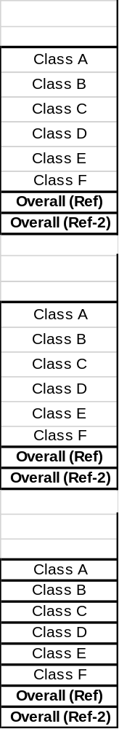
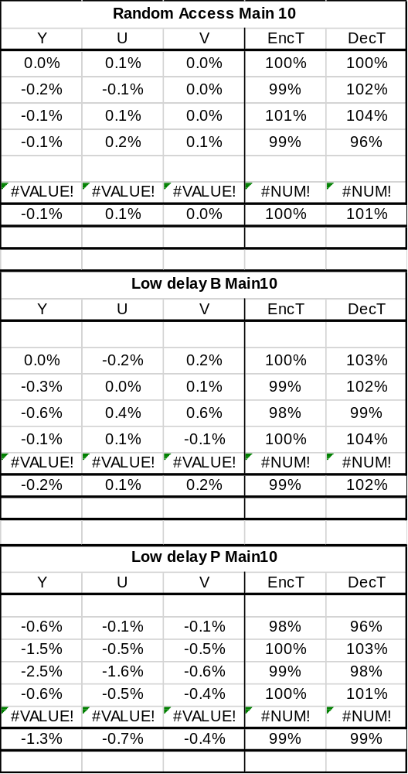
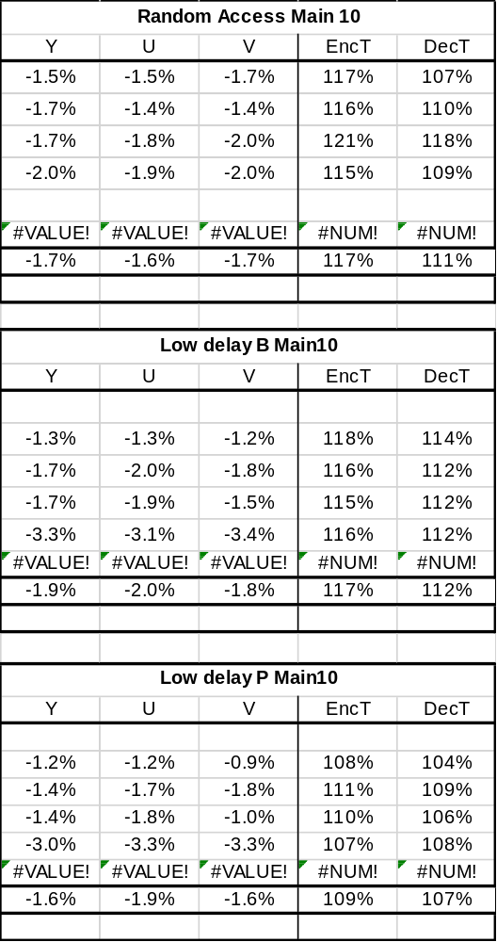
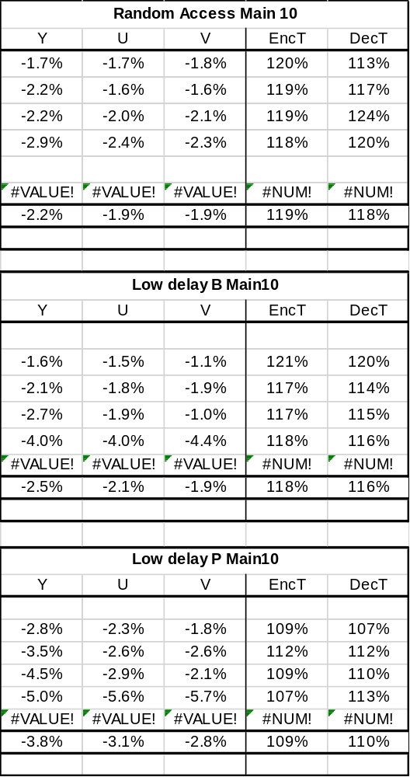
Results
HPMV
ATMVP
ATMVP + HPMV
Anchor: HM16.6

Slide 7
Results
 | RA JVET10 |  |  | LDB JVET10 |  |  | LDP JVET10
 | Y | U | V | Y | U | V | Y | U | V
Class A | 0.0% | 0.0% | -0.5%
Class B | 0.0% | 0.1% | -0.1% | 0.0% | 0.1% | 0.0% | -0.2% | 0.2% | -0.2%
Class C | -0.1% | -0.1% | -0.1% | -0.3% | -0.3% | -0.3% | -0.4% | -0.2% | -0.6%
Class D | 0.0% | 0.0% | 0.1% | -0.6% | -0.5% | -0.5% | -0.7% | -0.3% | -0.2%
Class E |  |  |  | -0.2% | -0.6% | -1.3% | -0.3% | -1.1% | -0.9%
Overall | 0.0% | 0.0% | -0.2% | -0.3% | -0.3% | -0.4% | -0.4% | -0.3% | -0.4%
Enc Time[%] | 102% |  |  | 103% |  |  | 102%
Dec Time[%] | 106% |  |  | 110% |  |  | 105%
Anchor: JEM-1.0.
Test: JEM1.0 + HPMV

