Slide 1
AHG18: Decoder side NN-based picture generation for lost picture substitution
JVET-AP0222
Kirill Malyshev, Maxim Sychev, Sergey Ikonin, Elena Alshina

Slide 2

T2
T1
T0
Introduction
Some pictures can be lost during transmission due to poor channel in ultra-low latency scenarios
Following pictures which refer on lost ones cannot be decoded as well
As result, frequent and long freeze events significantly affect subjective perception as was shown during
CfE evaluation of proposal JVET-AN0080
This contribution describes experiments in NN-based lost pictures substitution targeting reducing freeze ratio and corresponding software modifications
TL2
TL1
TL0
Example of a missed picture in low-delay configuration
Example of missed pictures in random access GOP4 configuration
Demo samples of implementation:
https://drive.google.com/drive/folders/1Eg_fdCfhQ5u49COikshW0QPLLsMNbCV7

Slide 3
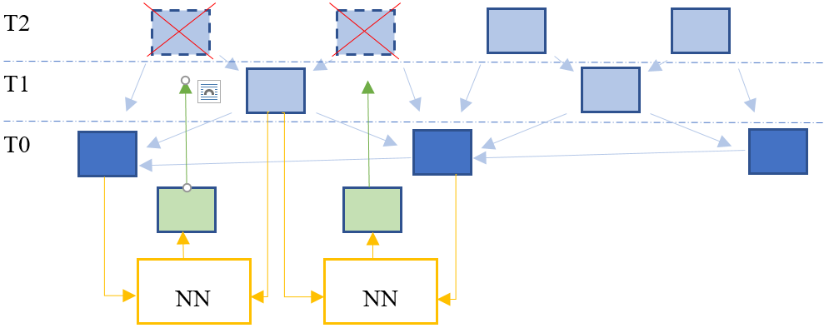
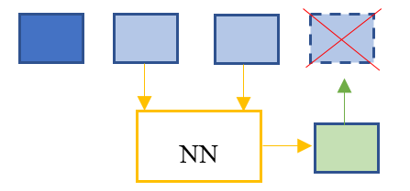
Proposal 1: lost picture generation for output
Two frame prediction NN models have been integrated into ULL software:
Temporal extrapolation model IFRVP [1] (based on IFRNet) for low delay, correspondin to TemporalExtrapolation NNPF SEI
Temporal interpolation model IFRNet [2] for random access, RateUpCobversion NNPF SEI
The proposed implementation is controlled via the NNPF interface and utilizes the additional syntax proposed
in JVET-AP0226.
Frame extrapolation for low-delay configuration
Frame interpolation for generation lost frames inside a GOP in random access configuration
[1] https://github.com/FykAikawa/IFRVP
[2] https://github.com/ltkong218/IFRNet

Slide 4
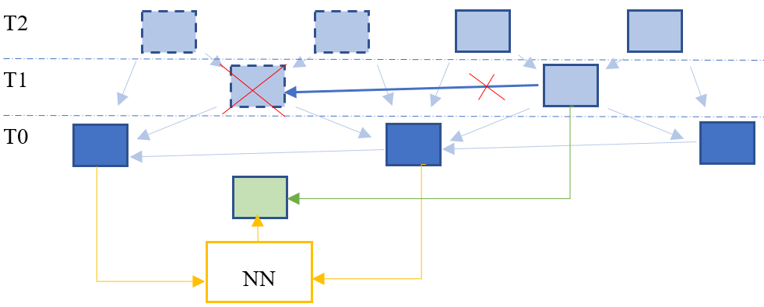
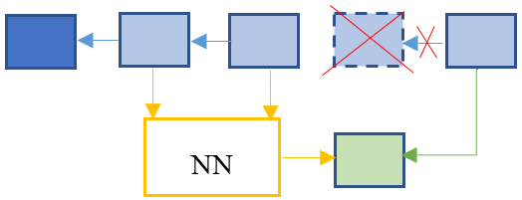
Proposal 2: lost picture generation for reference
Generated lost pictures can be used instead of unavailable references.
That provides continuous decoding process and helps to reduce freeze events
The extended functionality of using generated picture instead of unavailable reference has been additionally implemented and can be enabled by specific flag.
received picture
Using extrapolated frame as reference for low-delay configuration
Using interpolated frame as reference for random access configuration

Slide 5
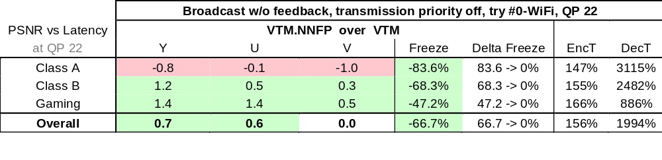
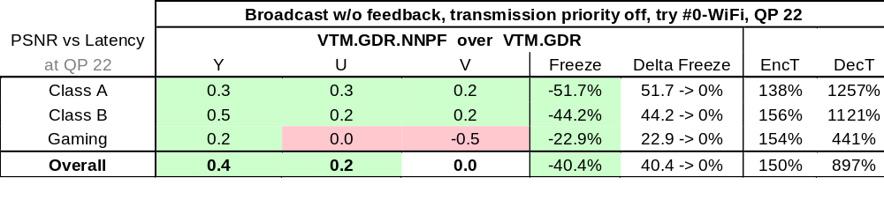
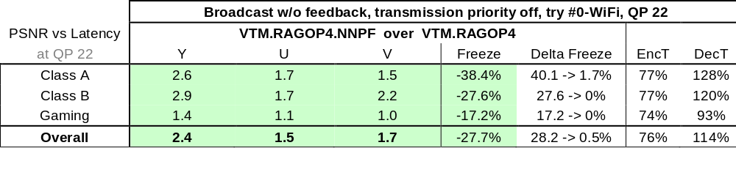
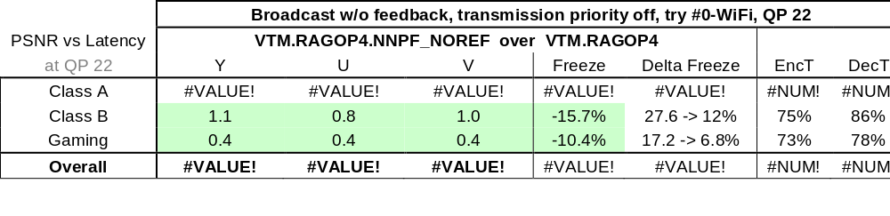
Test results
Three configurations have been tested according to AhG18 ULL CTC JVET-AN2039:
LDB
LDB with GDR enabled
Random Access GOP4
Results demonstrate meaningful freeze reduction for all tested configurations
Results for LDB is very dependent on content and pattern of losses.
GDR configuration gives more stable results with picture extrapolation since it is more robust configuration in itself
Random Access shows the most substantial gain due to obtaining temporal information from past and future
There is noticeable improvement for PSNR and freezes when missed reference replacement is used.
With missed reference replacement
Without missed reference replacement

Slide 6
Conclusions
The proposed modifications enhance video continuity and quality by mitigating freezes caused by network issues through decoder-side neural network-generated substitute frames
The implementation supports both low-delay (frame extrapolation) and random-access (frame interpolation) configurations
Missed refence generation is configurable option
It is proposed to include described software modification to AHG18 branch for experimenting on NN-based technologies for missed frame substitution
Demo samples of implementation:
https://drive.google.com/drive/folders/1Eg_fdCfhQ5u49COikshW0QPLLsMNbCV7

