Slide 1

JVET-AP0181
Non-EE2: Enhancement of Chroma MPM List Construction
Weihong Niu, Zhengang Li, Menghu Jia, Xing Zeng, Shaowei Xie, Yaxian Bai
(ZTE)

Slide 2
Introduction
The current chroma MPM list in ECM-19.1 includes 13 candidates as follows:
（1）6 CCP modes: LM_CHROMA, MDLM_L, MDLM_T, MMLM_CHROMA, MMLM_L and MMLM_T.
（2）7 Non-CCP modes: DM, chroma DIMD, PLANAR, DC, HOR, VER, the collocated luma modes, adjacent chroma modes, DBV modes; then using template matching to select the top 7 modes.
This proposal proposes to enhance the chroma MPM list construction for non-CCP mode.

Slide 3
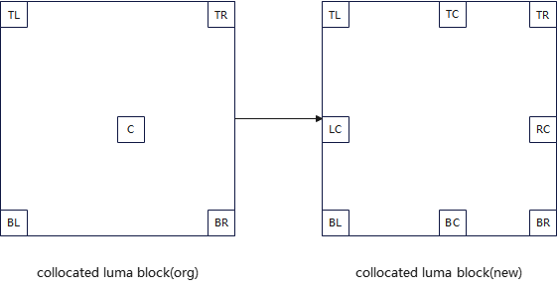
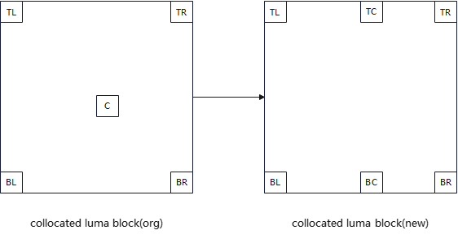
Proposed
Two aspects are included:
（1）Five positions of collocated luma block are modified to eight/six according to whether DBV is available or not, as shown in the right figure.
（2）The chroma intra mode is derived by offsetting +1 or -1 in the chroma mode list.
Figure 1. DBV mode is available
Figure 2. DBV mode is unavailable

Slide 4
Simulation results
The proposed method is implemented on top of ECM-19.1.
 | All Intra Main 10
 | Over ECM-19.1
 | Y | U | V | EncT | DecT | EncVmPeak | DecVmPeak
Class A1 | -0.02% | 0.03% | 0.07% | 100.2% | 100.3% | 100.1% | 99.9%
Class A2 | -0.01% | 0.00% | -0.04% | 99.8% | 100.7% | 100.0% | 99.8%
Class B | -0.01% | -0.02% | -0.08% | 100.0% | 100.6% | 99.2% | 100.0%
Class C | -0.02% | -0.02% | -0.01% | 99.9% | 101.0% | 100.4% | 100.0%
Class E | -0.03% | 0.08% | -0.07% | 100.0% | 101.6% | 101.0% | 100.0%
Overall | -0.02% | 0.01% | -0.03% | 100.0% | 100.8% | 100.0% | 100.0%
Class D | -0.01% | -0.40% | -0.14% | 100.2% | 100.9% | 100.1% | 100.0%
Class F | 0.01% | 0.00% | -0.30% | 100.2% | 102.8% | 100.8% | 100.1%
Class TGM | #VALUE! | #VALUE! | #VALUE! | #DIV/0! | #DIV/0! | #DIV/0! | #DIV/0!

Slide 5
Conclusions
The proposed methods can improve the coding efficiency of ECM.
It is suggested to further study in EE2.
Thanks to OPPO for cross-checking!

Slide 6
Thank you！

