Slide 1

JVET-AP0144: [EE1-related] Statistics on multilayer frame level RDO using DCVC-RT
M. Aderdor, T. Solovyev, E. Alshina (Huawei), F. Urban, F. Galpin, E. François (InterDigital)

Slide 2
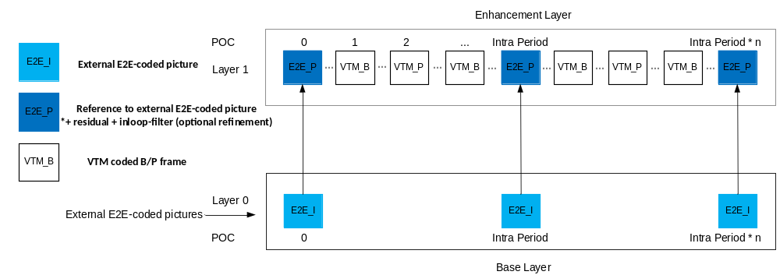
JVET-AP0144: [EE1-related] Statistics on multilayer frame level RDO using DCVC-RT
Introduction
I-frame insertion decision is done
  On base layer
  Based on frame level RDO
  NN pure reconstruction vs. VTM final reconstruction
Code is available in AO EE1-4.2 repo (--FLS=1 to enable)
E2E_I
or VTM_I
E2E_P
or VTM_I
VTM_B
E2E_P
or VTM_I
VTM_B
E2E_P
or VTM_I
E2E_I
or VTM_I
External E2E-coded picture
or
VTM coded I-frame
E2E_P
or VTM_P
E2E_P
or VTM_I
E2E_P: E2E_I + residuals + LF + Intra
VTM_B
E2E_B: VTM B frame
E2E_I
or VTM_I
E2E_I
or VTM_I
E2E_I
or VTM_I

Slide 3
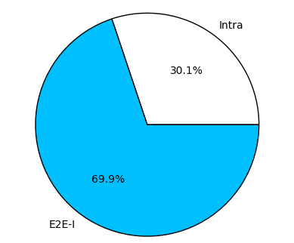
JVET-AP0144: [EE1-related] Statistics on multilayer frame level RDO using DCVC-RT
Statistics
Dataset: JVET CTC
QPs: [22, 27, 32, 37, 42]
Configuration: All Intra (TSR = 8)
NN Coder: DCVC-RT
Total frames: 6405
Overall choice distribution - CTC All Intra

Slide 4
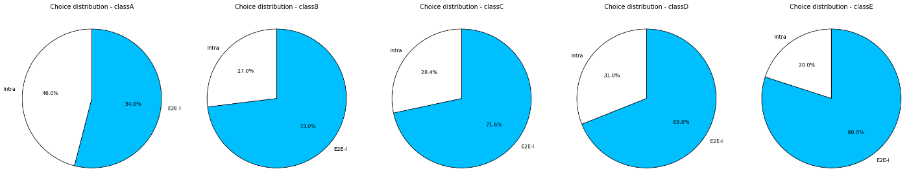
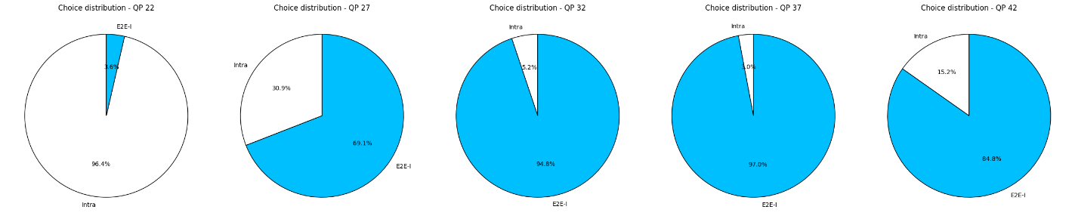
JVET-AP0144: [EE1-related] Statistics on multilayer frame level RDO using DCVC-RT
Per class statistics
Class A
Class B
Class C
Class D
Class E
Per QP statistics
QP 22
QP 27
QP 32
QP 37
QP 42

Slide 5
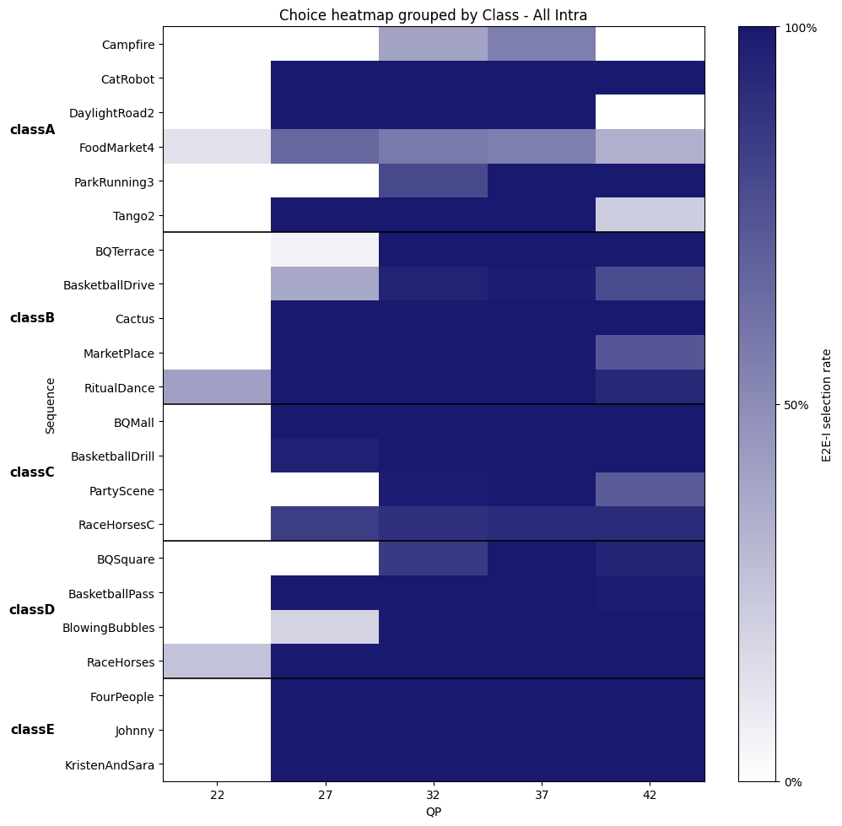
JVET-AP0144: [EE1-related] Statistics on multilayer frame level RDO using DCVC-RT
Conclusions
Majority of I-frames are DCVC-RT (70%)
Rare occurrences of DCVC-RT around QP 22
It’s possible for a single sequence to have both frames (VTM and E2E)
→ We propose to add frame level switching (FLS) functionality to NNVC software’s hybrid multilayer framework.

