Slide 1
Matrix based MPM prediction
Yanbo Gao
SHANDONG UNIVERSITY

Slide 2
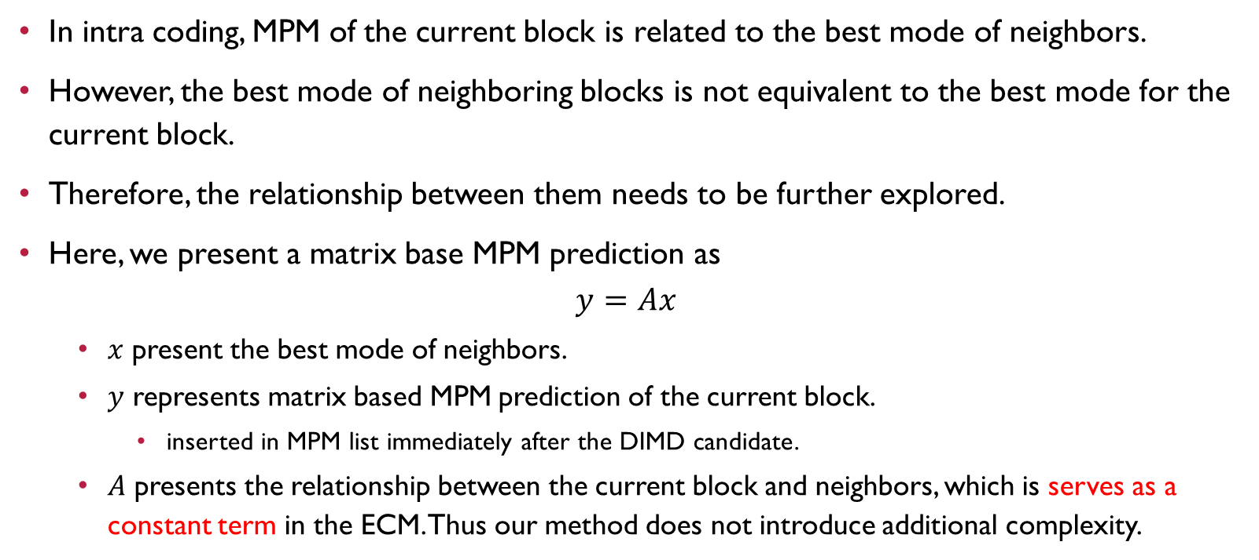
Matrix based MPM prediction
In intra coding, MPM of the current block is related to the best mode of neighbors.
However, the best mode of neighboring blocks is not equivalent to the best mode for the current block.
Therefore, the relationship between them needs to be further explored.
Here, we present a matrix base MPM prediction as
$$y=Ax$$
  $x$ present the best mode of neighbors.
  $y$ represents matrix based MPM prediction of the current block.
    inserted in MPM list immediately after the DIMD candidate.
  $A$ presents the relationship between the current block and neighbors, which is serves as a constant term in the ECM. Thus our method does not introduce additional complexity.
Notes:
That is, the correlation is strong, but not an equivalence relationship.

Slide 3
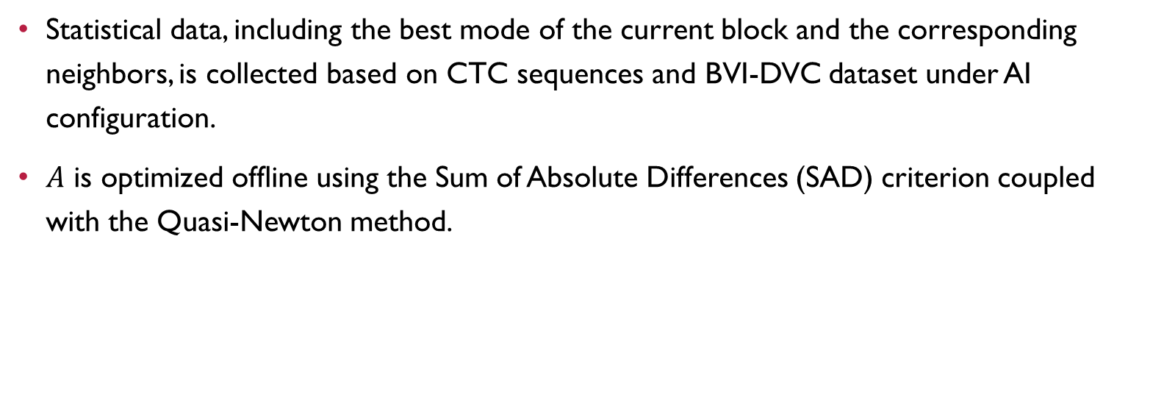
How to obtain A?
Statistical data, including the best mode of the current block and the corresponding neighbors, is collected based on CTC sequences and BVI-DVC dataset under AI configuration.
$A$ is optimized offline using the Sum of Absolute Differences (SAD) criterion coupled with the Quasi-Newton method.

Slide 4
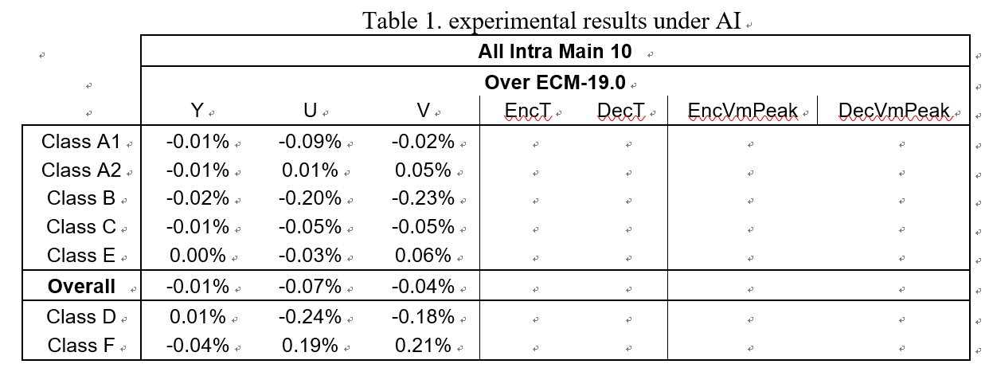
Results

Slide 5
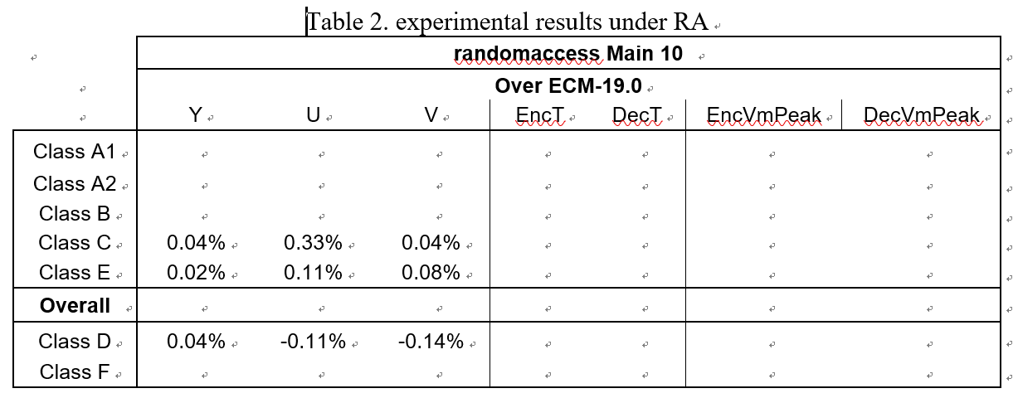
Results

