Slide 1
AHG12: Simplification on TALF
JVET-AO0071
Luhang Xu, Nan Song, Yue Yu, Haoping Yu, Jonathan Gan, Dong Wang (OPPO)

Slide 2
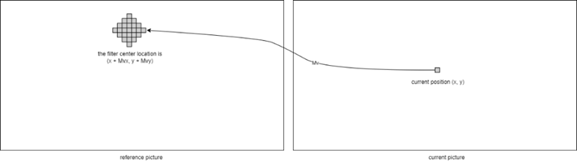
Introduction (1/2)
Temporal adaptive loop filter uses the reconstructed pixels of the reference pictures to improve the quality of the current picture, as shown in Figure 1. For the reconstructed pixels along the boundary of the reference pictures, the motion-compensation padded samples located in the padded area may also be used in TALF. TALF has 4 uni-filtering modes and 2 bi-filtering modes.
Figure 1 Example of using MV to find the
reconstructed samples in the reference picture

Slide 3
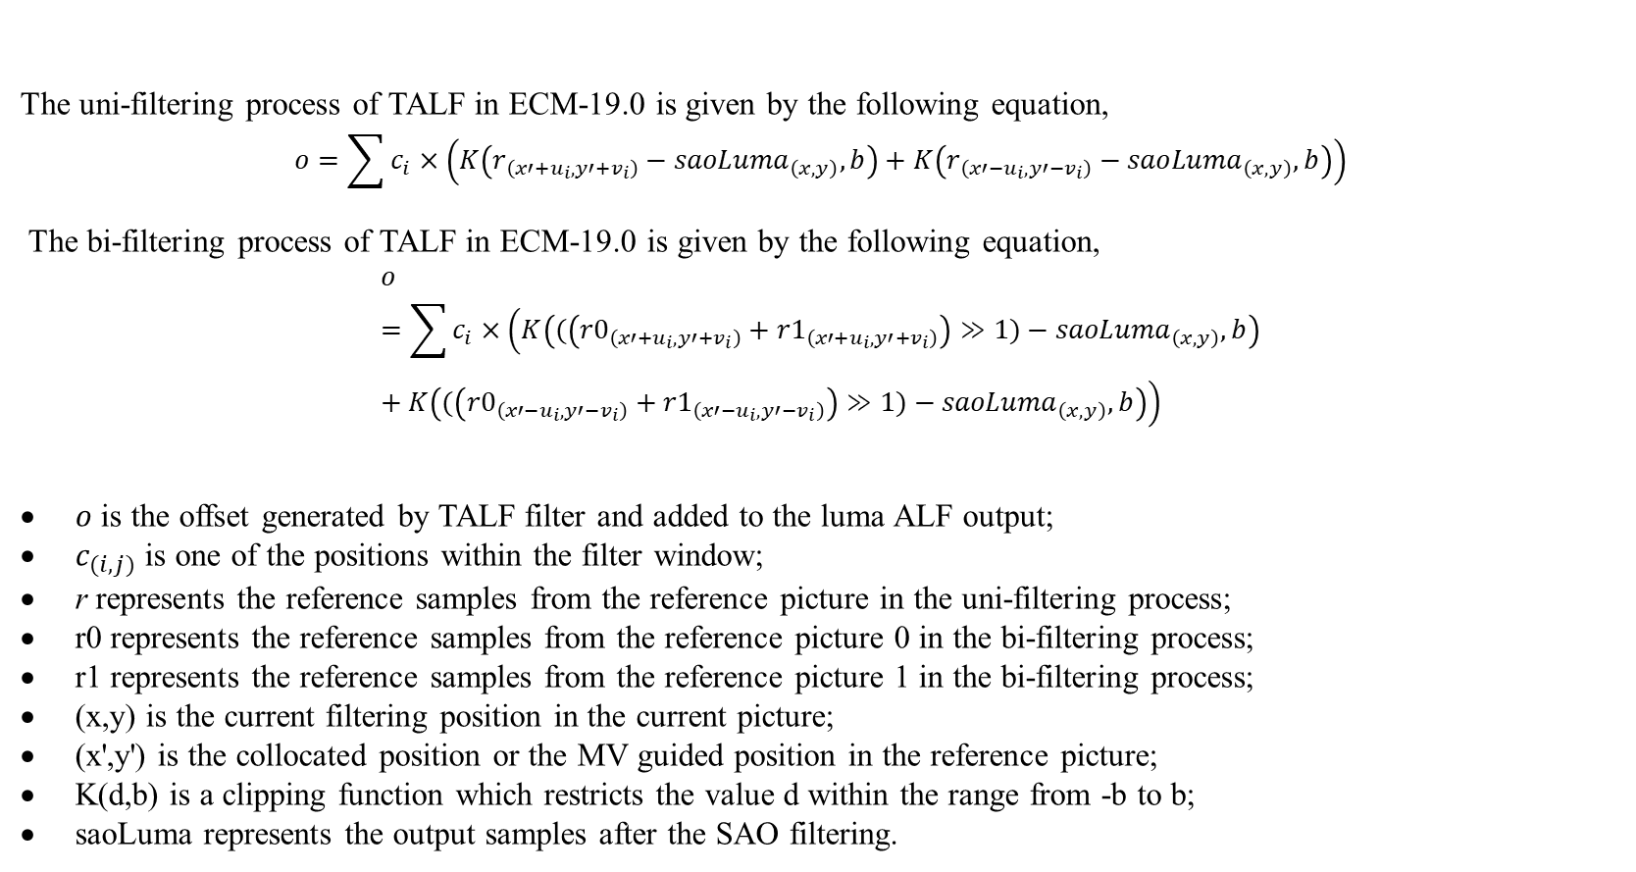
Introduction (2/2)
The uni-filtering process of TALF in ECM-19.0 is given by the following equation,
$$o=\sum{c_{i}×\left(K\left(r_{\left(x′+u_{i},y′+v_{i}\right)}−{saoLuma}_{\left(x,y\right)},b\right)+K\left(r_{\left(x′−u_{i},y′−v_{i}\right)}−{saoLuma}_{\left(x,y\right)},b\right)\right)}$$
The bi-filtering process of TALF in ECM-19.0 is given by the following equation,
$$o=\sum{c_{i}×\left(K\left((\left({r0}_{\left(x′+u_{i},y′+v_{i}\right)}+{r1}_{\left(x′+u_{i},y′+v_{i}\right)}\right)≫1)−{saoLuma}_{\left(x,y\right)},b\right)+K\left((\left({r0}_{\left(x′−u_{i},y′−v_{i}\right)}+{r1}_{\left(x′−u_{i},y′−v_{i}\right)}\right)≫1)−{saoLuma}_{\left(x,y\right)},b\right)\right)}$$
$o$ is the offset generated by TALF filter and added to the luma ALF output;
$c_{(i,j)}$ is one of the positions within the filter window;
r represents the reference samples from the reference picture in the uni-filtering process;
r0 represents the reference samples from the reference picture 0 in the bi-filtering process;
r1 represents the reference samples from the reference picture 1 in the bi-filtering process;
(x,y) is the current filtering position in the current picture;
(x',y') is the collocated position or the MV guided position in the reference picture;
K(d,b) is a clipping function which restricts the value d within the range from -b to b;
saoLuma represents the output samples after the SAO filtering.

Slide 4
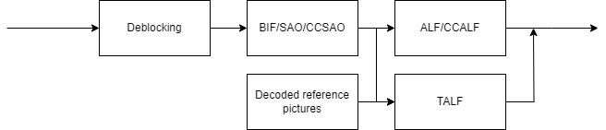
Problem statement
The existing TALF uses reconstructed samples in the reference pictures and the SAO output to generate the value for non-linear clipping. This means although TALF can be processed parallel with ALF/CCALF. It still requires the filtered samples after SAO.
Figure 2 Diagram of loop filters in ECM-19.0

Slide 5
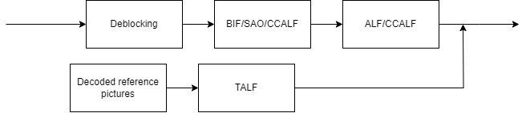
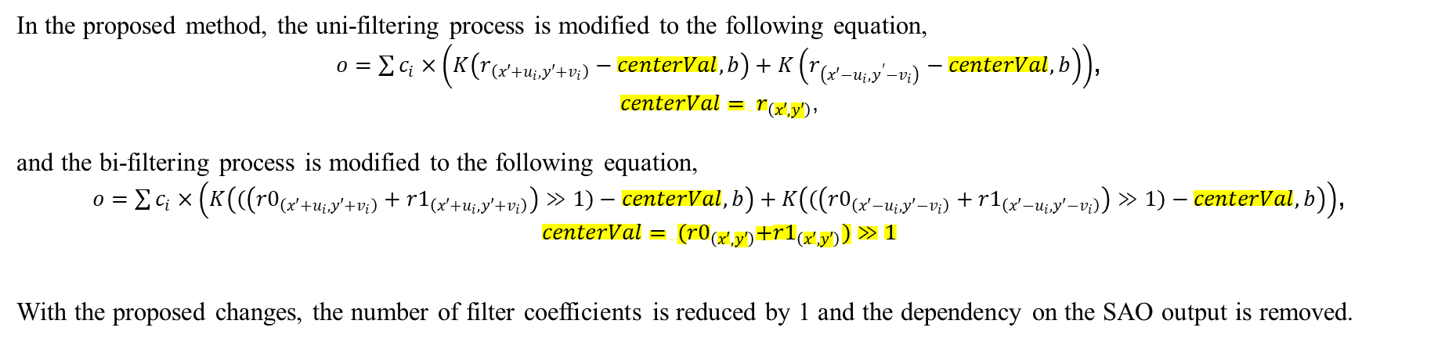
Proposed method
In the proposed method, the uni-filtering process is modified to the following equation,
$o=\sum{c_{i}×\left(K\left(r_{\left(x′+u_{i},y′+v_{i}\right)}−centerVal,b\right)+K\left(r_{\left(x′−u_{i},y^{′}−v_{i}\right)}−centerVal,b\right)\right)}$,
$centerVal= r_{\left(x′,y′\right)}$,
and the bi-filtering process is modified to the following equation,
$o=\sum{c_{i}×\left(K\left((\left({r0}_{\left(x′+u_{i},y′+v_{i}\right)}+{r1}_{\left(x′+u_{i},y′+v_{i}\right)}\right)≫1)−centerVal,b\right)+K\left((\left({r0}_{\left(x′−u_{i},y′−v_{i}\right)}+{r1}_{\left(x′−u_{i},y′−v_{i}\right)}\right)≫1)−centerVal,b\right)\right)}$,
$$centerVal= {(r0}_{\left(x′,y′\right)}+{r1}_{\left(x′,y′\right)})≫1$$
With the proposed changes, the number of filter coefficients is reduced by 1 and the dependency on the SAO output is removed.
Figure 3 Diagram of modified TALF

Slide 6
Summary
The proposed method is implemented on the ECM-19.0 reference software. The simulation results of RA and LDB configurations are shown in the following tables,
It is recommended to adopt the proposed changes into the next version of ECM,
Thanks to Canon for crosschecking this proposal.
 | Random Access Main 10
 | Over ECM-19.0
 | Y | U | V | EncT | DecT | EncVmPeak | DecVmPeak
Class A1 | 0.01% | -0.11% | -0.07% | 99.9% | 99.5% | 100.0% | 100.4%
Class A2 | -0.01% | -0.07% | 0.00% | 100.2% | 100.9% | 100.1% | 100.5%
Class B | 0.01% | -0.02% | -0.06% | 100.0% | 99.9% | 100.0% | 100.0%
Class C | -0.01% | -0.06% | -0.08% | 99.9% | 99.7% | 100.0% | 100.0%
Class E
Overall | 0.00% | -0.06% | -0.06% | 100.0% | 100.0% | 100.0% | 100.2%
Class D | 0.01% | -0.07% | -0.16% | 99.9% | 100.0% | 100.0% | 100.0%
Class F | 0.11% | -0.20% | -0.19% | 99.6% | 99.1% | 99.8% | 100.1%
 | Low delay B Main 10
 | Over ECM-19.0
 | Y | U | V | EncT | DecT | EncVmPeak | DecVmPeak
Class A1
Class A2
Class B | -0.08% | 0.02% | -0.34% | 100.3% | 99.9% | 100.1% | 100.0%
Class C | -0.01% | 0.25% | 0.00% | 99.8% | 100.3% | 100.0% | 100.0%
Class E | -0.03% | 0.51% | 1.00% | 100.2% | 99.9% | 100.2% | 100.0%
Overall | -0.04% | 0.22% | 0.11% | 100.1% | 100.0% | 100.1% | 100.0%
Class D | -0.01% | -0.32% | 0.04% | 101.0% | 99.6% | 99.9% | 100.0%
Class F | 0.00% | -0.57% | -0.06% | 100.2% | 99.8% | 100.1% | 99.8%

Slide 8
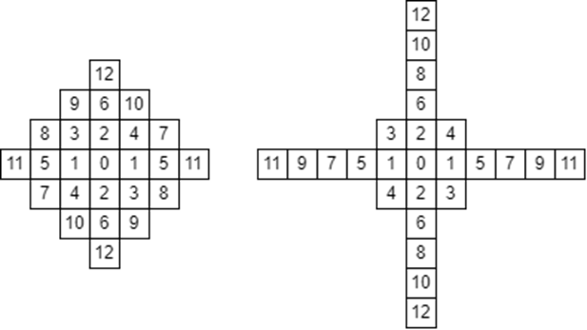
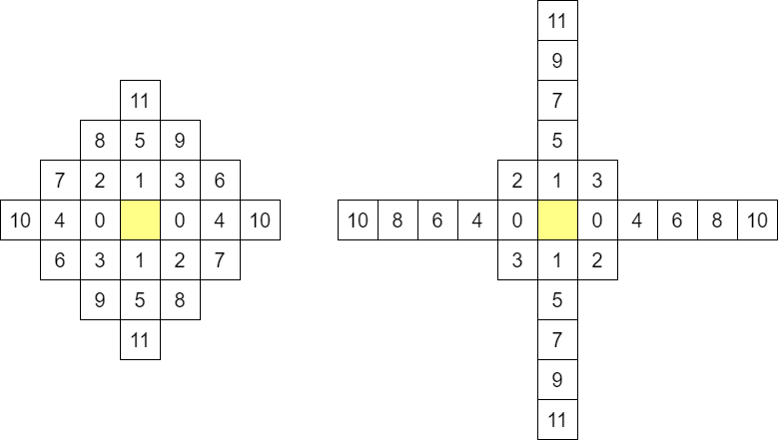
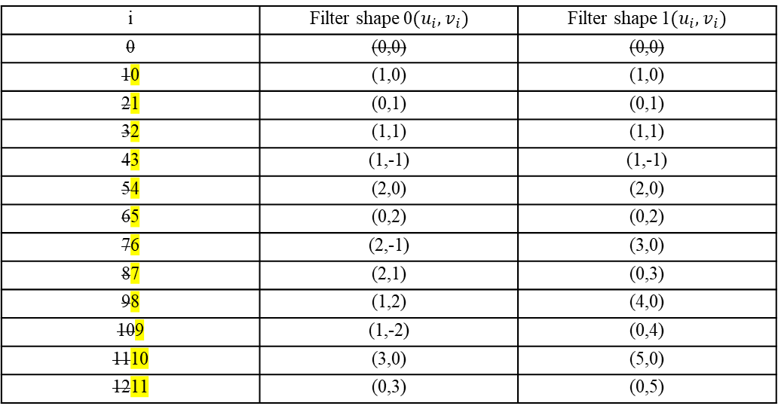
Detailed changes
i | Filter shape 0$(u_{i}, v_{i})$ | Filter shape 1$(u_{i}, v_{i})$
0 | (0,0) | (0,0)
10 | (1,0) | (1,0)
21 | (0,1) | (0,1)
32 | (1,1) | (1,1)
43 | (1,-1) | (1,-1)
54 | (2,0) | (2,0)
65 | (0,2) | (0,2)
76 | (2,-1) | (3,0)
87 | (2,1) | (0,3)
98 | (1,2) | (4,0)
109 | (1,-2) | (0,4)
1110 | (3,0) | (5,0)
1211 | (0,3) | (0,5)
Filter shape 0 and 1 in ECM-19.0
Modified filter shape 0 and 1,
centerVal is obtained from yellow marked positions

